Slide 1
Performance Assurance
Joerg Gerhardus
Notes:
introduction

Slide 2
Outline
Safety, quality and reliability program being used in the development of the instrument
Description of software quality system, and software IV&V plans
EEE parts selection and screening plans as well as materials selection and screening plans
Any special processes required to build the instrument
Contamination control and ESD
Plans for selection and qualification of special items such as detectors and mechanisms
Any exceptions being taken to the SPP PAIP
Preliminary FMEA, or plans for FMEA, Fault Tree Analysis
Describe the manner in which the reliability engineer works with the design team to ensure that reliability is maximized

Slide 3
Outline
Requirements
SMA Oversight & PAIPs
Organization
Design Assurance
Hardware Quality
Software Quality
EEE Parts Engineering
Safety
Path Forward

Slide 4
SPP PA Requirements and PAIPs
Tailored SMA Requirements negotiated with the SPP project:
Solar Probe Plus (SPP) Instrument Mission Assurance Requirements Compliance Matrix
SPP document # 7434-9096 Rev. A
Iterative process between SPP and ISIS SMA teams utilizing best practices and combined knowledge of the diverse teams at all participating organizations
ISIS Implementation through plans (PAIP) and operating procedures:
ISIS: SwRI document 16105-SPP-IMAR-COMPMAT-01 Rev. 0, released 10/07/13
EPI Lo: Solar Probe Plus (SPP) Performance Assurance Implementation Plan; APL document # 7434-9001 Rev. -, released 10/14/13
EPI-Hi: Caltech document CIT-SPP-004 Rev. -, released 10/07/2013

Slide 5
Performance Assurance Implementation Plan
Deliverables
General Quality Requirements
  Procurement
  QA Surveillance
  Training and Certification
  Design and Development Review Process
  Configuration Management
  Non Conformance Process and Reporting
Hardware Quality Requirements
  Manufacturing, Inspection, Assembly, Test, and Inspection Planning
  Controlled Stores
  Fabrication processes
  Inspection
  Acceptance Test Verification
  Handling Packaging, Shipping
Software Quality Requirements
  Requirements Analysis
  Reviews
  Verification and Validation
Safety
Reliability Assurance
EEE Parts Program

Slide 6
PA Organization Chart
SPP
Luke Becker
(APL)
SPP ISIS
Joerg Gerhardus
Eric Edlund
(SwRI)
EPI-Lo
Jim Burgum
EPI-Hi
Branislav Kecman
Mounting Bracket
Eric Edlund

Slide 7
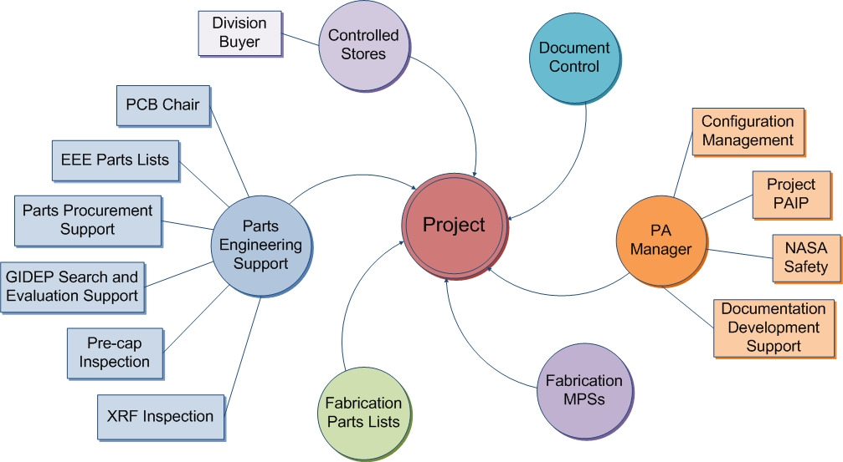
Project Quality Assurance
Project Team PA
  Reliability engineering
  Parts acquisition oversight
Division 15 PA Manager and Staff
  Coordinate Div 15 Resources
Independent Project
Quality Engineer
  Oversight & Coordination
  QA Engineering
  QA Inspections
Partner QA
  Implement local PAIP and support SwRI’s SPP ISIS PA Lead

Slide 8
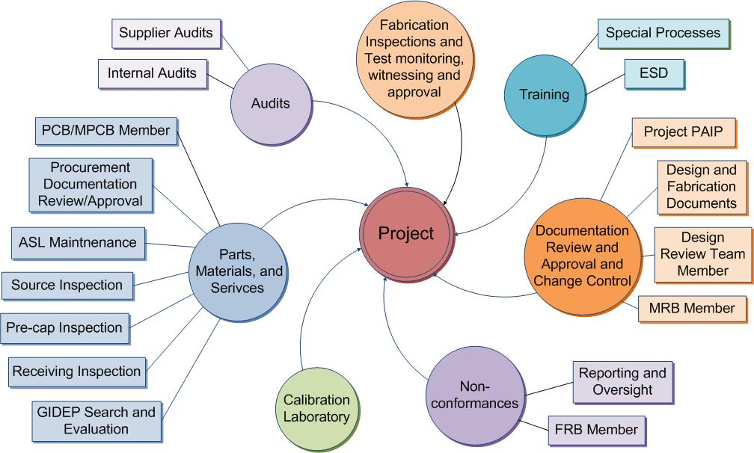
Quality Tasks

Slide 9
Design Assurance
Hardware designs governed by
  Design process and controls
    Requirements Definition
    System Engineering Process
    Design Planning
    Peer Reviews and checklist
    Verification and Validation
    Control of Design Changes
  Software designs governed by
    Structured software development process
    Contract Reviews, Software Development Folder, Planning
    Review of Requirements, and checklist
    Software Design Specification, Design Peer Reviews, and checklist
    Coding Standards, Configuration Control, and Code Walkthroughs
    Test Plans, Test Preparations, Formal Testing, and Reporting
    Independent QA surveillance and reporting

Slide 10
Quality Assurance
Procurements per released drawing and indentured parts list
Periodic GIDEP alert verification performed on EEE parts list
QA Receiving Inspection of EEE parts for flight hardware
Flight PWB procurement and coupon testing at GSFC
SwRI coordinates PCB effort for SPP ISIS with mission-level PCB

Slide 11
Quality Assurance (cont’d.)
Non-conformance control:
  Per organization’s established procedures
  MRB and FRB established
  All non-conformances will be processed as Anomalies or Problem/Failure reports and reported through SwRI to APL as required
Workmanship
  Technicians and inspectors are certified to NASA 8739 standards. Vince Ganley & Connie Ovalles are the in-house Level B certified instructors and are available to support other organizations as needed.
ESD
  Engineers, operators, and technicians are certified to NASA-STD-8739.7 / ANSI ESD S20.20.

Slide 12
Software Quality Assurance
ISIS SQA follows the AS9100 quality program in monitoring software activities which includes review of project documents, witnessing acceptance testing, tracking action items and defects, and performing surveillances/audits.
QA has approved the ISIS Software Development Plan (SDP) which references the EPI-Hi/Lo SDPs
Software Development Plan Solar Probe Plus Project ISIS Instrument Software, Document No. 16105-ISIS-SDP-01, Rev 0 Chg 0, September 2013
Regular surveillances of EPI-Hi and EPI-Lo software activity will focus on the teams compliance to their SDP and their organization’s quality/procedural requirements.
On-site surveillances by the SwRI SQA at EPI-Lo and EPI-Hi are planned.

Slide 13
EEE Parts Engineering
Primary role is to support ISIS hardware developers with meeting EEE parts requirements as called out in Solar Probe Plus Parts Control Plan, SPP document 7434-9001 Rev A
  SwRI has significant experience working with APL & GSFC Parts Engineering Branch
  Ensure that all parts presented to SPP Parts Control Board are compliant to the PCP
Provide procurement support where necessary
  Significant stock available at SwRI
    This has already been useful to aid in prototyping and EM hardware
      Avoid long leadtimes and expensive minimum buys
Support coordination of common buy activities as requested
  Allows for 1 consolidated response for the ISIS suite

Slide 14
Safety
SPP ISIS will provide Safety inputs
  The NPR-8715.3A process circle summarizes the overall safety program risk management approach:
Safety Hazards Analysis
Implementation of hazard controls
Verification

Slide 15
EPI Hi/Lo Hazards and Mitigations
EPI-Lo:
  High Voltage
    200V bias voltage to the SSDs
    Fully contained inside the instrument
    Only operated in high vacuum
    Safe/arm limiting plug design
  Ionizing Radiation Sources
    Planned use of the following sources (radiation datasheets have been provided to SPP):
      Am-241 foil, 100uCi, Type A2 Capsule
      Bi-207, 10uCi, MF-1 Disk, 25.4mm OD x 5.08mm AD, 100-200ug/cm2 Acrylic Window
      Ba-133, 10uCi, MF-1 Disk, 25.4mm OD x 5.08mm AD, 100-200ug/cm2 Acrylic Window
EPI-Hi:
  High Voltage
    250V bias voltage to each detector within the three telescopes
    Fully contained inside the instrument
  Ionizing Radiation Sources
    Planned use of the following sources:
      Beta / gamma sources 106Ru, 207Bi: <0.1 mCi
      Alpha sources 228Th, 241Am, 244Cm : <10 mCi
      alpha source for producing knock-on protons 210Po : <10 mCi
General Hazard:
  Nitrogen purging
    Controlled flow rates in ventilated areas
    Conducted by trained personnel
    Monitoring O₂ levels (where necessary)

Slide 16
Summary
SPP ISIS Performance Assurance plans and requirements are in place
PAIPs written in response to the tailored SPP MAR Matrix
SwRI QA independently verifies that we follow plans

