Slide 1
EPI-Lo Calibration
Don Mitchell
Notes:
introduction

Slide 2
Outline
Introduction
Species and Energy Ranges
Facilities
Calibration Plan
Test Flow
In-Flight Calibration

Slide 3
EPI-Lo Calibration
EPI-Lo measurements are intended to generate the information needed to derive differential intensities (j[cm² -sr-s-keV]⁻¹ )
The goal of EPI-Lo characterization and calibration efforts is to develop the quantitative procedures for converting the count rates (R [counts s⁻¹]) reported by EPI-Lo into estimates of j for the various defined ranges of energies, particle species, and arrival angles
“Calibration” for a particle instrument like EPI-Lo means determining the following:
Transfer function from counts into flux (physical units)
Characteristic of “Rate-in” versus “Rate-out”
Response to visible and ultraviolet light
Response to high energetic particle backgrounds

Slide 4
Calibration Types
Foreground
Ions and Electrons in the energy range of interest to the instrument
Background
Electrons
Characterize the rates from penetrating radiation
Characterize response to Solar Wind and/or photoelectron impact
Light
Characterize rejection of UV background, primarily H-alpha
Characterize rejection of sunlight and glint

Slide 5
Foreground Calibration Requirements
Foreground Electrons
40 keV to 1000 keV (Needed for understanding backgrounds)
1 keV to 30 keV Electron Gun at APL
30 keV to 100 keV Radioactive sources at APL
125 keV to 1.6 MeV Accelerator at GSFC
Foreground Ions (H, He3, He4, O, Fe)
40 keV to 15000 keV (Level 4 Requirements)
(Goal: protons to 20 MeV)
3 keV to 170 keV Accelerator at APL
30 keV to 5 MeV Degraded alpha sources
125 keV to 1.6 MeV Accelerator at GSFC
1 MeV to 20 MeV Accelerator at LBL

Slide 6
Test as You Fly
The instruments will be tested in flight-like environments
Since the instrument will need to operate in a high background environment, we will characterize response to high energy penetrating radiation, UV light, and low energy plasma (all potential sources of background counts for EPI-Lo)

Slide 7
Background Calibration Requirement
Background Electrons
2 eV to 10 MeV (from the expected environment)
1 eV to 100 eV Hot filament at APL
1 keV to 50 keV Electron Gun at APL
125 keV to 1.6 MeV Accelerator at GSFC
1 MeV to 10 MeV Accelerator at Idaho
Background Ions
3 keV to 50 MeV (from the expected environment)
3 keV to 170 keV Accelerator at APL
30 keV to 5 MeV Degraded alpha sources
125 keV to 1.6 MeV Accelerator at GSFC
1 MeV to ~100 MeV Accelerator at LBL
Photons
UV and visible lamps at APL

Slide 8
The JHU/APL Calibration Facility
The APL particle accelerator is a versatile system capable of producing a broad range of ion species at energies from 20 to 170 keV
The system includes a electron-impact ionization source, extraction gap, Einzel Lens and Wien filter mounted in the insulated terminal structure along with all associated power supplies
The system will produce beams of H, He, O, and noble gas ions with intensities over the range of 100’s to 1,000,000 particles/cm²/sec at the target position (mm² - cm²)
We also have a variety of radioactive sources as stimulus.

Slide 9
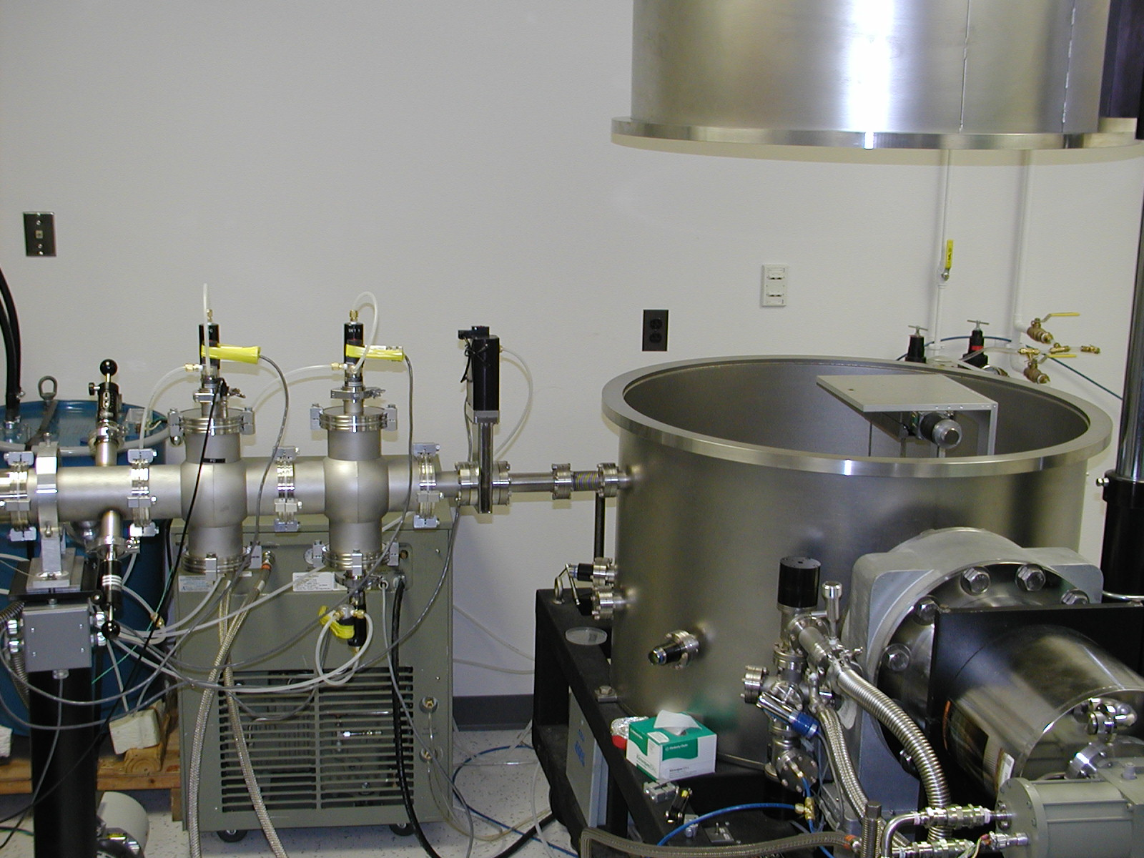
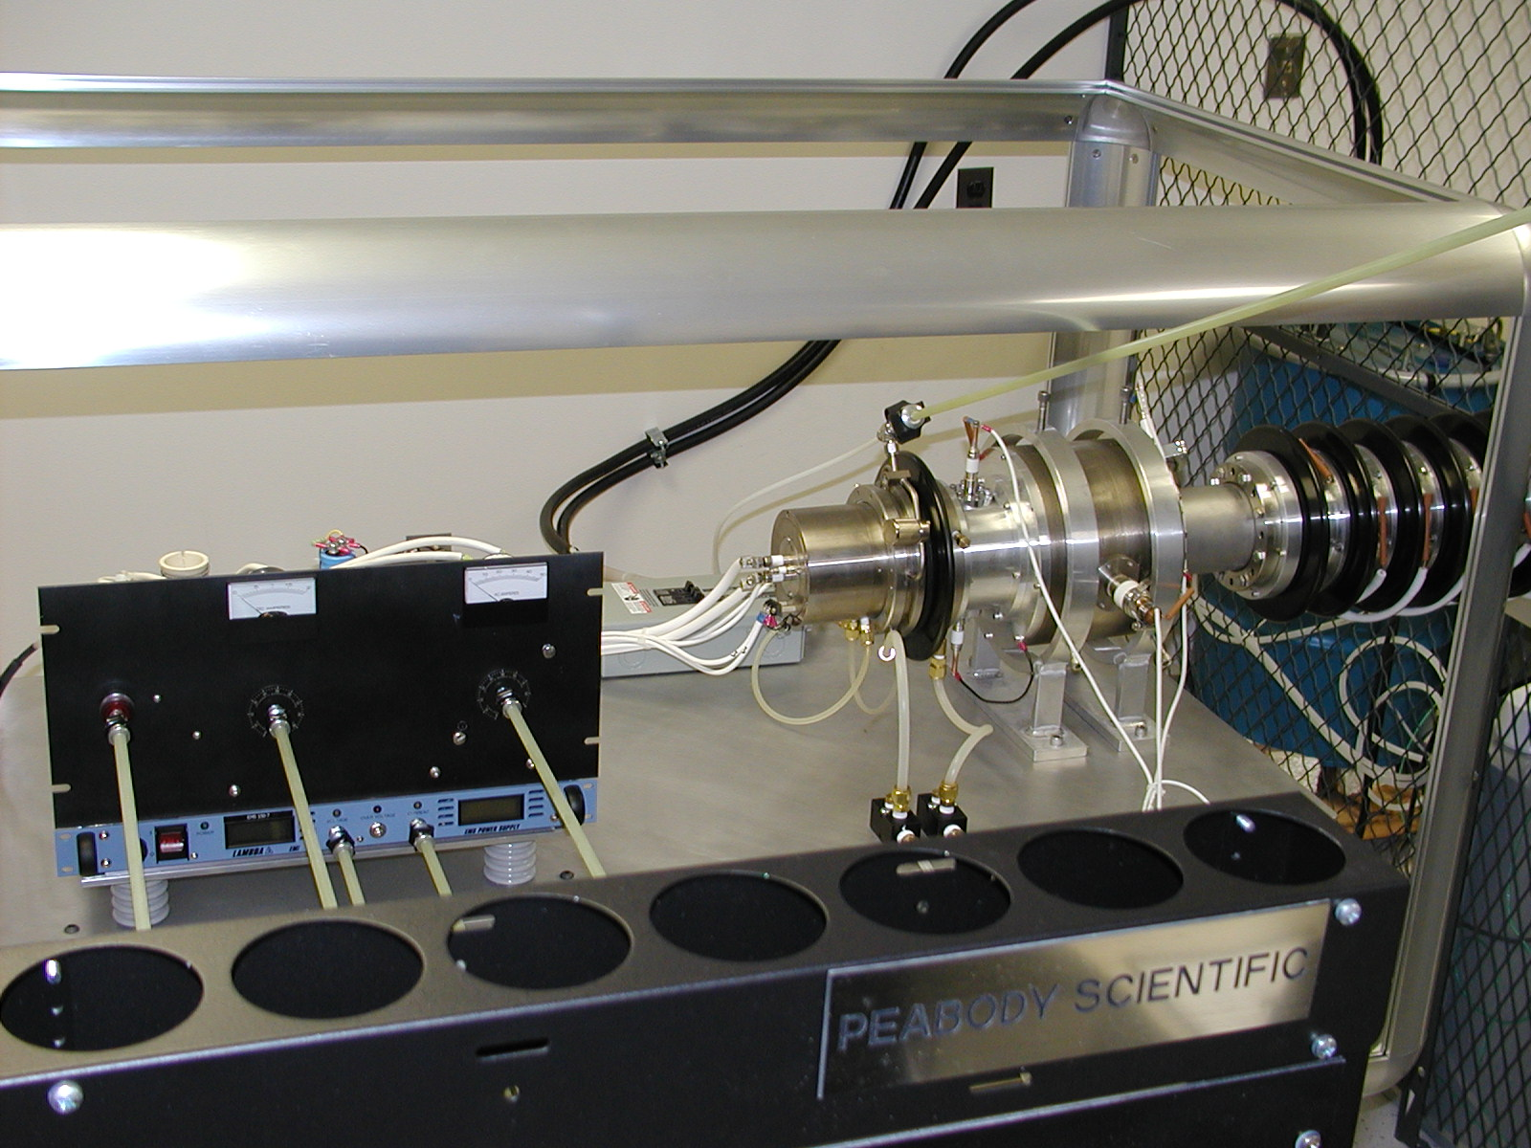
The JHU/APL Calibration Facility
All ions from a gas source
Energy continuously tunable: 3 to 170 kV
Wien filter
Beam intensity between 10 and 10¹⁰ ions/cm²/s
Purposed built articulation stage

Slide 10
Beam Tests at GSFC
It is planned to have four calibration sessions at the accelerator at the Goddard Space Flight Center. Each session starts with a one-day setup, check, and pump:
Session 1: Exploratory run to characterize EPI-Lo
Session 2: Use H beam to scan both angles to complete characterization of the transfer function
Session 3: Characterize sensor response with e- beam from ~100 keV to 1 MeV
Session 4: Use heavy ions (He, O, and Ar) to characterize the instrument response

Slide 11
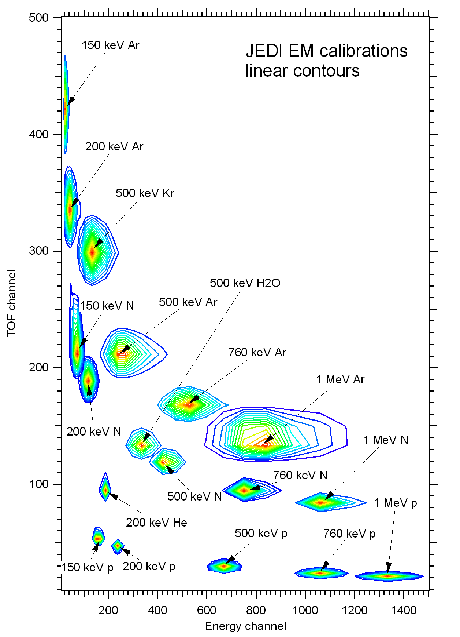
GSFC JEDI EM calibration results
Representative results from JEDI Cal.

Slide 12
EPI-Lo Test Summary
Prototype “EM” Testing
Validate instrument design and performance
Energy response;
Instrument efficiency;
Instrument geometry factor
Establish testing procedures
Flight Model (FM)
Verify instrument design and performance
Energy response;
Instrument efficiency;
Instrument geometry factor

Slide 13
Calibration Approach (Flight units)
FM Unit
All instrument integration activities will be performed in a Class 5 clean room environment
Test in bell jar to characterize geometry, energy response, and sensitivity
Calibrate using particle sources and in Beam Facilities at APL to characterize energy response, sensitivity, dynamic range
Compare with EM results to cover gaps in energy coverage
Test Philosophy:
FM will be extensively calibrated, and performance compared with more extended energy range EM calibrations (LBL, GSFC)
pre- and post-environmental qualification spot calibration
In-flight cross calibration between EPI-Lo and EPI-Hi

Slide 14
EPI-Lo Calibration Schedule
Final calibration for FM slated for three weeks
Major calibration efforts will be performed at APL facility
Substantial understandings of the instrument performance will be made with the EPI-Lo EM characteristics

Slide 15
Tests at Instrument Level
30
*Science requires relative/absolute accuracy: 20%/50%. Ground calibration 20% precision, reduced to 10% in flight.

Slide 16
In-Flight Calibration
On-orbit and cruise calibration achieves relative calibration to 10% precision
Uniformity confirmed by evolution of pitch angle distribution from onset to shock passage.
Such calibrations cover the entire energy and FOV coverage with linear instrument response (targeted rates, no pulse pileup)
Built-in features to determine on-orbit instrument ion performance
Measure pulse-height spectrum of secondary electrons from incident protons as function of time-of-flight
Unit has built-in stimulus to inject known pulse through the front-end electronics

Slide 17
Summary
Calibration plan satisfies all Level IV requirements
Calibration facilities have been identified that meet EPI-Lo needs
APL operates and maintains the key EPI-Lo calibration facility which allows maximum flexibility

Slide 18
Accuracy & Precision
Parameter | Required | Goal (Capability) | Comment/Heritage
Electron Energies | 50 - 500keV | 25 - 1000 keV | Electron capability from JEDI, RBSPICE
Ion Energies | 50 keV/nucleon – 15000 keV Total E | 40 keV/nucleon – 20000 keV Total E | Capability partially based on RBSPICE capabilities. Top energy ~250keV/nuc for Fe
Energy Resolution | 45% for required energy range | 40% for required energy range | Telemetry limited
Time sampling | 5 sec | 1 sec | Telemetry and/or statistics limited
Angle resolution | <30° x <30° | Ions, ~15° x 12° to <30° x <30° e-, 45° | Varies with elevation
Pitch Angle (PA) Coverage | 0°-90° or 90°-180°, some samples in both hemispheres | 0°-90° or 90°-180°, some samples in both hemispheres
Time for Full PA | 1 – 5 sec | 1 – 5 sec | Telemetry limited
Ion Composition | H, He3, He4, C, O, Ne, Mg, Si, Fe | H, He3, He4, C, O, Ne, Mg, Si, Fe | He3/He4 ~50 to 1000 keV/nuc
Electron Sensitivity: I=Intensity (1/cm².sr) | j = 1E1-1E6/cm²-s-sr | Sensor-G:0.144 (cm².sr) Pixel-G: ~0.02 (cm².sr) Up to 6E6 1/s counting | j=Intensity (1/cm²-s-sr) G=Geom. Factor (cm²-sr) 8 pixels/sensor
Ion Sensitivity | j = 1E1-1E6/cm²-s-sr | Sensor-G:0.16 (cm².sr) Pixel-G: ~0.002 (cm².sr) Up to 3.5E6 1/s counting (TOFxE) | 80 pixels/sensor

