Slide 1
Ground Support Equipment
Reid Gurnee
Notes:
introduction

Slide 2
Outline
Board Level GSE
Spacecraft emulators
GSEOS
Safe / Arm plugs
Calibration GSE
Mechanical GSE

Slide 3
Board-Level GSE (EPI-Lo)
Each EPI-Lo lead engineer is responsible for developing their own board-level GSE.
  Power Board: Load board, active load, HV load, breakout box, breakout board, I2C stimulus
  Event Board: energy and TOF preamp boards, test port box, breakout box, I2C slave, commercial pulsers
  Anode Board: Commercial pulsers, scope, HV power supply
All GSE is peer reviewed. Custom GSE is calibrated as needed.

Slide 4
Board-Level GSE (EPI-Hi)
EPI-Hi engineering team develops a board-level GSE for Caltech-designed boards that can be shared between boards based on common subsystems (MISC, I/F to a PC)
Test procedure written for each board, all GSE calibrated
EPI-Hi subcontractors develop their own board-level GSE for LVPS and Bias Supply
EPI-Hi mechanical GSE holds the rigid-flex board stack in binder style, allowing individual boards to “open” like book pages for testing before installation into the flight E-box.

Slide 5
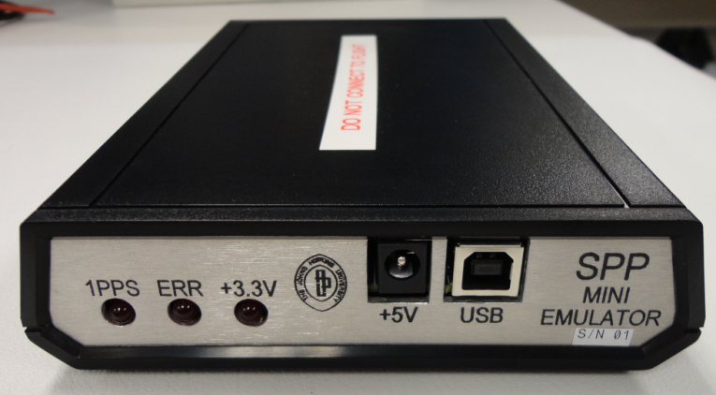
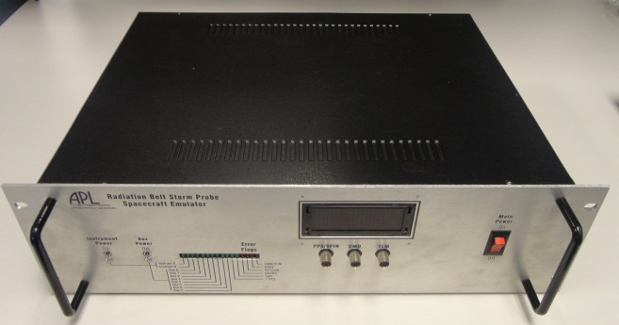
Spacecraft Emulator
Mini emulator
  Provides Instrument Data Interfaces only, No Power Interfaces, No Temperature Interfaces
  Provides virtual 1PPS
  GSEOS Interface is fully compliant
  Non-flight use only
Full emulator
  Provides Instrument Data, Power and Temperature Interfaces (no power supply)
  Provides virtual 1PPS
  Designed for use with Flight hardware
GSE verification performed by Project
Spacecraft Emulator Deliveries to ISIS
  Mini: (2 for EPI-Hi; 1 for EPI-Lo)
    SN 3 : ISIS-EPI-HI Delivered on 6/28/13
    SN 7 : ISIS-EPI-HI Delivered on 7/16/13
    SN 10 : ISIS-EPI-Lo Delivered on 7/11/13
  Full: (2 for EPI-Hi; 1 for EPI-Lo)
    April and May 2014
(

Slide 6
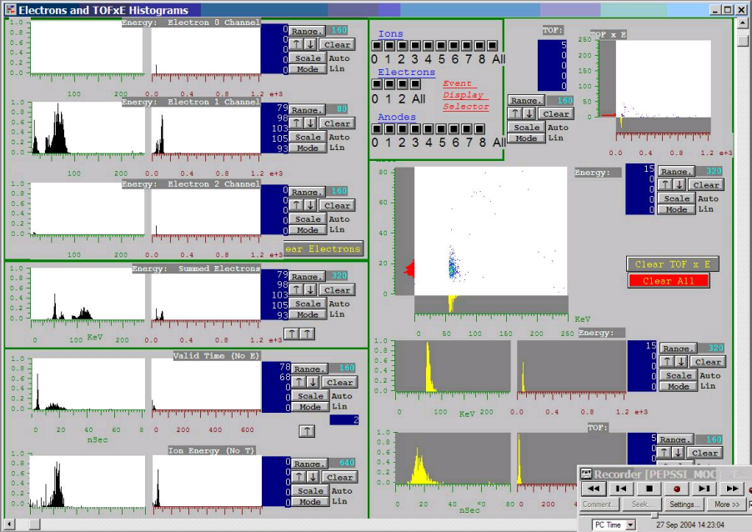
GSEOS
Common GSE software for all instruments
Display screens and instrument customizations can be used through all development cycles from bench testing, I&T deployment, to flight operations
Same platform used for EM, Flight, and Spacecraft operations
  Test scripts can be developed by individual teams, tested on EMs, and then executed at the S/C level
Software verification performed by project

Slide 7
Safe / Arm plugs
EPI-Lo has a HV air-safe plug
  When installed HV is limited to air safe levels (hardware and software limited)
  Plug will be removed for S/C TV testing
  Plug will be permanently removed during final closeout
Instrument covers
  ISIS instruments will have red-tag covers to protect the apertures
  Covers will be temporarily removed for S/C TV testing
  Covers will be permanently removed during final closeout

Slide 8
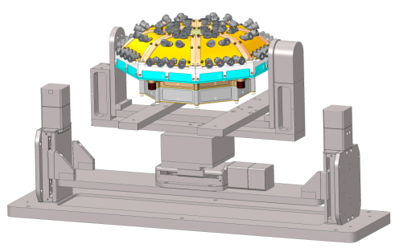
Calibration GSE for Instrument Articulation (EPI-Lo)
Requirements
  Use in APL accelerator facility
    Vacuum compatible (low outgassing)
  Cover full FOV for one octant
Status
  Specified and purchased custom system from Newmark Systems
  Received January ‘09
  Re-furbished in ’12 at Newmark. Added additional controller and position sensor feedback on all motors.
  Fully set up in vacuum chamber with all feed-throughs and control software
Future Work
  Build adaptor plate for EPI-Lo
  Test with mass prototype
Instrument
Articulation stage

Slide 9
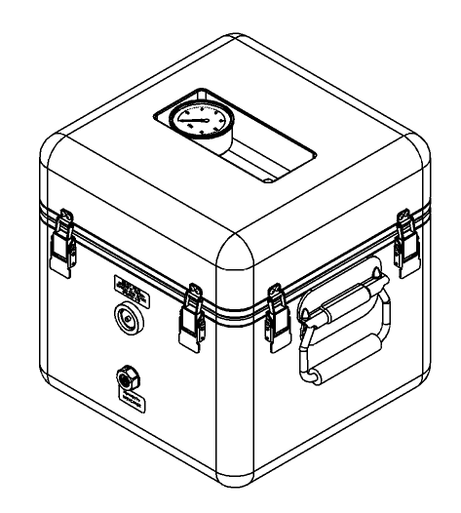
Mechanical GSE
Shipping Container
  Requirements
    N2 purged, humidity controlled and monitored
    Low outgassing
    Shock mounted and monitored
    Hermetically sealed with pressure relief valve
Purge Suitcase
Environmental Test Fixtures
  Thermal Vacuum Fixture
  Vibration Plate Fixture

Slide 10
Summary
GSE highly leveraged from previous programs
Most EPI-Lo GSE is built and ready for instrument testing
EPI-Hi mechanical GSE not designed yet

