Slide 1
Assembly, Integration, and Test
John Dickinson
ISIS SE (SwRI)
Notes:
introduction

Slide 2
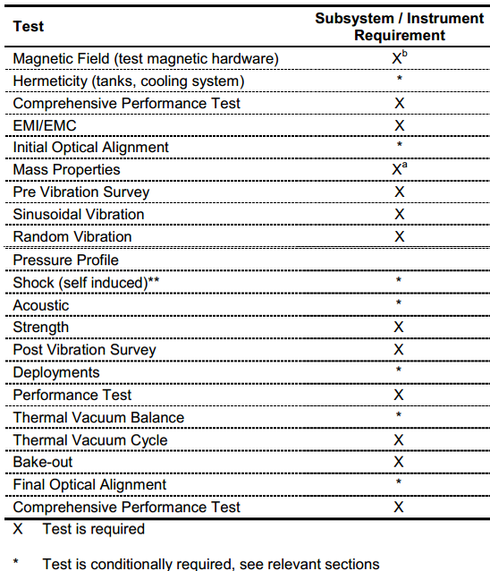
Outline
Typical Test Flow for Components and Instruments (EDTRD)
EPI-Hi Assembly, Integration, and Test Flow
EPI-Lo Assembly, Integration, and Test Flow
EDTRD Test Levels:
  Acoustic
  Vibration
  Thermal-Vacuum profile
Not Performed on ISIS

Slide 3
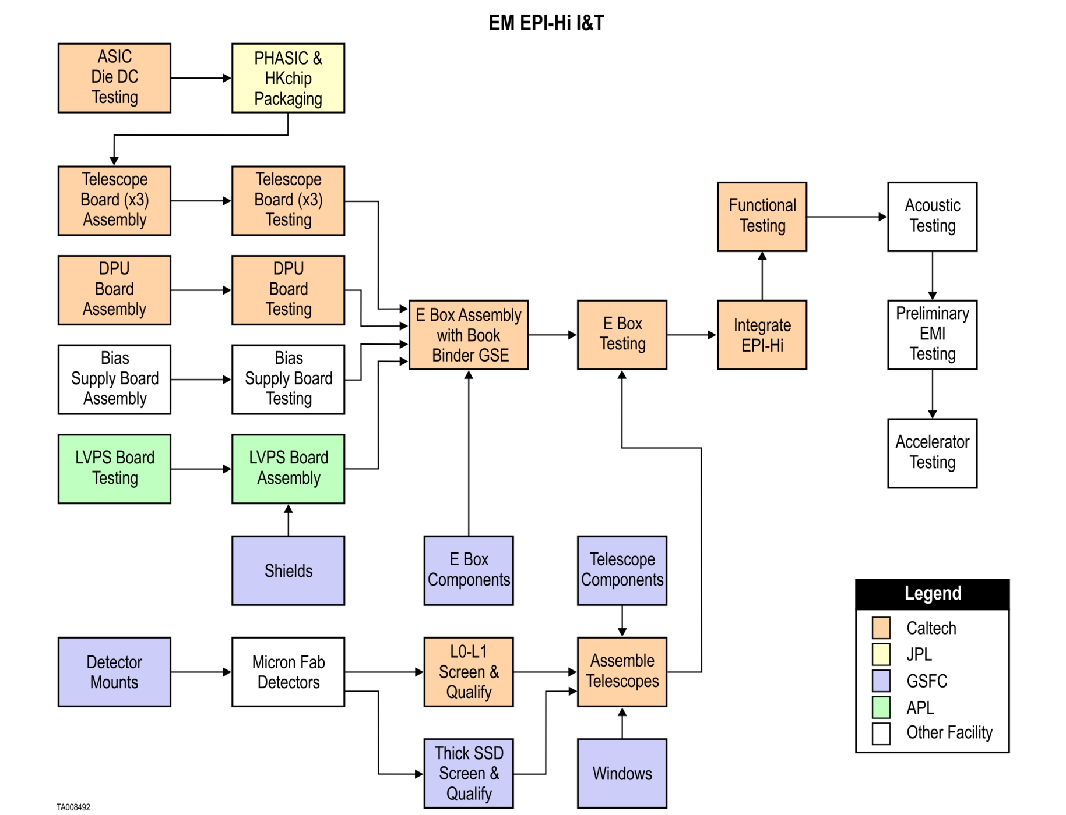
EM EPI-Hi Assembly, Integration, & Test
Last Rev in Drafting

Slide 4
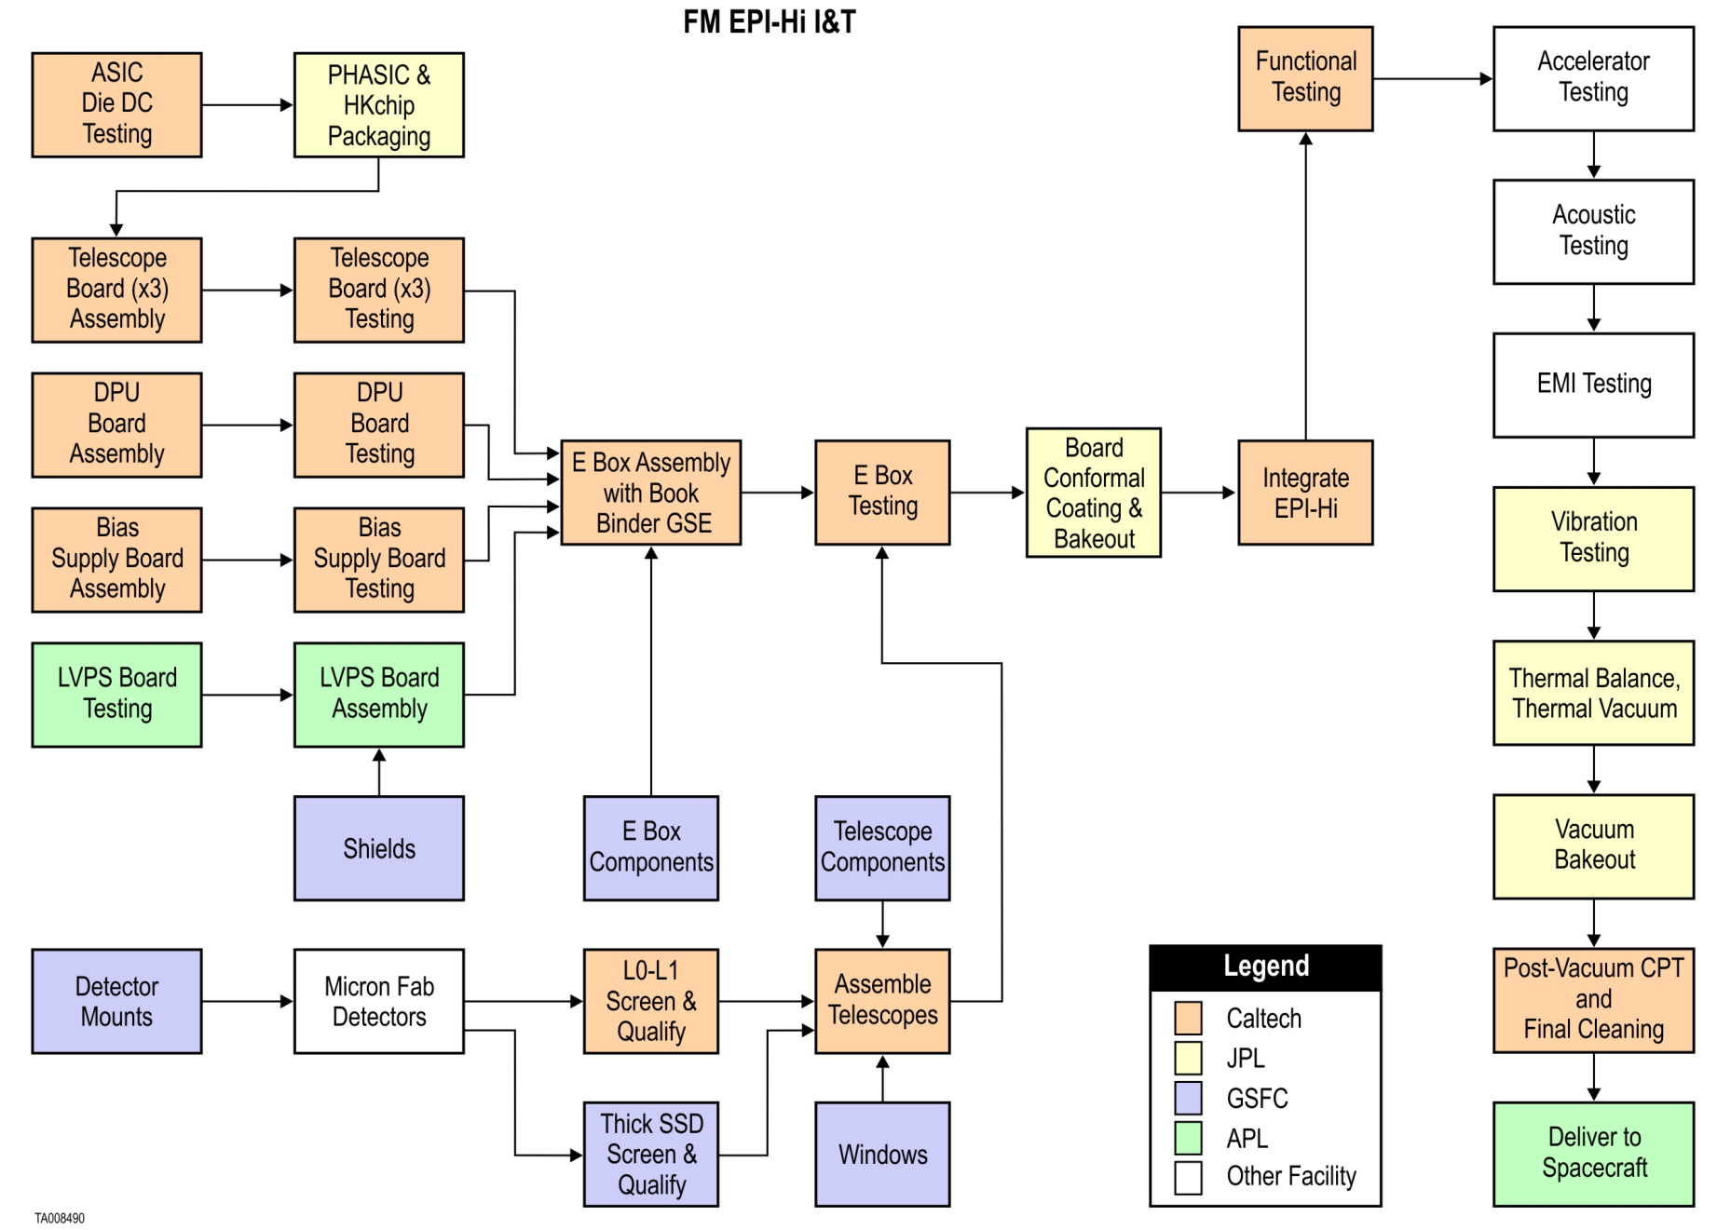
FM EPI-Hi Assembly, Integration, & Test
Last Rev in Drafting
Performance Tests performed between Qualification Tests

Slide 5
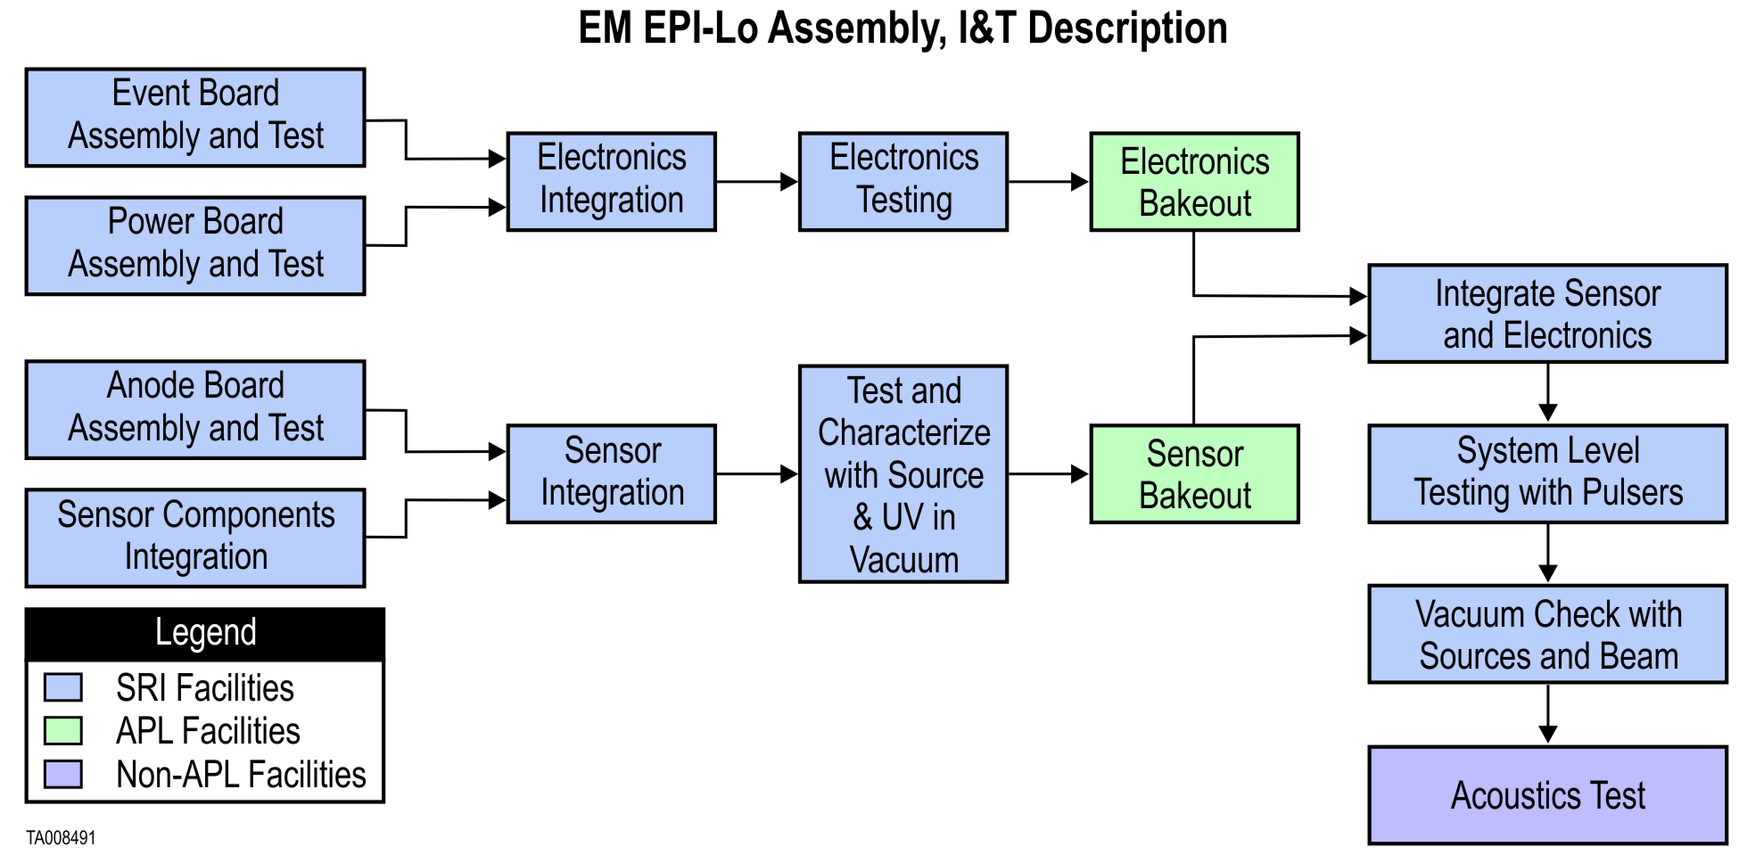
EM EPI-Lo Assembly, Integration, & Test
Last Rev in Drafting

Slide 6
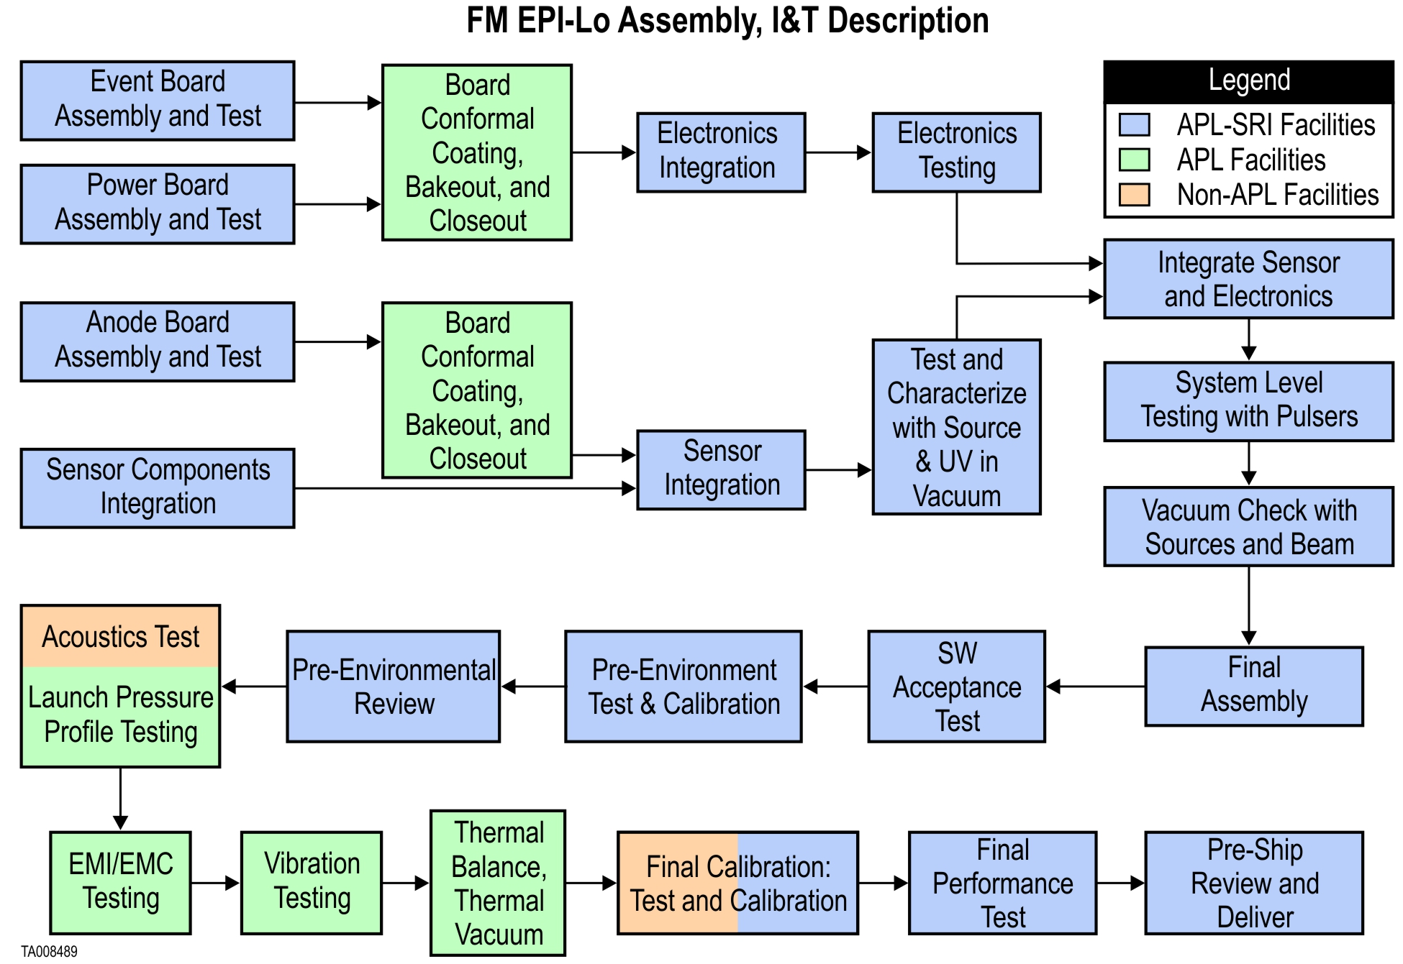
FM EPI-Lo Assembly, Integration, & Test
Performance Tests performed between Qualification Tests

Slide 7
Normal Vibration Levels
Side Panels Mounted Components & Subsystems Normal To Panel
Frequency (Hz) | Qualification (G²/Hz) | Protoflight (G²/Hz) | Acceptance (G²/Hz)
20 | 0.01 | 0.01 | 0.01
60 | 1.25 | 1.25 | 0.63
200 | 1.25 | 1.25 | 0.63
350 | 0.04 | 0.04 | 0.04
500 | 0.04 | 0.04 | 0.04
2000 | 0.01 | 0.01 | 0.01
Overall Grms | 16.4 | 16.4 | 12.6
Duration (mins) | 2 | 1 | 1
Normal
Lateral
Lateral

Slide 8
Lateral Vibration Levels
Side Panels Mounted Components & Subsystems Lateral To Panel
Frequency (Hz) | Qualification (G²/Hz) | Protoflight (G²/Hz) | Acceptance (G²/Hz)
20 | 0.01 | 0.01 | 0.01
35 | 0.04 | 0.04 | 0.04
500 | 0.04 | 0.04 | 0.04
2000 | 0.01 | 0.01 | 0.01
Overall Grms | 6.8 | 6.8 | 6.8
Duration (mins) | 2 | 1 | 1
Normal
Lateral
Lateral

Slide 9
Acoustics Levels
Table 7‑2. Acoustic Flight Levels
1/3 Oct Center Freq (Hz) | MEFL (dB) |  | 1/3 Oct Center Freq (Hz) | MEFL (dB)
32 | 123.0 |  | 630 | 120.5
40 | 124.8 |  | 800 | 119.1
50 | 126.2 |  | 1000 | 117.8
63 | 127.5 |  | 1250 | 116.4
80 | 128.3 |  | 1600 | 115.0
100 | 128.8 |  | 2000 | 113.6
125 | 129.0 |  | 2500 | 112.3
160 | 128.7 |  | 3150 | 110.9
200 | 127.5 |  | 4000 | 109.5
250 | 126.0 |  | 5000 | 108.1
315 | 124.3 |  | 6300 | 106.8
400 | 123.3 |  | 8000 | 105.4
500 | 121.9 |  | 10000 | 104.0
 |  |  | OASPL | 138.1

Slide 10
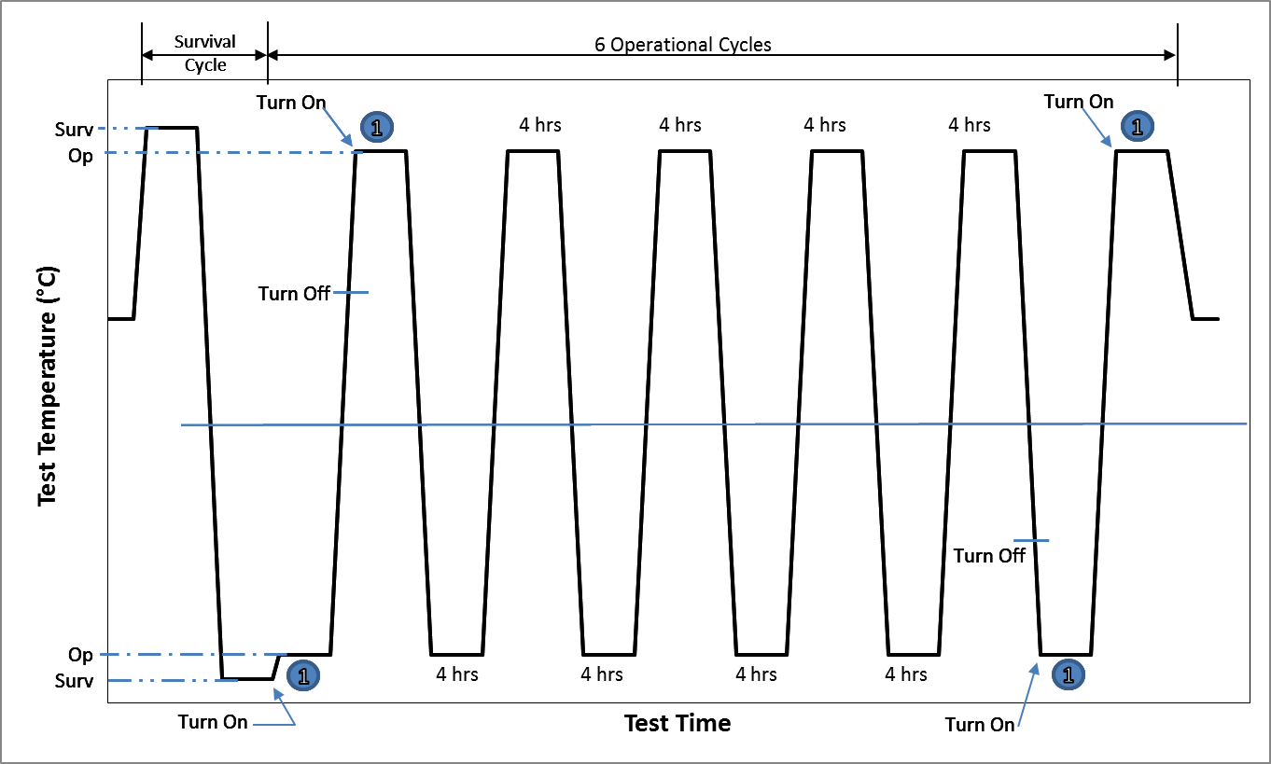
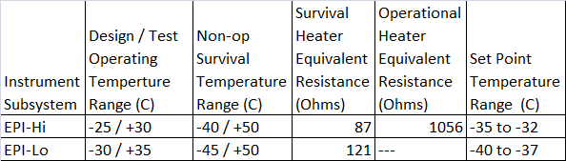
Thermal Vacuum Test Cycles
CPT
CPT
CPT
CPT

Slide 11
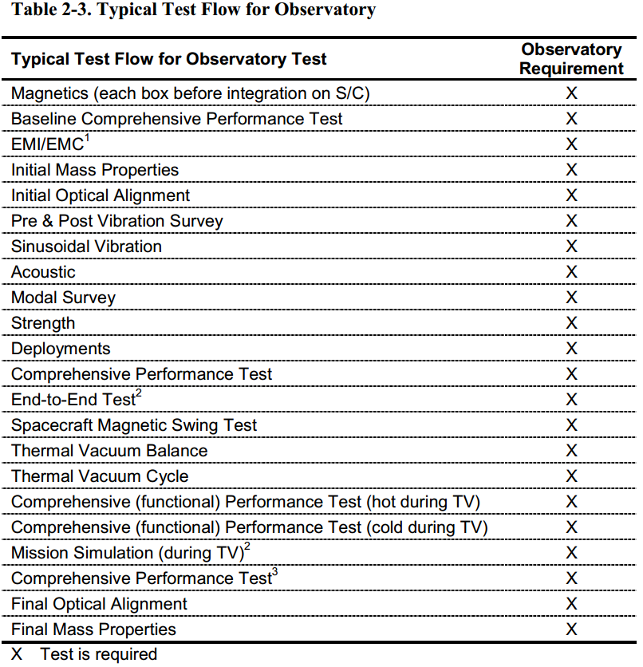
Observatory Environmental Testing
(N/A for ISIS)

Slide 12
Summary
EM is used as a pathfinder for FM integration and test
FM unit undergoes instrument level environmental testing to EDTRD levels
EM is used for command and procedure testing after FM delivery to spacecraft and to support commanding activities after launch

