Slide 1
EPI-Hi Electronics
Branislav Kecman / Rick Cook
Notes:
introduction

Slide 2
EPI-Hi Electronics
Implementation and Status
Branislav Kecman
Cognizant Electrical Engineer

Slide 3
Outline
Design/Assembly/Test Flow
Board Status
  DPU Board Layout
  Bias Supply Board Layout
EEE Parts Program and Status
  Significant Parts
  ASICs: PHASIC and HKchip
Resources
  Power
  Mass
Harness Diagram
  Thermal Harness

Slide 4
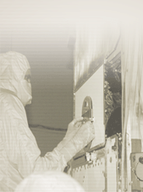
Design/Assembly/Test Flow
Mechanical design
S. Shuman
GSFC
Preliminary design
and schematic
R. Cook
J. Burnham
Detailed design
and schematic
J. Burnham
B. Kecman
Peer review
SwRI, JPL
EM layout
J. Burnham
B. Kecman
EM layout
review
SwRI
EM assembly
J. Burnham
B. Kecman
Test/rework/test
R. Cook
B. Kecman
J. Burnham
Parts identification, EM and flight
B. Kecman, J. Burnham
J. Tumlinson SwRI
Parts stress
analysis
J. Burnham
Parts procurement, EM and flight
B. Kecman, M. Windhausen GSFC
Flight layout mods
J. Burnham
B. Kecman
Flight layout
review
SwRI
Flight board
assembly & inspection
JPL
Flight board test
R. Cook
B. Kecman
J. Burnham
Staking,
conformal
coating
JPL

Slide 5
Board Status
Board | Spec | Schem | Peer review | EM layout | EM fab began | EM parts procured | EM test starts at Caltech
Telescope x3 | N/A | 80% | √ | 20% | No | 60% | Jan-Jun ‘14
DPU | N/A | √ | √ | √ | No | 80% | 2/28/14
LVPS | √ | √ | √ | √ | Yes | √ | 1/27/14
Bias Supply | √ | √ | √ | 60% | No | 70% | 4/7/14
Breadboard | Spec | Schem | Peer | Layout | Fab | Parts | Test
Bias Supply | √ | √ | N/A | √ | √ | 90% | In progress

Slide 6
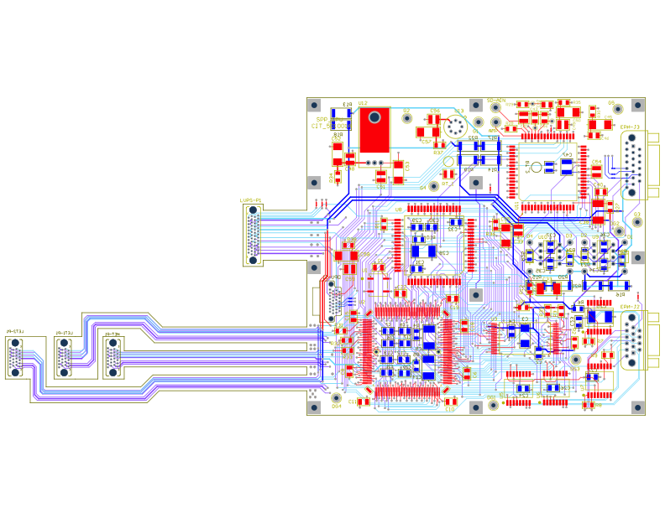
DPU Board Layout
View from sunward direction
13.50 cm, square

Slide 7
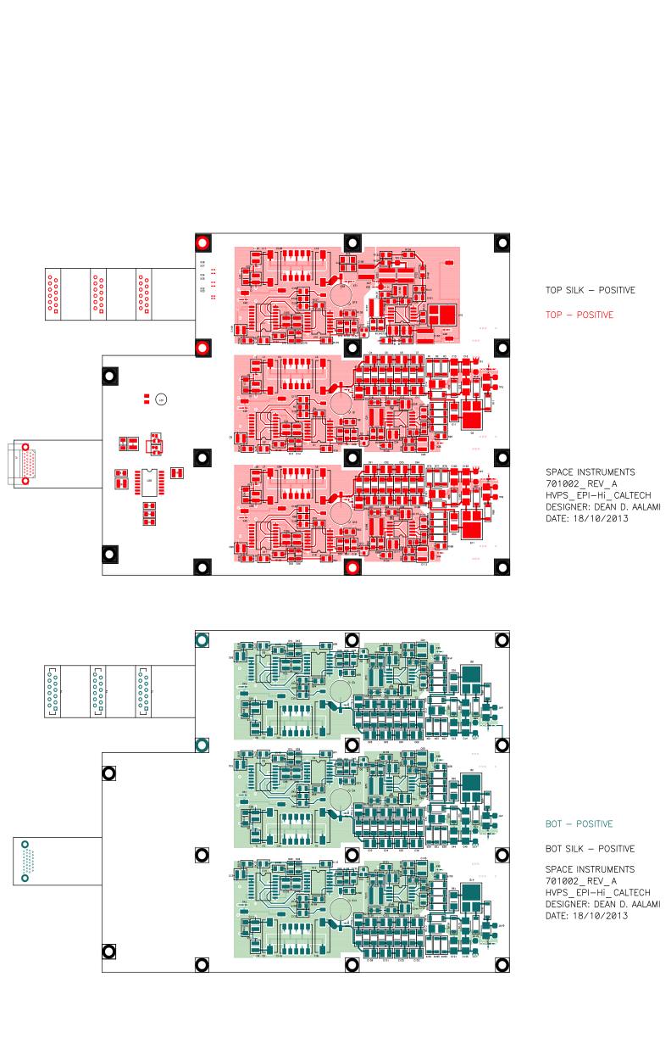
Bias Supply Board Layout
13.50 cm
View from sunward direction
14 cm
17.50 cm

Slide 8
EEE Parts Program and Status
All parts required to meet EEE-INST-002, Level 2
  PCB approval required for all parts
    PCB review in process for all parts
Existing Caltech custom databases used to track inventory and kit history for all parts
Procurement in process now for prototype/EM parts
Where possible, flight parts will come from Caltech, GSFC, SwRI and JPL inventory
  Parts more than 5 years old will have additional testing performed as required by the PCB

Slide 9
Significant Parts
Part Number Part Type | Manufac-turer | Heritage | Notes
RTAX250SL-CQ208B FPGA | Microsemi SoC (Actel) | NuSTAR | Existing stock at Caltech
5962R0323601QXC SRAM, 4Mb (128k x 32) | Aeroflex | NuSTAR | Existing stock at Caltech
5962R0422701QXC SRAM, 16Mb (512k x 32) | Aeroflex
5962R1222201VXC MRAM, 16Mb (2M x 8) | Aeroflex |  | Common buy with S/C
10229545 PHASIC, Hybrid ASIC | JPL | STEREO | Existing stock at Caltech Modification required
TBD HKchip, ASIC | JPL |  | Will follow similar process as PHASIC

Slide 10
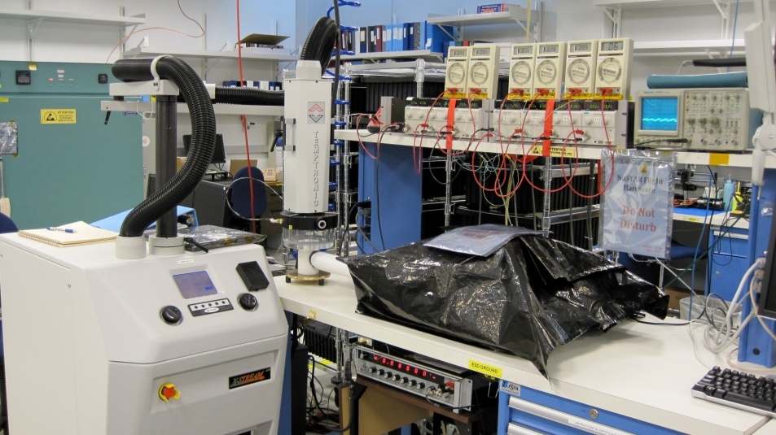
ASICs: PHASIC and HKchip
PHASIC: Hybrid ASIC developed for STEREO
  Using existing stock with modifications
    New rad-hard wafers will be produced
      TID and SEL testing planned
    Heritage die will be removed and replaced
    Packaging will be performed by JPL Hybrid Lab
    Assembled part will undergo full screening and qualification performed by JPL and Caltech
HKchip: New part, monolithic ASIC
  Will follow the same wafer procurement, packaging and
  test plan as the PHASIC

Slide 11
Resources - Power
Subsystem | Power [ W ]
LET1 board | 1.06
LET2 board | 0.76
HET board | 0.95
DPU board | 0.62
Bias Supply @ Beginning Of Life | 0.12
LVPS @ BOL (70% efficiency) | 1.50
Total @ BOL | 5.0
End Of Life
Bias Supply @ End Of Life | 0.68
LVPS @ EOL (70% efficiency) | 1.74
Total @ EOL | 5.8

Slide 12
Resources - Mass
Subsystem | Mass [ g ]
LET1 telescope LET1 board | 225 258
LET2 telescope LET2 board | 145 233
HET telescope HET board | 120 250
DPU board Bias Supply & RF shields LVPS & RF shields | 197 225 + 130 160 + 100
Elec. box, hardware & shielding Telescope brackets Thermal hardware MLI blankets | 925 + 250 +100 160 50 100
Total | 3,628

Slide 13
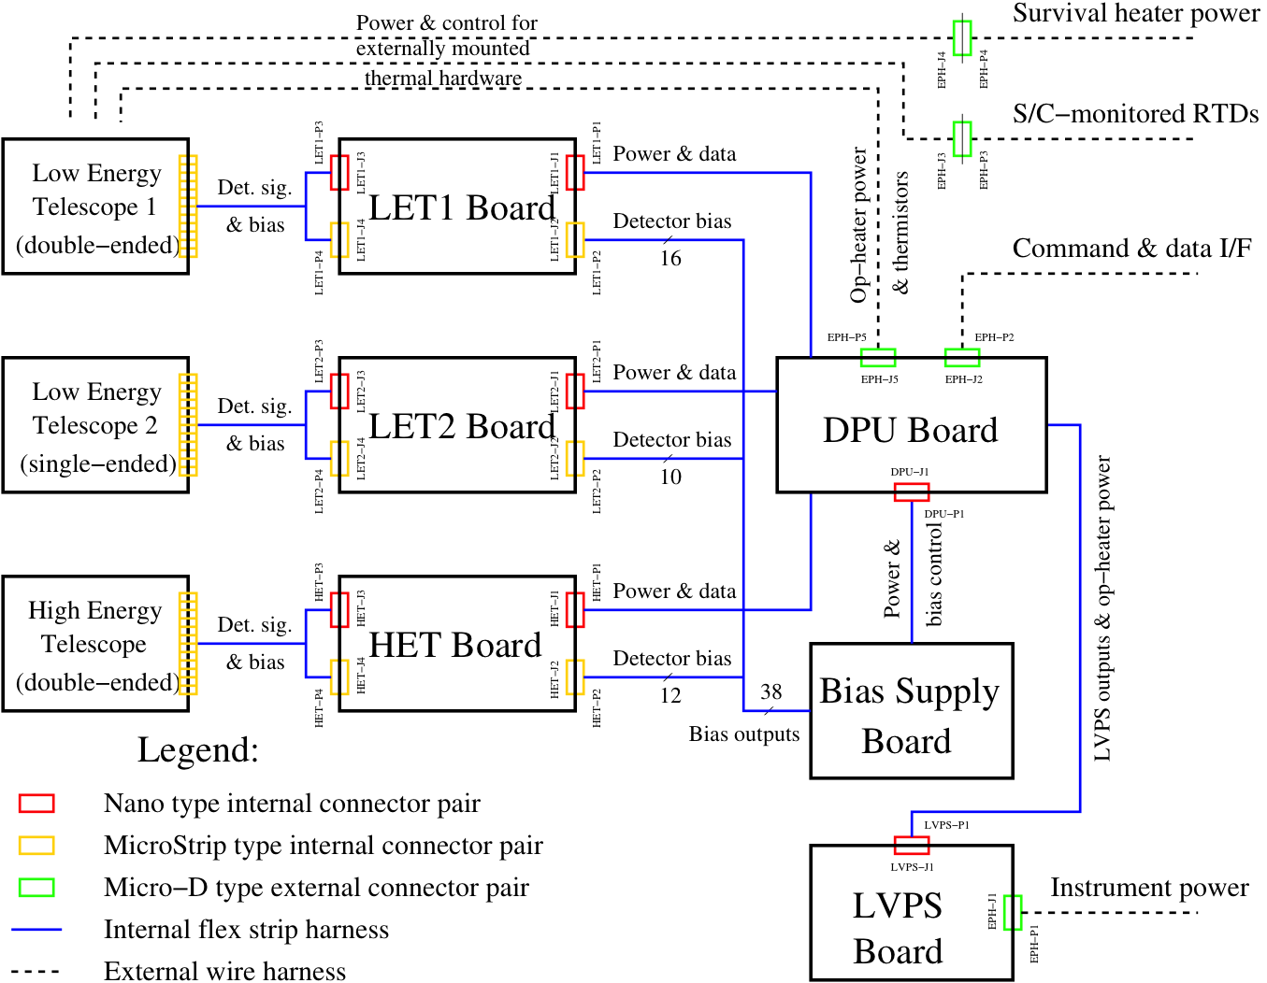
Harness Diagram

Slide 14
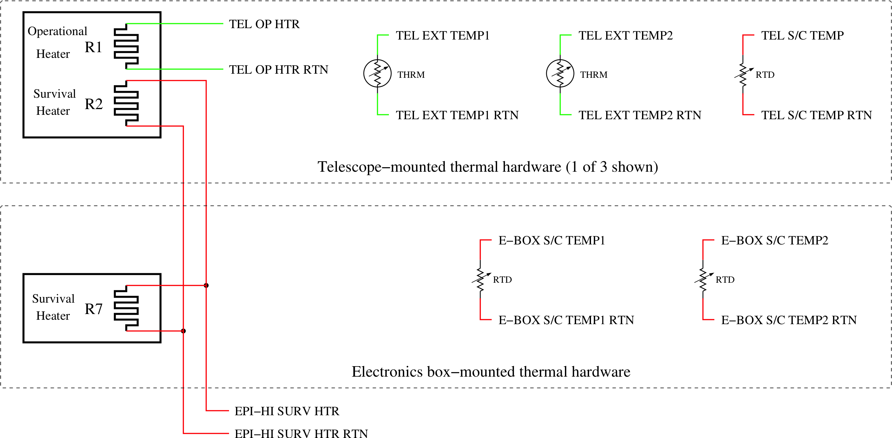
Thermal Harness Diagram

