Slide 1
EPI-Lo Electronics
Reid Gurnee
Notes:
introduction

Slide 2
Outline
Electronics Overview
Block Diagrams
Driving Requirements
Event Board
  Functionality, Interfaces, prototyping, FPGA, layout
Anode Board
  Functionality, Interfaces, prototyping, layout
Energy Board
  Functionality, Interfaces, prototyping, layout
Packaging and thermal considerations
Radiation analysis
Plans for testing
Preliminary parts list and special screening considerations
Status Summary
Plan Forward
Peer Review Status

Slide 3

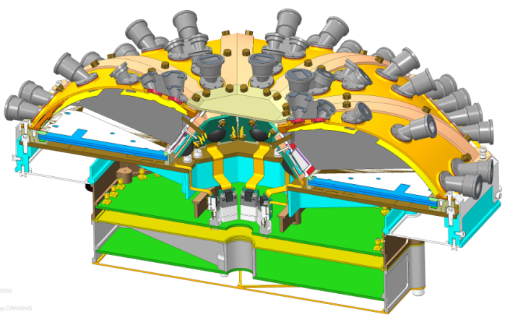
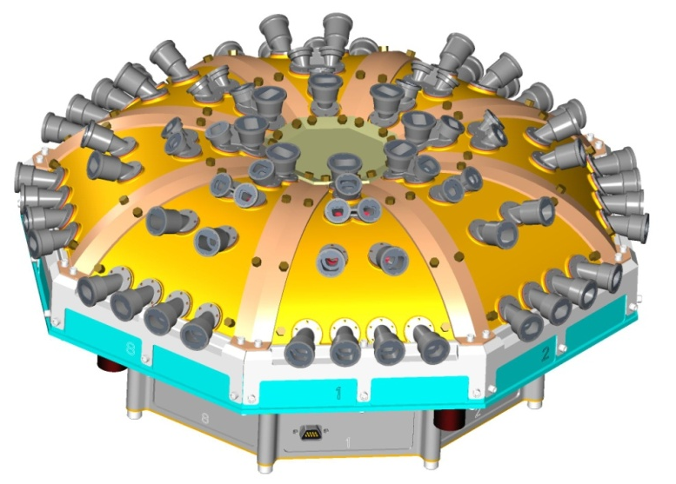
EPI-Lo – Electronics Overview
Energy Boards (x8)
Anode Boards (x4)
Event Board
Power Board
(presented later)

Slide 4
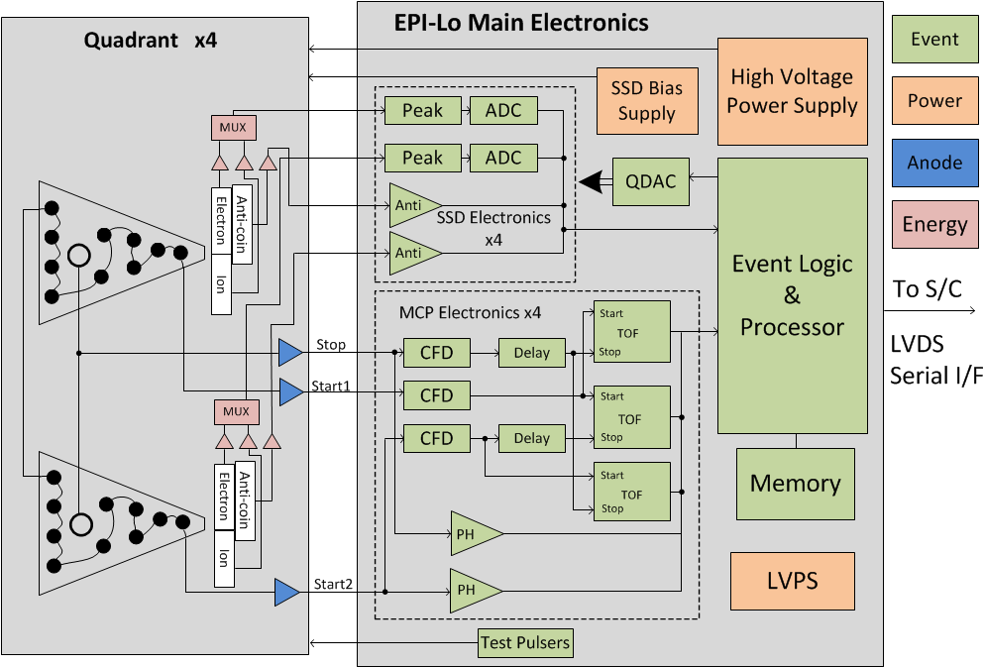
EPI-Lo Block Diagram

Slide 5

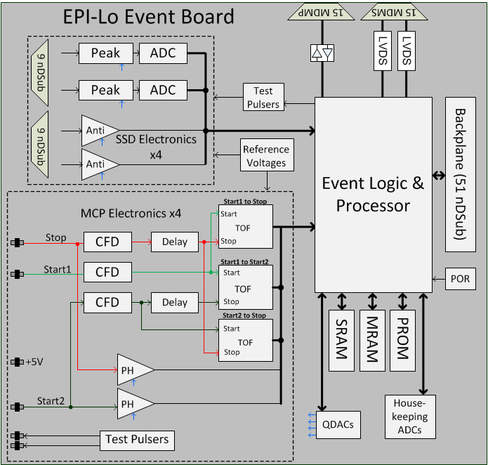
Block Diagram

Slide 6
Electronics Driving Requirements
Analog Performance
  Timing resolution < 400pS FWHM
  Energy resolution < 15KeV FWHM
MCP timing system dynamic range of 500k to 25M electrons
Energy system dynamic range of 50keV to 15MeV
  Higher energies (>1MeV) use pulse width mode
Temperature
  Survival: -55°C to +85°C
  Operational: -35°C to +65°C
Radiation
  TID: 25 kRad (based on FASTRad analysis)
  SEL: 80 MeV-cm^2/mg
Event board very similar to previous programs (RBSPICE, JEDI, EIS). All major changes have been prototyped.

Slide 7
Event Board Functionality (1/2)
Instrument processor
  Embedded processor in RTAX2000
    Execute Flight Code, Accumulating and Formatting Telemetry, Commanding, and Alarm Detection and Action
  Spacecraft communication
  Boot code in PROM, classification tables and application code in MRAM
  Accumulate data into classification tables
Event Processing
  Communicate and handle timing with ADCs, TOF-Ds
  Pre-process and accumulate event data
  Accumulate Rates
HVPS control
  Control four opto-coupler generated HVPS outputs
  Provide high speed safing of HVPS in response to over current

Slide 8
Event Board Functionality (2/2)
Time-of-flight based on APL TOF-D and CFD-D ASICs
  New ASICs developed for future programs
  Improved size and performance from previous ASICs
  12 CFD-Ds and 4 TOF-Ds for timing system
Solid State Detector Energy Measurements
  8 Peak detect ASICs and A/D converters for energy system
  Peak detect chips are APL ASICs flown on previous missions (PEPSSI, Jedi, RBSPICE)
MCP pulse height comparators
Pulsers
  Independent pulsers for start and stop signals on each anode board
  2 pulsers for Energy system

Slide 9
Event Board Interfaces
Solid State Detector Interface
  8, 9-pin ndsub connectors to energy boards
  ~10 mV to over 1 V unipolar-shaped pulses
  Control, pulser, and power lines
Anode Board Interface
  12 Time-of-Flight Coax connectors
    ~10 mV to over 1V fast-shaped pulses
  4 power and 8 pulser Coax connectors
Test Port Connector
  2 Test Inputs (to aid in end-to-end timing tests)
  5 Test outputs
Spacecraft data connector
  Redundant LVDS interface (2 drivers, 2 receivers)

Slide 10
Energy System Updates
Energy system re-designed from previous instruments
  8 ADC121s read out the 8 peak detect chips
  Prior designs used MUX and one fast ADC
  New design allows de-coupling of quadrants – each quadrant has completely independent readout electronics and can be operated as an individual instrument
  Event logic will be identical for each quadrant and then the data will be combined
  New approach significantly simplifies event logic design, and increases data processing rates and redundancy

Slide 11
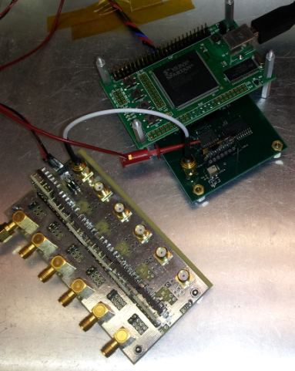
Energy System Prototype
Fully tested interface of energy chip to peak–detect SIP to ADC using flight-like components
Energy resolution of test setup far exceeds requirement (15keV)
Digital readout
atten. DB | KeV | FWHM (KeV)
-6 | 912.161 | 8.78712
-7 | 812.964 | 6.26275
-8 | 724.555 | 6.08932
-9 | 645.760 | 5.81954
-10 | 575.535 | 5.5883
-15 | 323.647 | 4.91385
-20 | 182.000 | 4.64407
-25 | 102.346 | 4.50918
-30 | 57.553 | 4.29721
-35 | 32.365 | 4.14305
-40 | 18.200 | 4.54772
ADC128 (EM)
Peak Detect SIP
SSD pre-amplfiers

Slide 12
FPGA Functionality
FPGA contains all event logic and event processing
  SCIP: 16-bit 10 MIPS processor (reused custom embedded processor based on Harris RTX2010 and APL’s FRISC)
  Processor memory interface to PROM, MRAM, SRAM
  Support I/O
    Provide voltage supply clocks, read safing status, set thresholds, monitor housekeeping, etc.
    LVDS spacecraft communication interface
    Processor test port interface
  Event Logic
    Count sensor basic rates and diagnostic rates
    Provide pulser stimulus
    Collect and process TOF values to generate start direction and particle time-of-flight
    Select appropriate SSD channel and record energy deposited
    Detect anti-coincidence (electron only) and pulse-height over-threshold (start and stop)
    Send selected valid events based on commanded event criteria to processor event buffer
    Event logic test port for ground testing

Slide 13
FPGA Resources
Actel RTAX2000SL -1 speed CCGA-624 (common buy part)
  Estimate ~40% resource utilization based on RBSPICE design
  Internal RAM for event FIFO only
    No minimum size required and soft memory is fine (parity check)
  418 user I/O total, 18 spares
    3 spares to power board + 7 spares through Schmitt triggers to test connector + 8 true spares = 18 spares
    Note: At the FPGA requirement review, moderate reuse designs are green for at least 17 uncommitted I/O pins
  1.5V Core Voltage, 3.3V I/O Supply Voltage
    +/-5% voltage tolerance
    Supplies can be powered up or powered down in any sequence as long as some app note details are considered
    I/O are tri-stated during power-up

Slide 14
FPGA Development
Part prototyping
  Reprogrammable Aldec/Actel system for EM
  Board layout also accommodates commercial socket if needed
Design prototyping/reuse
  SCIP is identical to RBSPICE
  Similar approach to RBSPICE for many interfaces: S/C communication, power supplies, QDACs, test port, memories, peak detects, pulsers
  New interfaces prototyped prior to EM: TOF-D rather than TOF-C, new ADC for HK and energy readout
  Significant previous experience with all design tools: VHDL (with tcl scripts, pdc files etc.), Synplify Pro, Actel Libero, ModelSim
No expected areas of concern
  No timing closure challenges expected (most of design at 10MHz, some at 40MHz)
  Primarily synchronous design techniques with standard clock domain crossing techniques and no gated clocks
  Straightforward reset filtering and routing network
  Sufficient clock nets available for clocks and reset

Slide 15
Event Board Layout
Sensitive analog is separated from digital
  FPGA, S/C communication, SRAM, PROM, MRAM, and oscillator on top of board
  TOF electronics on left and right of board
  Peak detect and ADC electronics on bottom of board
  All critical routing isolated by ground planes from digital routing
12 layers, 2 ground planes, 2 power planes, 8 routing planes
Actel located with SRAM directly adjacent
  Reduce track-length to SRAM to reduce noise
  Actel on Primary side, to allow the Development Tool access to the program pins

Slide 16
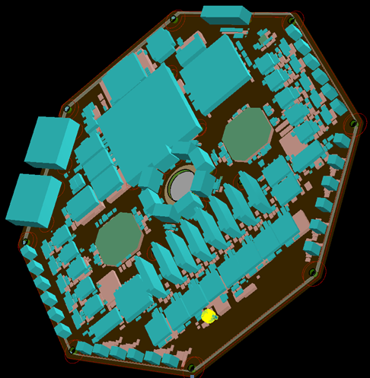
Event Board Layout
FPGA (socket footprint shown)
RAM
MRAM, PROM
CFD-Ds
TOF-Ds
LVDS, Test Port
Peak Detect SIPs
TOF-Ds
ADCs
CFD-Ds

Slide 17
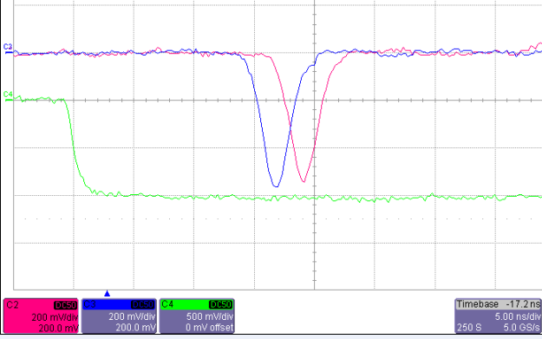
Anode Board Description
Functionality
  3 fast discrete amplifiers
    Stop anode and each end of the start delay line
    50 ohm impedance matched, designed to drive 50 ohms
  Anode is at 3kV, PCB embedded capacitors isolate HV from LV
  1 start pulser and 1 stop pulser
    Start pulser location in imaginary anode between sensor wedges
Interfaces
  6 coax SSMB connectors
  Power, 3 outputs, 2 pulsers

Slide 18
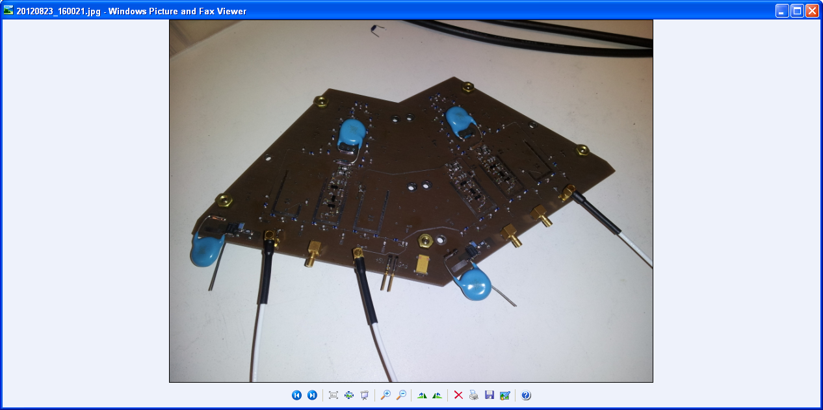
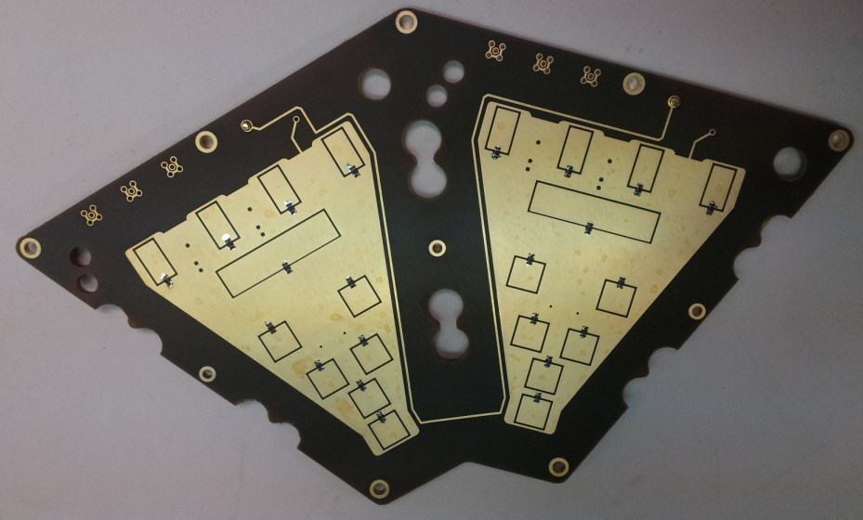
Anode Board Prototyping
Initial prototype board fabricated, assembled, and tested
  First implementation of embedded capacitors for HV anode
  Verified quadrant design
EM anode board fabricated, assembled, and in testing
  Electrical and mechanical interfaces well defined
  Position mapping on prototype verified simulations for start pad locations
  Kapton layer provides dielectric strength of ~20kV for embedded capacitors
    Passed 10 day, 2x HV standoff test (recommended by Steve Battel)
  APL packaged transistor array

Slide 19
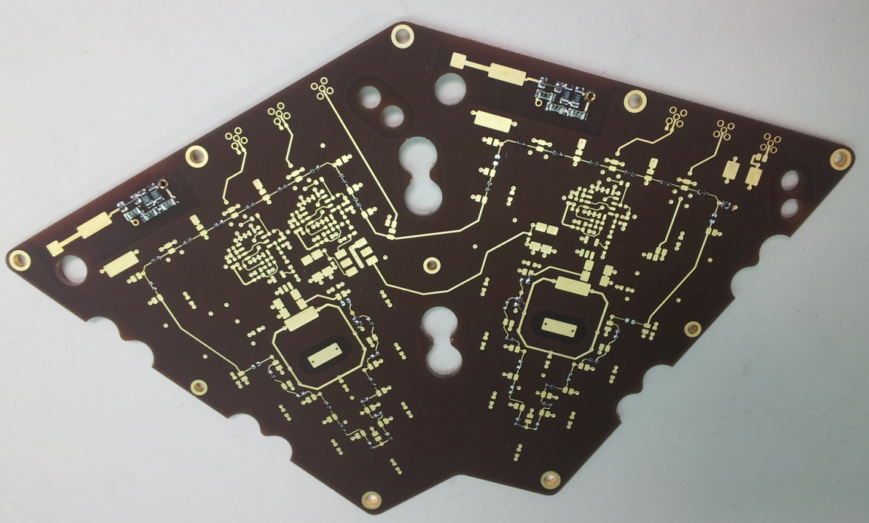
Anode Board Layout
Connectors
Pre-Amps
HV Filters
Delay line elements

Slide 20
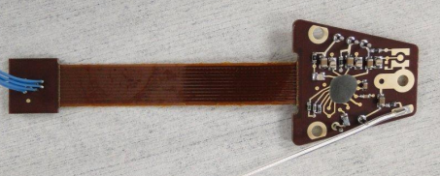
Energy Board
Functionality
  SSD Pre-amplifier and shaper
  Energy ASIC supports 3 pre-amplifiers and MUX
    Ion channel, electron channel, anti-coincidence channel
    Select between Ion channel, or electron and anti-coincidence channels
  Thermistor for temperature measurements
  Test connector for pulser inputs
Interfaces
  9 pin ndsub connector for power, signals, pulser, and temperature monitor
  Bias voltage from
  separate HV wire (<200V)
  Test connector (MMCX)
  SSD connections
  (Mill-Max Socket)
EM energy board
fabricated and in testing

Slide 21
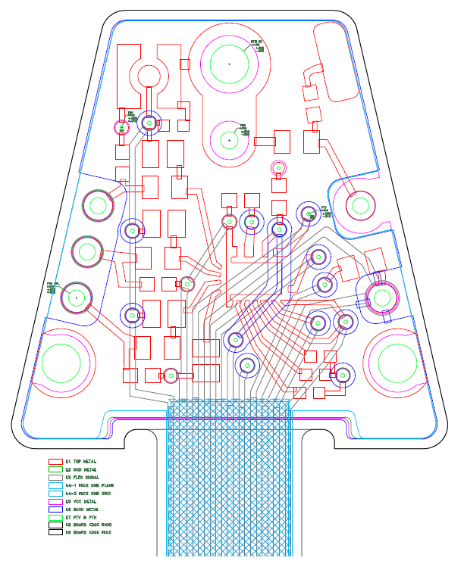
Energy Board Layout
Test connector
Bias supply input
SSD inputs for ion, electron, and anti-coincidence detectors
HV (bulk) connection to SSDs
Ground (front) connection to SSDs
Interface to event board
Energy ASIC Die

Slide 22
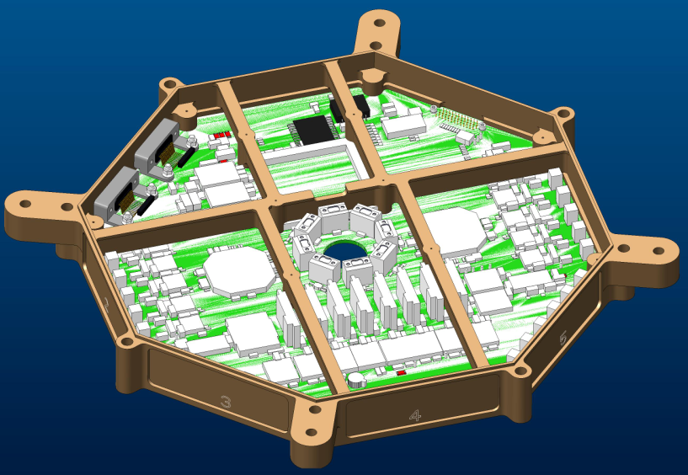
Event Board Packaging
Packaged in octagon frame “slice”
  Board is loaded from the bottom and has six center mounting supports and full contact around the perimeter
  FPGA is supported on four corners
Large number of thermal vias under the higher power parts
  Actel, RAM, and MRAM to
  dissipate power into the
  board planes and out to
  the frame.
  Total board power is ~1
  watt. No thermal issues
  expected.

Slide 23
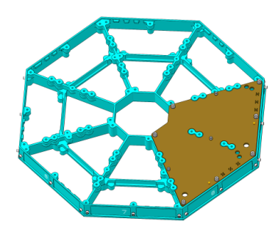
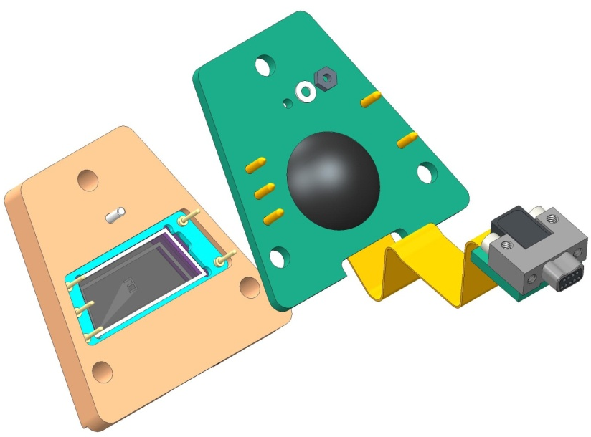
Anode and Energy Board Packaging
Anode Board
  Anode board is mounted to instrument main support structure
  Total board power is 90mW, no thermal concerns
Energy board is mounted directly behind SSD
  Total board power is 25mW, no thermal concerns
one of four anode boards shown

Slide 24
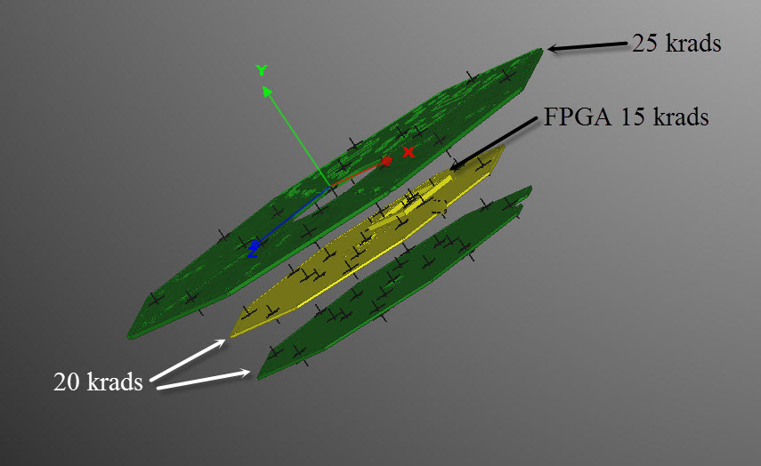
Radiation Analysis
FASTRad analysis performed on instrument in S/C model to predict doses seen at electronics (bracket, instrument, and S/C modeled)
Electronics boards: <25 krad
Detectors: <40 krad

Slide 25
Plans for Testing
Follows APL Manufacturing Flow, these are significant highlights
  Populate Passive Components
  Execute Test Procedure to Verify Passive Components
  Populate First-level Active Components
    Voltage References, Power-on Reset, Oscillator, applicable Tailor Flags
  Execute Test Procedure to Tailor and Verify First-level Active Components
  Populate Actives and Install Known Tailors or Tailor Flags
  Install into Flight Frame
  Execute Test Procedure to Test and Tailor Entire Board
  ESS Testing
  Execute Functional Test Procedure
  Photograph and Conformal Coat
  Execute Test Procedure to Calibrate and Characterize Board (over temperature)
  Release to Next Assembly

Slide 26
Preliminary Parts List
Investigating ADC for single event transients
ADCMP600 being qualified by project
Transistor array die being packaged by APL into ceramic 16 pin LCC

Slide 27
Status Summary
Event board
  EM parts placement complete
  Routing in process
  EM PCB expected in December
  All critical circuits have been prototyped
Anode Board
  Prototype anode board fabricated, assembled and tested
  EM anode board fabricated, assembled and testing in process
  10 day, 2x HV standoff test successfully completed on EM
Energy Board
  EM Board fabricated, assembled, and testing in process

Slide 28
Plan Forward
Anode Board
  Complete testing on Anode board
  Fabricate flight anode board
Energy Board
  Complete testing on energy board
  Fabricate flight energy board
Event Board
  Fabricate EM board
  Complete testing on EM board
  Fabricate flight Event board
Finalize all documentation and procedures for flight build
Build, tailor, calibrate, and qualify flight units

Slide 29
Peer Review Status
Event and Power Board Peer Review
  August 21, 2013. Summarized with action items in memo SRI-13-029
  11 action items generated / 11 action items closed (6 for event board)
Anode Board Peer Review
  June 21, 2013. Summarized with action items in memo SRI-13-025
  6 action items generated / 6 action items closed
Energy Board Peer Review
  August 26, 2013. Summarized with action items in memo SRI-13-030
  4 action items generated / 4 action items are closed
Parts Stress Analysis
  No issues expected
WCA
  No issues expected

