Slide 1
EPI-Lo Mechanical
Scott Cooper
Steve Layman
Shaughn London
Notes:
introduction

Slide 2
Outline
Summary of mechanical design requirements
Overview of mechanical design
Detailed description of the instrument mechanical design
  Wedge Assembly
  MCP Assembly
  SSD Assembly
Assembly process
Mechanical development status
Summary of analyses
Summary of Peer Review results

Slide 3
Mechanical Design Requirements
7434-9039, SPP Environmental Design and Test Requirements Document
  Subsystem to have min frequency > 80 Hz
  PWAs to have min frequency > 150 Hz
  Quasi-static load factor: 40g (Figure 4-11 & Table 4-19)
  Factors of safety: Table 4-5, Unpressurized Factors of Safety
  Random vibration levels: Table 4-8 and Table 4-9
7464-0008 EPI-Lo-S/C Mechanical ICD
  Generated by EPI-Lo to document placement and orientation of instrument on spacecraft

Slide 4
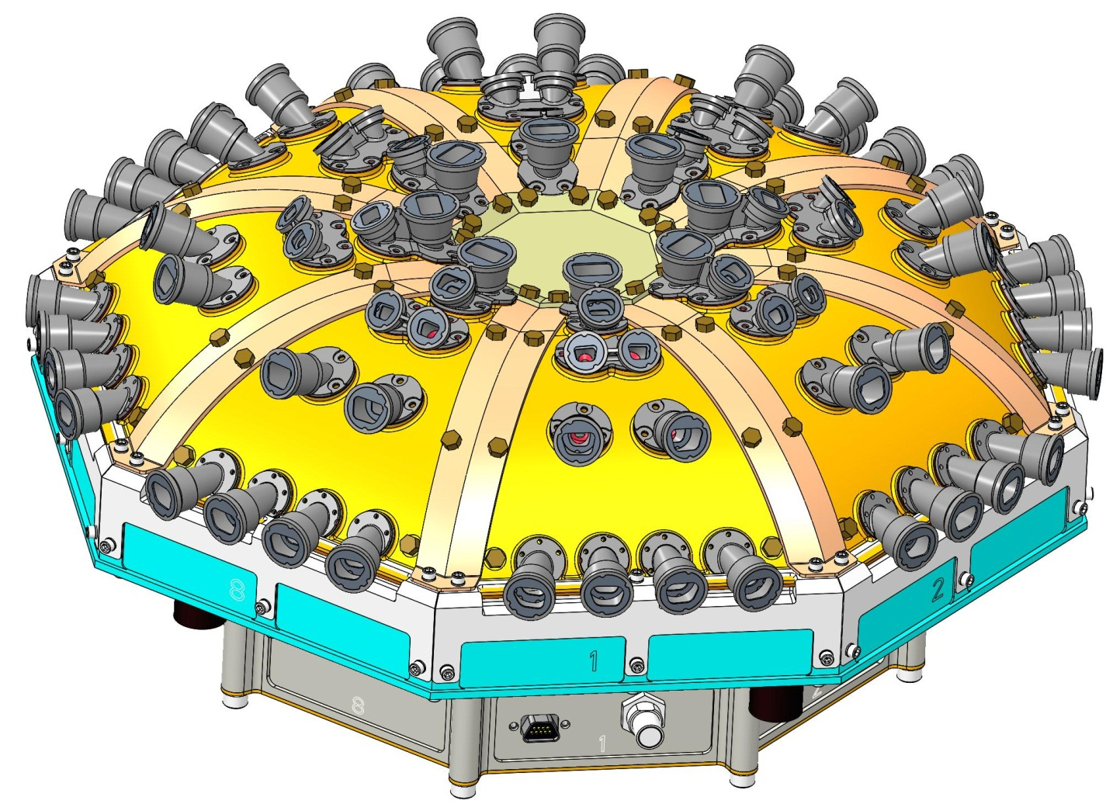
Instrument Overview
TOP CLOSEOUT
WEDGE CLOSEOUT,
8 PLACES
EDGE CLOSEOUTS,
8 PLACES
WEDGE ASSEMBLY
8 places
SPIDER FRAME
EPI-Lo Instrument Isometric View

Slide 5
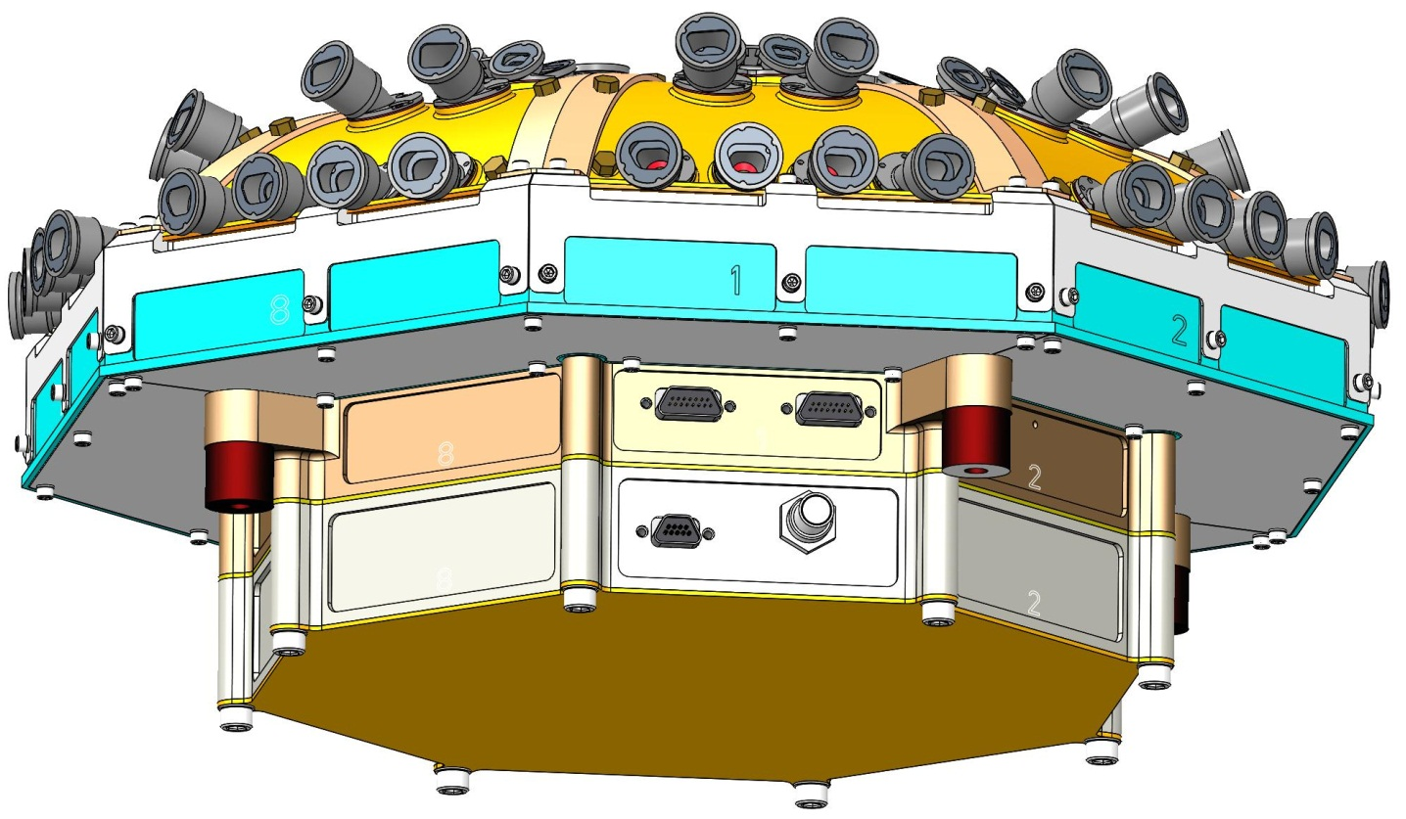
Instrument Overview
SPIDER
CLOSEOUTS,
8 PLACES
EVENT BOARD SLICE
MOUNTING INTERFACE ISOLATERS, 4 PLACES
POWER BOARD SLICE
INSTRUMENT CONNECTOR PANEL
EPI-Lo Instrument Side Isometric View

Slide 6
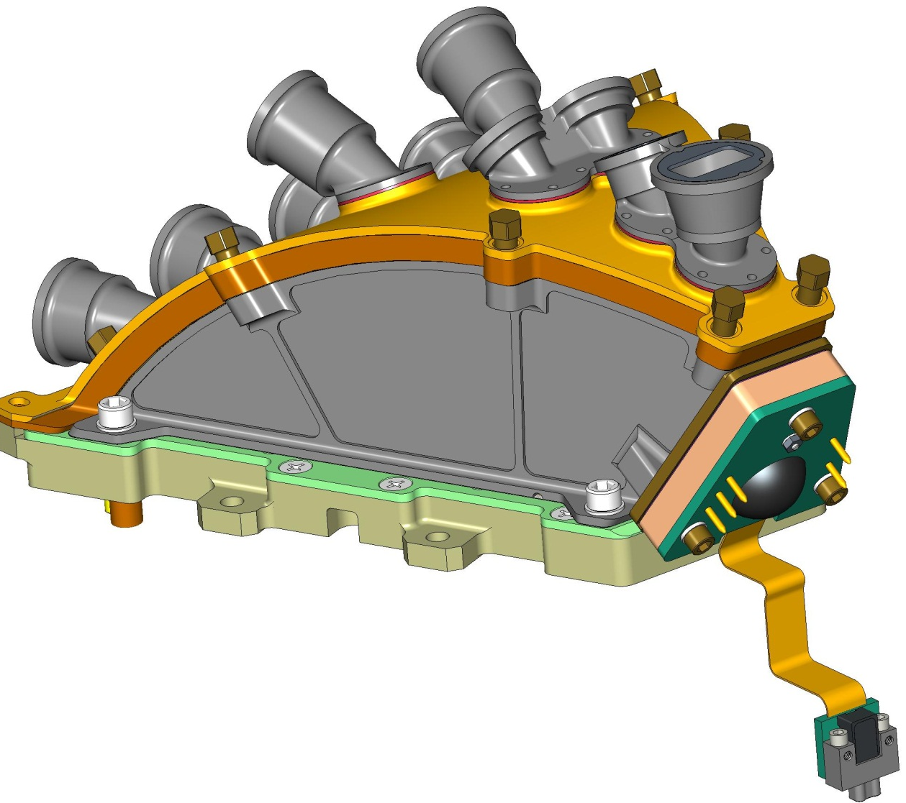
Wedge Design
SENSOR COVER AT GROUND ALUMINUM 6061-T651
WEDGE INSULATOR
ULTEM 2300
SCREWS
TORLO
SSD INSULATOR
ULTEM 2300
MCP ASSEMBLY IN A ULTEM 2300 HOUSING
COMPRESSION PLATE AT 1kV
STAINLESS 303
SIDE WALLS AT 1kV ALUMINUM 6061-T651
EPI-Lo Sensor Wedge Assembly

Slide 7
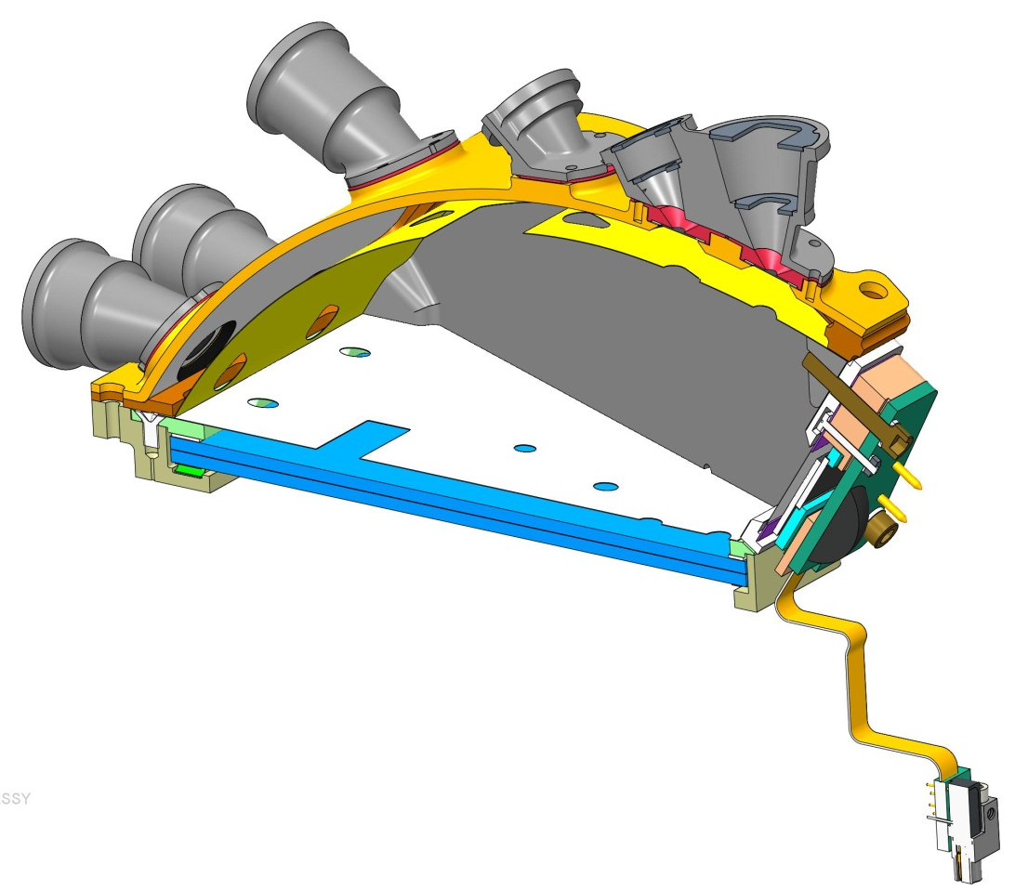
Wedge Design
SENSOR WEDGE COVER, GROUND
COLLIMATORS, AT GROUND
APERTURE START FOIL GRID, GROUND
WEDGE INSULATER ULTEM 2300
WEDGE GRID, 1kV
MCP COMPRESSION PLATE, 1kV
SCREWS, TORLON
MCP GRID, 1kV
BOTTOM MCP 2.9kV
TOP MCP, 900V
(TOP OF ANODE PWB NOT SHOWN, 3kV)
EPI-Lo Sensor Wedge Assembly Cross-Section View

Slide 8
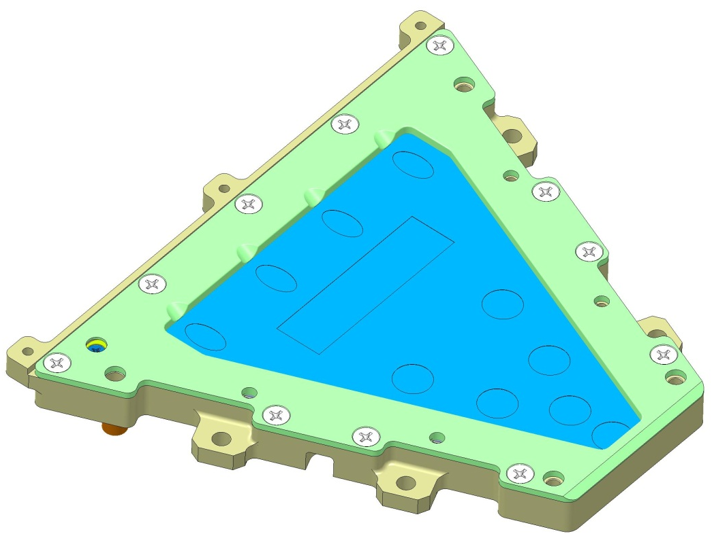
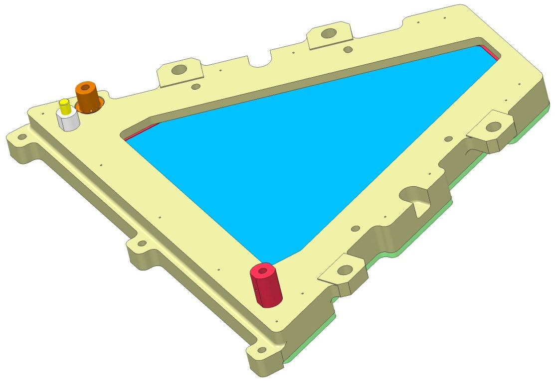
MCP Assembly Design
COMPRESSION PLATE
BOTTOM VIEW
1KV LUG
TOP VIEW
900V LUG
2.9KV LUG
MCP Assembly

Slide 9
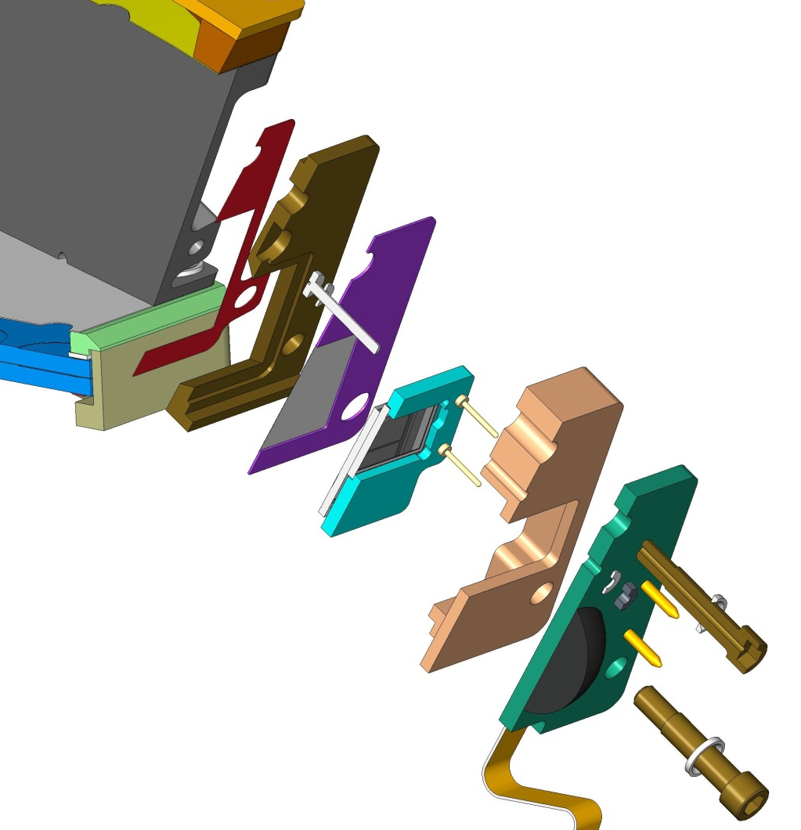
SSD Assembly Design
SSD WEDGE GRID, 1kV
SENSOR WEDGE ,
1kV
SSD STOP GRID-FOIL, GROUND
GROUNDING SCREW
SSD ASSY HOUSING, ULTEM 1000
ENERGY PWB ASSY
SSD INSULATOR, ULTEM 2300
SSD ASSY
SCREWS, TORLON
SSD Assembly Exploded Cross-Section View

Slide 10
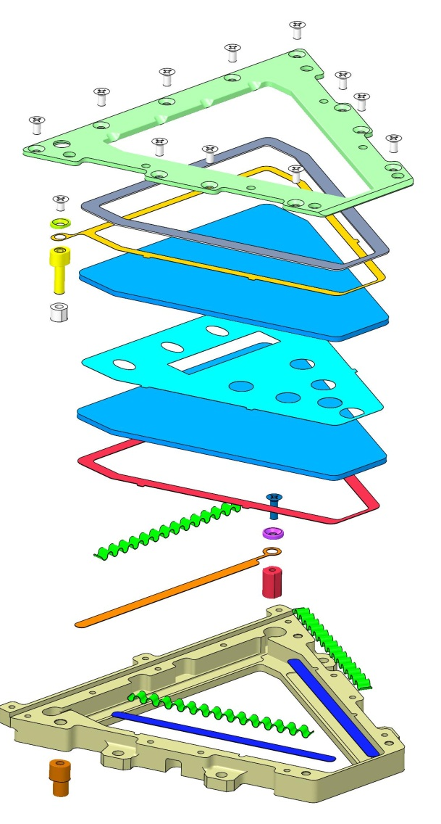
MCP Assembly Process
COMPRESSION PLATE
SCREW
INSULATED SHIM, ULTEM 1000
GUARD WASHER
900 V LUG ASSY
900V ELECTRODE
MCP
NUT
SPACER .002
SLIDE-SPACER ELECTRODE
MCP
LINEAR EXPANDERS, 3 PLACES
SCREW
WASHER
2.9 kV ELECTRODE
2.9kV LUG ASSY
SLIDES FOR EXPANDERS, 2 PLACES
1kV LUG ASSY
MCP HOUSING
MCP Assembly Exploded View

Slide 11
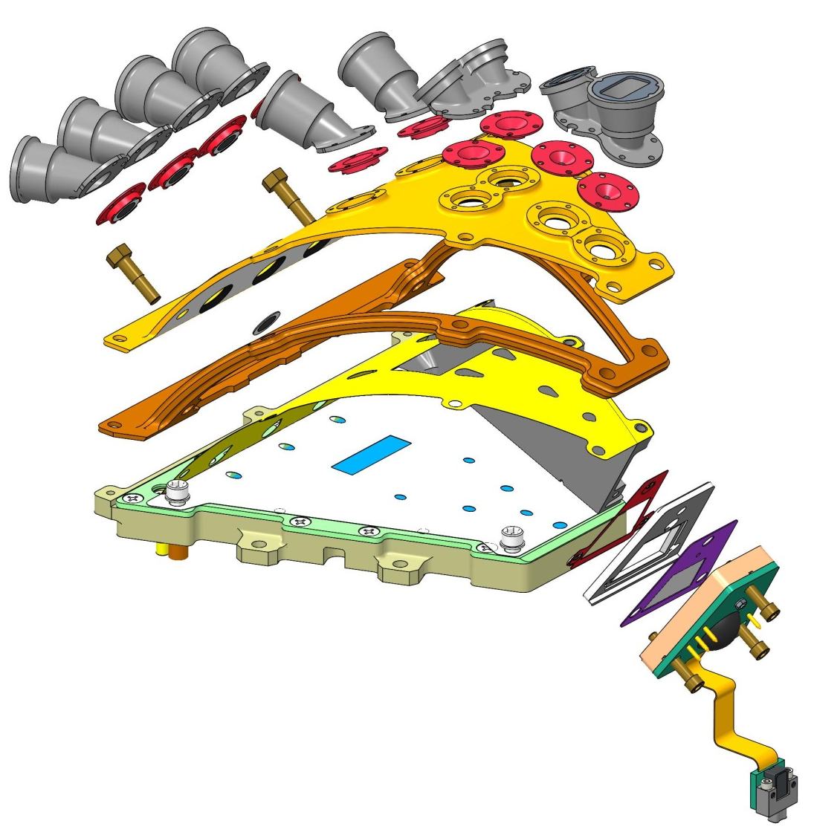
Wedge Assembly Process
COLLIMATORS
APERTURE START FOILS
WEDGE COVER
WEDGE INSULATOR, ULTEM 2300
WEDGE GRID
MCP GRID
(SIDE WALL REMOVED FOR CLARITY)
EPI-Lo Sensor Wedge Assembly Exploded View

Slide 12
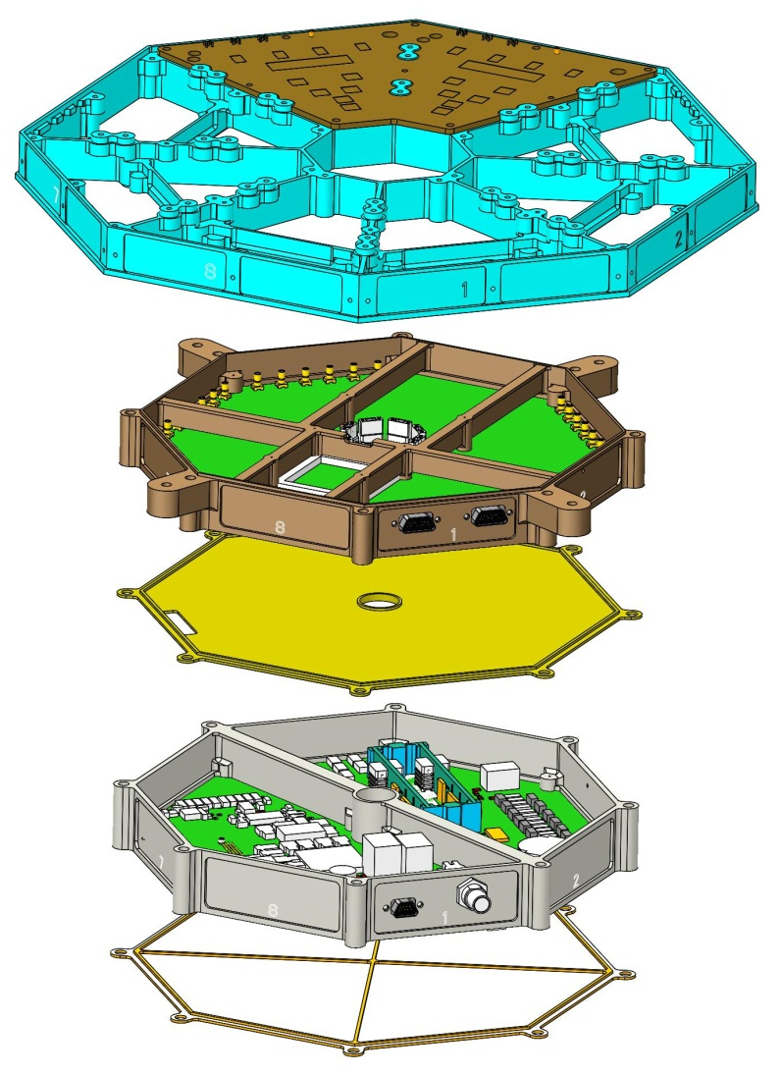
Spider and Electronics Integration
ANODE BOARD,
4 PLACES
SPIDER FRAME
EVENT BOARD PWA
ELECTRONICS BULKHEAD
POWER BOARD PWA
BOTTOM COVER
EPI-Lo Electronics Frames Exploded View

Slide 13
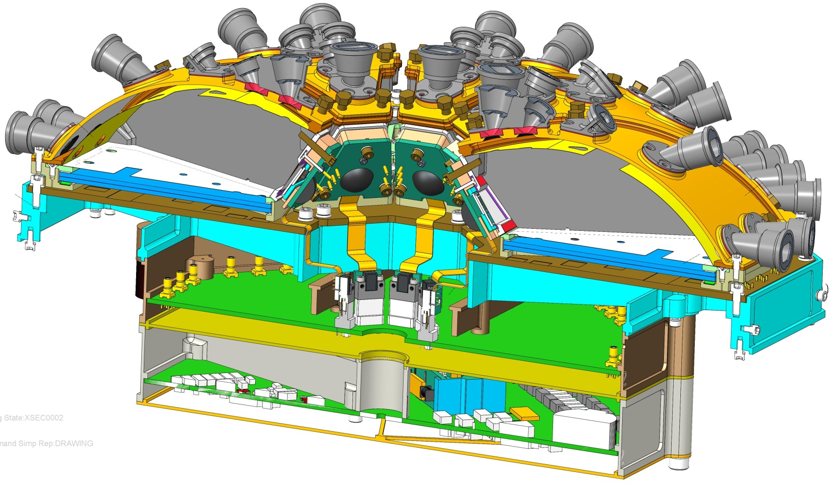
Wedge Integration and Cable Routing
ANODE BOARD CONNECTORS
(SEE NEXT SLIDE)
CABLE PASS THRU
EVENT BOARD CONNECTORS
CABLES TO ANODE BOARD
SSD ASSEMBLY
HARNESS CONNECTORS
(POWER HARNESS CONDUIT NOT SHOWN)
EPI-Lo Cross-Section Isometric View

Slide 14
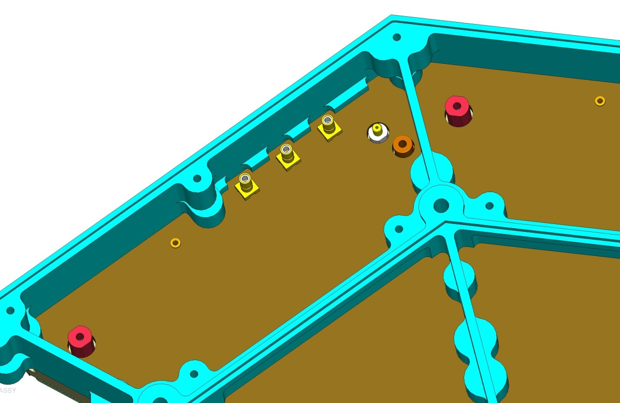
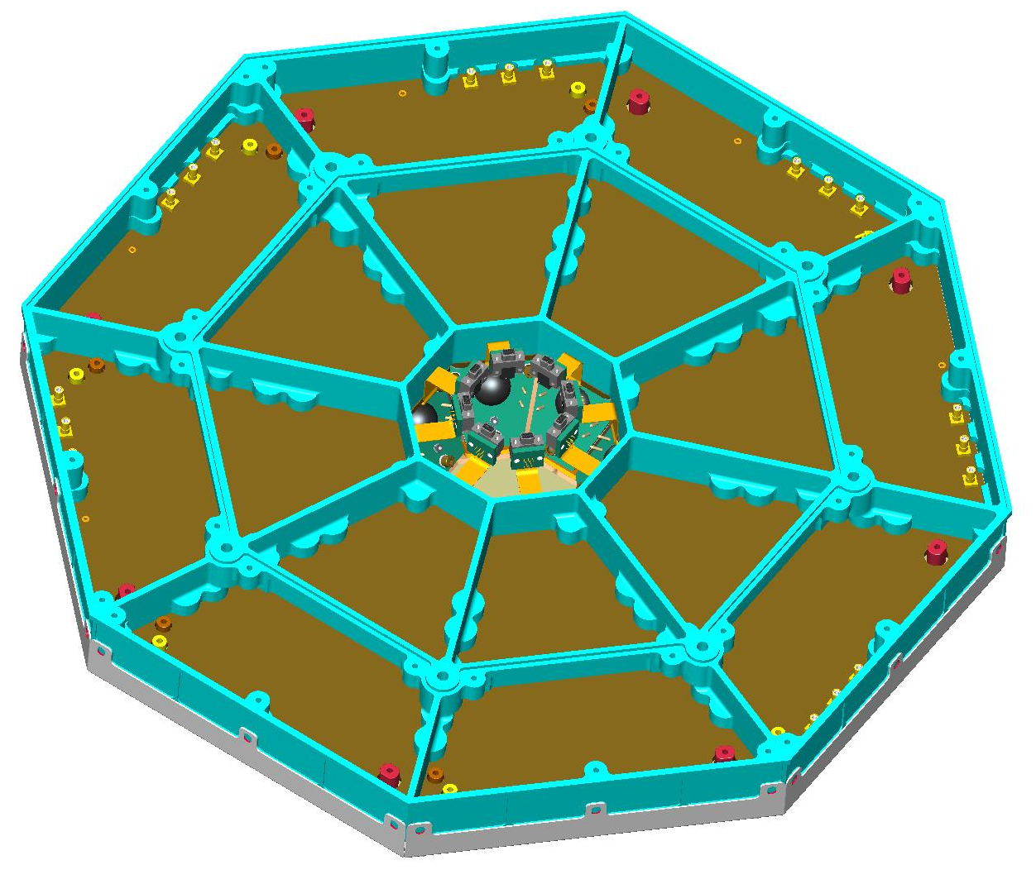
Cable Connections
ANODE BOARD HV CONNECTORS
3.7 mm MIN SPACE BETWEEN LUG AND WALL
SPIDER STRUCTURE
900V LUG
1KV LUG
2.9KV LUG
ANODE BOARD SIGNAL CONNECTORS
Anode PWB Assembly,
Bottom Side Shown
Mounted To Spider Frame

Slide 15
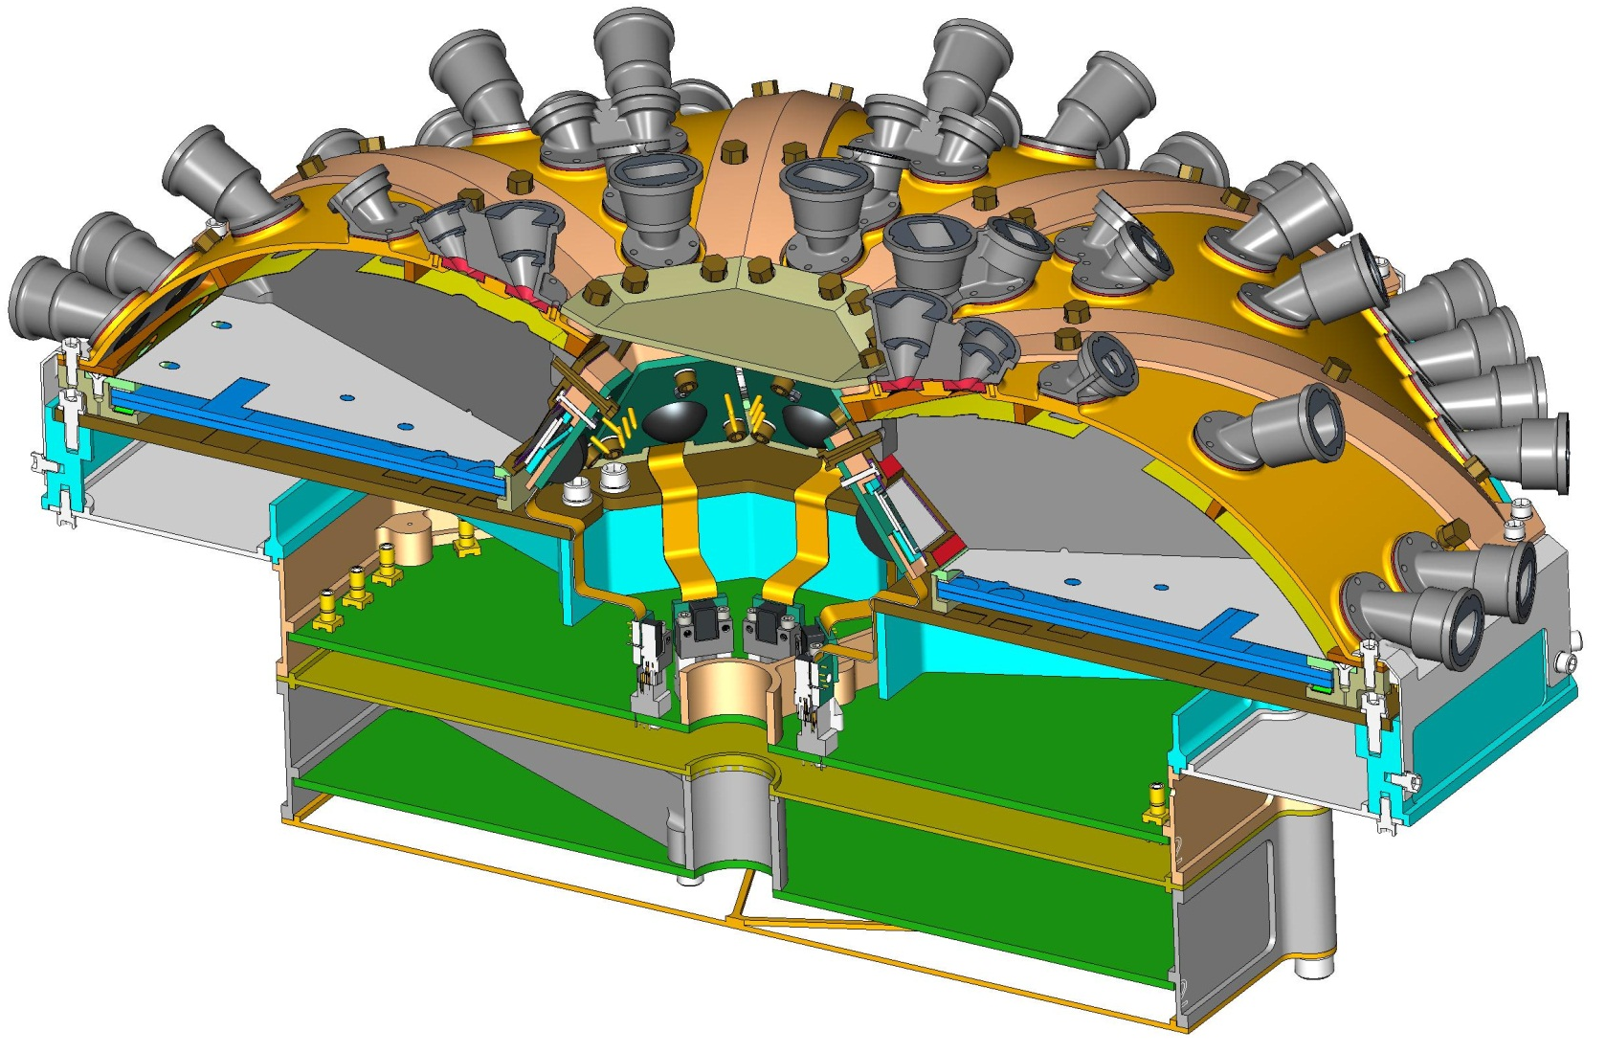
Instrument Closeout Installation
TOP CLOSEOUT
WEDGE CLOSEOUT
SPIDER CLOSEOUT
EDGE CLOSEOUT
EPI-Lo Cross-Section Isometric View

Slide 16
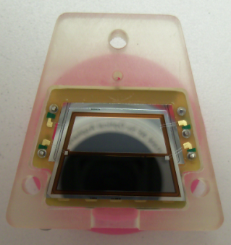
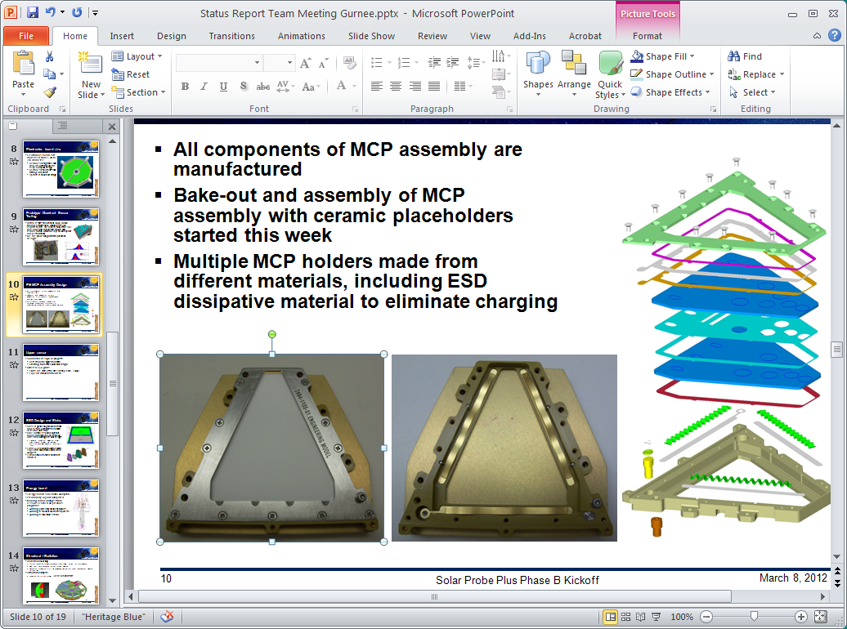
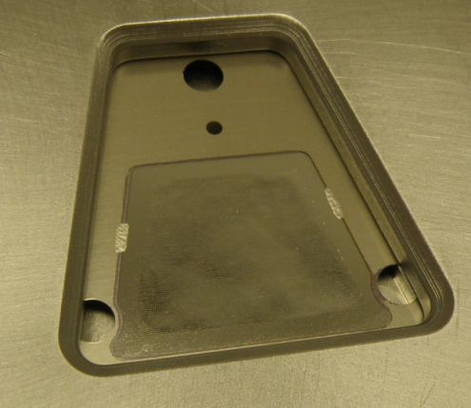
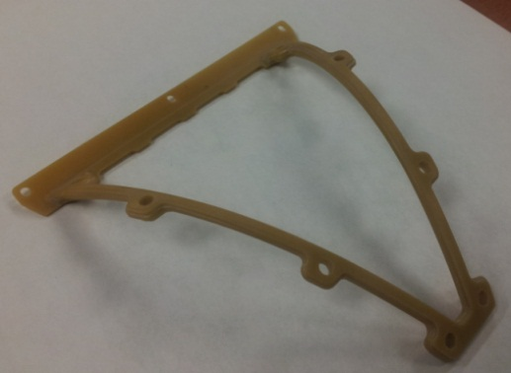
Development Status
Prototype sensor fully assembled and tested
EM sensor
  EM MCPs in house
  EM SSDs in house and mounted to carrier
  MCP holder with all electrodes assembled and tested at HV with ceramic plates
  All EM grids and foils procured and in-house
  Upper sensor parts in fabrication
    Side walls, top cover, collimators

Slide 17
Mechanical – path forward
Sensor EM Testing
  Test MCP assembly with MCPs and EM anode board
  Assemble upper sensor parts
  Test sensor wedge
    Start and stop secondary electron locations
    Timing performance
  Integrate SSD to sensor wedge
  Full performance testing with source and in APL accelerator
Instrument-level EM testing
  Fabricate chassis and e-box frames
  Vibration testing with bracket, EPI-Hi mass model, two sensor wedges and other wedges as mass models
  Acoustics testing with bracket, EPI-Hi mass model, two sensor wedges and other wedges as mass models
  Thermal Testing (simplified model representing outer surface)

Slide 18
Preliminary Analysis Results
SPP EPI-Lo instrument analyzed
  Created from EPI-Lo CAD model as of 6/19/2013 SPP configuration
  Instrument orientation to S/C panel taken from SwRI bracket CAD model: 4/19/2013
  Instrument mass estimated at 2.99 kg (6.58 lbm)
Structural model analyzed based on 7434-9039 SPP EDTRD requirements
  Modal frequencies of assembly
  Quasi-static design limit load per EDTRD Section 4.4.2.1 and 4.4.7.1
  Random vibration analysis per EDTRD Section 4.4.3
    Grms acceleration response for various components of the assembly
    Peak 3-σ stress and displacement results

Slide 19
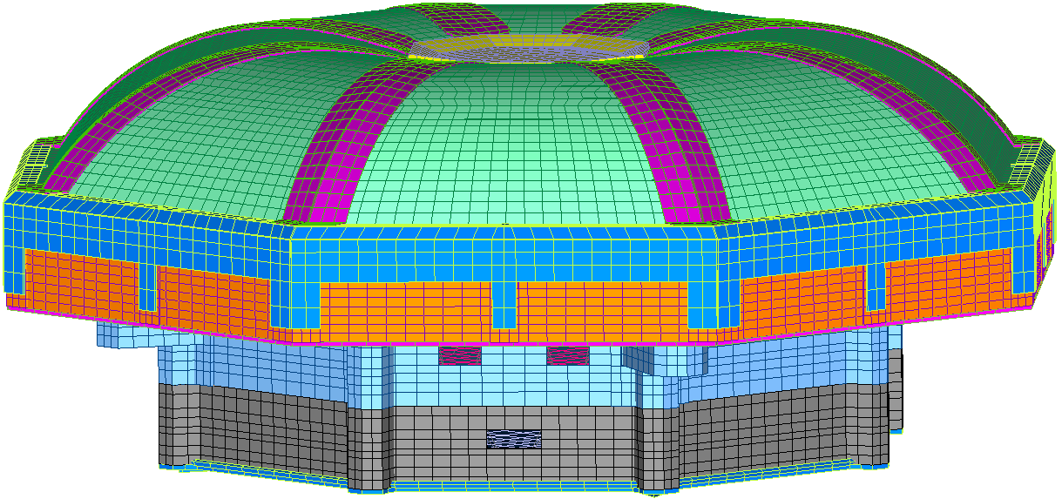
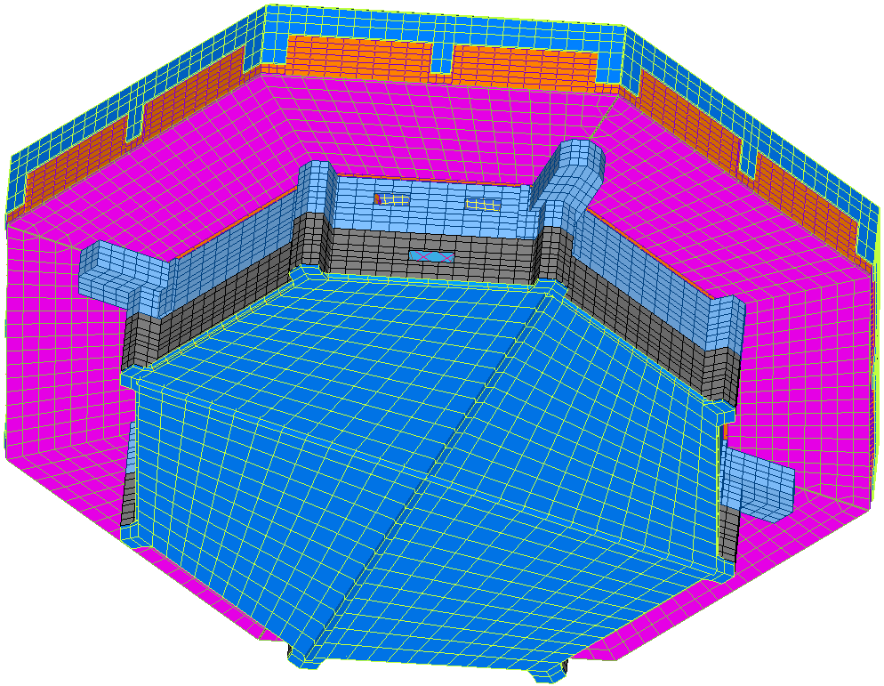
FEM Overview - Instrument Level
Modeling Strategy
  Plate elements where applicable: PWAs, frames, covers
  Solid elements where necessary: frame bosses, bookbolt bosses, small aspect ratios
  Beam elements: chassis ribs, LVPS bottom cover ribs
  PWA: EEE part mass smeared over total board area
  Rigid elements (RBE2s): bookbolts, mounting hardware, Connectors
Model size: nodes = 89,077, elements = 70,645
Closeout Covers (8x)
Anode Cover (4x)
Wedges (8x)
Event ASSY
LVPS ASSY
Spider ASSY
LVPS Cover

Slide 20
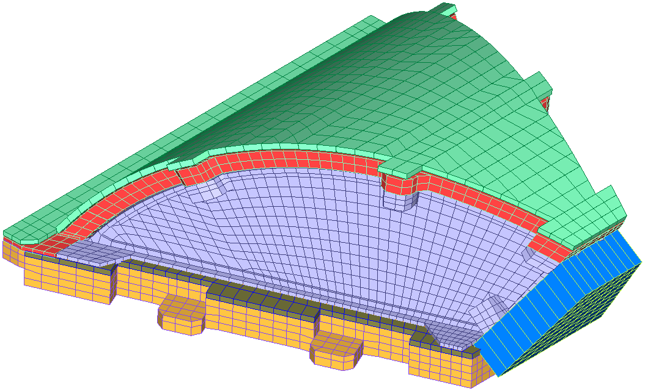
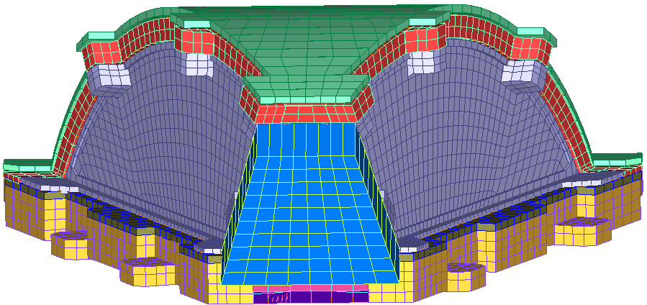
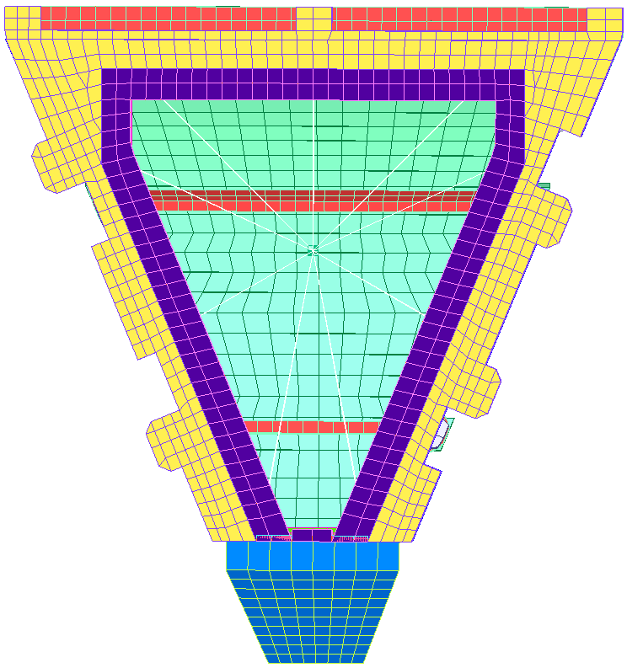
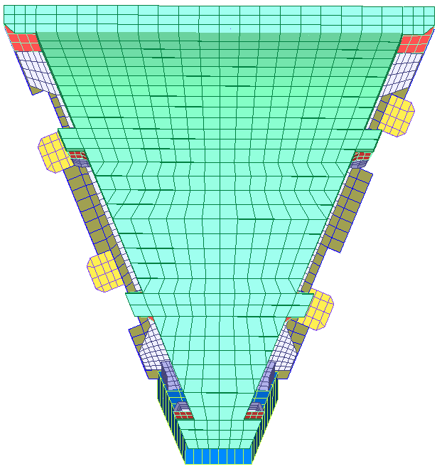
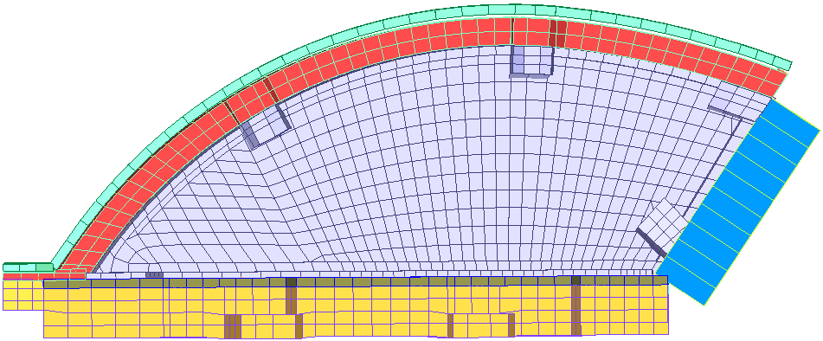
FEM Overview - Wedge Assembly
EPI-Lo has 8 identical wedges
Top cover: plate elements, Al-6061 properties & collimator mass smear
Wedge Frame Insulator: plate and solid elements, Ultem1000 material properties
Side cover: beam, plate and solid elements, Al-6061 material properties
MCP Cover: plate elements, SS 304 properties
MCP: mass element & RBE3 to MCP cover and baseplate
MCP Baseplate: plate and solid elements, Ultem100 material properties
SSD Assembly: plate elements, Ultem100 material properties
Wedge assembly connected using RBE2s at all bolted interfaces
Wedge Frame Insulator
Top Cover
Side Cover
MCP Cover
Front View
SSD
ASSY
MCP Baseplate
MCP
Bottom View
Side View
Top View

Slide 21
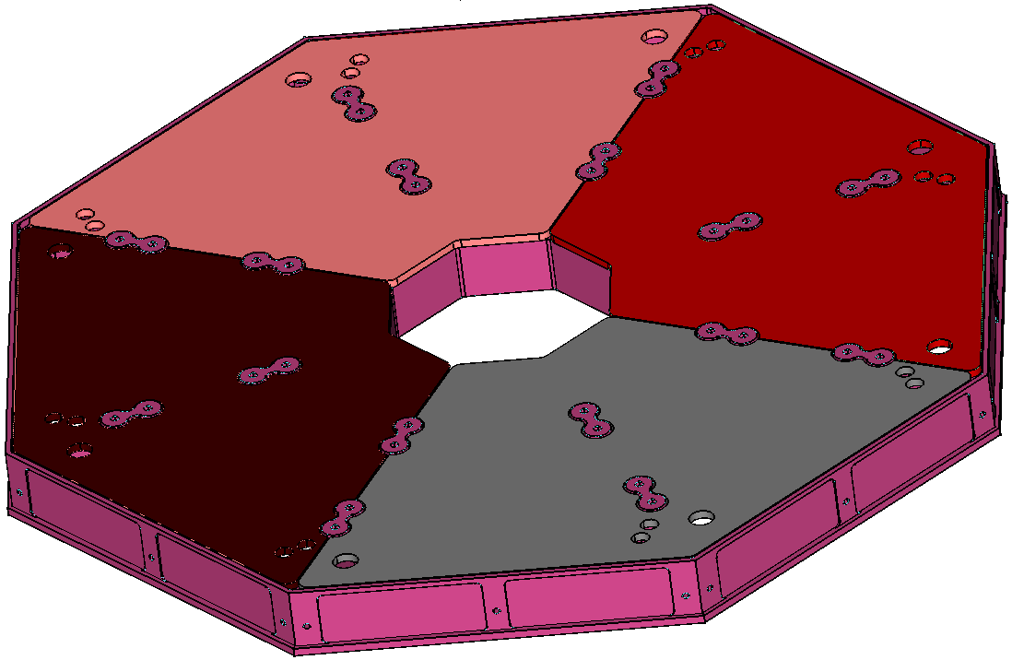
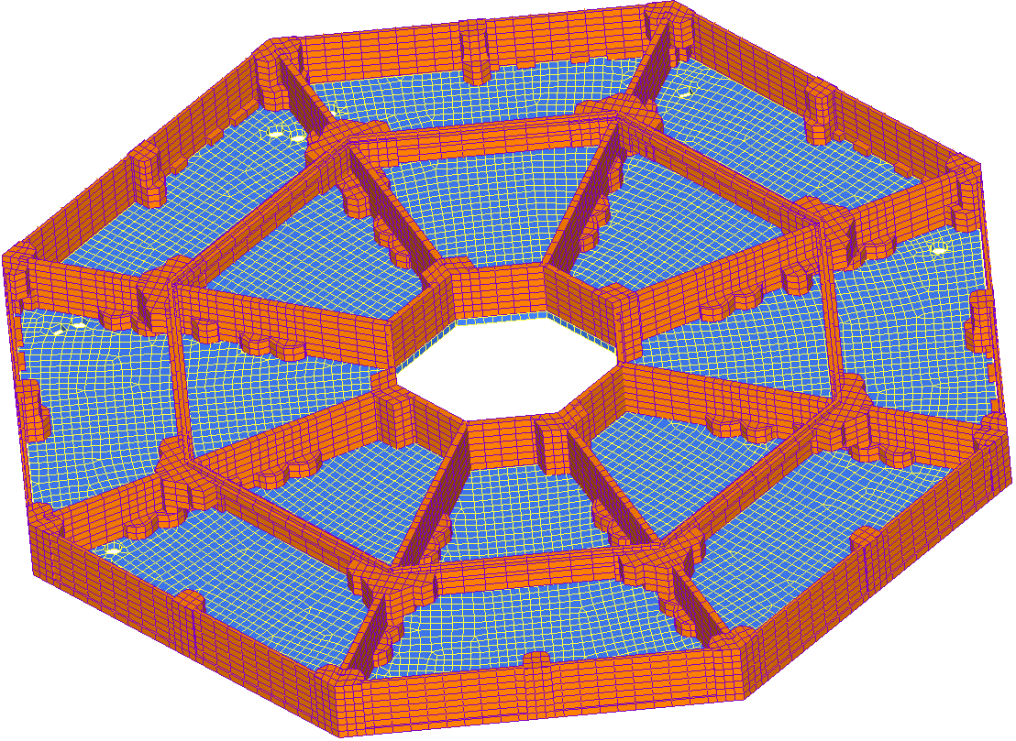
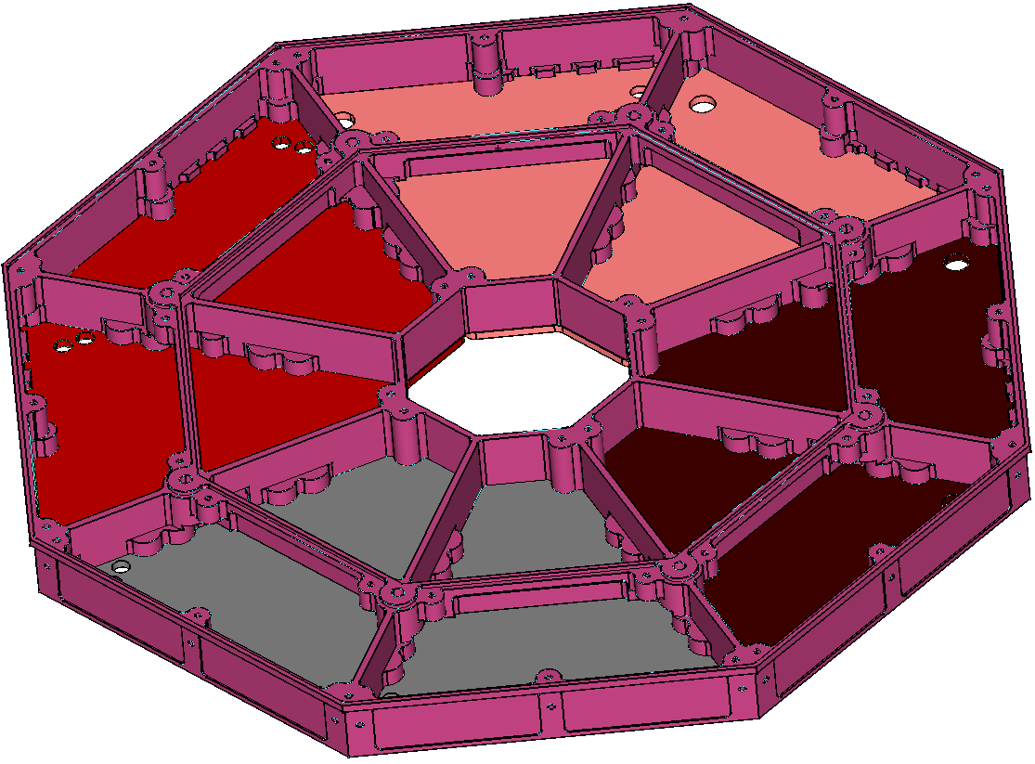
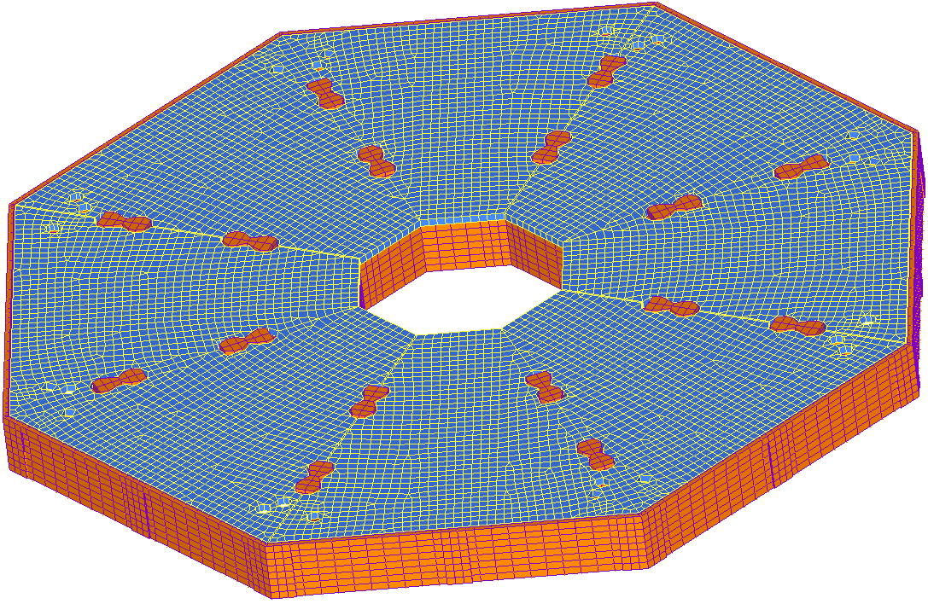
FEM Overview - Spider & Anode PWAs
Spider frame modeled in detail using plate and solid elements with Al 6061 material properties
Anode PWAs (4x) modeled using plate elements and PWA material properties with estimated board mass smeared across PWA
PWAs connected to Spider frame at mounting hardware bosses using RBE2 elements
Top Side
Back Side
Anode PWA (4x)

Slide 22
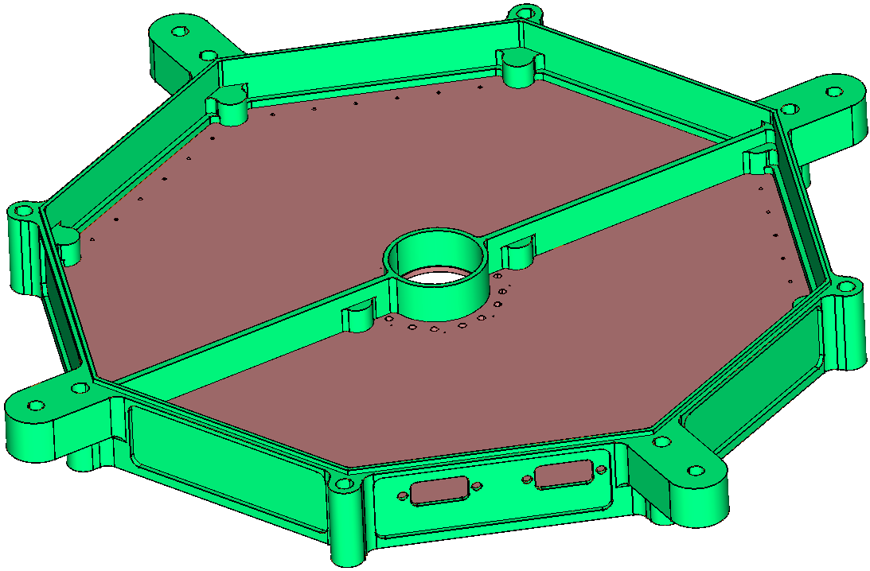
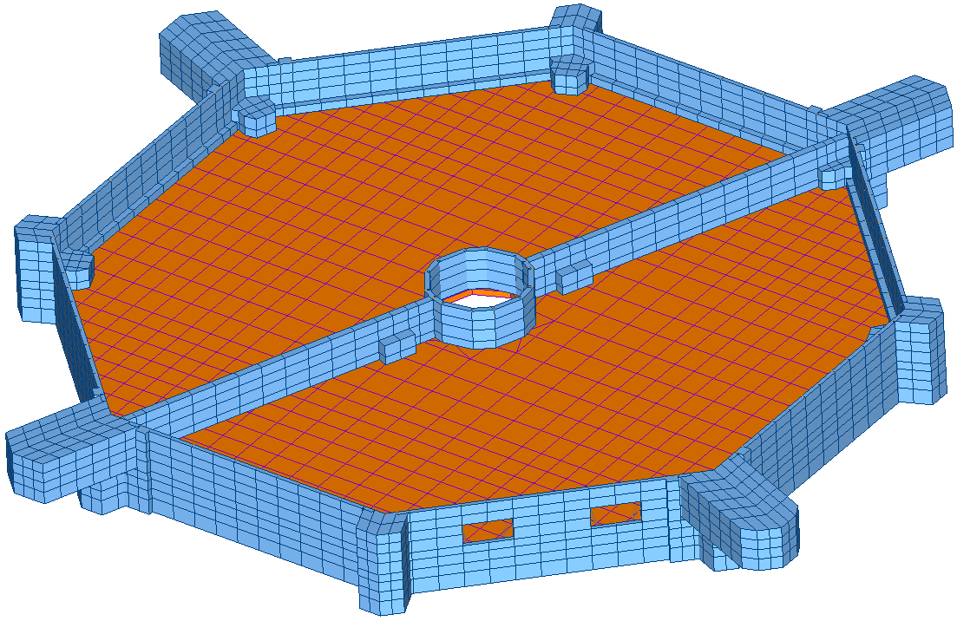
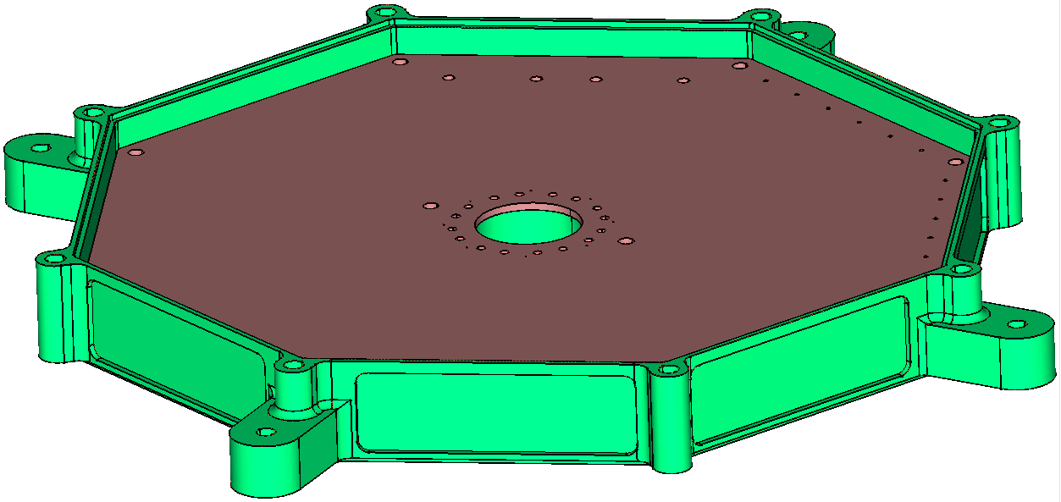
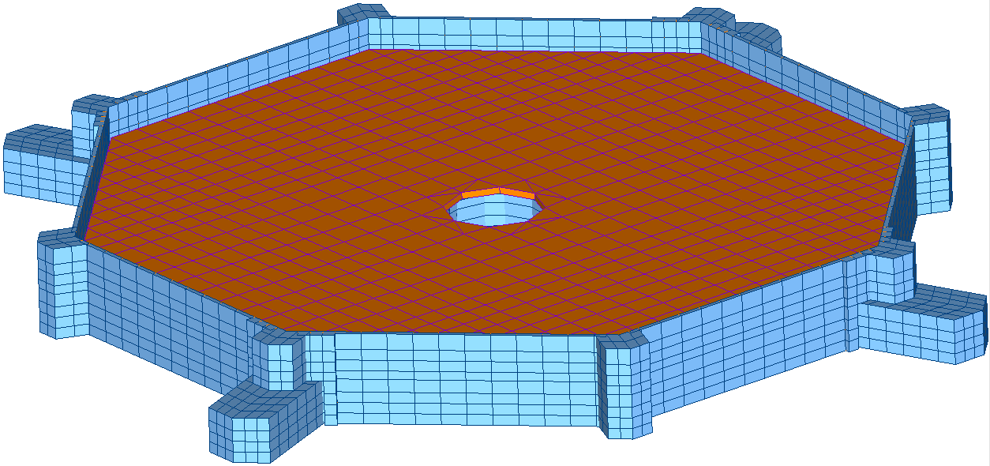
FEM Overview - Event Slice Assembly
Event housing: plate and solid elements, Al 6061 material properties
Event housing thickness .040” at minimum, thicker at bosses
Event PWA: plate elements, PWA material properties and EEE part mass smeared across board
PWA: diameter = 7.0”, thickness = 0.093”
Right-angle MDM connectors modeled with RBE2s from frame to board
PWA connected to housing with RBE2s at mounting bosses
Top Side
MDM Connectors
Back Side

Slide 23
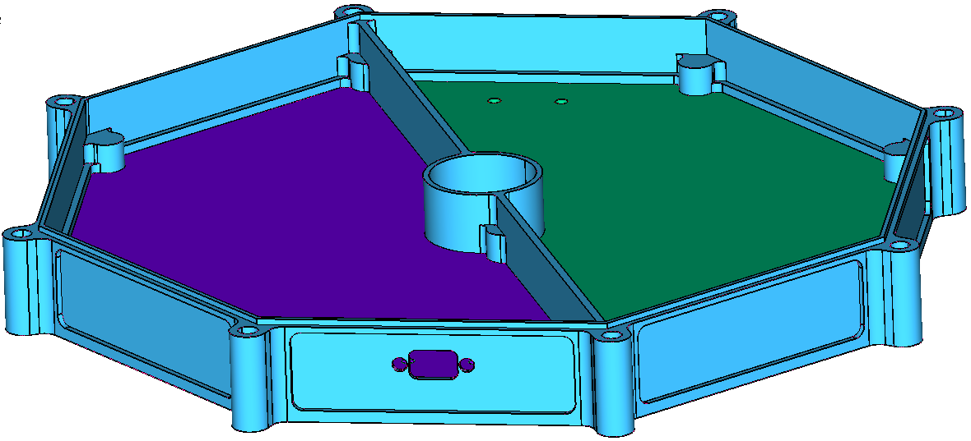
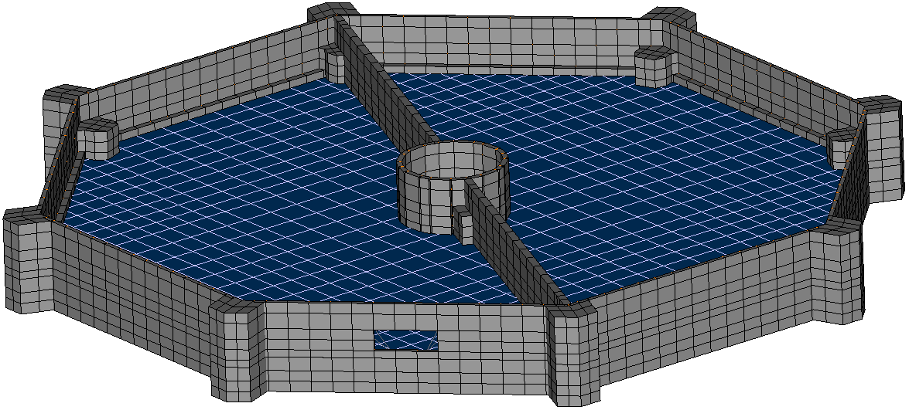
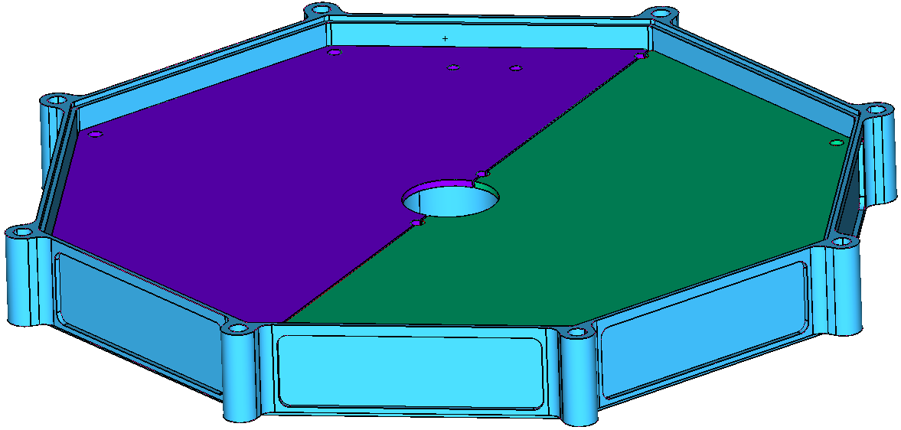
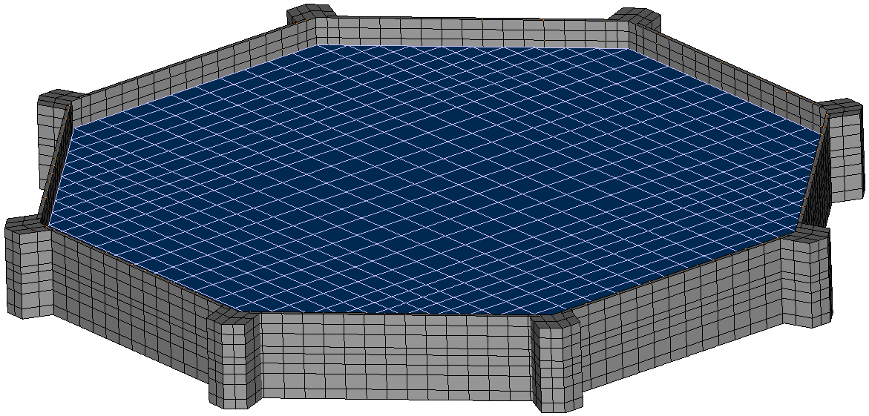
FEM Overview - LVPS Slice Assembly
LVPS housing: plate and solid elements, Al 6061 material properties
LVPS housing thickness .040” at minimum, thicker at bosses
LVPS PWA: plate elements, PWA material properties and EEE part mass smeared across board
PWA: diameter = 7.0”, thickness = 0.093”
Right-angle MDM connector modeled with RBE2 from frame to board
PWA connected to housing with RBE2s at mounting bosses
CAD PWA model does not capture flight design, FEM representative of flight config.
Top Side
MDM Connector
Hole NOT in flight design.
Back Side

Slide 24
Forced Response Analysis
All relevant structural environmental inputs per 7434-9039 SPP EDTRD
Assume critical damping = 2.5% across full frequency range
Sine sweep spec per Section 4.4.4 (TBD), not analyzed
Random vibration levels per Section 4.4.3
  Table 4-8, Side panel mounted components & subsystems parallel to panel
  Table 4-9, Side panel mounted components & subsystems lateral to panel
Items of interest for random response analysis:
  Grms acceleration response of instrument and PWAs
  Peak 3-σ displacement response
  Peak 3-σ stress & margins of safety
Random vibration analysis results envelope Static 40g load (per Section 4.4.2.1),
40g static load results not presented in this analysis
Normal to Panel |  | Parallel to Panel
Freq (Hz) | ASD Level (g²/Hz) | Freq (Hz) | ASD Level (g²/Hz)
20 | 0.01 | 20 | 0.01
60 | 1.25 | 35 | 0.04
200 | 1.25 | 500 | 0.04
350 | 0.04 | 2000 | 0.01
500 | 0.04
2000 | 0.01
Overall Amplitude: 16.4 grms |  | Overall Amplitude: 6.8 grms

Slide 25
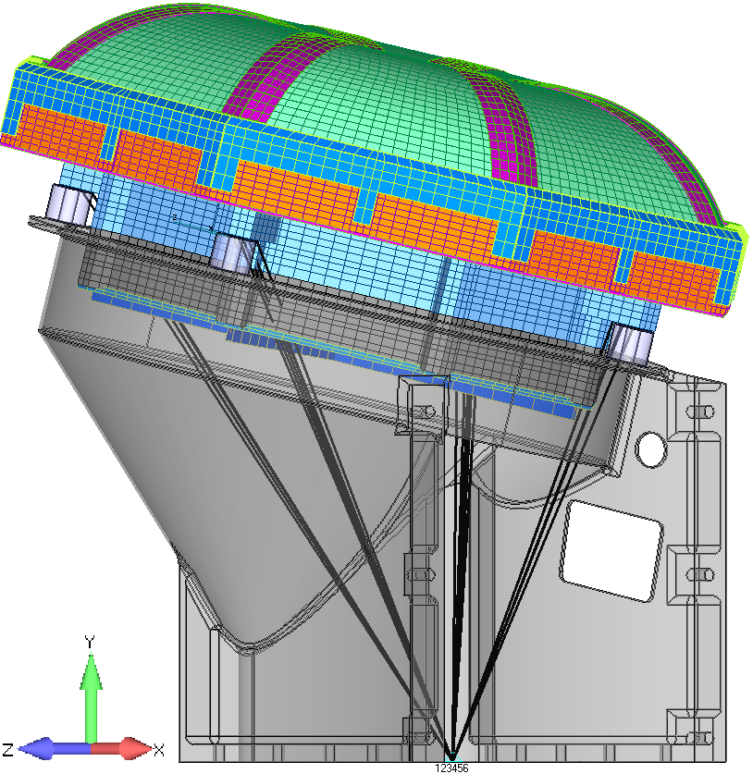
Forced Response Analysis
Random Vibration Grms Results
Random vibration inputs simulated at B.C. node
  B.C. node “spidered” to nodes at instrument mounting interface to SwRI bracket
  SwRI bracket and G-10 standoffs NOT part of EPI-Lo FEM, assume instrument “hard-mounted”
  Inputs simulated one axis at a time for all three orthogonal axes
Acceleration spectral density (ASD) response for various nodes
  Nodes represent worst case response per subassembly
  Across full range (20-2,000 Hz) of interest
Due to EPI-Lo’s mounting configuration in relation to the input load, there are significant cross-axes responses
Y-axis Input 3-σ grms Response
X-axis Input 3-σ grms Response
Z-axis Input 3-σ grms Response
ID | X-Axis | Y-axis | Z-Axis
Input | 0.0 | 16.4 | 0.0
C.G. | 7.8 | 67.9 | 8.1
Event PWA | 31.2 | 193.0 | 30.1
LVPS PWA | 26.4 | 158.1 | 25.1
LVPS Cover | 26.9 | 153.5 | 26.2
Top Cover | 16.0 | 112.1 | 17.0
Anode PWA | 9.4 | 76.5 | 10.2
Anode Cover | 12.2 | 92.3 | 12.8
Spider Frame | 5.5 | 66.1 | 9.5
ID | X-Axis | Y-axis | Z-Axis
Input | 6.8 | 0.0 | 0.0
C.G. | 30.9 | 7.8 | 3.4
Event PWA | 26.2 | 41.4 | 8.0
LVPS PWA | 48.9 | 97.9 | 27.4
LVPS Cover | 45.7 | 30.5 | 14.8
Top Cover | 58.0 | 16.3 | 5.6
Anode PWA | 30.8 | 61.5 | 10.3
Anode Cover | 35.7 | 161.1 | 27.0
Spider Frame | 29.9 | 64.0 | 12.1
ID | X-Axis | Y-axis | Z-Axis
Input | 0.0 | 0.0 | 6.8
C.G. | 3.4 | 8.2 | 31.3
Event PWA | 13.6 | 64.7 | 29.4
LVPS PWA | 24.1 | 71.9 | 46.5
LVPS Cover | 14.2 | 27.7 | 50.9
Top Cover | 5.6 | 17.0 | 57.9
Anode PWA | 11.8 | 65.4 | 33.9
Anode Cover | 13.1 | 67.3 | 26.8
Spider Frame | 8.7 | 28.1 | 31.4

Slide 26
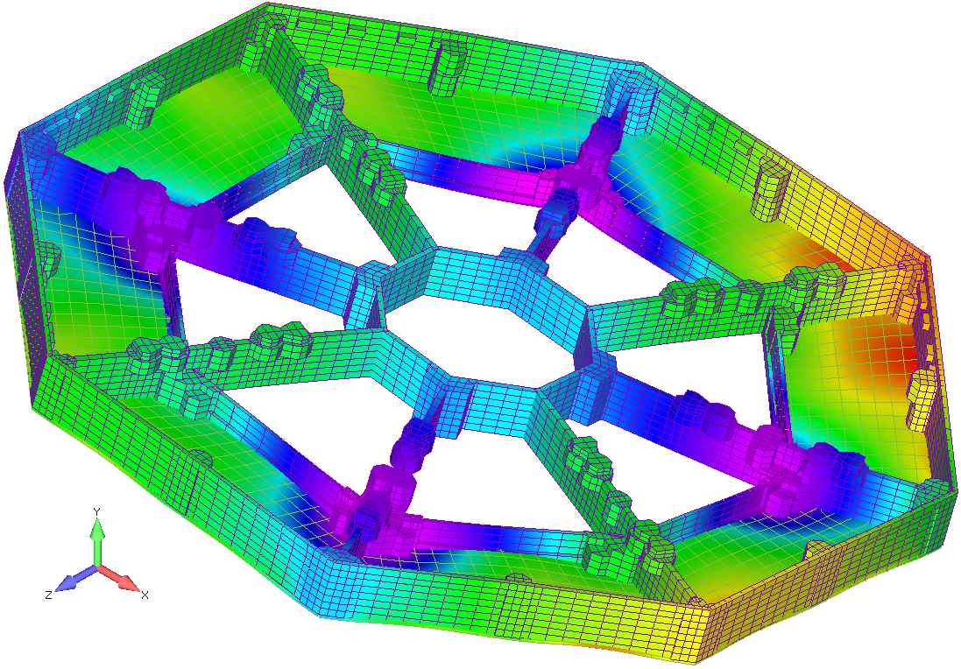

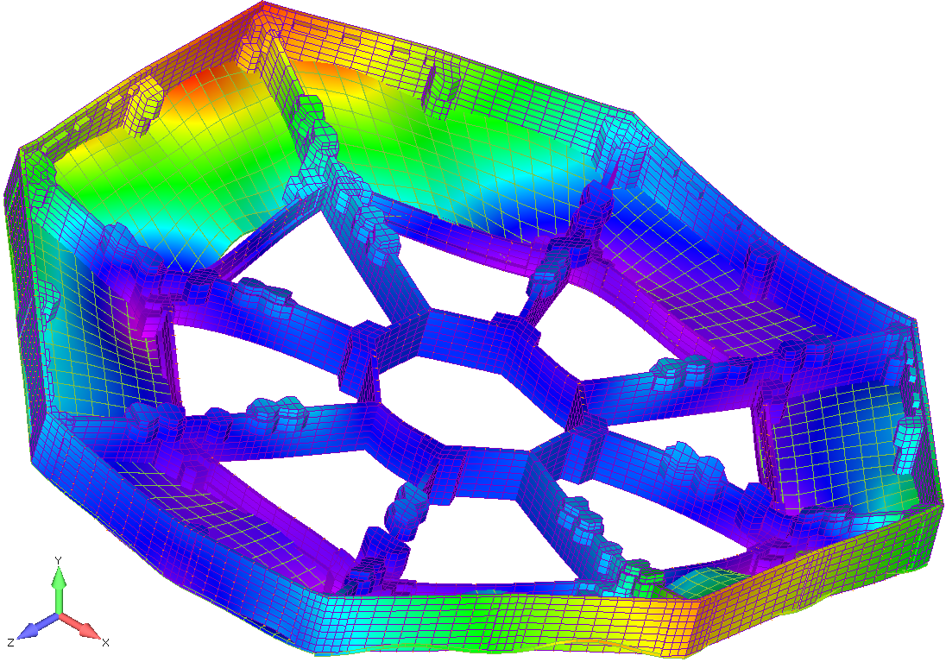

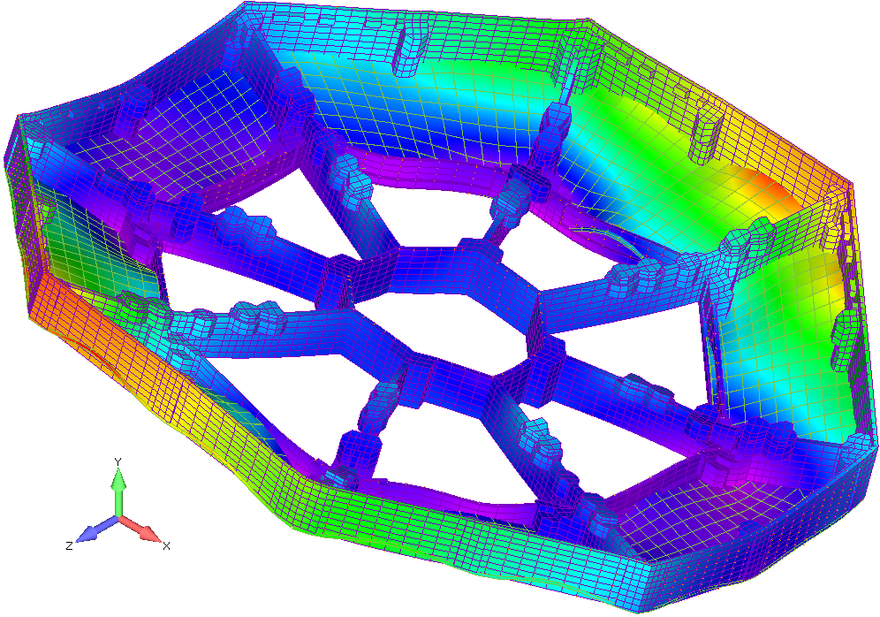

Forced Response Analysis
Random Vibration Results: Displacement
Y-axis Loading
inch
inch
X-axis Loading
Spider frame and Anode cover total displacement results for the 3 individual loading conditions
Max displacement ~ 2 mil for all 3 loading conditions
Spider frame rigid out-of-plane due to hexagonal rib design
Anode covers stiff due to 9 mounting holes, all corners and mid-span
Z-axis Loading
inch

Slide 27
Forced Response Analysis
Random Vibration Results: von Mises Stress
Model analyzed for von Mises stress under random vibration loading using MAYA structural analysis toolkit
3-σ stress results output for complete model
Interested mainly in PWA and Frame stress
Fastener analysis not done at this time
Factors of safety (FoS) taken from 7434-9039 SPP EDTRD rev e, table 4-5.
  Additional 1.28 factor for random analysis per Section 4.4.2.2
  Metallic structures: FoSu = 2.68, FoSy = 2.53
  Composite (PWA + Ultem1000): FoSu = 2.78, FoSy = N/A
Margins of safety (MoS) calculations performed,
  MoS formula ->
  MoS table on the following slide
All margin of safety results are positive for the current design iteration

Slide 28
Analysis Summary
Preliminary structural analysis of the baseline SPP EPI-Lo Instrument performed
MSC.Nastran, MAYA SATK, and Femap used for analysis
  Model simplified wherever possible to aid solution time
  PWAs modeled as plate elements with uniform stiffness, thickness and density
  Instrument model oriented to SwRI bracket configuration in relation to S/C panel
Modal analysis performed, 1st mode = 304 Hz (Event PWA), Instrument mode #1 = 553 Hz
Analysis environmental input levels per 7434-9039 SPP EDTRD Rev -
  Analysis performed for all three orthogonal axes relative to S/C panel
  Sine vibration analysis not performed (TBD in EDTRD)
  EPI-Lo 3-σ acceleration random response enveloped static load requirement
  Random vibration analysis 3-σ response desired for EPI-Lo instrument displacements, stresses and forces
Random vibration PWA displacement response may be relatively high for EEE part solder/lead wire fatigue resistance, further analysis needed after EEE parts placement finalized
All margin of safety positive for model configuration as of 6/19/13 under EDTRD Rev - inputs
Detailed analysis needed for the flight configuration to confirm flight design will have positive margins and meet minimum frequency requirement

Slide 29
Instrument Peer Review
EPILo Sensor Peer Review
  Held May 22, 2013 at APL
  Review yielded 12 action items, all are now closed
EPI-Lo Instrument Peer Review
  Held August 19, 2013 at APL
  Review yielded 8 mechanical action items, all are now closed

Slide 30
Backup

