Slide 1
ISIS Overview
Scott Weidner
Notes:
introduction

Slide 2
Outline
ISIS Organization Chart
ISIS Suite
Spacecraft Accommodation
Changes since MDR
Summary

Slide 3
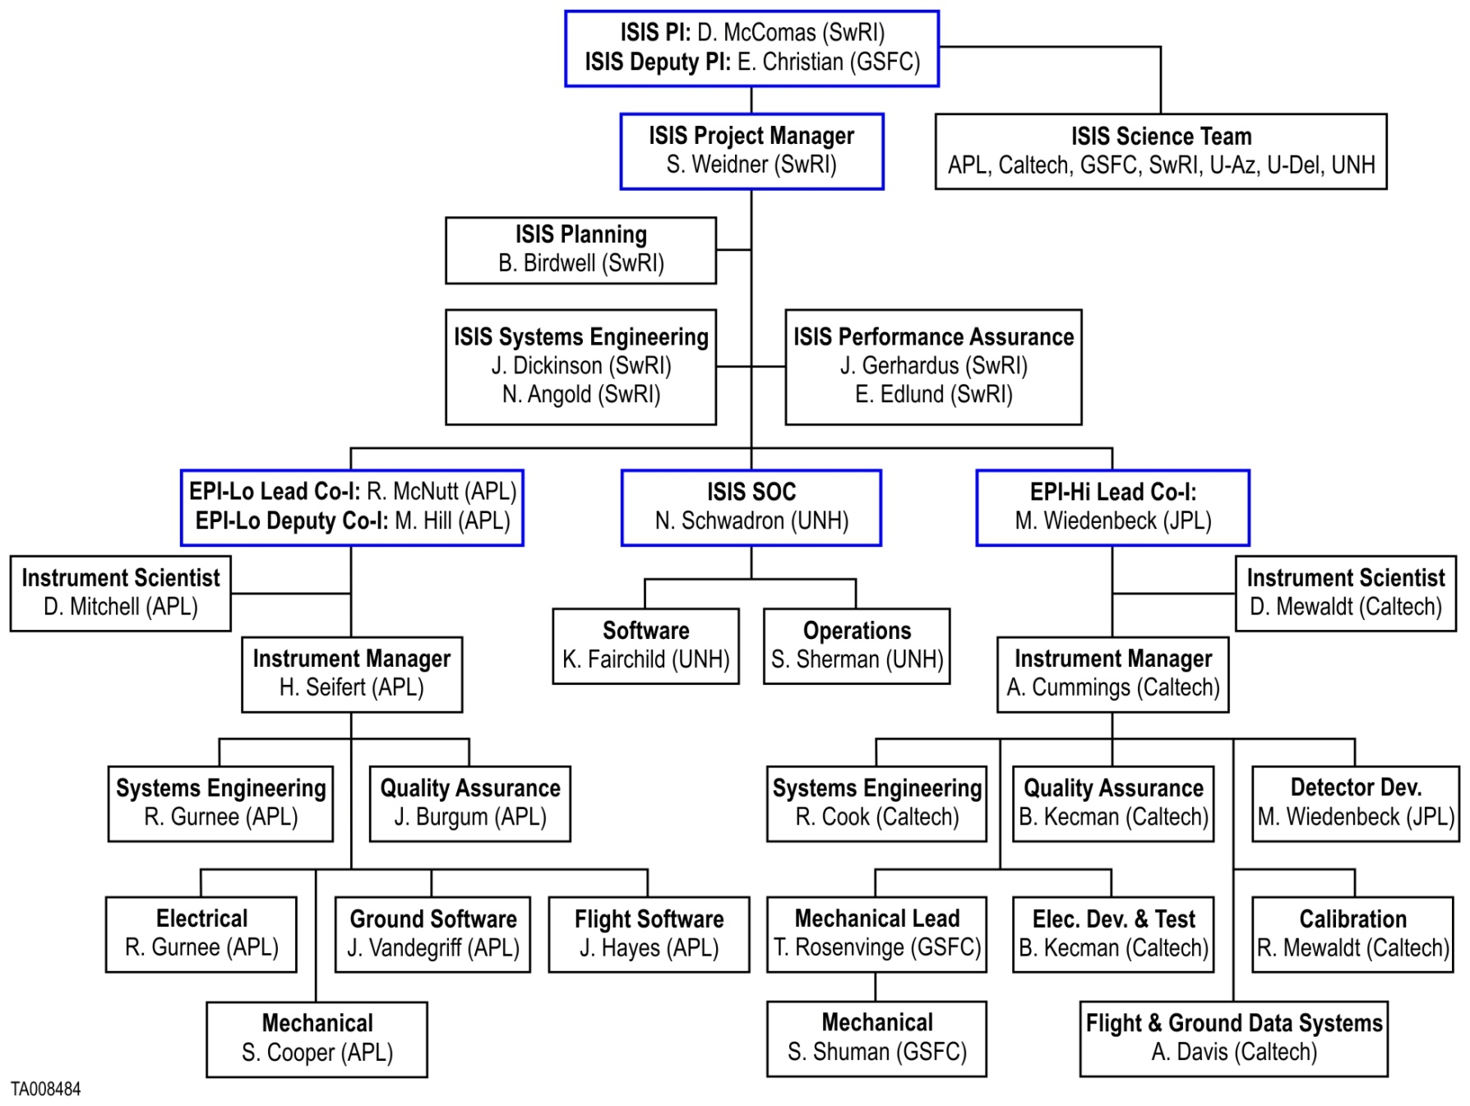
ISIS Team

Slide 4

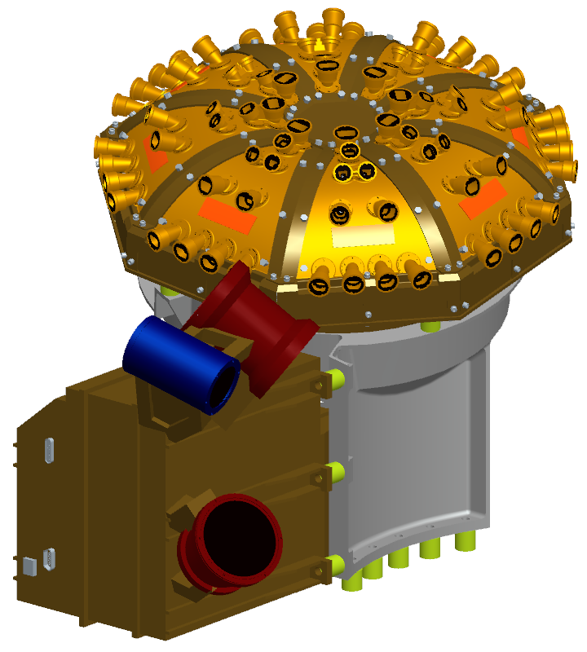
ISIS Suite
EPI-Lo
ISIS Energetic Particle Suite
  Measures energetic particles, including electrons, protons, and heavy ions
Two instruments for wide energy coverage
  EPI-Hi (Caltech & GSFC)
  EPI-Lo (JHU/APL)
ISIS Allocations
  Mass: 9.383 kg
  Power: 11.768 W
  Telemetry: 12 Gbit/orbit
ISIS
Bracket
EPI-Hi

Slide 5
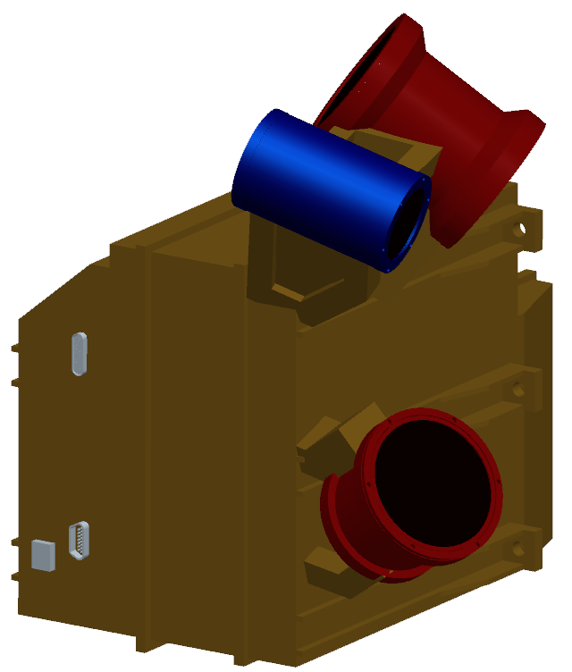
ISIS EPI-Hi
Three Telescopes
  HET – High energy
  LET1 – Low energy
  LET2 – Low energy, single-ended
Required Energy Range
  Ions:
    1 MeV/nucleon – 50 MeV/nucleon
  Electrons:
    0.5 MeV – 3 MeV
FOV: ≥π/2 sr in sunward and anti-sunward hemispheres (incl. 10°from S/C-Sun line)
LET1
HET
LET2
Electronics
Box

Slide 6
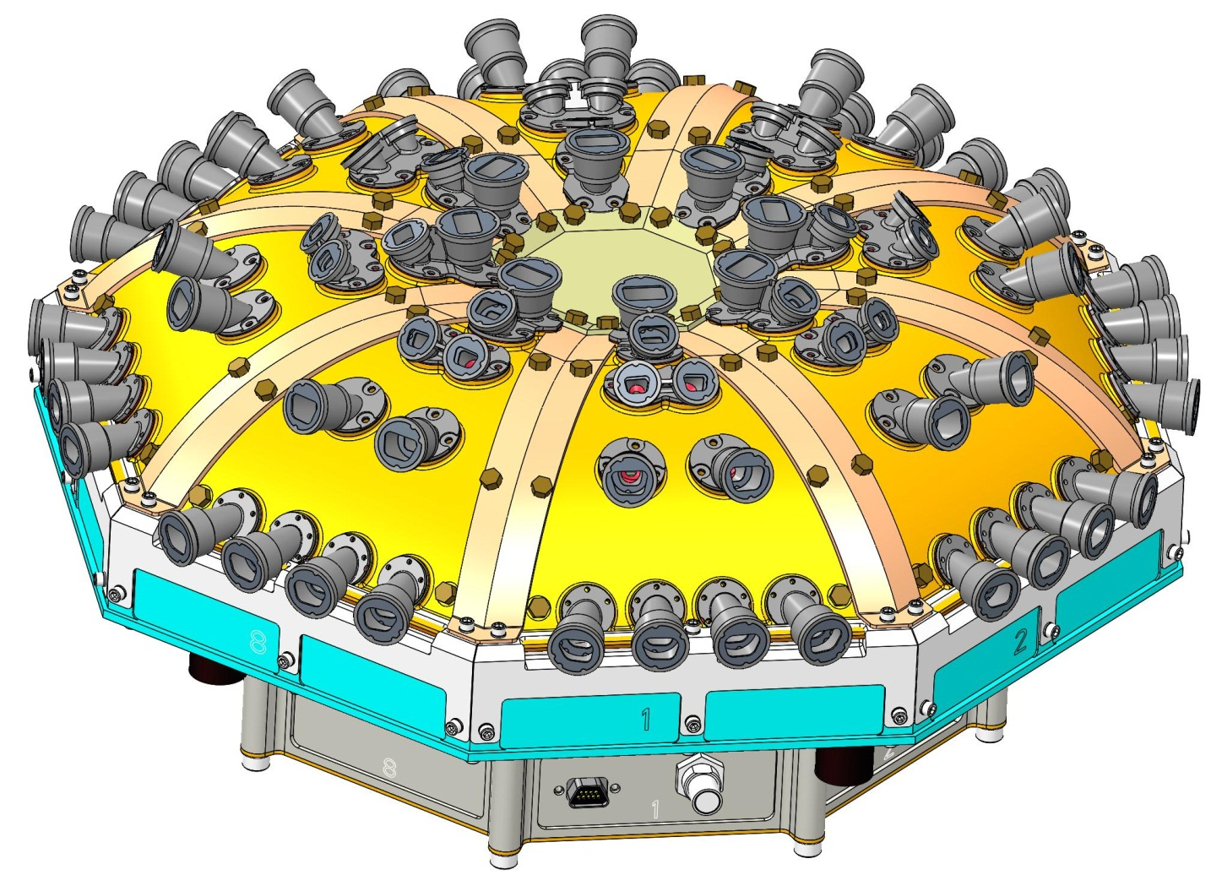
ISIS EPI-Lo
8 Wedges configured in 4 independent quadrants
Required Energy Range
  Ions:
    50 keV/nucleon –
    15,000 keV Total E
  Electrons:
    50 – 500 keV
Nearly 2-π FOV
Sensor
Wedges
Electronics
Housing

Slide 7
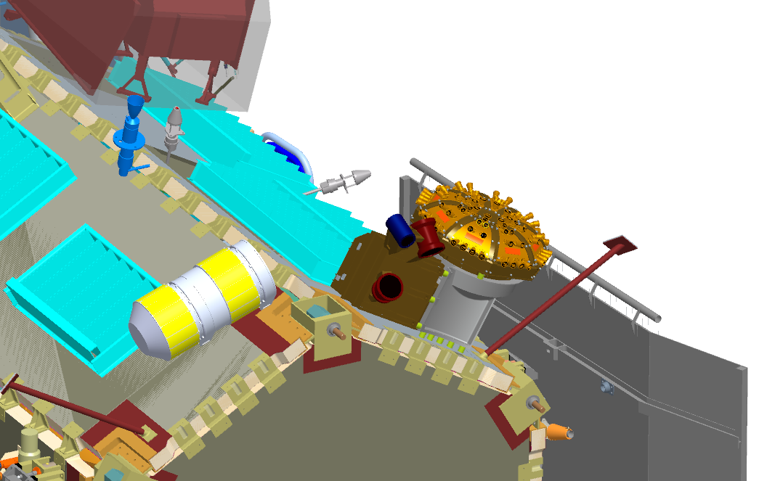
Spacecraft Accommodation

Slide 8
Late-Breaking Trade with the S/C
New Solar Limb sensor placed near ISIS
Analysis of the effect on our FOV is on-going
Not really enough time to roll change into ISIS PDR
No “show stoppers” expected but analysis will be completed
Working the process-issues with the Spacecraft team

Slide 9
Changes Since MDR
No changes to Science
Updated design for EPI-Hi Electronics Box
EPI-Lo electronics box reduced in diameter and fits inside the ISIS bracket
ISIS Bracket modified to accommodate the Ebox changes
Mass increased as part of risk-reduction process run by the SPP spacecraft when the nominal orbit was modified
Power and telemetry have held steady with some reductions in uncertainty
Two small additions
  EPI-Hi added a background pixel
  EPI-Lo added an anti-coincidence detector
  Both of these use spare resources of existing electronics and provide large payoff for dynamic range

Slide 10
Summary
ISIS team has completed definition, preliminary design, and a substantial amount of analysis work in Phase B
Some adversities (Government Shutdown) have made challenges for the EPI-Hi team
We’ve brought in coast-to-coast teams to help Peer Review details of each subsystem
New design elements have been prototyped and tested
We look forward to your feedback on our progress

