Slide 1
EPI-Hi Mechanical
Sandy Shuman

Slide 2
EPI-Hi Outline
Overview of Instrument Configuration
Location on Spacecraft
Telescope FOV’s
Mass Allocation
Detailed description of the instrument mechanical design
  Electronics configuration
  Detector holders
  Telescope housings
  Cable routing within Electronics housing
Assembly process
  Electronics
  Telescopes
  Telescope to Electronics
Summary of Peer Review results

Slide 3
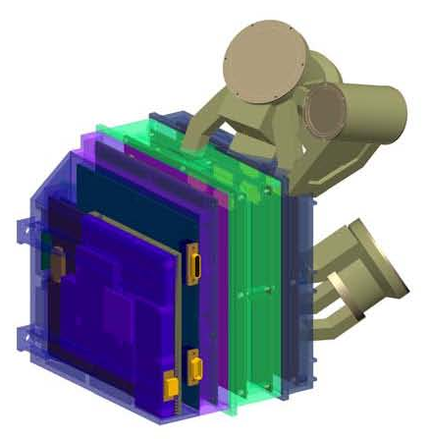
EPI-Hi Component Configuration
LET1
Low Energy Telescope 1
HET
High Energy Telescope
DPU/Bias
LET2
Low energy Telescope 2
LVPS
LET2 Electronics
LET & HET Electronics

Slide 4
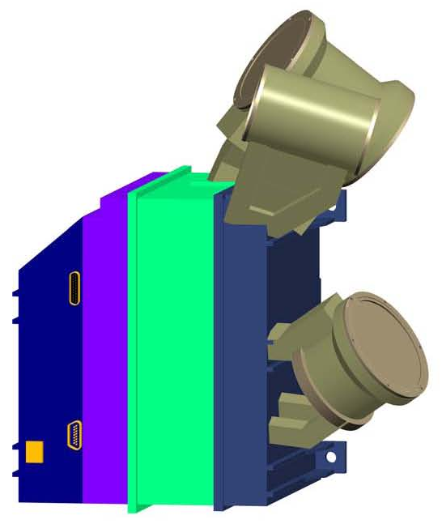
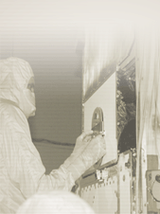
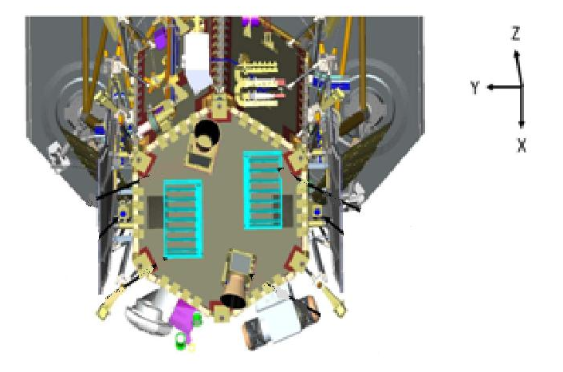
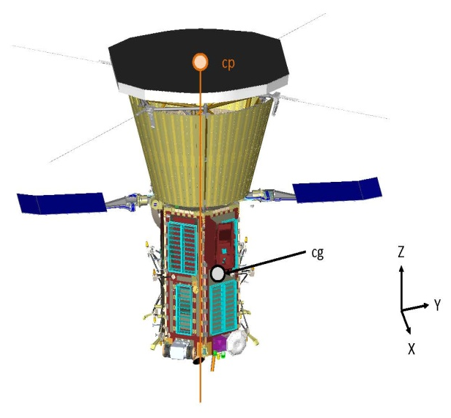
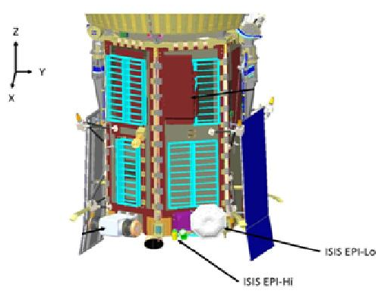




EPI-Hi Instrument
Location of instrument on spacecraft
Located on +X side (RAM side).
Lower right mounting bolt on instrument located at: X= 46.16
Y= 23.39
Z= 6.13
S/C MOUNTING
LOCATION
REFERENCE
ISIS-EPI-HI
RAM SIDE

Slide 5
EPI-Hi Instrument FOV’s
HET conical 90 Degree FOV
  Double–ended.
  20 degrees above the S/C-Sun line.
LET1 conical 90 Degree FOV
  Double–ended.
  45 degrees above the S/C-Sun line.
LET2 conical 90 Degree FOV
  Single–ended.
  Orthagonal to LET1 Telescope (135 degrees from S/C-Sun line.

Slide 6
EPI-Hi Mass Allocations
Subsystem | Mass [ g ]
LET1 telescope LET1 board | 225 258
LET2 telescope LET2 board | 145 233
HET telescope HET board | 120 250
DPU board Bias Supply & RF shields LVPS & RF shields | 197 225 + 130 160 + 100
Elec. box, hardware & shielding Telescope brackets Thermal hardware MLI blankets | 925 + 250 +100 160 50 100
Total | 3,628

Slide 7
EPI-Hi Enclosure Requirements
Work within tight mass constraints.
Design to meet S/C launch environment requirements for Vibration, Acoustics and Thermal conditions.
Design for radiation dose shielding environment.
Package boards maintaining adequate parts clearance board to board.
Provide adequate RF and/or ground shielding board to board and through the enclosure.
Provide thermal isolation between electronics box and bracket, as well as between telescopes and electronics box.

Slide 8
EPI-Hi Electronics Enclosure
Electronics box is made up of 4 major components, the LVPS Assembly, the DPU/HV Bias Assembly, the HET/LET1 Electronics Assembly and the LET2 Electronics Assembly.
Each Electronics Assembly is mounted in a perimeter style frame.
All “frames” when assembled together will provide a continuous RF shield for internal electronics.
Wall thickness will be minimum 1,0mm (~40 mils) for radiation dose shielding.
Internal shielding between critical components will create separate shielded areas as necessary for proper electronics function.
Board interconnect is achieved using rigid/flex boards w/ built in cables terminating to individual nanonics/microstrip connectors on mating boards.
Connections to the S/C will be via standard Micro-D connectors.

Slide 9
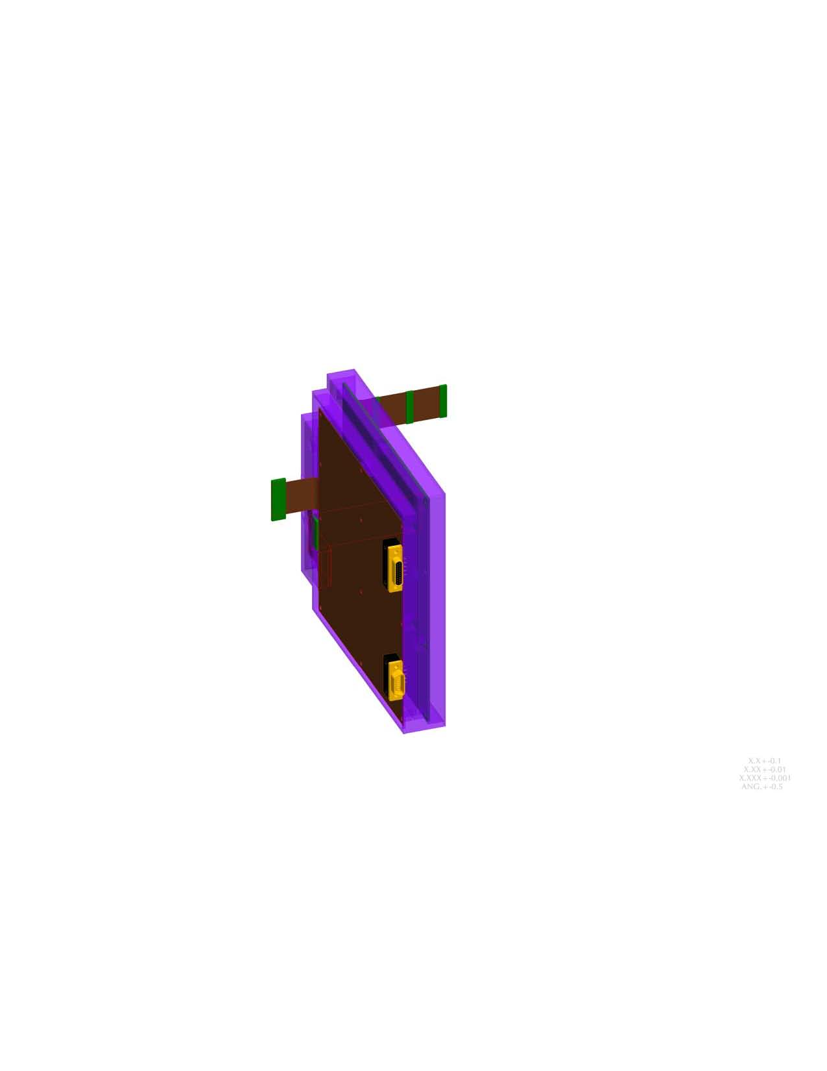
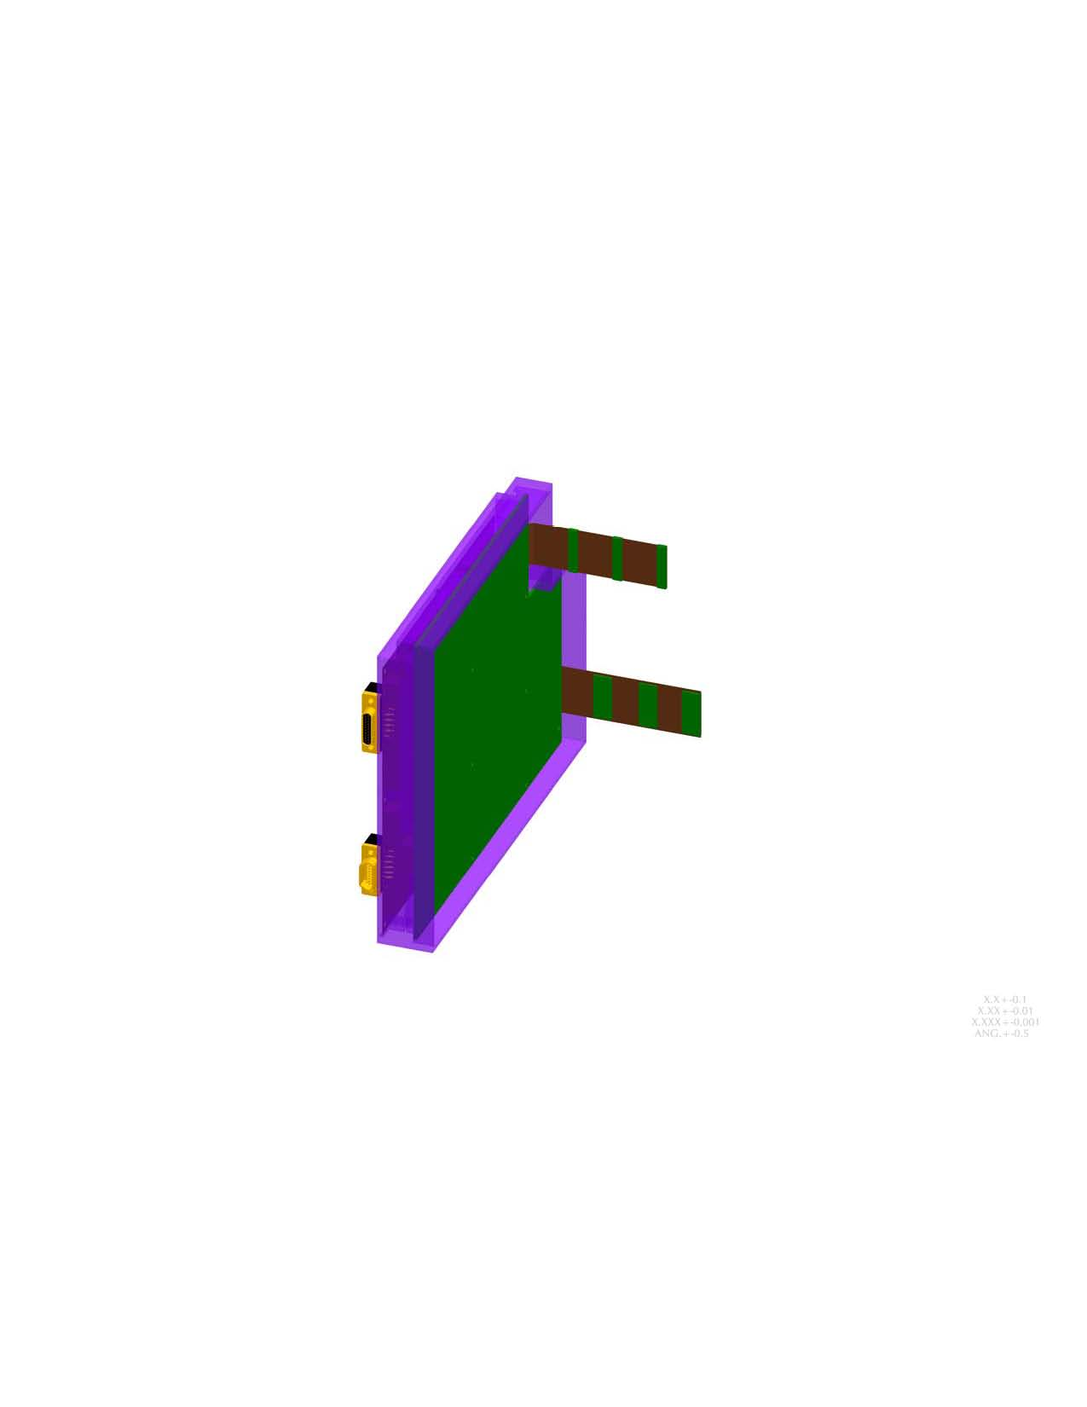
EPI-Hi Electronics Enclosure
DPU Board (mounted in one side of frame)
  Flex connection to Telescope Boards.
  Flex connection to LVPS.
  S/C connectors (PCB mount).
  PCB’s mounted to machined in posts in chassis.
Bias Supply Board (mounted in one side of frame)
  Flex connection to 3 Detector Boards.
  Flex connection to DPU Board.
  R/F shielding.
  PCB’s mounted to machined in posts in chassis.

Slide 10
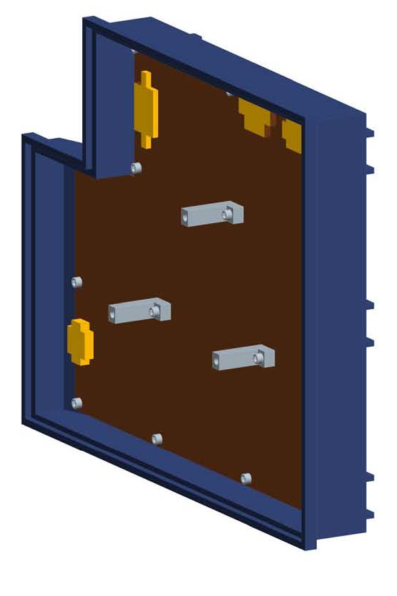
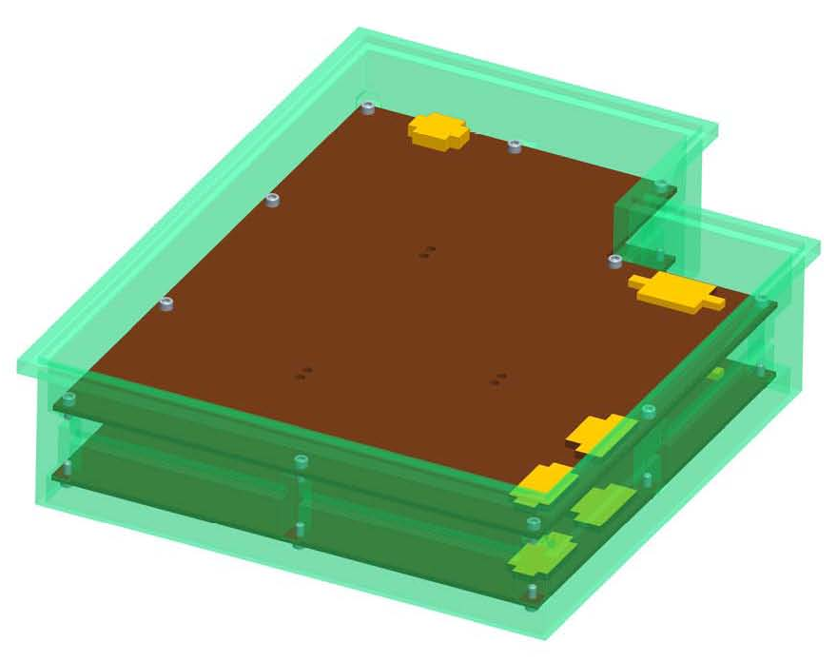
EPI-Hi Electronics Enclosure
LET2 Telescope Electronics Assembly
  Receives flex connection from Bias Board
  Receives flex connection from DPU Board
  Receives 2 flex connections from Telescope
  Housing provides feet for Instrument to bracket mounting.
HET & LET1 Electronics Assembly
(each board)
  Flex connection from Bias Board
  Flex connection from DPU Board
  2 Flex connections from Telescope
  PCB’s mounted to machined in posts in chassis

Slide 11
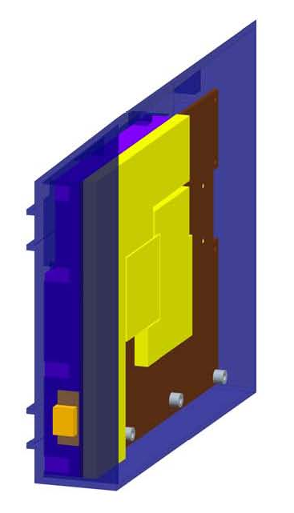
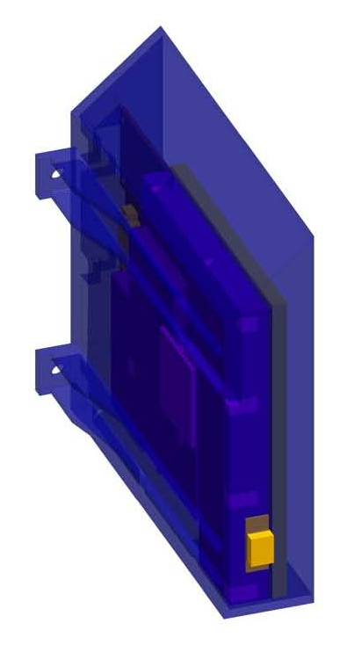
EPI-Hi Electronics Enclosure
Low Voltage Power Supply
  Receives flex connection from DPU Board
  S/C connectors (PCB mount).
  Individually shielded primary/secondary circuits top and bottom.
  Housing is tapered to avoid HET Telescope FOV.
  Housing provides feet for Instrument to bracket mounting.
  PCB’s mounted to machined in posts in chassis.
*LVPS Board provided by APL
*Chassis and shields designed/provided by GSFC

Slide 12
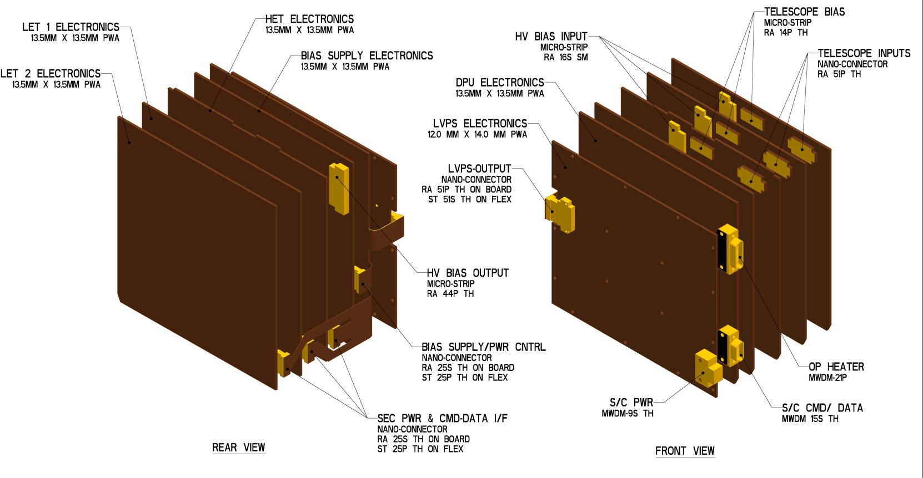
EPI-Hi Interconnect

Slide 13
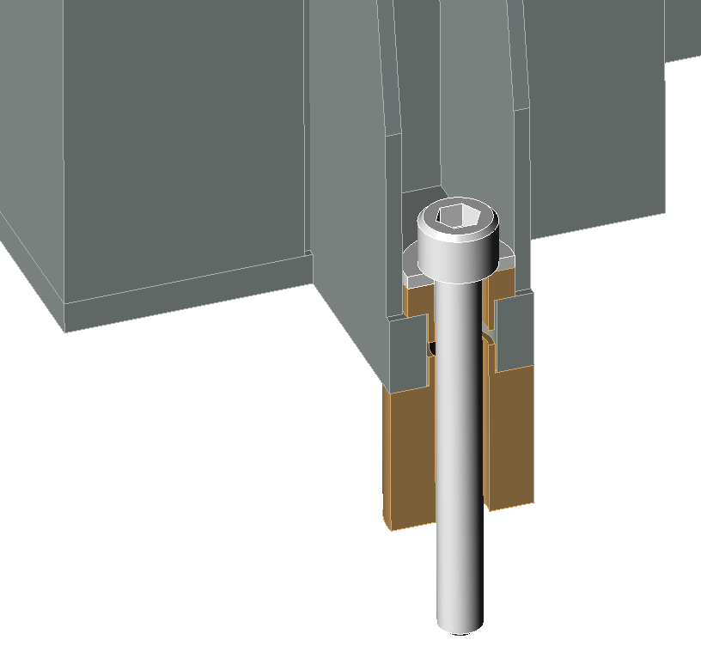

EPI-Hi Thermal Isolation
Typical Mounting Foot Showing Thermal Isolation
Mounting Bolt
Washer
Ultem Isolation Bushings

Slide 14
EPI-Hi Mount Design Requirements
Detector Mounts
  Able to transmit signals from silicon detectors, via wire bond connections to output connector.
  Allows the stacking of detectors maintaining 0,5mm spacing surface to surface between thickest detectors (1,0mm) .
  Allows any detector to be stacked face up or face down with any other detector.
  Allows for the protection of wire bonds from being crushed on either side when placed on flat surface during storage and/or test.
  Provides electrical breakdown protection to next detector, when stacked, of up to 200V differential between crown of HV wirebonds to conductive surface of opposing detector.

Slide 15
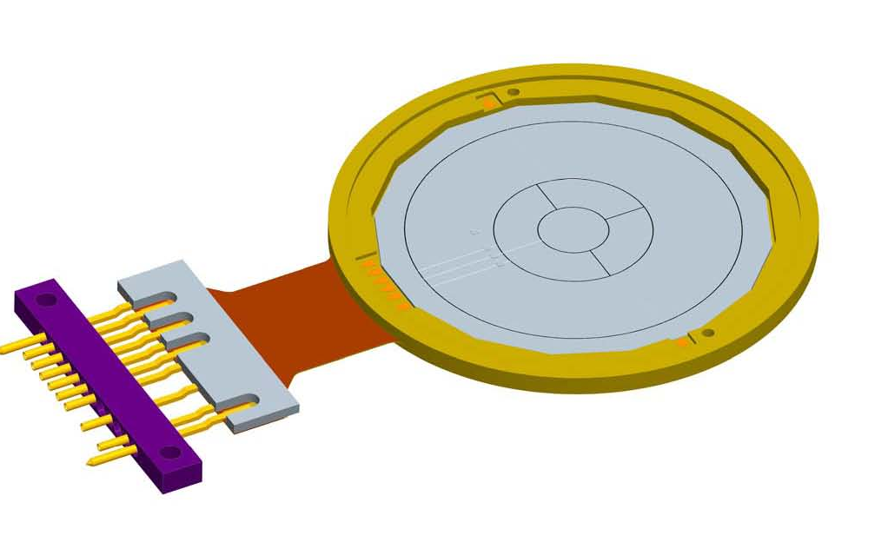
EPI-Hi Detector Mount
Recessed detector shelf for silicon detector installation.
Micro-strip connector output.
Flex stiffener to rigidize the area where connector is mounted.
Alignment achieved with alignment pins and concentric stacking shelves on mount and connector.
Tolerancing for mounts will be tightly constrained, but within current CNC machining capabilities.
Detector alignment will be verified through measurement and testing on assembled flight detectors.

Slide 16
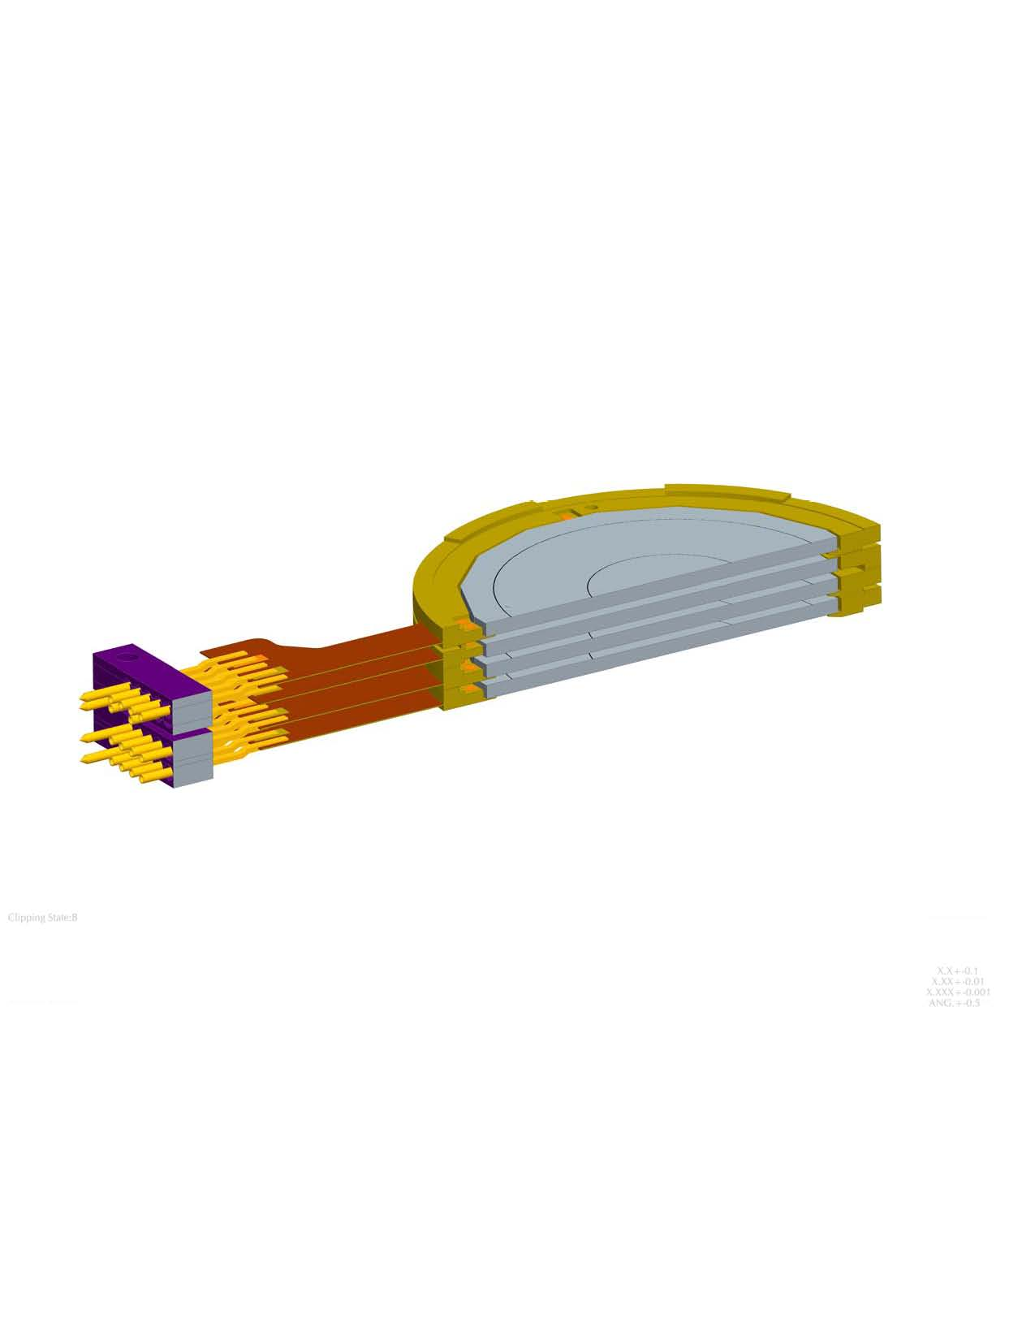
EPI-Hi Detector Mount
Mount design allows stacking of detectors face to face, face to back and back to back while maintaining same spacing.
Mounts are spaced 1,5mm apart when stacked allowing for 0,5mm separation between thickest detectors.
Detector Voltage ranges from ~2V up to ~200V.
Mounts provide adequate spacing/protection for wirebond clearance.

Slide 17
EPI-Hi Telescope Design
3 Telescope comprised of silicon wafer detectors.
Provides ~6,0mm of aluminum shielding to block unwanted particles from entering through the housing body.
Will have multiple foils for micro-meteorite/light protection.
Mounted directly to the top of the enclosure allowing the flex interconnect cable to be routed internally to provide proper RF shielding.
Will be thermally isolated from the electronics enclosure.
Will all have red-tag covers over all aperture openings.

Slide 18
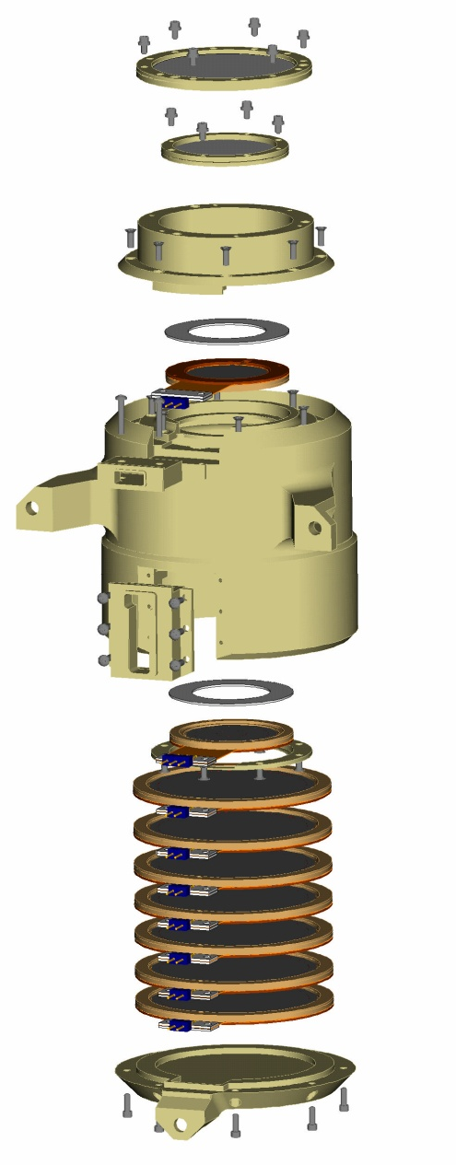
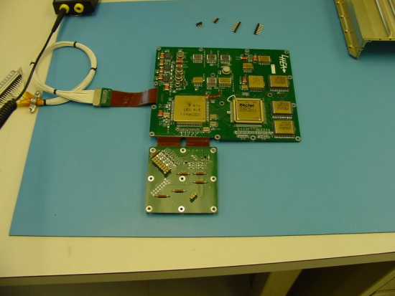
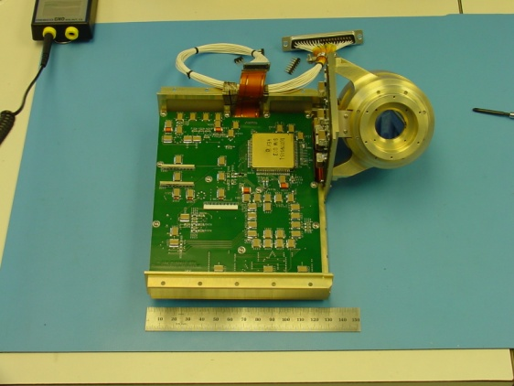
EPI-Hi Telescope Design
Heritage design.
Uses alignment pins to stack detectors in telescope body.
Mounting bracket designed into telescope body.
Output signal cable will be completely enclosed in assembly providing proper shielding.
Pictures shown are of STEREO\HET Telescope

Slide 19
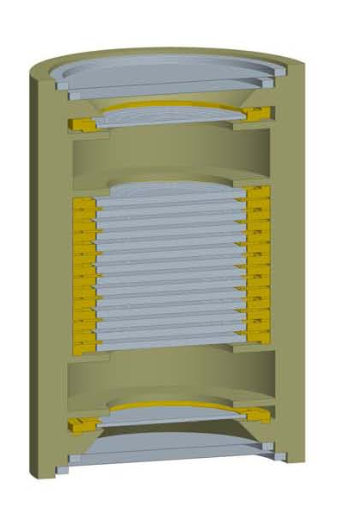
EPI-Hi High Energy Telescope
2- ~127um (5 mil) Foils for micro-meteorite /light protection on each end.
Comprised of 16 silicon wafer detectors mounted in flex-rigid mounts.
The front two detectors at each end are spaced apart in order to set a 90 degree FOV angle.

Slide 20
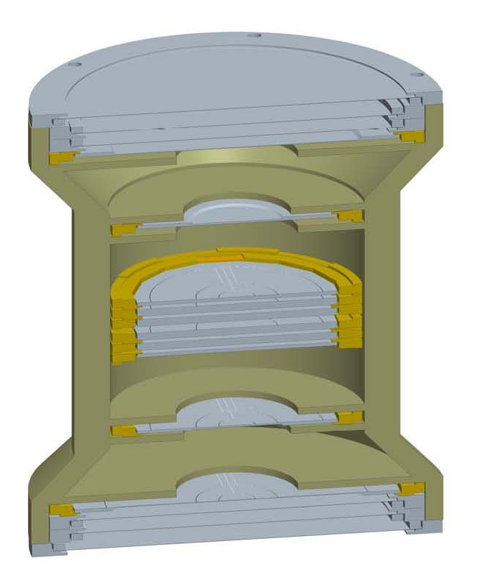
EPI-Hi Low Energy Telescopes
LET1
  Double Ended FOV.
  3 Foils for micro-meteorite/light protection on each end.
    Outer foil to be 2um polyimide.
    Inner 2 foils to be 1um polyimide.
  Comprised of 10 silicon wafer detectors mounted in flex-rigid mounts.
  The front 3 detectors at each end are spaced apart in order to set a 90 degree FOV angle.
LET2
  Single-ended FOV.
  Comprised of one half of a LET1 Telescope.
(LET1 shown)

Slide 21
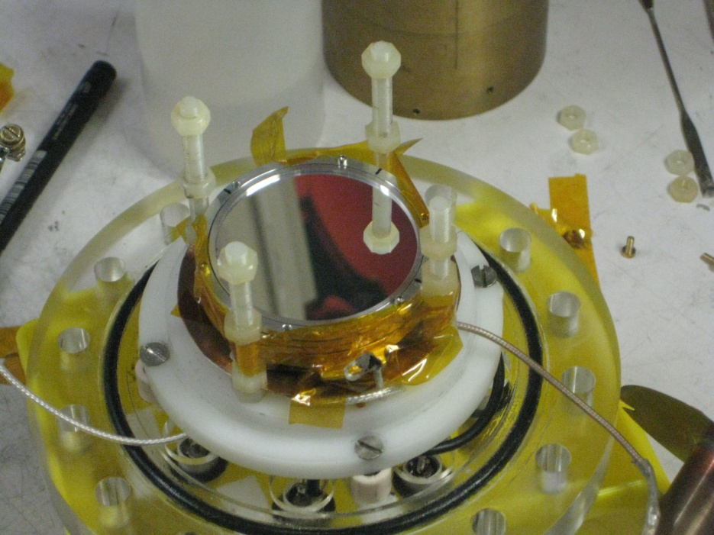
EPI-Hi LET Foils
All foils will be aluminized polyimide manufactured by the Luxel corporation.
Full sized prototype foils (1, 2, and 4 micron) have been manufactured by Luxel during Phase B.
Prototype foils have been thoroughly tested, including a high-velocity dust test at the Heidelberg dust accelerator
Stack of three Luxel foils (1 micron, 2 micron and 4 micron) in dust accelerator set up.

Slide 22
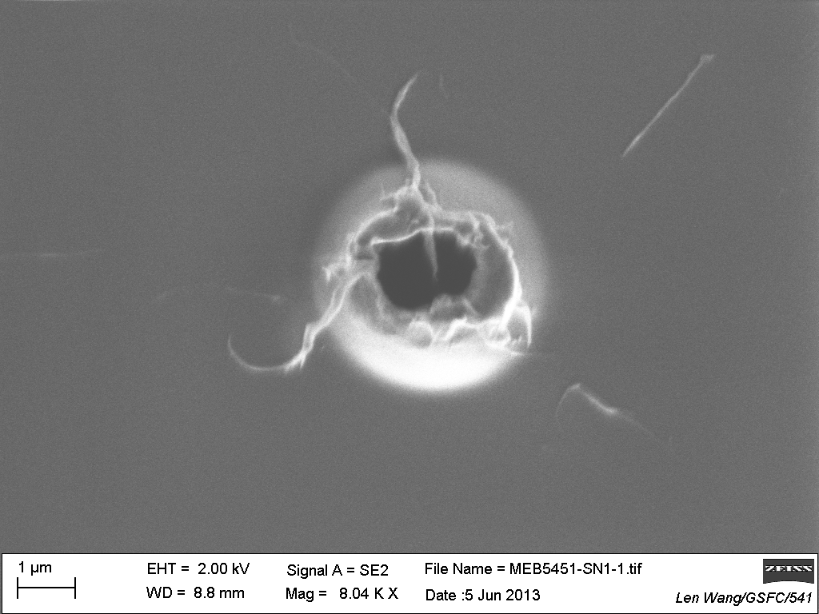
EPI-Hi LET Foils
Dust test show that holes do not propagate.
Melted polyimide actually appears to strengthen the edge of the hole.
Thermal requirements met with aluminization only on the inside surface.
Atomic Force Microscope image of dust impact in 1 micron thick polyimide. Image is from back (exit) side.

Slide 23
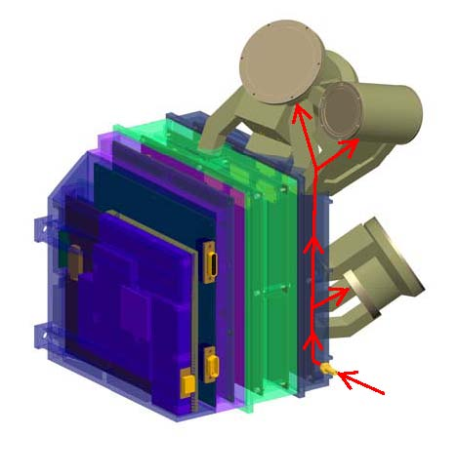
EPI-Hi Telescope Purge
Purge will be established to the individual telescopes with a single purge fitting on the outside of the instrument.
Purge will be distributed internally through a manifold that will send the purge gas into the center volume of each telescope.

Slide 24
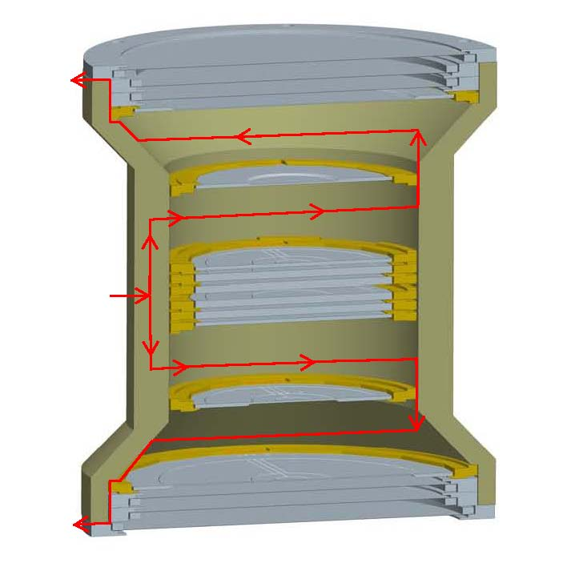
EPI-Hi Telescope Venting
Heritage venting strategy that was used on several prior missions.
Purge gas enters thru housing into open center volumes.
Gas then flows outwards thru vent slots in housing shelves, detector mounts and foil rings.
Gas exits each end of the telescope thru vent slots below outer foil.
PURGE GAS

Slide 25
EPI-Hi Assembly Flow
Electronics Assembly Flow
  Assembled board will be put into it’s corresponding frame.
  Electronics boards will be tested independently.
  Boards then interconnected and fanned out like a book for troubleshooting and further testing.
  Purge hoses and fittings will be installed.
  External RF shields will be added before assembly is closed up.
  Frames then bolted together and last remaining board cabling is installed/ connected through access panels in frames.
  Access panel covers installed.
  Test, Test, Test…

Slide 26
EPI-Hi Assembly Flow
Telescope Assembly Flow
  Processed Silicon wafers are placed in mounts and tested.
  Detector selections are made and mount thicknesses recorded.
  Detectors are stacked in telescope w/ proper shims, covers and spacers.
  Polyimide Foils are installed in collimators.
  Collimators/covers are installed onto telescope.
  Red Tag/ Protective covers installed.
  Telescope tested w/ electronics and Radio-active sources.
  Stored for integration to box.

Slide 27
EPI-Hi Assembly Flow
  Telescope to Electronics Box Assembly
  Mating cable is assembled over detector pins and secured in place.
  Closeout cover installed over cable.
  Telescope positioned over electronics and cable fed through corresponding frame.
  Cables connected at electronics end thru access panels in frames.
  Access covers installed.
  Test, Test, Test…
  Telescopes mapped by source testing/accelerator calibrations.

Slide 28
EPI-Hi Peer Review Results
Peer Review was conducted earlier this month, summary has been received, but no Actions received as of yet.
  Concern was shown for thin detectors and the implications of environments thereon…these will be considered and appropriate testing will be done.
  Concern was shown over PCB/wall mounted connectors. Appropriate measures will be taken to minimze stresses during installation.
  Concern was raised about whether “bolt slip” during instrument/ telescope mounting will be sufficient enough to keep Telescope FOV’s within spec. This will be analized and verified.

