Slide 1
Ground Support Equipment
Reid Gurnee
Notes:
introduction

Slide 2
Outline
EGSE
  Board Level
  S/C Emulators
  Safe/Arm Plugs
EGSE software should be described including requirements, design and verification of EGSE software
MGSE
  Aperture covers
  Handling fixtures
  Transport cases
Instrument purge equipment
Alignment requirements and features
<< Reid, the MGSE isn’t very complex and are things you are very used to. The ME’s will supply the details, but I thought you would be a good person to make the overall pitch since you have some of the best knowledge of the latest versions of the EGSE from your RBSP experience >>

Slide 3
Board-Level GSE
Each lead engineer is responsible for developing their own board-level GSE.
  Power Board: Load board, active load, HV load, breakout box, breakout board, I2C stimulus
  Event Board: energy and TOF preamp boards, event board, test port box, breakout box, I2C slave, commercial pulsers
  Anode Board: Commercial pulsers, scope, HV power supply
All GSE is peer reviews and XXX (talk to Jim Burgum)
RBSPICE CDR August 3 & 4, 2009

Slide 4
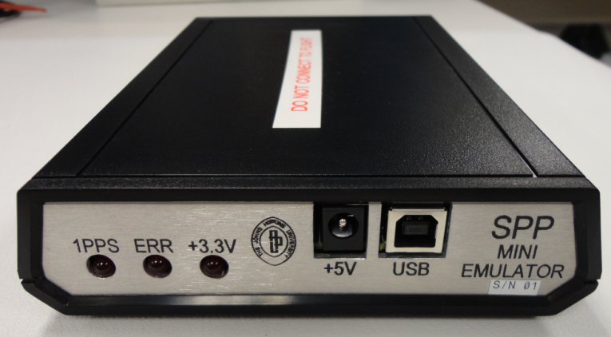
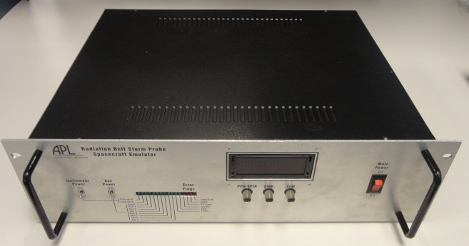
Spacecraft Emulator
Mini emulator
  Provides Instrument Data Interfaces only, No Power Interfaces, No Temperature Interfaces
  Also provides 1PPS and Gated_PPS Interfaces for Instrument EGSE
  GSEOS Interface is fully compliant
  Non-flight use only
Full emulator
  Provides Instrument Data, Power and Temperature Interfaces
  Also provides 1PPS and Gated_PPS Interfaces for Instrument EGSE
  Designed for use with Flight hardware
GSE verification performed by project
QTY provided to ISIS?

Slide 5
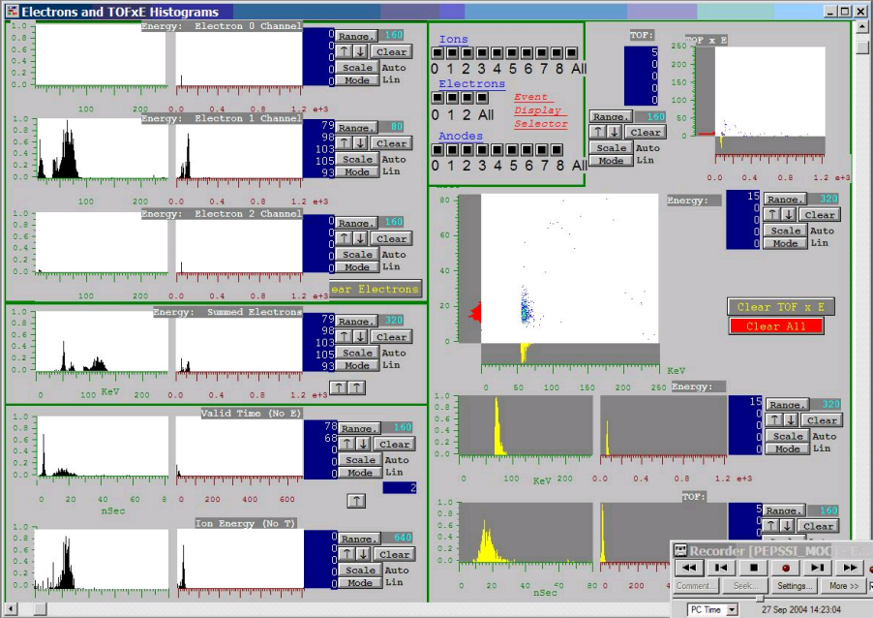
GSEOS
Common GSE software for all instruments
Display screens and instrument customizations can be used through all development cycles from bench testing, I&T deployment, to flight operations
Same platform used for EM, Flight, and Spacecraft operations
  Test scripts can be developed by individual teams, tested on EMs, and then executed at the S/C level
Software verification performed by project

Slide 6
Safe / Arm plugs
EPI-Lo has a HV air-safe plug
  When installed HV is limited to air safe levels
  Plug will be removed for S/C TV testing
  Plug will be permanently removed during final closeout
EPI-Hi???
Instrument covers
  ISIS instruments will have red-tag covers to protect the apertures
  Covers will be temporarily removed for S/C TV testing
  Covers will be permanently removed during final closeout

Slide 7
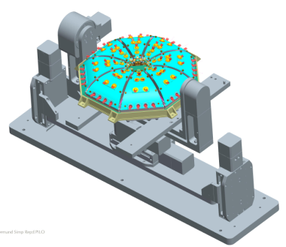
Calibration GSE for Instrument Articulation
Requirements
  Use in APL accelerator facility
    Vacuum compatible (low outgassing)
  Accommodate vertical and horizontal-mount instrument with open doors
  Cover full FOV
Status
  Specified and purchased custom system from Newmark Systems
  Received January ‘09
  Fit tested with instrument
  Remote software interface under development
Future Work
  Make small modifications for mounting
  Test with mass prototype and EM instrument
Instrument
Update Photo
EPI-Hi?
Articulation stage
RBSPICE CDR August 3 & 4, 2009

Slide 8
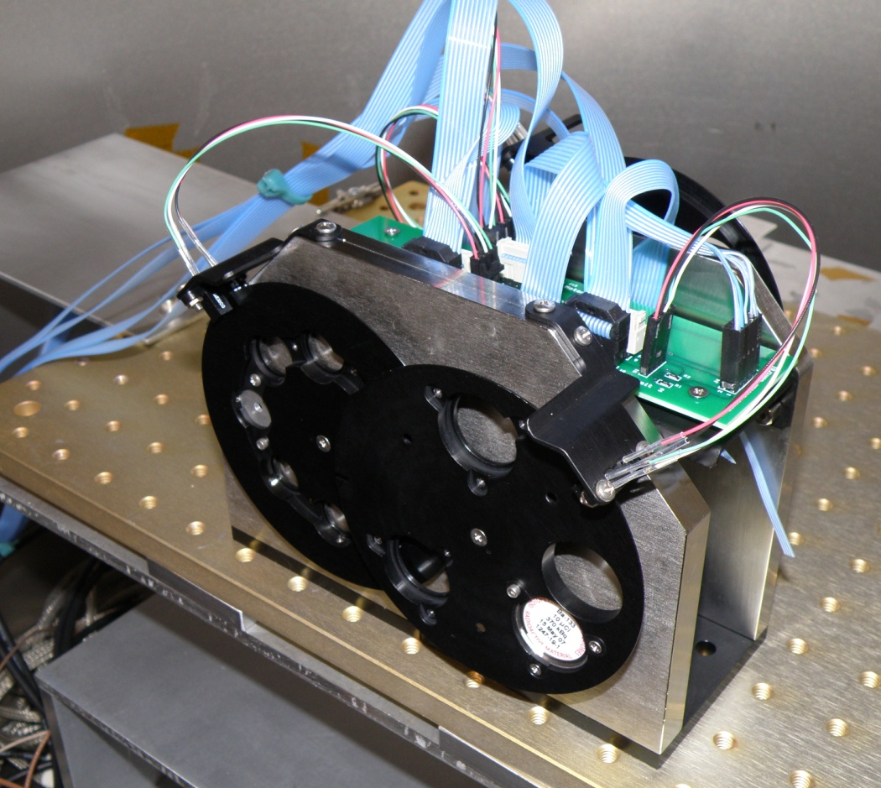
Calibration GSE for Beam Generation
Requirements
  Use in APL calibration facility with particle accelerator
    Vacuum compatible (low outgassing)
  Allow user to select ion or electron calibration source and intensity
  No stray light from optical switches
Status
  Designed and built custom system
    Three-wheel implementation
    Optical switches off when not homing
  Installed and in use in APL facility
Detector wheel
Foil wheel
Source wheel
RBSPICE CDR August 3 & 4, 2009

Slide 9
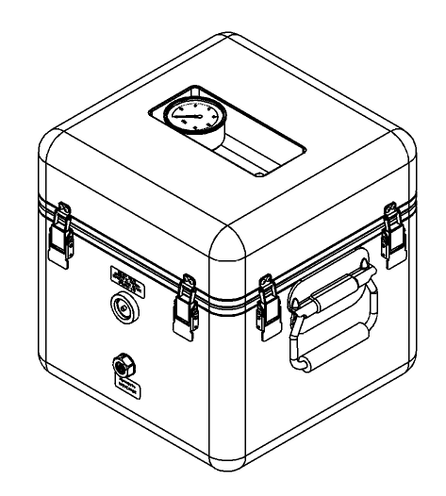
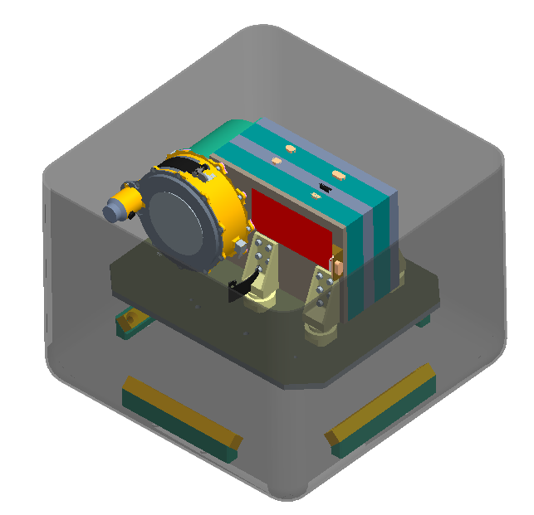
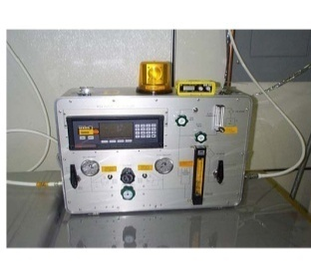
Mechanical GSE
Shipping Container
  Requirements
    N2 purged, humidity controlled and monitored
    Low outgassing
    Shock mounted and monitored
    Hermetically sealed with pressure relief valve
  Status: Under design
Environmental Test Fixtures
  Thermal Vacuum Fixture
  Vibration Plate Fixture
  To be based on JEDI fixtures
Purge Suitcase
Update Photo
RBSPICE CDR August 3 & 4, 2009

Slide 10
Alignment Requirements
EPI-Lo
EPI-Hi

Slide 11
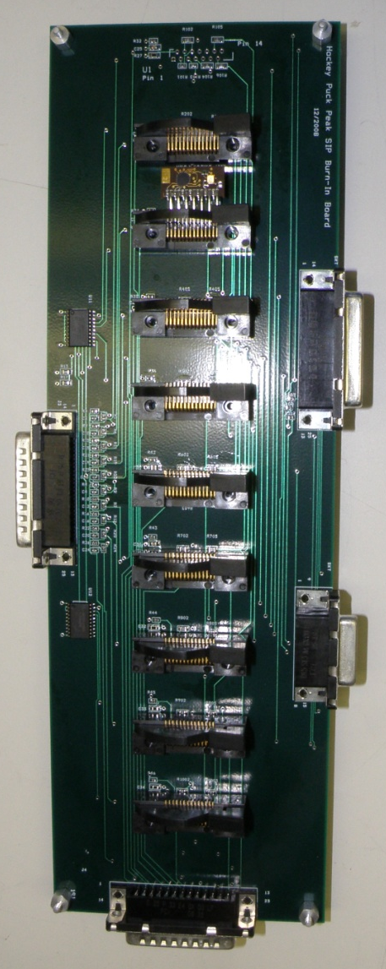
Component-Level Electrical GSE
Component-Level GSE designed and reviewed for supporting flight build
Requirements
  Functionality to test component requirements
  Fail-safe flight component interface
Status
  Energy board test board
    Board is designed, built, and tested
    Used to test EM and flight Energy boards
  Energy board burn in board
    Schematic is complete
Update Photo
RBSPICE CDR August 3 & 4, 2009

