Slide 1
ISIS Thermal
Gregory J Dirks
Notes:
introduction

Slide 2
Outline
Driving Instrument Thermal Requirements
Thermal Design and Implementation
Thermal Management
Heaters and Sensors
MLI Design
Materials and Finishes
Predicted Performance and Margins
Thermal Model Details
Design Cases
Optical Properties
Predictions and Margins
Plans for Thermal Verification

Slide 3
Requirements
Design Temperature Limits
EPI-Hi EPI-Lo
Margin Guidelines – Includes Test and Model Uncertainty
Hot Limits 10 C and Cold Limits 5 C (Heater Controlled)
Component | Hot Op. (°C) | Cold Op. (°C) | Cold Surv. (°C)
EPI-HI HET | 40 | -25 | -40
EPI-Hi LET1 | 40 | -25 | -40
EPI-Hi LET2 | 40 | -25 | -40
EPI-Hi DPU | 40 | -25 | -40
EPI-Hi Bias | 40 | -25 | -40
EPI-Hi LVPS | 40 | -25 | -40
EPI-Hi HET Tel | 30 | -25 | -40
EPI-Hi LET 1 Tel | 30 | -25 | -40
EPI-Hi LET 2 Tel | 30 | -25 | -40
Component | Hot Op. (°C) | Cold Op. (°C) | Cold Surv. (°C)
Detector | 35 | -30 | -45
Anode Board | 55 | -30 | -45
Event Board | 55 | -30 | -45
Power Board | 55 | -30 | -45
Dome | 35 | -30 | -45

Slide 4
Requirements
Interface Temperatures
Operational: -25 / +65 C
Non-Operational: -30 / +70 C
Heaters
75% Maximum Duty Cycle
Resistance Determined at 26 V

Slide 5
Design
EPI-Hi
E-box Radiator to Dissipate Internally Generated Heat
Telescopes Conductively Isolated from E-box
Operational Heaters on Telescopes
Survival Heaters on Telescopes and E-box
MLI on Surfaces Except Apertures and Radiators
Telescopes
Radiator Surface
E-Box
Circuit Boards

Slide 6
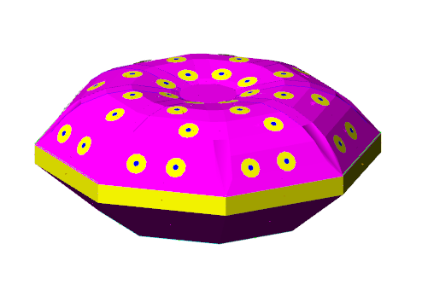
Design
EPI-Lo
Wedge Radiators (8) to Dissipate Internally Generated Heat
Eight Survival Heaters (One on Each Wedge)
MLI on Surfaces Except Apertures and Radiators

Slide 7
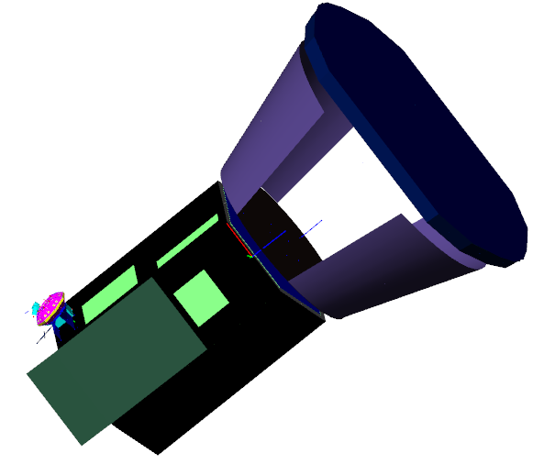
Design
ISIS
EPI-Hi and EPI-Lo are Thermally Isolated from the Bracket
Bracket is Thermally Isolated from the S/C

Slide 8
Heaters and Sensors
EPI-Hi Heater Operations
One S/C Thermistor on Each Telescope and Two S/C Thermistors on E-box (Primary and Redundant)
Operational Heaters on Each Telescope are on One S/C Service, but Controlled by E-box
Survival Heaters on Each Telescope and the E-Box are on One S/C Service and Controlled by S/C with Sense Location Currently Baselined as the E-box
Survival Heaters Also Used to Warm Instrument to Cold Operational Temperature for Cold Turn On by using Different Set Points

Slide 9
Heaters and Sensors
EPI-Lo Heater Operations
Two (Primary and Redundant) S/C Thermistors on Dome for Heater Control and One More (To Be Positioned)
Survival Heaters on One S/C Service (Separate from EPI-Hi) Controlled by S/C with Sense Location Currently Baselined as One of the Wedges
Survival Heaters are Used to Warm Instrument to Cold Operational Temperature for Cold Turn On by Using Different Set Points
Survival Heaters are Also Used to Maintain Minimum Cold Operating Temperature During Low Power Operating Conditions
Summary
One S/C Operational Heater Service (EPI-Hi)
Two S/C Survival Heater Services
Eight total (5 EPI-Hi and 3 EPI-Lo) S/C Thermistors

Slide 10
MLI
Coverage
Entire Instrument (Including Underneath) Other than Apertures and Radiators
Specifications
Each Separate Blanket Grounded with Wire to S/C
Vented Using Edge Mesh Screens Directed away from Apertures
Edges and Seams Sealed using GBK Tape
Blankets Secured using G-10 Buttons and SS Snap Rings

Slide 11
Materials and Finishes
Radiators
Z-93Z55 Conductive White Coating
MLI
Germanium Black Kapton (GBK)
Apertures
EPI-Hi: TBD
EPI-Lo: TBD
Thermal Isolators
G-10 Fiberglass

Slide 12
Thermal Model
EPI-Hi Modeled by Vertex Aerospace
Rommel Zara and Santino Rosanova
EPI-Lo Modeled by APL
Shawn Begley
Bracket Modeled by Vertex Aerospace
ISIS Model Integrated by Vertex Aerospace
All Models Created using Thermal Desktop Software
Pre-PDR Model Delivered to S/C in June
Good Correlation between Instrument and S/C Results

Slide 13
Design Cases
Hot Operational
0.TBD AU with +65 C I/F Temperature
EOL Power and Optical Properties
Low MLI e* = 0.03
Cold Operational
0.TBD AU with -25 C I/F Temperature
BOL Power and Optical Properties
High MLI e* = 0.05
Cold Non-Operational
0.TBD AU with -30 I/F Temperature
BOL Optical Properties and e* = 0.05
Hot Non-Operational
0.TBD AU with +70 I/F Temperature
EOL Optical Properties and e* = 0.03

Slide 14
Optical Properties
Radiator: Z-93Z55 White Coating
BOL: a = 0.20, e = 0.90
EOL: a = 0.45, e = 0.90
MLI Exterior: GBK
BOL: a = 0.49, e = 0.81
EOL: a = 0.55, e = 0.78

Slide 15
Predictions
EPI-Hi Hot Operational
Component | Limit (°C) | Predict (°C) | Margin (°C)
EPI-HI HET | 40 | 29.2 | 10.8
EPI-Hi LET1 | 40 | 29.3 | 10.7
EPI-Hi LET2 | 40 | 27.9 | 12.0
EPI-Hi DPU | 40 | 28.4 | 11.6
EPI-Hi Bias | 40 | 28.4 | 11.6
EPI-Hi LVPS | 40 | 29.9 | 10.0
EPI-Hi HET Tel | 30 | 3.5 | 26.5
EPI-Hi LET 1 Tel | 30 | -15.3 | 45.3
EPI-Hi LET 2 Tel | 30 | -1.2 | 31.2

Slide 16
Predictions
EPI-Hi Cold Operational
Component | Limit (°C) | Predict (°C) | Margin (°C)
EPI-HI HET | -25 | -6.76 | 18.24
EPI-Hi LET1 | -25 | -6.73 | 18.27
EPI-Hi LET2 | -25 | -8.58 | 16.42
EPI-Hi DPU | -25 | -7.99 | 17.01
EPI-Hi Bias | -25 | -7.32 | 17.68
EPI-Hi LVPS | -25 | -6.55 | 18.45
EPI-Hi HET Tel | -25 | -20 | 5
EPI-Hi LET 1 Tel | -25 | -20 | 5
EPI-Hi LET 2 Tel | -25 | -20 | 5
Heater Location | Heater Power(W)
EPI-Hi HET TEL | 0
EPI-Hi LET1 TEL | 0.35
EPI-Hi LET2TEL | 0.13
TOTAL | 0.48

Slide 17
Predictions
EPI-Hi Cold Non-Operational
Heater Location | Heater Power (W)
EPI-Hi EBOX | 2.78
LET 1 Telescope | 0.47
LET 2 Telescope | 0.35
HET Telescope | 0.21
TOTAL | 3.81

Slide 18
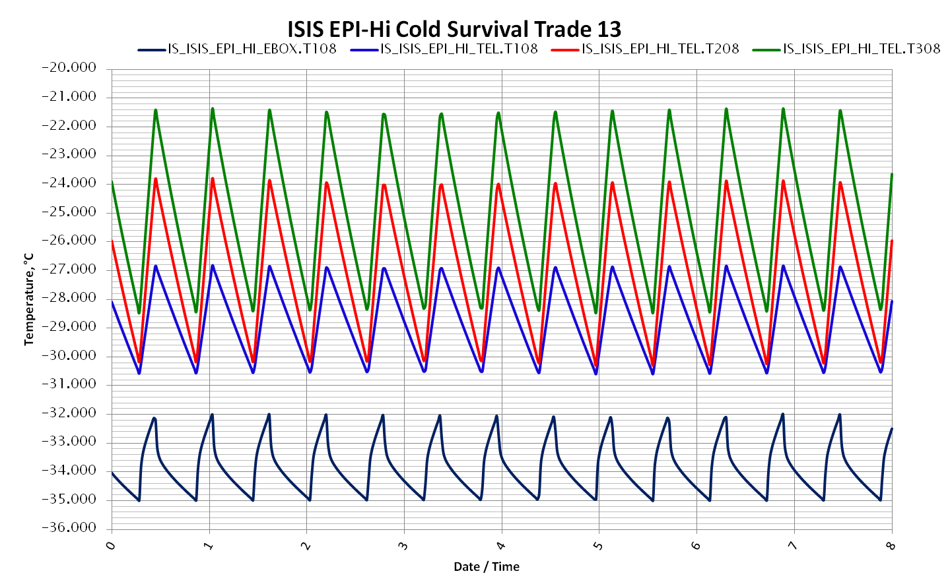
Predictions
EPI-Hi Cold Non-Operational Temperatures

Slide 19
Predictions
EPI-Hi Hot Non Operational

Slide 20
Predictions
EPI-Lo Hot Operational
Component | Limit (°C) | Predict (°C) | Margin (°C)
Detector | 35 | 24.62 | 10.4
Electronics | 55 | 33.01 | 21.99

Slide 21
Predictions
EPI-Lo Cold Operational
Component | Limit (°C) | Predict (°C) | Margin (°C)
Detector | -30 | -20.65 | 9.35
Electronics | -30 | -13.39 | 16.61

Slide 22
Predictions
EPI-Lo Cold Non Operational
Component | Limit (°C) | Predict (°C) | Margin (°C)
Detector | -45 | -40.24 | 4.76
Anode Board | -45 | -41.28 | 3.72
Event Board | -45 | -41.17 | 3.83
Power Board | -45 | -41.27 | 3.73
Dome | -45 | -40 | 5
 | Heater Power (W)
EPI-Lo Surv Heater | 2.45

Slide 23
Predictions
EPI-Lo Hot Non Operational

