Slide 1
ISIS Structural
Nick Alexander
Notes:
introduction

Slide 2
Outline
Summary of mechanical design/structural requirements
Description of the ISIS overall mechanical configuration
Description of the finite element models (FEMs) and load cases used to demonstrate structural integrity of applicable components
Information on structural design margins as well as plans for strength verification
Description of plans for fabrication of mechanical/structural items

Slide 3
Mechanical Design Requirements
ISIS bracket must hold EPI-Hi & EPI-Lo in position on the SPP deck
ISIS bracket must be capable of independently removing EPI-Hi & EPI-Lo, in either order
ISIS bracket must survive all environments for deck mounted components
  Minimum resonant frequency >80 Hz
  Random vibration
  Sine vibration
  Shock
All ISIS suite testing shall be performed on the bracket, with instruments or instrument analogs as appropriate

Slide 4
Mechanical Design Overview

Slide 5
FEM - Setup
Model includes bracket, EPI-Hi & EPI-Lo mass models (at max allocation) and thermal isolators
  Bracket & mass models assigned Aluminum 6061-T6 material properties
  Thermal isolators assigned G10 material properties
Mass models represent accurate mass & CG properties
  Test results will be easy to compare to model
  Mass models are stiff enough to not introduce modes
Edge to surface connections for all mounting interfaces
Fixed supports on all 10 bracket mounting holes

Slide 6
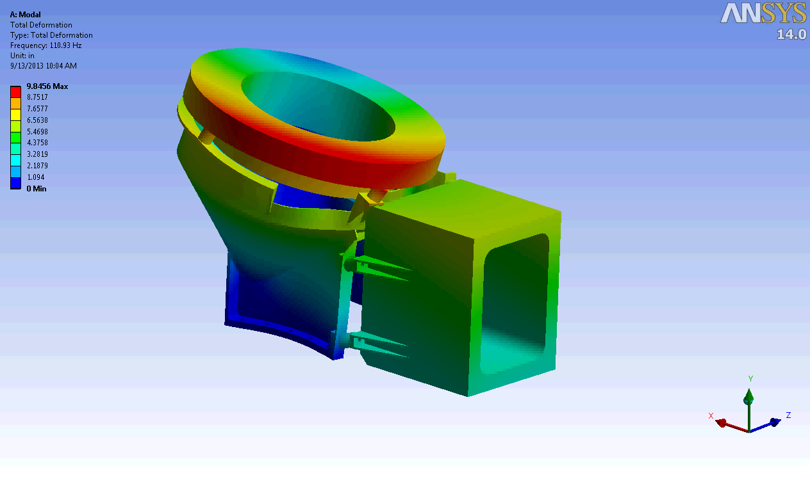
FEM - Modal Results

Slide 7
FEM - Structural Setup
Table 4‑8. Side Panels Mounted Components & Subsystems Normal To Panel
PSD G acceleration applied uni-axially, all 3 major axes
  2 direction lateral to panel, 1 direction normal to panel
PSD input from EDTRD
  Section 4.4.3, Tables 4-8 & 4-9
Frequency (Hz) | Qualification (G²/Hz) | Protoflight (G²/Hz) | Acceptance (G²/Hz)
20 | 0.01 | 0.01 | 0.01
60 | 1.25 | 1.25 | 0.63
200 | 1.25 | 1.25 | 0.63
350 | 0.04 | 0.04 | 0.04
500 | 0.04 | 0.04 | 0.04
2000 | 0.01 | 0.01 | 0.01
Overall Grms | 16.4 | 16.4 | 12.6
Duration (mins) | 2 | 1 | 1
Frequency (Hz) | Qualification (G²/Hz) | Protoflight (G²/Hz) | Acceptance (G²/Hz)
20 | 0.01 | 0.01 | 0.01
35 | 0.04 | 0.04 | 0.04
500 | 0.04 | 0.04 | 0.04
2000 | 0.01 | 0.01 | 0.01
Overall Grms | 6.8 | 6.8 | 6.8
Duration (mins) | 2 | 1 | 1
Table 4-8: Side Panels Mounted Components Normal to Panel
Table 4-9: Side Panels Mounted Components Lateral to Panel

Slide 8
FEM - Structural Results (Preliminary)
Still running stress cases
  Refining model to mitigate high stress concentrations
Need to perform bolt analysis for bracket mounting bolts

Slide 9
Structural Design Margins
Structural results must meet Safety Factors per EDTRD
  Section 4.4.2.2, Table 4-5 for Metallic Structures (Tested)
    Ultimate: 1.40 (Aluminum 6061-T6 F_{TU} = 42 ksi*)
    Yield: 1.25 (Aluminum 6061-T6 F_{TY} = 35 ksi*)
Margin of Safety must always be positive
  MS = Allowable/(FS x Applied) – 1.0
  Maximum Allowable Ultimate Stress = 30 ksi
  Maximum Allowable Yield Stress = 28 ksi
ISIS bracket will be exposed to random vibration with mass models attached for verification prior to EPI-Hi & EPI-Lo testing
*Per MIL-HDBK-5J

Slide 10
Bracket Fabrication
The ISIS bracket can be machined using conventional machining processes
  Monolithic design, will be machined from a single Aluminum block
  All operations can be performed on conventional machines (i.e. lathe, mill, etc.)
Thermal isolators & mass models will also be fabricated to be used during structural testing
Bracket height increase due to TPS shift can easily be accommodated as needed

