Slide 1
ISIS Power
David Do
Notes:
introduction

Slide 2
Outline
EPI-Lo and EPI-Hi LVPS
  Power requirements
  Block diagrams
  Circuit topologies and descriptions
  Circuit margins
  Packaging
  Thermal management
Plans for testing including bench checkout equipment
Maturity of the design (BB testing, design, analysis completed)
Preliminary parts lists and any special testing required
Summary and follow-up from peer review held prior to the instrument PDR

Slide 3
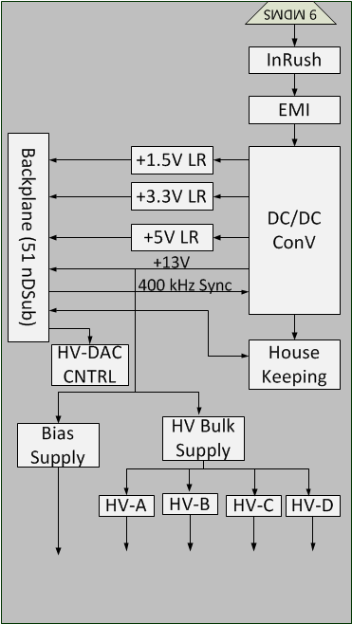
Block Diagram
Need Update

Slide 4
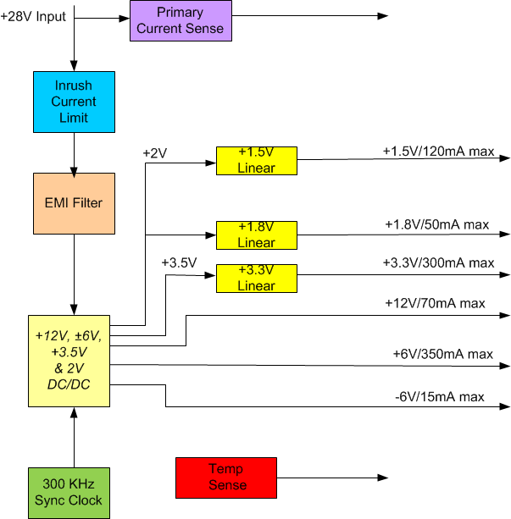
EPI-Hi Block Diagram
Need Update

Slide 5
Environment
Operating Temp: -30°C to +60°C
Radiation: 100Krad, 82MeV

Slide 6
Input Power Requirement
  Input voltage: 24V- 35V, 28V nominal
  1Mohm isolation minimum
  EMI/EMC
  Inrush Current
CE01& CE03 Limit
In-Rush Current Limit

Slide 7
Power Topology
Main converter is forward with resonant reset operating at 200kHz. Efficiency is >80%.
Digital voltages are linear regulated
Bulk high voltage is set at 3.5kV
High voltages of up to 3.4kV are controlled through Optocouplers

Slide 8
EPI-Lo Output Requirement
 | Outputs Regulation | Min Load (mA) | Nom Load (mA) | Max Load (mA)
+1.5V | ±3% | 45 | 80 | 200
+3.3V | ±3% | 150 | 200 | 460
+5V | ±5% | 115 | 135 | 160
+13V | ±5% | 10 | 63 | 90

Slide 9
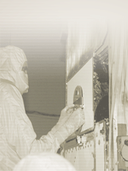
Sensor Voltages
Collimators
Grounded Foils
Tecan Grid
SSD
1000V
100V
+ 900V
MCP
MCP
+3200V
+3400V
200V
Anode/Preamp
900V (total diode drop)
MCP Return is a ground reference at HVPS (allows MCP current measurement across resistor)
MCP return
HVPS Out +3400V

Slide 10
EPI-Lo HVPS
 | Max Output Voltage (V) | Min Load (uA) | Max Load (uA)
Bias | 200 | 0 | 20
Bulk | 3500 | 0 | 200
HVPS | 3400 | 0 | 40
Grid | 1000 | 0 | 1
MCP | 900 | 0 | 40

Slide 11
EPI-Hi Output Requirements
 | Output Regulation | Min Load (mA) | Nom Load (mA) | Max Load (mA)
+1.5V | ±2.5% | 50 | 100 | 150
+1.8V | ±2.5% | 20 | 40 | 60
+3.3V | ±2.5% | 145 | 287 | 430
+6V | ±5% | 79 | 338 | 500
+12V | ±7% | 8 | 16 | 64
-6V | ±7% | 6 | 12.6 | 19

Slide 12
Thermal Analysis

Slide 13
LVDS Fault Mitigation
Transformer: primary and 3.3V winding is well isolated
+3.3V is linear regulated from +3.5V
+3.5V is monitored on housekeeping

Slide 14
Packaging

Slide 15
Peer Reviews
EPI-Hi LVPS: May 2013
EPI-Lo Power: Aug 2013
Major Action Items:
  EPI-Hi:
    Shielding over switching circuits
    Output Loads
    Output Regulations
  EPI-Lo:
    MCP voltage accuracy
    LVDS fault mitigation
    Bias Voltage Zener diode protection

Slide 16
Breadboard Testings

Slide 17
Analysis
Preliminary EMI completed
Worst Case analysis for digital voltages completed

Slide 18
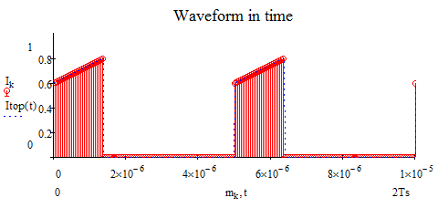
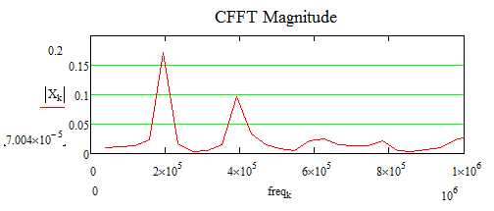
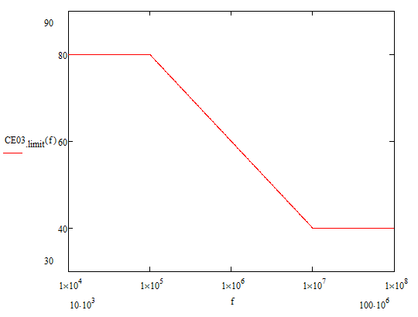
EPI-Lo EMI Analysis
Primary Current in Discrete Time
Primary Current in CFFT
CE03 Limit
EMI Filter Attenuation

