Slide 1
EPI-Hi Flight Software
Andrew Davis, Rick Cook
Notes:
introduction

Slide 2
Outline
Software requirements, software design and functionality, software documentation and unit testing as well as plans for software integration, testing and verification at the instrument level
Plans for software maintenance for the duration of the mission
Description of the software development environment and plans for preserving the development environment
Maturity of the design
Summary and follow-up from peer review held prior to the instrument PDR
Notes:
NOTE: this is the outline provided by Scott

Slide 3
Software Requirements
The Flight Software Requirements Document details the flow-down from higher-level requirements, and from GIS and SIS ICDs
These requirements are quite similar to those for our work on recent NuSTAR and STEREO missions
The same modular flight processor and software architecture that we used for NuSTAR and STEREO will meet the EPI-Hi requirements
The requirements are mapped into a set of modular software tasks, implemented on the EPI-Hi flight processors

Slide 4
Documentation Status
Document | Status/due date
Flight Software Requirements | Baseline draft Delivered
Flight Software Development Plan | Baseline draft Delivered
Flight Software Design Document | Prelim draft delivered at PDR
Flight Software Test Plan | Due by CDR
Test verification matrix | Due by CDR
Instrument Telemetry Data Format Document | Due by CDR
P24 MISC Processor Manual | Delivered

Slide 5
Processor and Software Architecture
Software distributed across 4 Minimal Instruction Set Computers (MISCs)
1 MISC in DPU, 1 each in LET1, LET2, HET
Custom FPGA-embedded micro-controller
Design implemented in Actel RTAX250SL
Architecture used in STEREO and NuSTAR space missions
24-bit CPU, up to 512 Kwords SRAM, Forth operating system, can boot from MRAM or serial interface
Only DPU MISC has MRAM (2M×8).
DPU can boot from MRAM, or via serial uplink from ground
The three “satellite” MISCs communicate with DPU MISC via RS-422 serial links, 460.8kbps
Satellite MISCs booted via serial link by DPU MISC
Satellite MISCs use boot images from DPU MRAM
Notes:
The P24 MISC has a 24-bit CPU core with dual stack architecture intended to efficiently execute Forth-like instructions. The processor design is simple to allow implementation within field programmable gate arrays. The basic MISC processor design is in the public domain. For the EPI-Hi application, the MISC design is implemented in the ACTEL RTAX250SL FPGA, with Caltech SRL customizations developed for the STEREO mission. The MISC can be clocked at speeds up to 25MHz; we will use [14.7] MHz (TBC) for the EPI-Hi application.
See the P24 MISC Processor Manual and Software Dev plan for more details.

Slide 6
Processor and Software Architecture
Notes:
Data from the MISCs associated with the LET1, LET2 and HET telescopes (the peripheral MISCs) will be gathered by the DPU MISC and formatted for transmission to the spacecraft (per the SPP GIS
Interface between the EPI-Hi DPU and the spacecraft
The DPU MISC will interface with the spacecraft via two serial interfaces: command and telemetry (see Figure 2.1). These interfaces are defined in the SPP GIS. Commands, telemetry data and command responses from the DPU will be in the form of CCSDS packets enclosed within Instrument Transfer Frames (ITFs). The ITF protocols for transferring commands, command responses, and telemetry data over these interfaces are also defined in the EPI-Hi Instrument/Spacecraft ICD. Instrument telemetry data formats, and instrument CCSDS data packet definitions will be defined in the EPI-Hi Instrument Science Data Format document (Ref. 9).
Interface between the DPU MISC and the LET1, LET2, and HET MISCs
There will be two RS422 serial interfaces between the DPU MISC and each of the three peripheral MISCs (LET1, LET1, and HET MISCs). The first interface will be bi-directional, for transferring boot-code, commands, and command responses. The second interface will be uni-directional, for transferring data from the peripheral MISCs to the DPU. These interfaces will be defined in the EPI-Hi Inter-MISC command/data interface Document (Ref. 8).

Slide 7
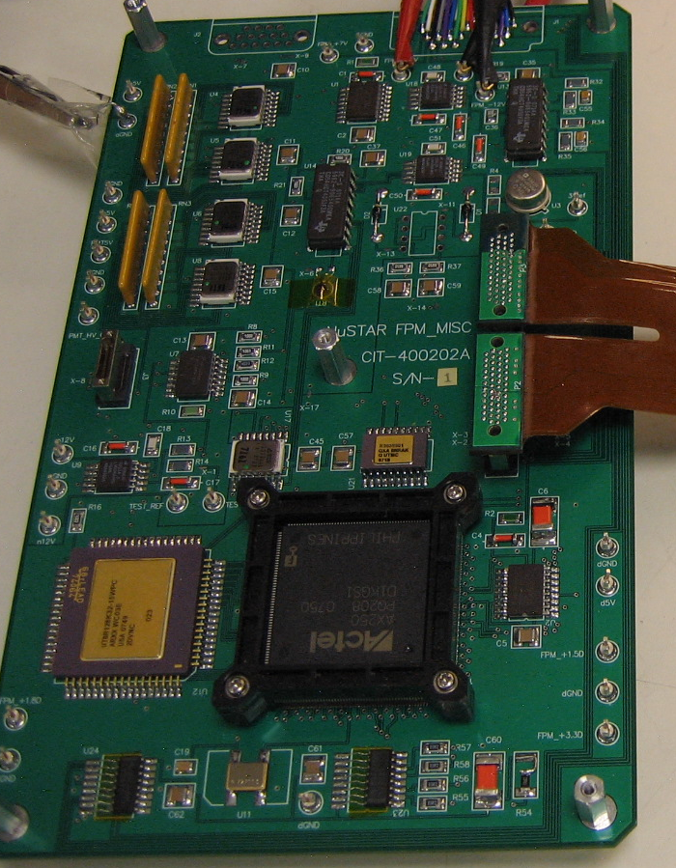
Development Environment
Initial testing of new code takes place on MISC development boards
Forth system on development boards accessed via serial link to PC
New code is easily uploaded via the serial link
Testing of code that accesses hardware is done on EM units
Low-level MISC I/O routines are in everyday lab use, where MISCs are used to acquire test data and control test runs
The same central MISC / multiple satellite MISC architecture was used for NuSTAR and STEREO
EM units are preserved after launch, and used for testing/verification of software uploads and command sequences
NuSTAR MISC EM board
Notes:
Update with EPI-Hi EM board pic?

Slide 8
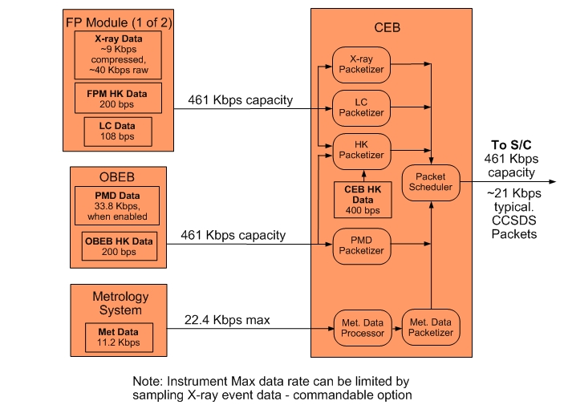
Instrument Data Flow
NuSTAR version – to be updated for EPI-Hi
Notes:
NuSTAR version - To be updated for EPI-Hi

Slide 9
DPU Software Tasks
Forth operating system and low-level I/O routines
Power-on and initialization sequence management
Satellite MISC serial boot sequence management
Housekeeping data collection
Inter-MISC communication management, and data acquisition/buffering from satellite MISCs
Setup and control of instrument LVPS, bias supply, heaters, and other electronics systems
Receive/Monitor status and time-synchronization data from the spacecraft, and perform autonomous mode adjustments as needed
Management of software uploads and MRAM “burns”
Formatting and transfer of science & housekeeping data and command responses to the Spacecraft
Monitor heartbeat from peripheral MISCs, and perform autonomous diagnostics/reboot as needed

Slide 10
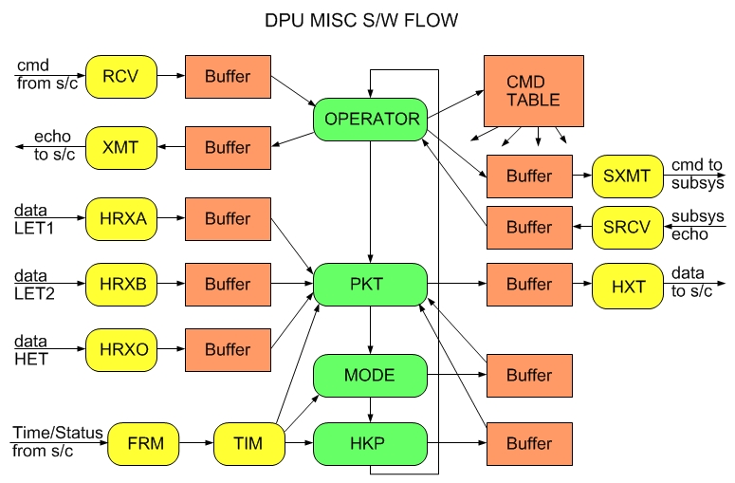
Software Flow – DPU MISC
Notes:
Needs review/update by Rick Cook – will the Time/Status message from S/C generate a FRM interrupt?

Slide 11
Satellite MISC Software Tasks
Forth operating system and low-level I/O routines
Science data acquisition
Science data processing and reduction (particle ID)
Housekeeping data acquisition
Processing of status, time-synchronization, and command data from the EPI-Hi DPU
Monitor key counting rates and adjust the telescope operating condition to optimize data quality
Monitor temperatures and adjust detector gain/offset settings to compensate for temperature variations
Formatting and transfer of science & housekeeping data and command responses to the EPI-Hi DPU
Setup and control of any instrument HV, bias supply, heaters, etc. not controlled by the EPI-Hi DPU.

Slide 12
Software Flow – HET MISC
TBD
Notes:
Need a software flow diagram for one of the LET/HET MISCs - TBD

Slide 13
Integration, Testing and Verification
The EPI-Hi Flight Software Test Plan document will define this plan in detail. This plan will include a software requirements verification matrix.
Software tests will start at the module level. As the code builds up, system-level testing will start, and the majority of the test time will be targeted at the system level.
A Test Readiness Review will precede formal acceptance testing. SPP Project and ISIS personnel will oversee/participate in this review.
Formal acceptance tests will be performed on the EPI-Hi instrument, including the flight software, during the EPI-Hi integration and test phase.
During environmental tests and SPP I&T, more experience will be gained with the flight software, real sensor data, and with controlling the instrument via the SOC-MOC interfaces. Flight software changes may be expected as a result. Any changes in the flight software at this stage will result in CCB review, and a repeat of these acceptance tests.
The acceptance tests for the EPI-Hi flight software will be designed to verify each of the software functional requirements as called out in the requirements documents and also the functions provided by the Forth operating system, the I/O API, and the multitasking software running on the MISC processors.
A software requirements verification matrix will be created and maintained by the EPI-Hi team to aid in verifying that the software meets the requirements. The matrix will be available for review by the SPP Project. A preliminary software requirements verification matrix will be presented at CDR and a final version will be presented at the Software Acceptance Review, following successful completion of the acceptance tests.
A Software Acceptance Review will follow the successful completion of the acceptance tests, and the EPI-Hi team will present a test report. SPP Project will oversee/participate in this review.

Slide 14
Software Maintenance, Configuration Management
Version control and software archiving: achieved via Subversion version control system (SVN) (http://subversion.apache.org/). The subversion server is hosted and maintained by Caltech Space Radiation Lab IT personnel. It is access-controlled for security, and is backed-up regularly.
The lead engineer will maintain the structure of the SVN repository, including separate directories for each of the MISC’s flight software, separate directories for different software builds, etc.
All problems and change requests will be documented/tracked in the Software Development Log by the lead engineer. Given such a small dev team, a change request tool such as JIRA is an unnecessary overhead.
After the beginning of I&T with flight hardware, all flight software changes will be approved by a CCB prior to being loaded into flight hardware. Also after this point, Version Description Documents (VDDs) will accompany all Software releases. The VDD will contain the functionality of the release, a list of closed software problem reports, a list of any liens/workarounds, installation instructions, and a list of deliverable source code files.
The CCB membership will consist of the EPI-Hi lead engineer and software developer, and the Epi-Hi Project Manager, plus any other ISIS or SPP Project engineers that the QA team at SWRI deems necessary.
Notes:
More details in Dev plan

Slide 15
Software Status and Margins
TBD
Provide estimates of % complete status of the various software tasks
Provide estimates of CPU, RAM, MRAM margins

Slide 16
Pre-PDR Peer Review Summary
TBD

