Slide 1
EPI-Hi Sensor System

Slide 2
Outline
requirements
system overview (?)
detector telescopes
measurement capabilities
energy range and resolution
fields of view and angular sectoring
species coverage / composition
cadences
dynamic range in particle intensities
expected performance compared with requirements
maturity of design
system testing approach
summary and peer-review follow-up

Slide 3
EPI-Hi Measurement Requirements
Protons and Heavy Ions
energy range: 1 MeV/nuc (TBR) to ≥50 MeV/nuc
energy binning: ≥6 bins per decade
cadence: at least energy bin with time resolution of 5 s or better
FoV: ≥π/2 sr in sunward and anti-sunward hemipsheres (incl. 10° from S/C-Sun line)
angular sectoring: ≤30° sector width
composition: at least H, He, C, O, Ne, Mg, Si, Fe, ³He
species resolution: FWHM ≤ 0.5 (TBR) × separation from nearest abundant neighbor
max intensity: up to 10% (TBR) of upper limit proton spectrum from EDTRD
Electrons
energy range: 0.5 MeV (TBR) to ≥3 MeV
energy binning: ≥6 bins per decade
cadence: at least energy bin with time resolution of 1 s or better
FoV: ≥π/2 sr in sunward and anti-sunward hemipsheres (incl. 10° from S/C-Sun line)
angular sectoring: ≤45° sector width
max intensity: up to 10% (TBR) of upper limit electron spectrum from EDTRD*
*Note: upper limit electron spectrum not yet specified in EDTRD

Slide 4
EPI-Hi Sensor System Overview
Sensor Approach:
all sensor elements are silicon solid state detectors
multiple detector telescopes to provide large energy range and sky coverage
some telescopes double ended to increase sky coverage
detector segmentation to provide angular sectoring and adjustable geometrical factor
Heritage:
numerous energetic particle instruments over the past 40 years
direct predecessor: STEREO/LET & HET
Key Differences:
thinner detectors and windows to reduce energy threshold
compact telescope designs to reduce saturation at high particle intensities and backgrounds at low intensities

Slide 5
EPI-Hi Block Diagram
3 detector telescopes:
one double-ended low-energy telescope (LET1)
one single-ended low-energy telescope (LET2)
one double-ended high-energy telescope (HET)
all sensor elements are ion-implanted silicon solid-state detectors
signals from each telescope processed by an individual electronics board

Slide 6
Low-Energy Telescopes: LET1 and LET2
Energy Range
Stack Thickness through L4B: 3.5 mm of Si
highest stopping energies:
H & He: ~25 MeV/nuc
C: ~45 MeV/nuc
Fe: ~100 MeV/nuc
e: ~1.3 MeV
Front Detector Thickness: 12 μm Si
Combined window thicknesses: 3 μm Si equiv.
energies to penetrate windows + first detector:
H: ~1.0 MeV
He: ~0.9 MeV/nuc
C: ~1.3 MeV/nuc
Fe: ~1.5 MeV/nuc
e: ~0.4 MeV (penetration to L3)
HET2 is single ended and identical to HET1 down through L3B
Need to replace figure with version that includes inactive elements (windows, housing, etc.)

Slide 7
High-Energy Telescope: HET
Energy Range
Stack Thickness: 15 mm of Si
highest stopping energies:
H & He: ~55 MeV/nuc
C: ~100 MeV/nuc
Fe: ~230 MeV/nuc
e: ~6 MeV
Front Detector Thickness: 0.5 mm Si
energies to penetrate windows + first detector:
H & He: ~10 MeV/nuc
C: ~18 MeV/nuc
Fe: ~36 MeV/nuc
e: ~0.4 MeV
colored regions: active Si
uncolored: inactive material

Slide 8
Solid State Detector Designs
Add table of thicknesses, sizes, segmentation with accompanying drawings or photographs, as available.
Indicate that the thin detectors are technology development item that will be discussed in a subsequent presentation.

Slide 9
Measurement Capabilities:
Energy Range and Resolution
Insert Species versus Energy Plot Showing Planned Binning
Include both LETs and HET
Include show bins both with and without sectoring
This is similar to the chart needed for showing measurement cadences (for which there is presently a placeholder slide later in this package). It may be possible to combine the two into a single slide.

Slide 10
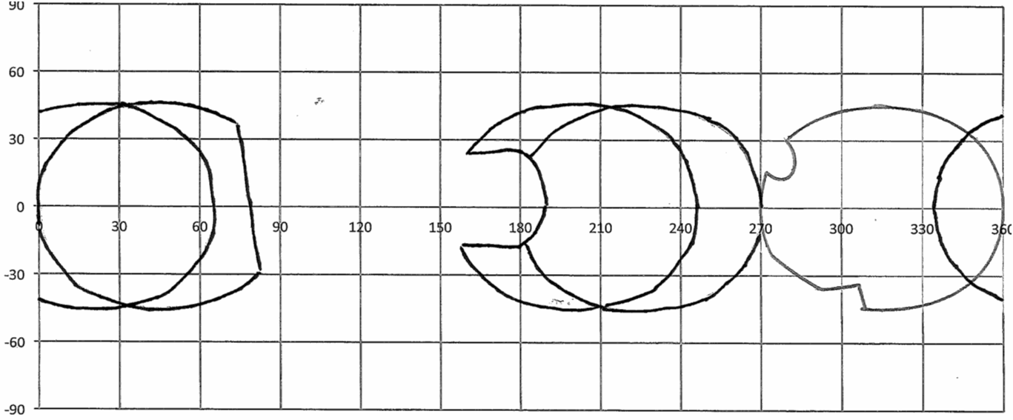
Measurement Capabilities:
Fields of View
five 45°-degree half-angle view cones
HET
aft
LET1
aft
HET
forward
LET1
forward
HET
aft
LET2
region blocked by spacecraft
TPS
replace with better version of this figure after confirming determining whether the FoVs shown here (from January 2011) are still correct
regions with full energy coverage

Slide 11
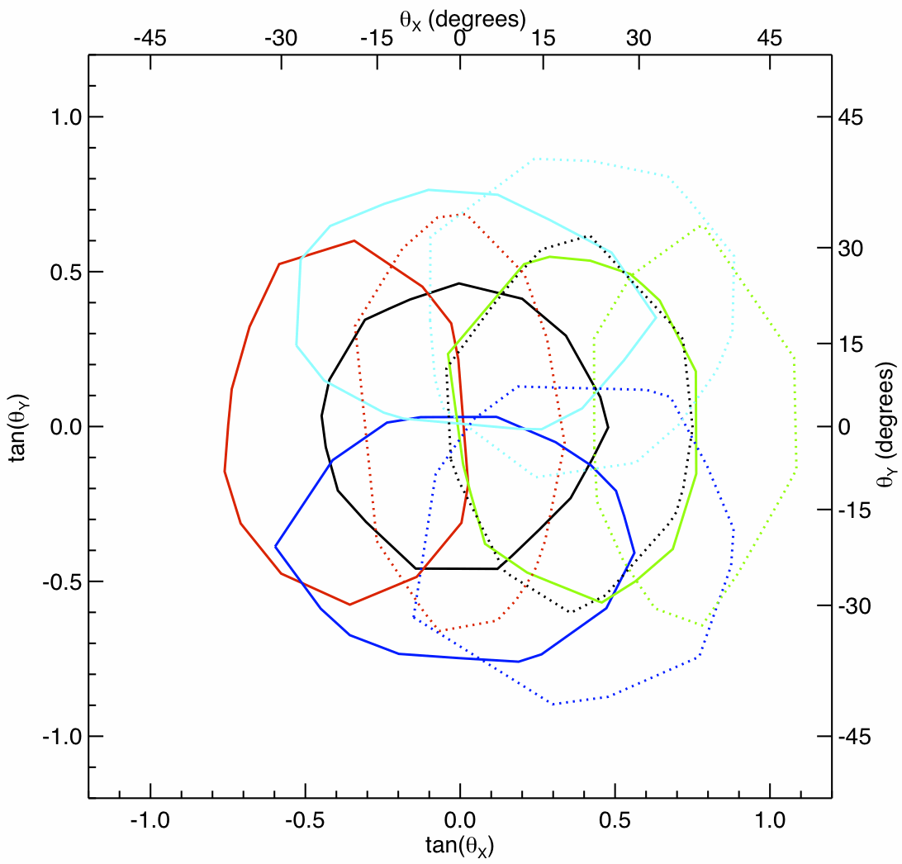
Measurement Capabilities:
Angular Sectoring
Particle direction of incidence determined based on active element hit in two position-sensitive Si detectors (L0 and L1, L1 and L2, or H1 and H2)
each of these detectors has central bull’s eye surrounded by 4 quadrants
area of each active element is 0.2 cm²
quadrants in the second detector rotated 45° relative to those in the first first
25 combinations of hit elements in the two detectors used to assign event to a viewing sector
HET provides sectored electron data, LET1 provides only front-back direction information for electrons
Illustration of selected angular sector boundaries: to be replaced with new version including all 25 sectors made with higher statistics to better define boundaries and with boundaries adjusted to enclose selected fraction (e.g., 90%) of the particles in the sector.

Slide 12
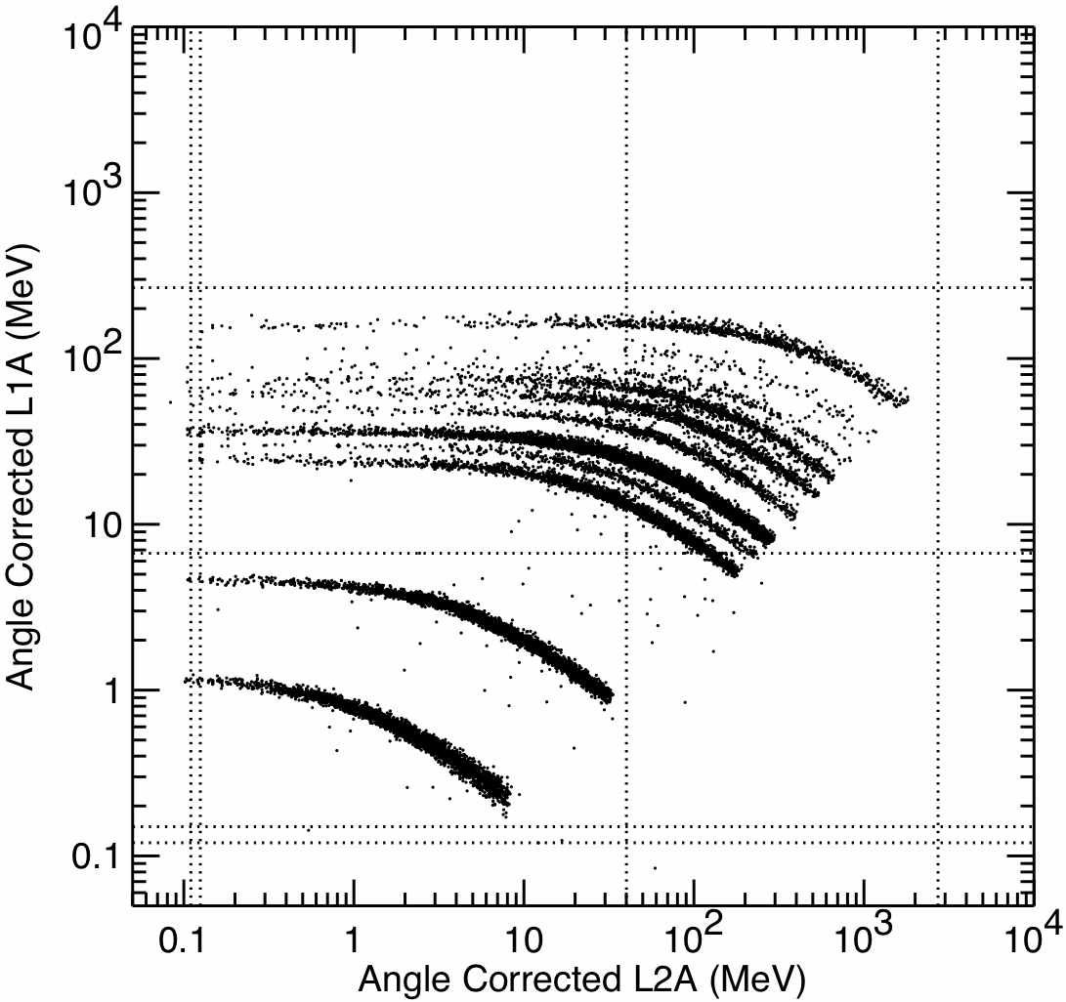
Measurement Capabilities:
Species Coverage / Elemental Composition
Energy loss measurements from the detector in which a particle stops (E’) and the preceding detector (ΔE) organize the data into distinct tracks for the various elements.
Sector information is used to obtain mean thickness penetrated in the ΔE detector and make an on-board correction to the measured energies to optimize species resolution.
Energy assigned on board includes energies measured in overlying detectors and calculated energy loss in windows.
Monte Carlo simulation of ion response.
Example:
ΔE measured in L1A (25 μm)
E’ measured in L2A (500 μm)
all incidence directions included
Fe
Si
O
Ne
C
He
H
Species resolution for L0 vs L1 will be a bit poorer than shown in this example. Could include L0 vs L1 plot as a backup slide.

Slide 13
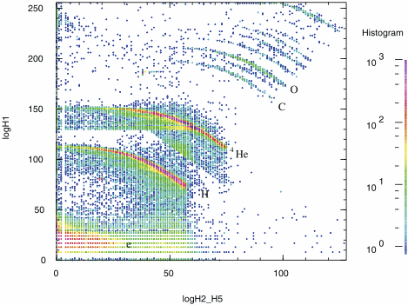
Measurement Capabilities:
Electron Identification
Measurements from the STEREO/HET telescope in the 13 Dec 2013 SEP event
(von Rosenvinge et al. 2008)
Ideally we should replace this figure with a Monte Carlo simulation of the EPI-Hi/HET electron response because the front detector in EPI-Hi is thinner than that used for STEREO/HET (500μm vs 1000μm). It is not clear that there will be time to do the necessary simulation before the PDR package needs to be finalized in mid-October.
electrons

Slide 14
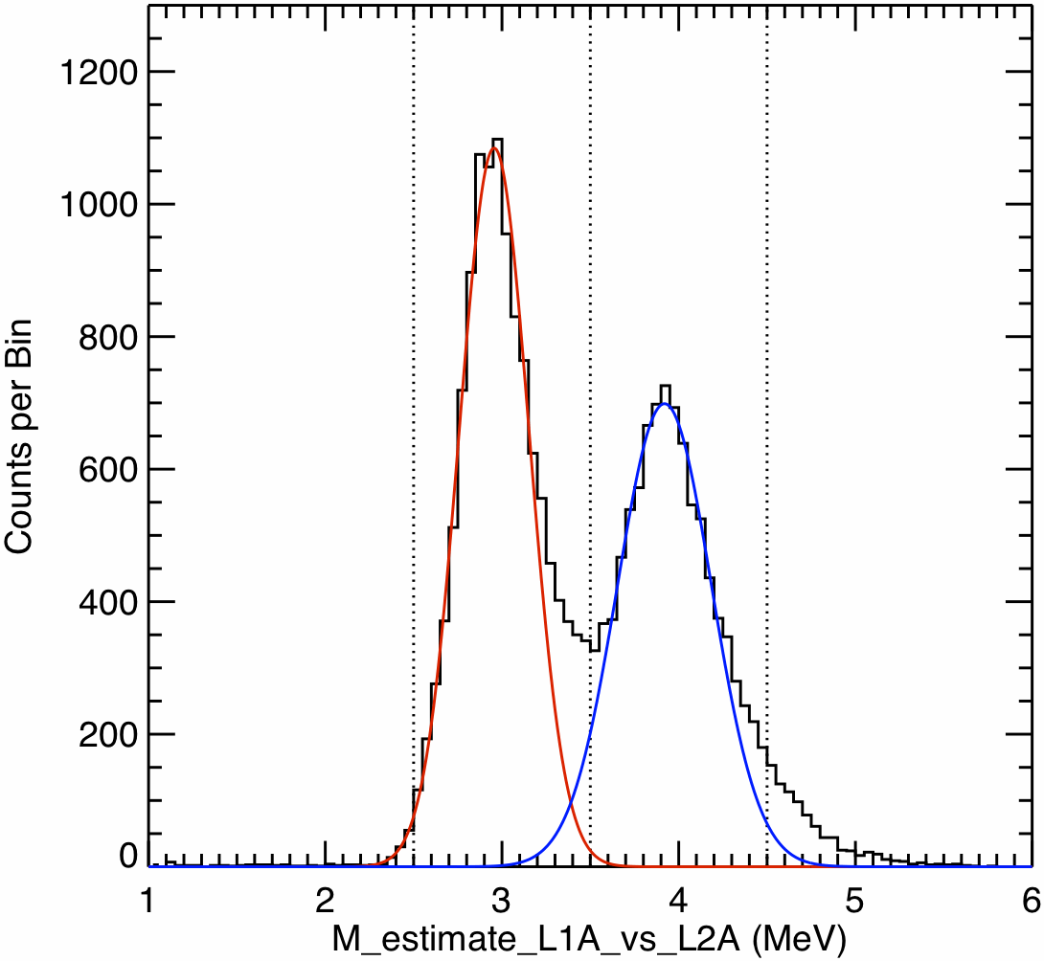
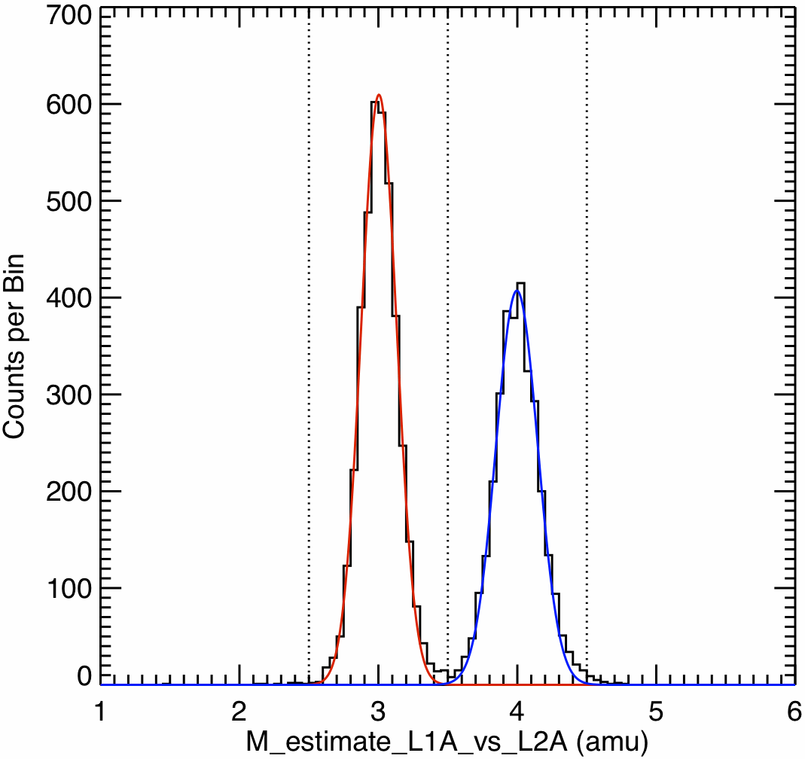
Measurement Capabilities:
Helium Isotope Identification
geometry defined by L0•L1•L2 coincidence (~1/4 of L1•L2 geometry)
full geometry defined by L1•L2 coincidence
FWHM:
³He 0.47 amu
⁴He 0.64 amu
FWHM:
³He 0.30 amu
⁴He 0.35 amu
Monte Carlo simulation of He isotope resolution: example based on L1A vs L2A
resolution dominated by effect of incidence angle uncertainty on ΔE thickness penetrated
restricting analysis to narrow-angle sectors gives higher resolution dataset
other effects (e.g., channeling) limit measurable ³He/⁴He ratio at energies of a few MeV/nuc to >~5%

Slide 15
Measurement Capabilities:
Cadences
Insert a table containing high-level summary of cadences for the various species/energy/angle bins for both telescopes.
It may be possible to combine this slide with that showing energy range and resolution.

Slide 16
Measurement Capabilities:
Dynamic Range in Particle Intensities
Close to perihelion the expected peak intensities in the largest SEP events are extreme: ~6×10⁷ protons/cm²-sr-s above 5 MeV estimated as worst-case (95% confidence) peak intensity in EDTRD
Calculated count rates for this worse case spectrum:
LET1
LET2
HET
Front-end electronics can process slightly more than 10⁵ events/s, as demonstrated on STREREO
Instrument design allows reduction of geometrical factor in a series of steps to allow measurements over a large dynamic range in intensities
“Dynamic threshold” approach successfully used in STEREO/LET and HET instruments
Need to add additional text (possibly with a figure) discussing successive steps used to handle high rates: dynamic threshold approach (example from STEREO?), small pixels, reliance on HET when LET becomes saturated. Also need to discuss expected capabilities in small events.

