Slide 1
EPI-Lo Sensor
Prepared by: Matt Hill
Notes:
introduction

Slide 2
Outline EPI-Lo Sensor Design
ISIS Science Requirements Relevant for EPI-Lo
EPI-Lo Instrument
Block Diagrams
Principles of Operation Overview
Electrostatic Optics
Collimators and Start Foils
Solid State Detectors & Stop Foils
  Anti-coincidence System
Microchannel Plate (MCP)
Mass Resolution (??)
Follow-up from peer reviews
Summary

Slide 3
EPI-Lo Focused Science Requirements
 | Intensity | FOV | etc.
Ions
Electrons
etc.

Slide 4
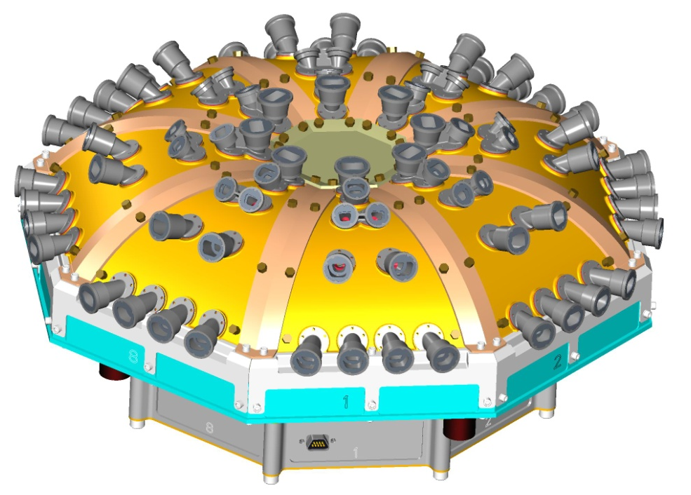
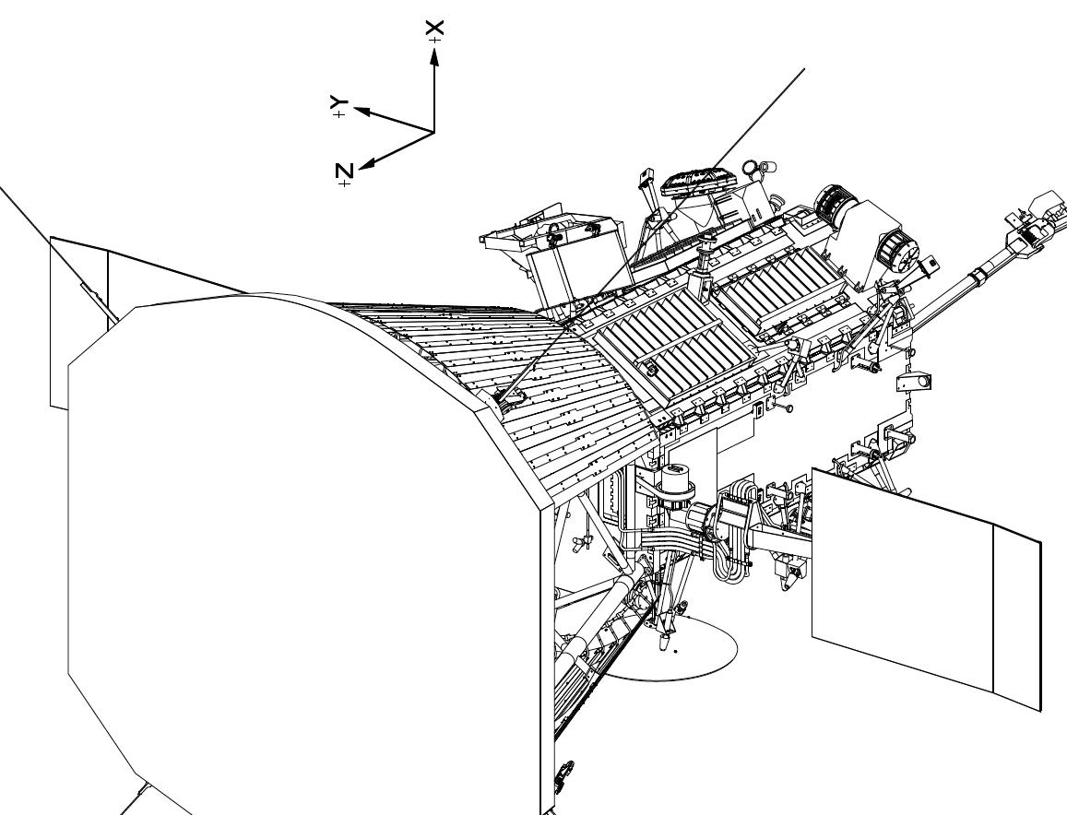
The EPI-Lo Instrument

Slide 5
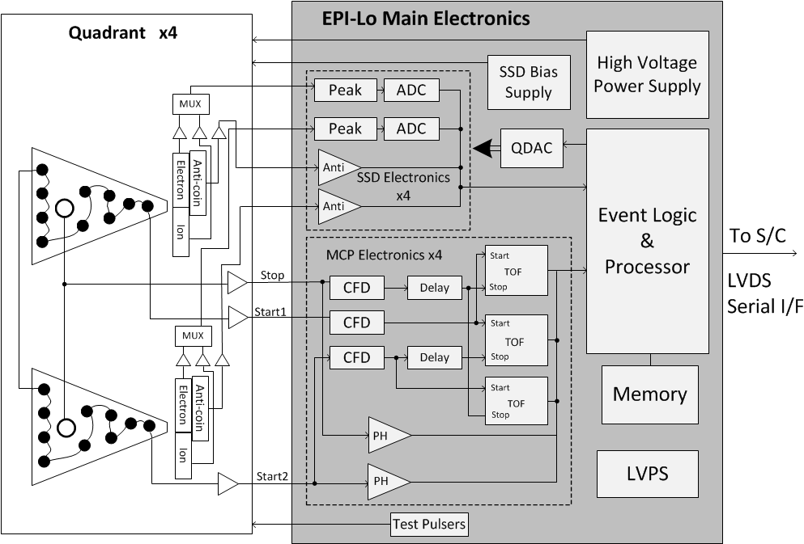
EPI-Lo Block Diagram

Slide 6
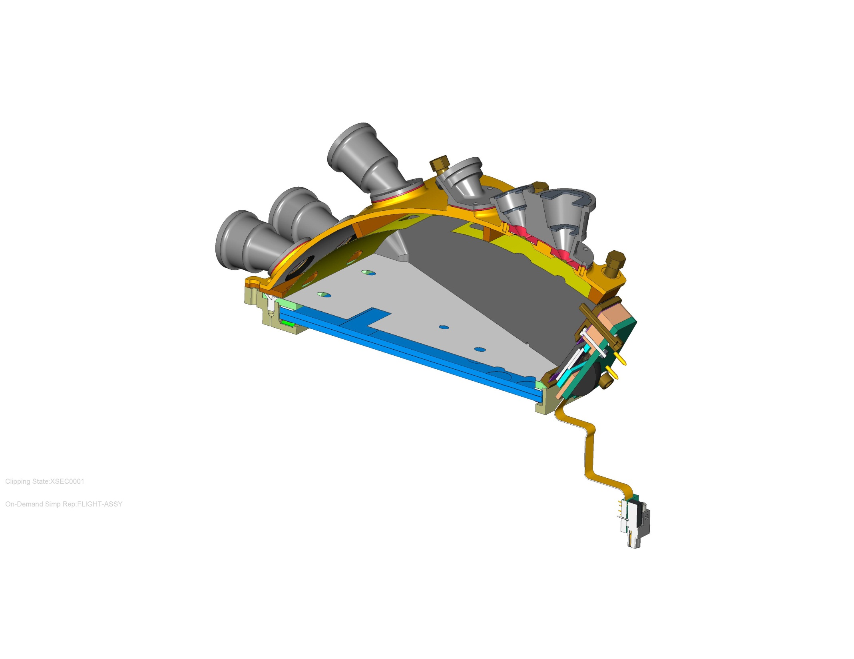
Principles of Operation
First
  xxxxx
  xxxxxx
Second
Third
  xxxxxx
  xxxx
Forth
  xxxxxxx
  xxxxxx

Slide 7
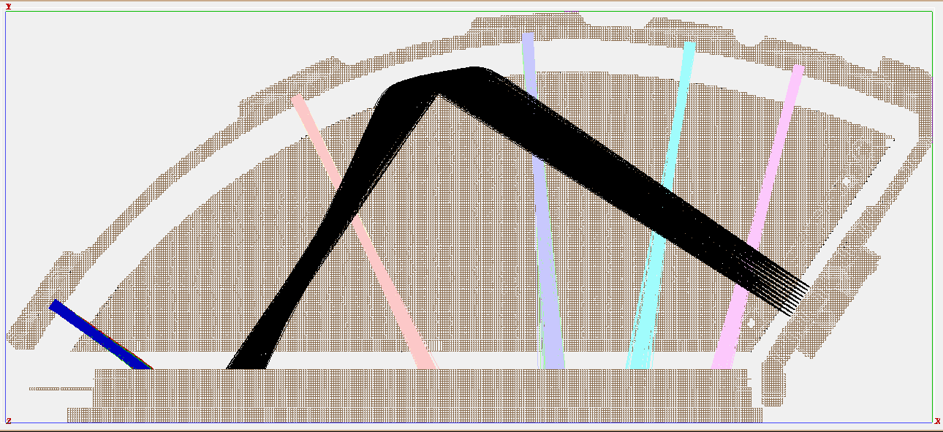
Electrostatic Optics
First
  xxxxx
  xxxxxx
Second
Third
  xxxxxx
  xxxx
Forth
  xxxxxxx
  xxxxxx

Slide 8
Collimators and Start Foils
First
  xxxxx
  xxxxxx
Second
Third
  xxxxxx
  xxxx
Forth
  xxxxxxx
  xxxxxx

Slide 9
Solid State Detector and Stop Foils
First
  xxxxx
  xxxxxx
Second
Third
  xxxxxx
  xxxx
Forth
  xxxxxxx
  xxxxxx

Slide 10
Anti-coincidence System
First
  xxxxx
  xxxxxx
Second
Third
  xxxxxx
  xxxx
Forth
  xxxxxxx
  xxxxxx

Slide 11
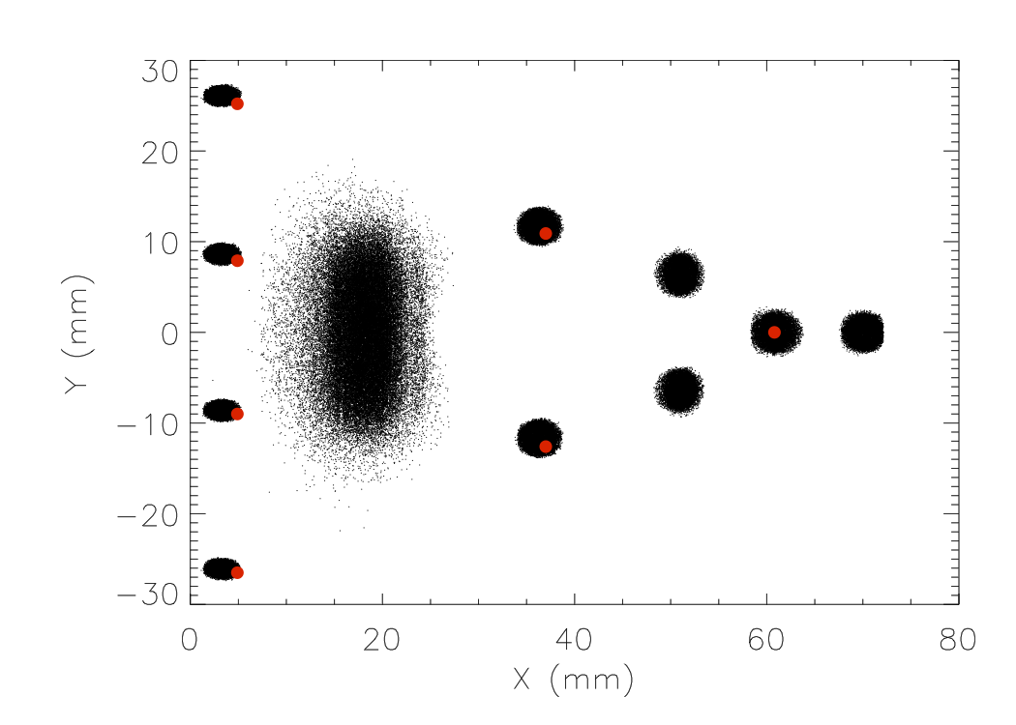
Microchannel Plate (MCP)
First
  xxxxx
  xxxxxx
Second
Third
  xxxxxx
  xxxx
Forth
  xxxxxxx
  xxxxxx

Slide 12
Mass Resolution
First
  xxxxx
  xxxxxx
Second
Third
  xxxxxx
  xxxx
Forth
  xxxxxxx
  xxxxxx

Slide 13
Follow Up from Peer Reviews
First
  xxxxx
  xxxxxx
Second
Third
  xxxxxx
  xxxx
Forth
  xxxxxxx
  xxxxxx

Slide 14
Summary
First
  xxxxx
  xxxxxx
Second
Third
  xxxxxx
  xxxx
Forth
  xxxxxxx
  xxxxxx

