Slide 1
EPI-Lo Technology Development
EARLY DRAFT
Reid Gurnee
Notes:
introduction

Slide 2
Outline
EPI-Lo Technology Developments to TRL6
Performance requirements and derivation
Energy System Development
  Fidelity of Test Article
  Test and Analysis Results
  Transition to Flight
Sensor / Timing System Development
  Fidelity of Test Article
  Test and Analysis Results
  Transition to Flight
TOF/CFDD ASIC Development
  Fidelity of Test Article
  Test and Analysis Results
  Transition to Flight
Update to match
presentation

Slide 3
EPI-Lo Technology Developments to TRL6
Energy and TOF performance to meet 3He / 4He separation
  Validate one anode covering two quadrants has adequate timing performance
  Validate SSD has adequate energy performance
  3He, 4He: 0.5 FWHM AMU
  for incoming energies between ≤0.2 MeV and ≥2.0MeV
TOF and CFD ASIC development

Slide 4
EPI-Lo Performance Modeling
Species composition driven by two systems, energy system and timing system
Two independent models used
  Monte-Carlo
    Inputs are timing noise, SSD noise, and path length variation
  Inputs can by any distribution (not limited to Gaussian)
  Analytical
    Inputs are timing noise, SSD noise, and path length variation
    All inputs are Gaussian
  The two models have been compared and shown to give similar results
  Does not include foil losses (not significant for 200keV He)
Modeling shows 400nS FWHM, 15keV FWHM performance comfortably meets requirements

Slide 5


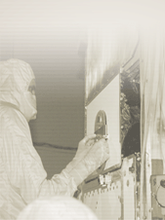
22.5 degree aperture
Mass is calculated by
Therefore uncertainty is mass measurement is
He separation requirement

Slide 6
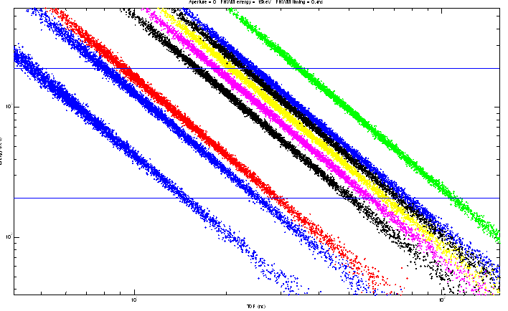
Track Simulations
Monte-carlo model for all species

Slide 7
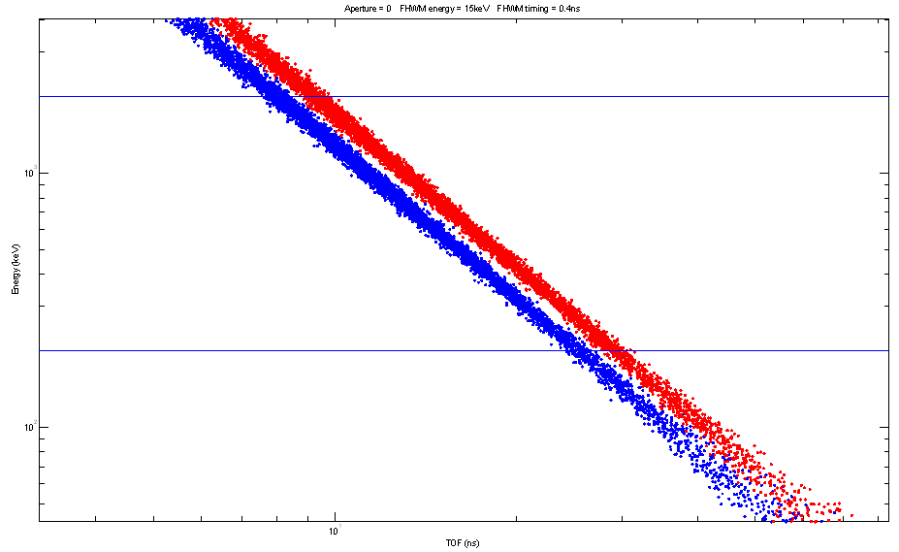
He3/He4 separation
Monte-carlo model shows separation of He3/He4 over 200 keV to 2 MeV

Slide 8
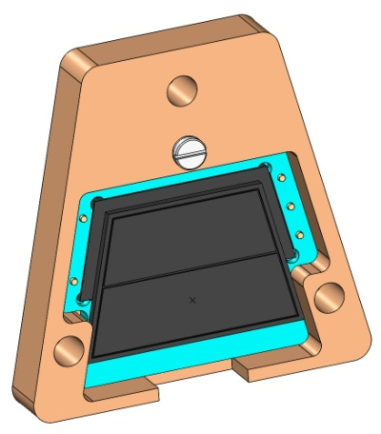
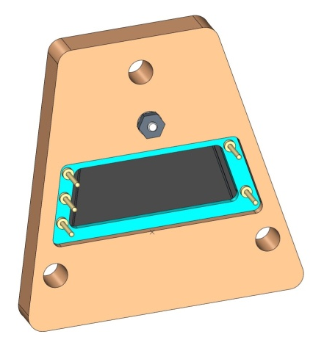
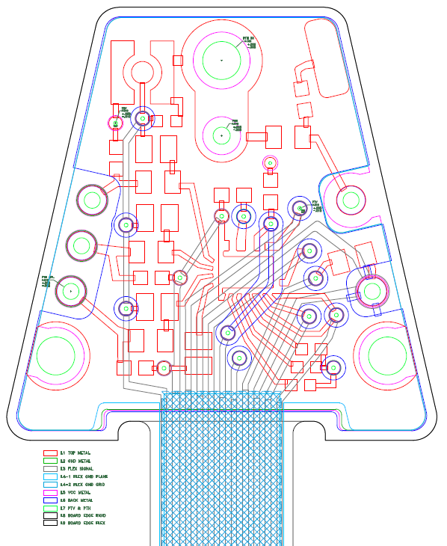
Energy System Development
Solid State Detector is fabricated and mounted to carrier board
Energy board is fabricated and populated
All components nearly identical to flight – no design changes expected
Expect SSD tested
with energy board by early Oct
Add photos of hardware

Slide 9
RBSPICE DATA with 60keV X-ray source
FWHM in keV
SSD performance base-lined on RBSPICE instrument tested with 60keV Xray
Performance is ~11keV FWHM
Expect SSD tested
with energy board by early Oct
Add test data
If data not available use puck test data

Slide 10
Timing performance: Timing Budget
CFD: 200pS
TOF ASIC: 200pS
Electron Dispersion: 200pS
Total: 350pS (requirement is 400pS)

Slide 11
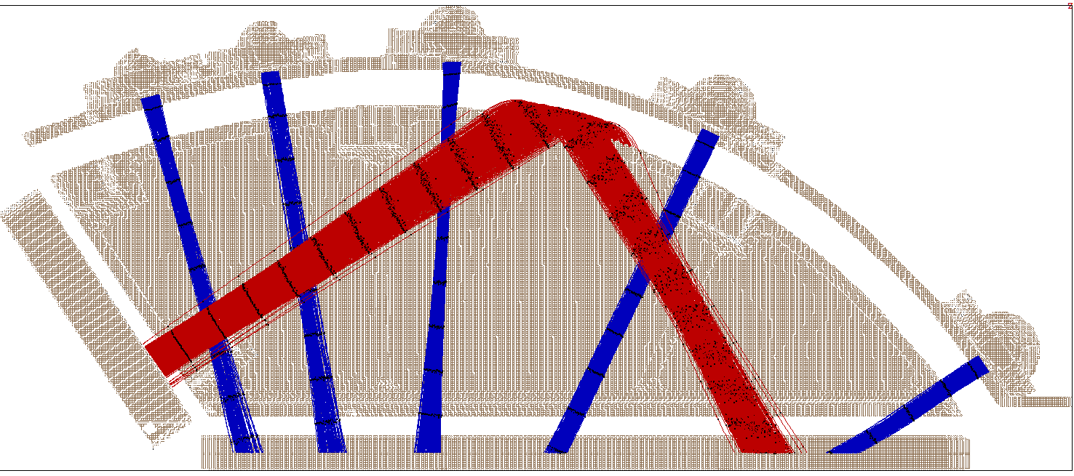
Timing budget – secondary electron dispersion simulatoins
250 ps Time Markers
Electron dispersion is less than 200pS
Updates expected from
Joe Westlake

Slide 12
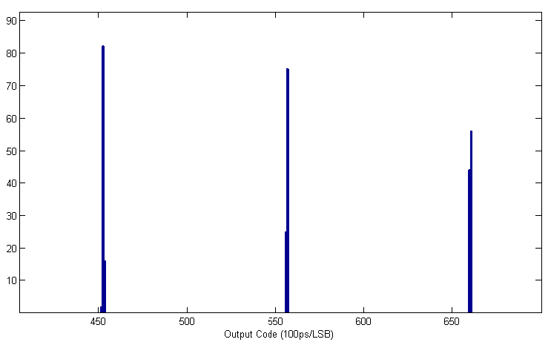
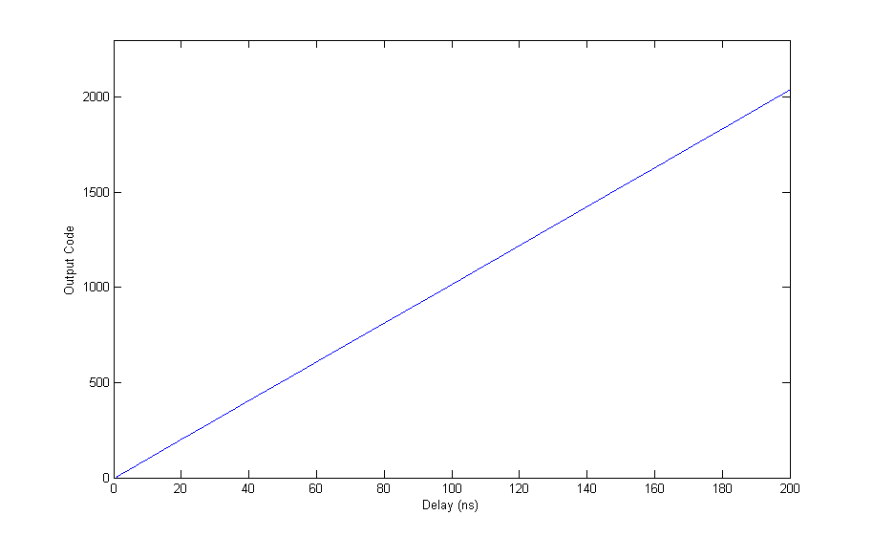
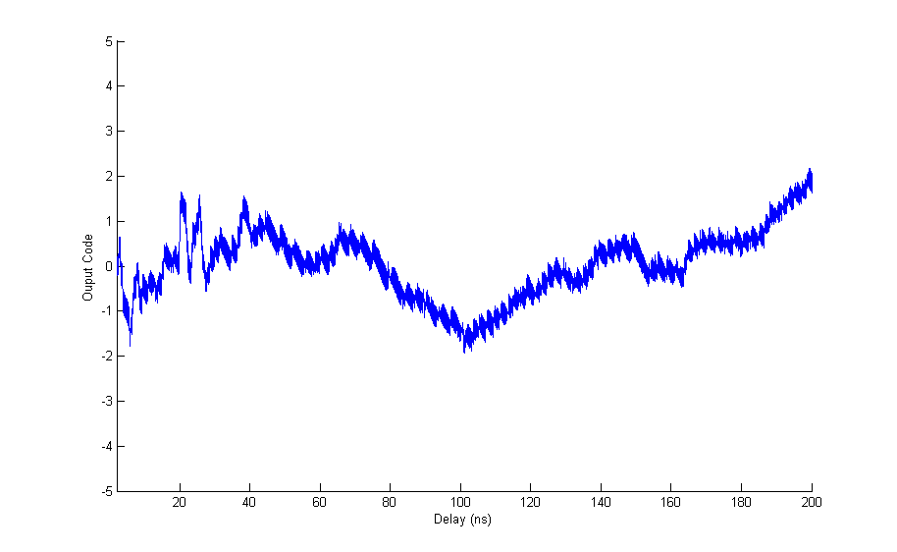
TOF-D Test Results
TOF-D performance meets requirement
INL variations compensated for with look-up-tables
  Same LUTs used to normalize path length for different apertures
Jitter is less than 1 LSB FWHM
Generate plots with
larger axis labels
TOF range for He3/He4 separation requirement

Slide 13
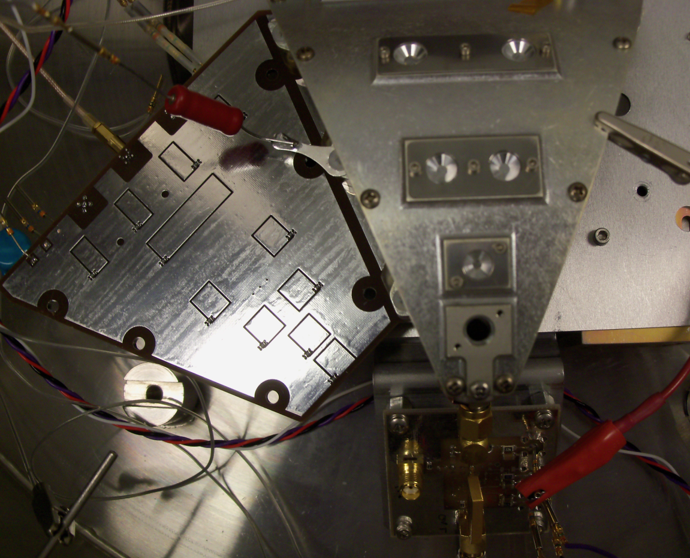
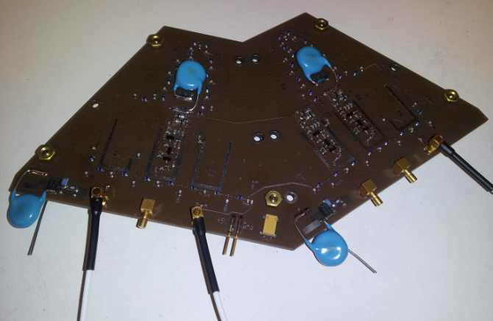
Prototype Quadrant Sensor Testing
Timing performance testing completed on prototype sensor
End-to-end test includes variations due to electron dispersion, anode board performance, and CFDD V0 performance
  Does not include TOFD ASIC
Prototype anode board is close to flight configuration
  HV isolation in imbedded capacitance
  Start delay line covers two sensors
  Does not mechanically fit flight design
Prototype sensor is similar to flight sensor – key sensor geometries are the same

Slide 14
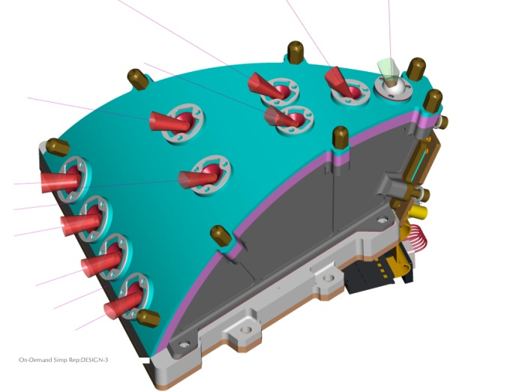
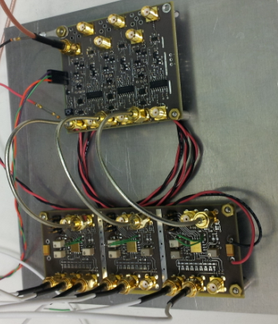
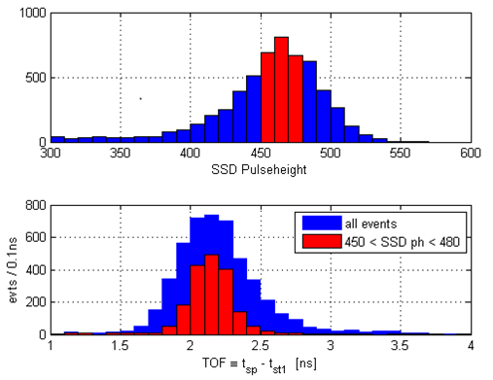
Prototype Quadrant Sensor Testing
Initial results show about 300pS FWHM timing performance (CFD and Electron optics contributions), which meets our requirements. The next version of the CFD has lower jitter at low thresholds and reduced walk, which we expect will improve performance.

Slide 15
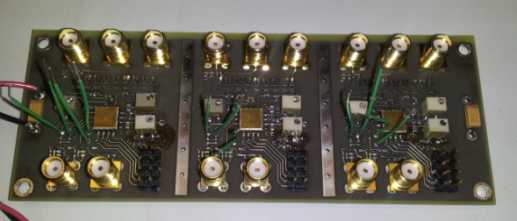
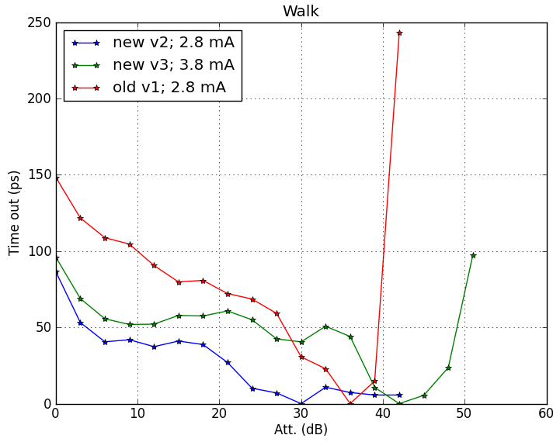
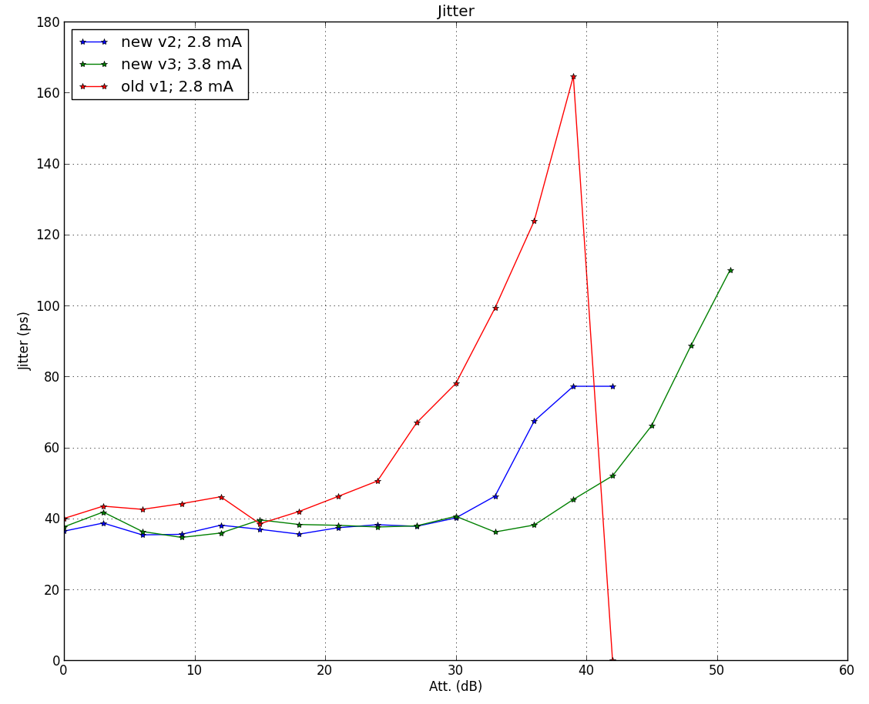
CFDD test results
CFDD extensively tested
Tests performed using CFDD test board
CFDD V3 has improved performance

Slide 16
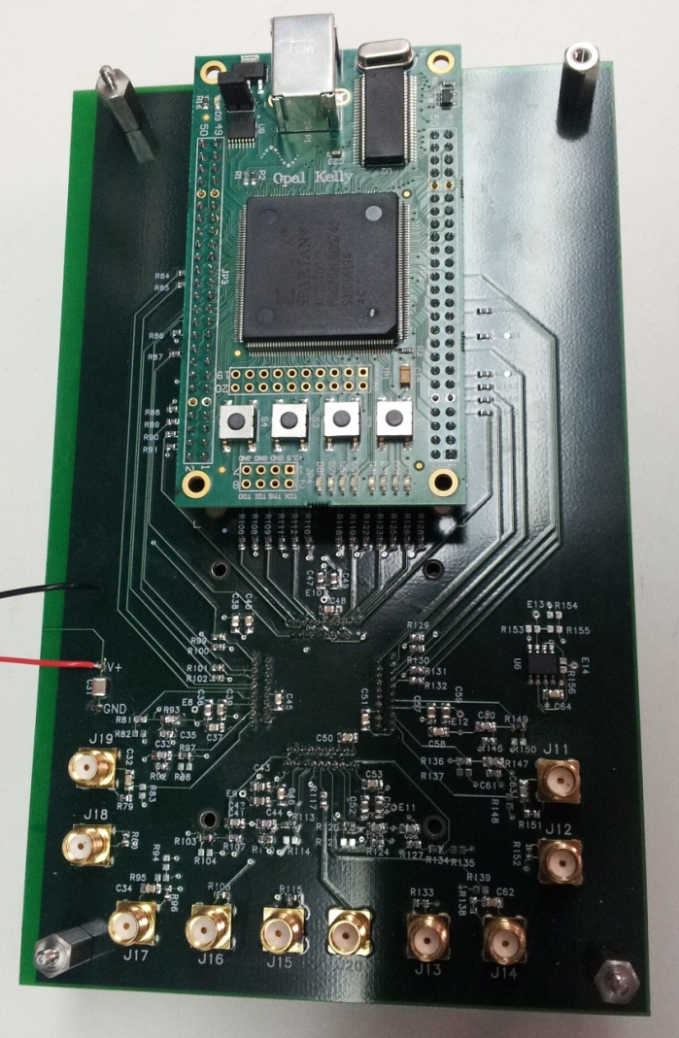
Technical Development:
ASIC Progress
First version of TOF chip fabricated and tested
  Temperature testing from -40°C TO 70°C
  Supply tested from 3.0V to 3.6V
  Functionality verified over 10ps to 2ns LSB
  Successfully completed SEE testing at Texas A&M
  Completed total dose testing
Second version of TOF chip and first version of CFD chip fabricated and tested
Flight Fabrication - Third version of TOF chip and second version of CFD chip fabricated and tested
  Temperature testing from -40°C TO 70°C
  Supply tested from 3.0V to 3.6V
  TOF functionality verified over 10ps to 2ns LSB
Working with vendor for final qualification of both ASICs

Slide 17
Transition to Flight
TOF, CFD ASICs
  Complete qualification with external test house
  Radiation testing on flight parts (prototype parts passed all radiation testing)
Sensor Development
  Build and test EM sensor
  Integrate sensor with SSD
SSD
  EM design complete
  Flight design will be identical

Slide 18
Notes
These will be removed from the final presentation

Slide 19
Talked to Don
  We are officially moving ahead with 0.4nS FWHM, 15keV FWHM. All model simulations are based on these performance numbers
  Helium not much affected at 200keV by foil losses
  Something on efficiency??? Not sure why this made it into SwRI’s spreadsheet for TRL6 activities.

Slide 20
EPI-Lo Wedge Development
Test type | Test location | Notes
Efficiency Measurement of detector system | JHU/APL | Complete
Fabrication/testing of quadrant electronics | JHU/APL | Complete
Integration of dectector wedges to quadrant anode | JHU/APL | Complete
Demonstration of low TOF dispersion | JHU/APL | Complete
Performance demonstration of separation of 3He 4He | JHU/APL | Complete
 |  | TRL6 achieved
EPI_Lo TOF ASIC Development
Test type | Test location | Notes
Prototype ASIC |  | Complete
Fabrication and Test | JHU/APL | Complete
Temperature testing | JHU/APL | Complete
Supply Voltage variation test | JHU/APL | Complete
TOF functionality 10ps to 2 ns | JHU/APL | Complete
Radiation Testing | Texas A&M | Complete
Flight ASIC |  | Test of Flight ASICs for TRL6 success
Fabrication and Test | JHU/APL
Temperature testing | JHU/APL
Supply Voltage variation test | JHU/APL
TOF functionality 10ps to 2 ns | JHU/APL
Radiation Testing | Texas A&M

Slide 21
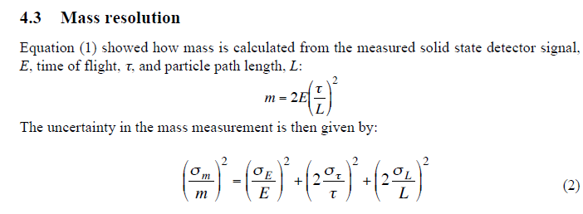
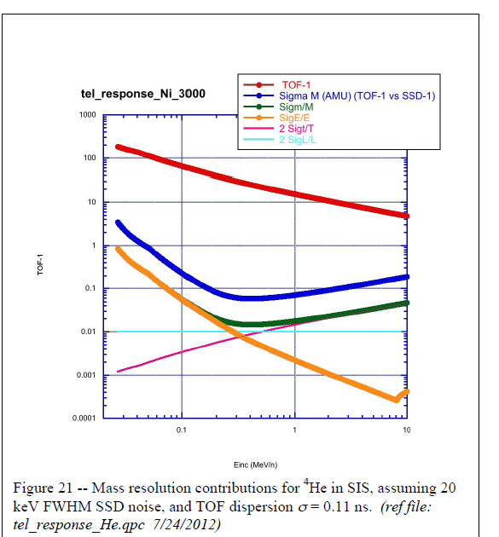
EPI-Lo performance Model

