Slide 1
ISIS Science Ops Center
N. A. Schwadron
Instrument SOC Lead
U. New Hampshire

Slide 2
Science Operations Center Agenda
List of Governing Documents
Heritage
SOC Organization
Requirements Analysis
SOC Description - Architecture
SOC Description - Software Systems
SOC Description – Operations Planning
SOC Description – Commanding
SOC Description – Instrument Health & Safety
SOC Description – Telemetry
SOC Description – Data Processing
Data Products
Development Plan and Schedule
Test Plan
Current Status

Slide 3
List of Governing Documents
7434-9047 SPP Mission Requirements Document (MRD)
7434-9081 SPP Science Team Allocated Requirements Document (STARD)
7434-9101 SPP Science Data Management Plan (PDMP)
7434-9016 SPP Concept of Operations
7434-9078 SPP Mission Operations Center (MOC) to SPP Science Operations Center (SOC) and Interface Control Document (ICD)
7434-9139 SPP MOC Data Product Document

Slide 4
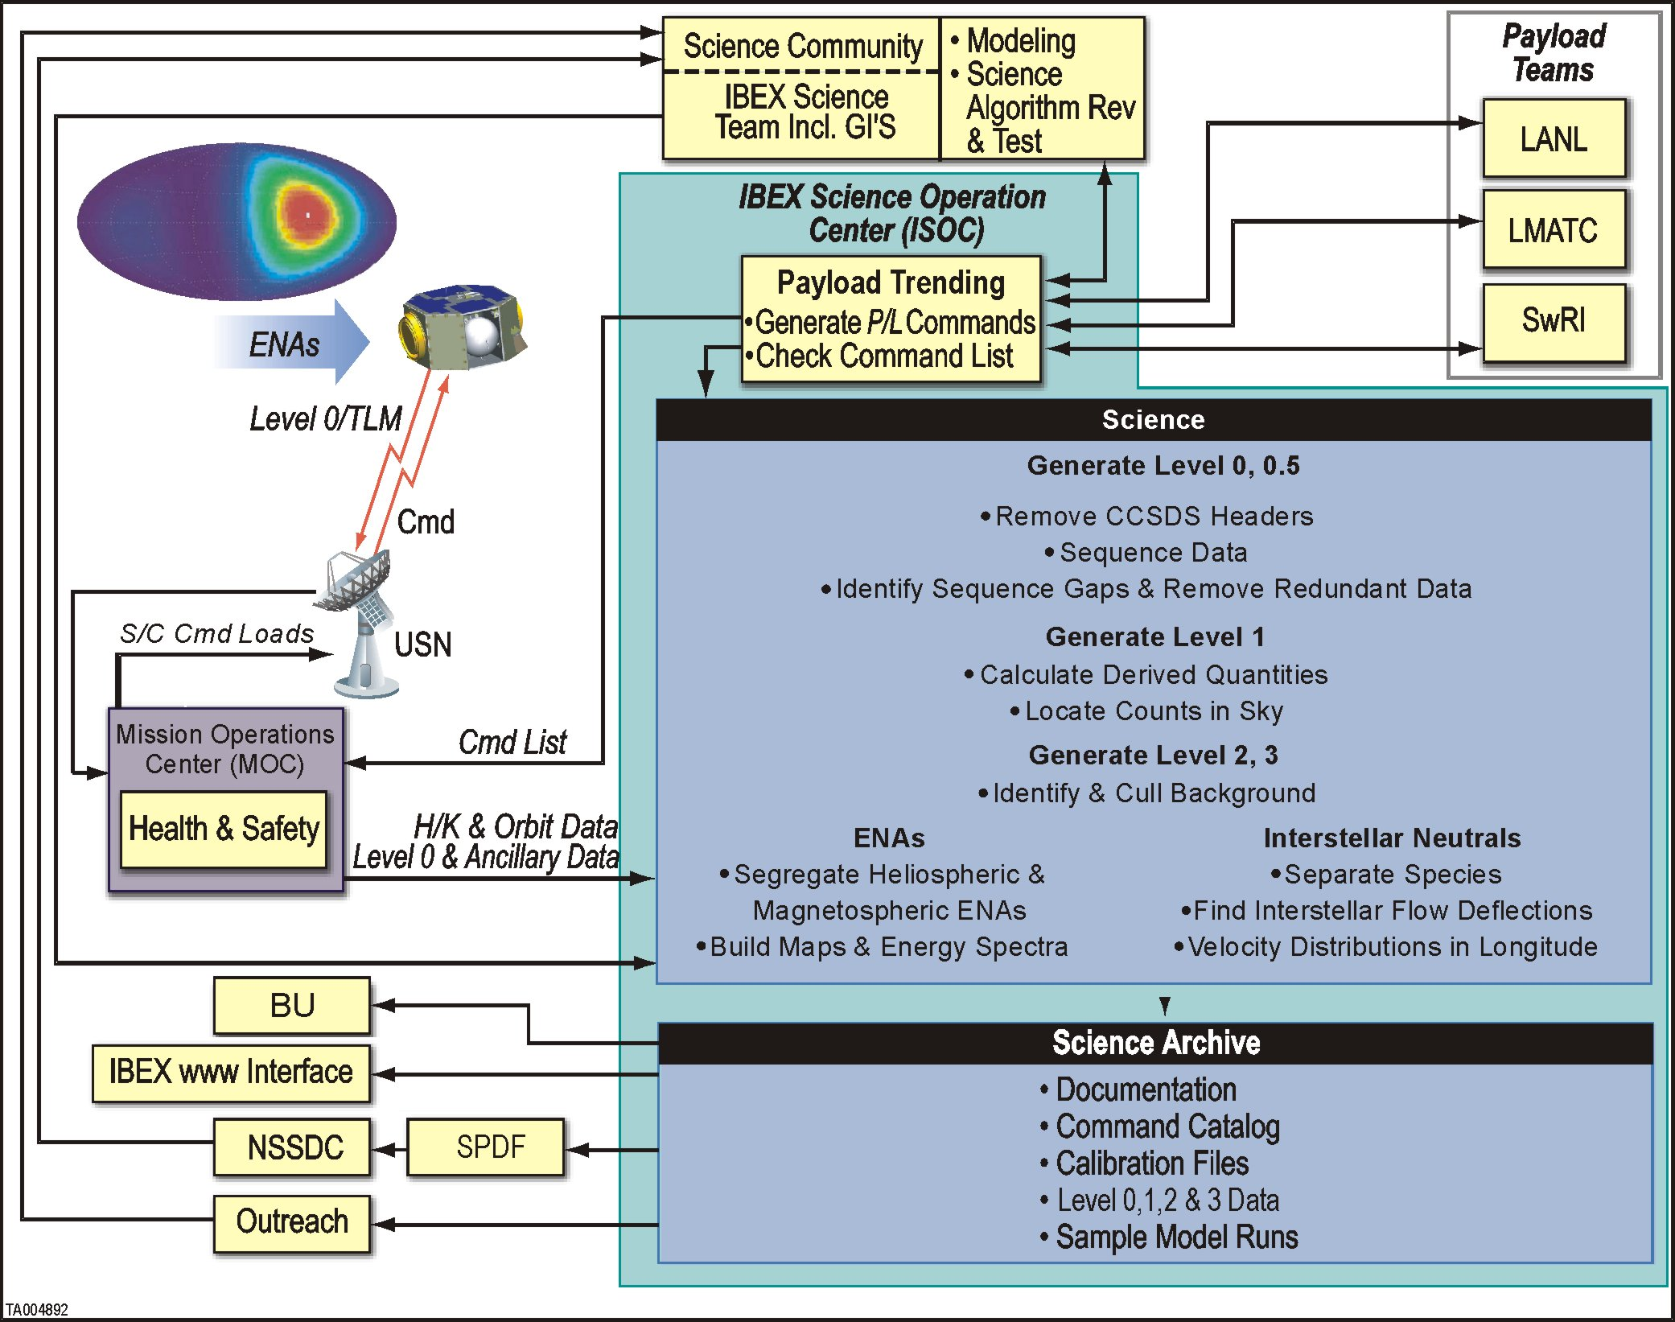
Heritage
Interstellar Boundary EXplorer SOC (ISOC) at UNH
  Two particle instruments
  Software, Instrument Operations all managed by the ISOC
  Interfaces with central MOC at Orbital

Slide 5

SOC Organization
ISIS SOC Lead
N. Schwadron
ISIS SOC Ops
S. Smith
EPI-Hi SOC Interface
A. Davis
EPI-Lo SOC Interface
M. Hill
Software Lead
TBD
ISIS SOC Test Engineer
J. Legere
Software Support
TBD
Science and Operations Functions managed by SOC
Software development needed for Ops, Science and Health & Safety
ISIS SOC Testing via GSEOS – “Test as you fly and fly as you test”

Slide 6
Requirements Summary
Public quicklook data 30 days after downlink (6 months for first 3 orbits)
Public science data 60 days after downlink
Share science/engineering/ancillary data among teams
At SOC, archive all telemetry, data, software and docs for mission + 1 year
All SOC software + data to final, deep archive by 9 mo. after mission end
SOC must have APL (SPP project) approved security on computers
SOC able to receive "remote SOC notification" of instrument fault conditions as detected by the SC

Slide 7
Level 2 Requirements
  [MRD-29] SPP Instrument Shared Data
    The Mission shall be capable of sharing a limited amount of instrument messaging fir purposes of coordinating concentrated or focused (Burst mode) periods
  [MRD-66] Data Delivery: Science Data Management Plan
    The Mission shall create, update and adhere to a NASA Headquarters-approved Science Data Management Plan that specifies file contents, metadata, formats, standards, schedule and pathways for public data access, and the destination of the data upon mission termination.
  [MRD-58] Data Delivery: Quick-Look Data
    The Mission shall ensure that each SOC provides for public dissemination a quick-look processed version of science data (e.g. thumbnails) within 30 days (TBR) of downlink.
  [MRD-59] Data Delivery: Sharing Among Instrument Teams
    The Mission shall be capable of sharing data between instrument teams to support data analysis
  [MRD-60] Data Delivery: Engineering Data Sharing
    The Mission shall be capable of sharing ancillary engineering information necessary to validate and calibrate science data sets to all investigation teams prior to depositing them in a NASA approved data repository.

Slide 8
Level 2 Requirements
  [MRD-61] Data Delivery: Public Release
    The Mission shall ensure that each SPP science investigation provides processed science data obtained as part of the SPP mission to the public no later than 6 months (TBR) from downlink of all a given encounter's data.
  [MRD-63] CDH Data Delivery: Data Retention at SOC
    The Mission shall ensure that all instrument telemetry received by the MOC, all associated ancillary data products generated by the ground system, and any processed science data products received by the MOC at any point in the mission life cycle are retained at the MOC throughout the duration of the operational phase of the mission plus one year (TBR).
  [MRD-64] Data Delivery: Data Retention at SOCs
    The Mission shall ensure that each SOC maintains a data archive of its instrument science, documentation, software and science data products for the life of the mission plus one year (TBR).
  [MRD-65] Data Delivery: Data Delivery to NASA
    The Mission shall ensure that each science investigation team delivers their respective data archive from the operational phase of the mission to a NASA-designated location for a deep data archive within 12 months of completion of the operational phase of the mission.

Slide 9
Level 2 Requirements
  [MRD-72] FP: Instrument Power-Down Time (ISIS SOC Tracks this for Heath & Safety)
    The Mission shall provide instrument fault protection to include ground system monitoring of selected instrument health data, remote SOC notifications of critical fault conditions, and autonomous onboard instrument power-downs in response to instrument request and critical telemetry.
  [MRD-82] Safety: JHU/APL Network Security
    The Mission shall ensure that all SPP equipment that connects to the JHU/APL internal or mission operations networks complies with JHU/APL security requirements.

Slide 10
Level 3 Requirements
[PAY-133] CDH Data Delivery: Quick-Look Data
  All Science Operations Centers shall provide for public dissemination a quick-look processed version of science data within 6 months (TBR) of downlink for the first three orbits after launch and 60 days (TBR) of downlink thereafter.
  Traced back to MRD-58 : The Mission shall ensure that each SOC provides for public dissemination a quick-look processed version of science data (e.g. thumbnails) within 60 days (TBR) of downlink.
[PAY-134] CDH Data: Data Sharing
  All Science Operations Centers shall be capable of sharing data with other SPP instrument teams to support data analysis as specified in the Science Data Management Plan (7434-9101).
  Traced back to MRD-59 : The Mission shall be capable of sharing data between instrument teams to support data analysis

Slide 11
Level 3 Requirements
[PAY-135] CDH Data: Engineering Data Sharing
  All Science Operations Centers shall be capable of sharing ancillary engineering information necessary to validate and calibrate science data sets with all investigation teams prior to depositing them in a NASA approved data repository
  Traced back to MRD-60 : The Mission shall be capable of sharing ancillary engineering information necessary to validate and calibrate science data sets to all investigation teams prior to depositing them in a NASA approved data repository.
[PAY-136] CDH Data: Public Dissemination
  All Science Operations Centers shall provide processed science data obtained as part of the SPP mission to the public no later than 6 months from downlink of all a given encounter's data.
  Traced back to MRD-61 : The Mission shall ensure that each SPP science investigation provides processed science data obtained as part of the SPP mission to the public no later than 6 months (TBR) from downlink of all a given encounter's data.

Slide 12
Level 3 Requirements
[PAY-137] CDH Data Delivery: Data Retention at SOC
  All Science Operations Centers shall maintain all instrument telemetry & all associated data products throughout the duration of the operational phase of the mission plus one year (TBR).
  Traced back to MRD-63 : The Mission shall ensure that all instrument telemetry received by the MOC, all associated ancillary data products generated by the ground system, and any processed science data products received by the MOC at any point in the mission life cycle are retained at the MOC throughout the duration of the operational phase of the mission plus one year (TBR).
[PAY 138] CDH Data Delivery: Data Retention at SOCs
  All Science Operations Centers shall maintain a data archive of its instrument science, documentation, software and science data products for the life of the mission plus one year (TBR).
  Traced back to MRD-64 : The Mission shall ensure that each SOC maintains a data archive of its instrument science, documentation, software and science data products for the life of the mission plus one year (TBR).

Slide 13
Level 3 Requirements
[PAY 139] CDH Data Delivery: Data Delivery to NASA
  All Science Operations Centers shall deliver its data archive from the operational phase of the mission to a NASA-designated location for a deep data archive within 12 months (TBR) of completion of the operational phase of the mission.
  Traced back to MRD-65 : The Mission shall ensure that each science investigation team delivers their respective data archive from the operational phase of the mission to a NASA-designated location for a deep data archive within 12 months (TBR) of completion of the operational phase of the mission.
[PAY 151] FP: Instrument Power-Down Time (ISIS SOC Tracks this for Heath & Safety)
  All instruments shall be capable of safely powering down within TBD s upon receipt of a status message with a bit indicating power-down command.
  Tracked back to MRD-72 : The Mission shall provide instrument fault protection to include ground system monitoring of selected instrument health data, remote SOC notifications of critical fault conditions, and autonomous onboard instrument power-downs in response to instrument request and critical telemetry.

Slide 14
Level 3 Requirements
[PAY 221] FP: Instrument Reconfiguration (ISIS SOC Tracks This For Health & Safety)
  All instruments shall be capable of autonomous reconfiguration to a pre-defined operational state following spacecraft-commanded power-down and subsequent power-on.
[PAY 152] FP: Instrument Power-Down Preparedness (ISIS SOC Tracks This for Health & Safety)
  All instruments shall be designed to accommodate immediate loss of power (without warning) without damage to the instrument.
  Tracks back to MRD-72 : The Mission shall provide instrument fault protection to include ground system monitoring of selected instrument health data, remote SOC notifications of critical fault conditions, and autonomous onboard instrument power-downs in response to instrument request and critical telemetry.
[PAY 283] Compliance: MOC to SOC ICD
  All SOCs shall comply with the requirements and constraints imposed by the MOC to SOC ICD 7434-9078.

Slide 15
Level 3 Requirements
PAY 303 ISIS Calibration
  ISIS shall shall be capable of operating to support calibration for at least 70% (TBR) of the time the spacecraft is not in a power or operationally-constrained mode outside of 0.25 AU.
  Traces to MRD-97: Mission shall measure energetic protons and heavy ions …
PAY-215 Payload: ISIS Burst Mode (This is tracked by ISIS-SOC)
  ISIS shall be capable of sharing a limited amount of instrument messaging information sufficient for the purposes of coordinating concentrated or focused measurement (burst mode) periods, as defined in the SPP Instrument Shared Data Document 7434-XXXX (TBR).
  This requirement meets Level 2 Requirements. ISIS will be participating in Burst Mode data sharing.

Slide 16
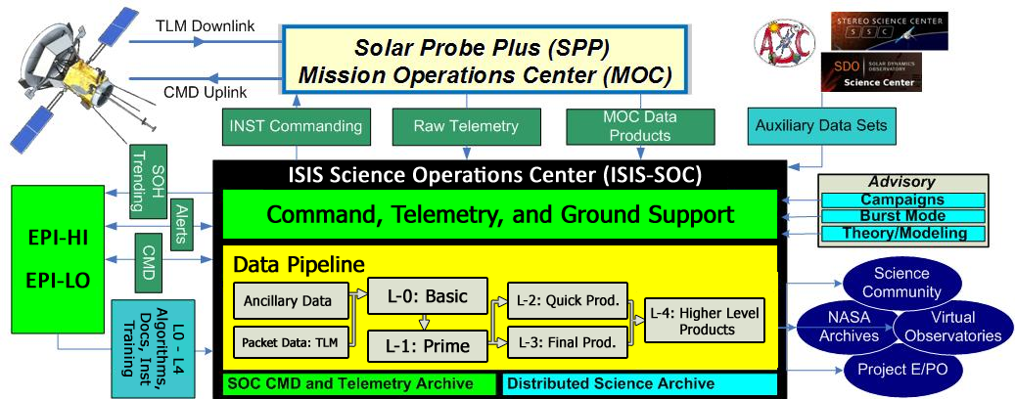
ISIS SOC – Architecture (1/2)
Both instrument teams and SOC utilize GSEOS and have the capability to perform real-time commanding in the event of contingencies and during commissioning
Instrument-to-MOC connections will be preserved and tested periodically to insure contingency preparedness
Need dedicated EPI-Lo & EPI-Hi “Test SOCs” in Mission Ops Center
SOC-MOC connections will be exercised as the standard mode of instrument commanding

Slide 17
ISIS SOC –Architecture (2/2)
The ISIS Science Operations Center (ISSOC) manages the commanding of EPI-Lo and EPI-Hi in coordination with instrument teams.
University of New Hampshire (UNH) hosts the ISSOC, which is staffed by a small team responsible for day-to-day operations.
Operators are brought on-board early in the project and operate the instruments during I&T.
Command and telemetry database developed during I&T is used during flight operations.
ISSOC utilizes a similar architecture as the IBEX Science Operations that was developed by N. Schwadron and currently runs at UNH.

Slide 18
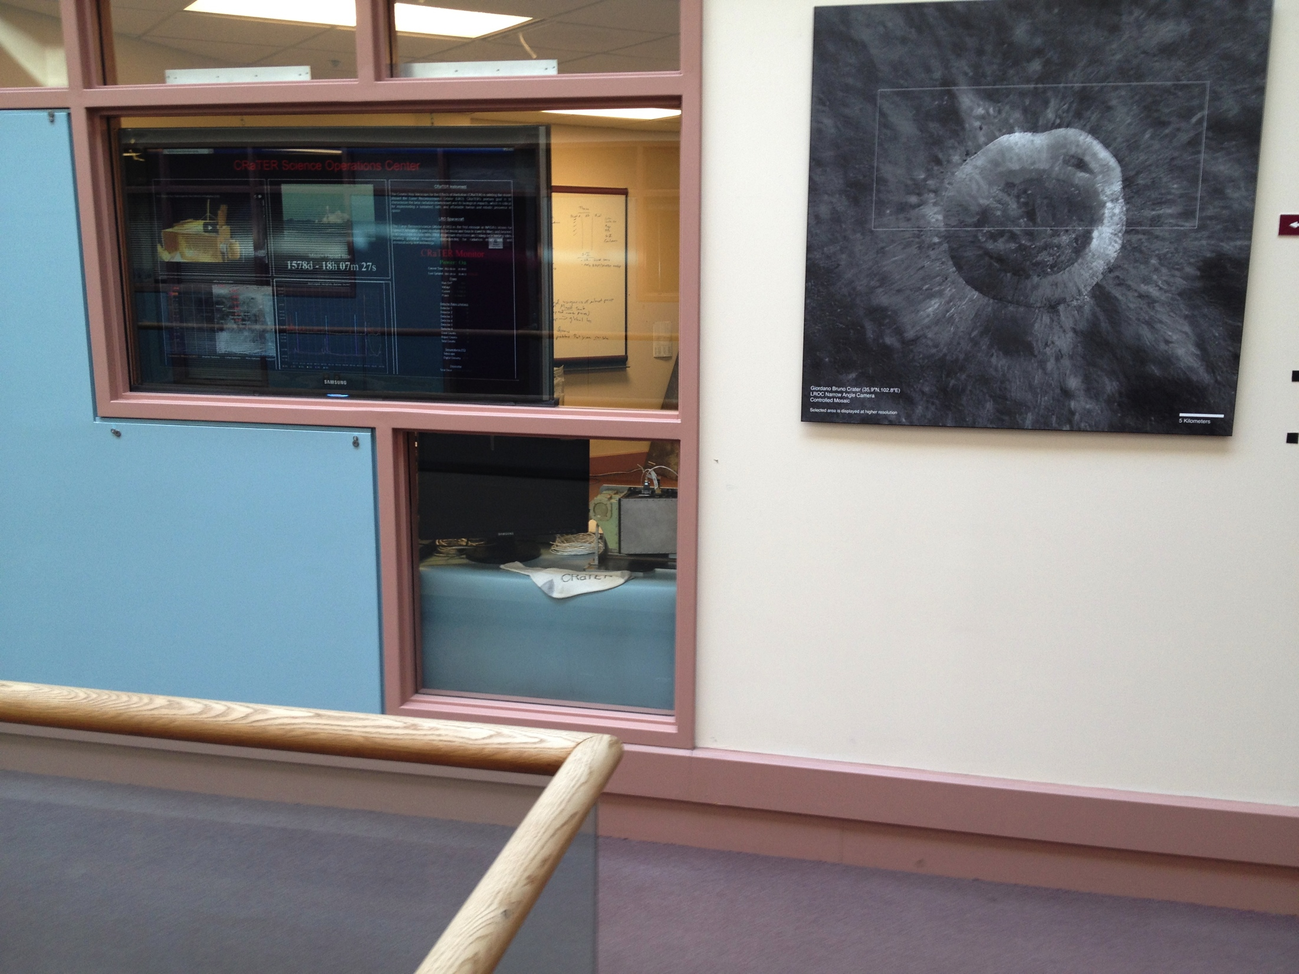
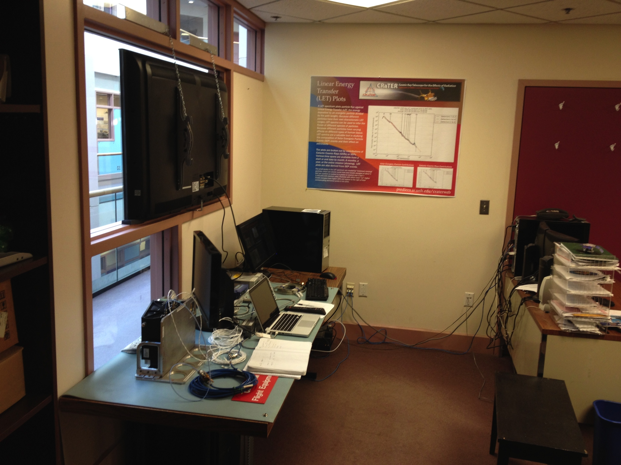
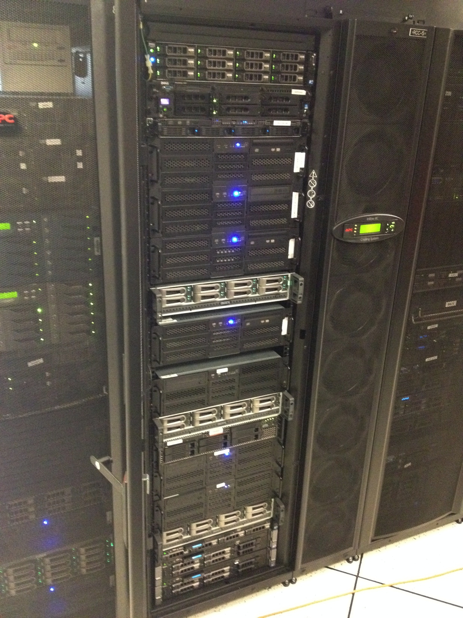
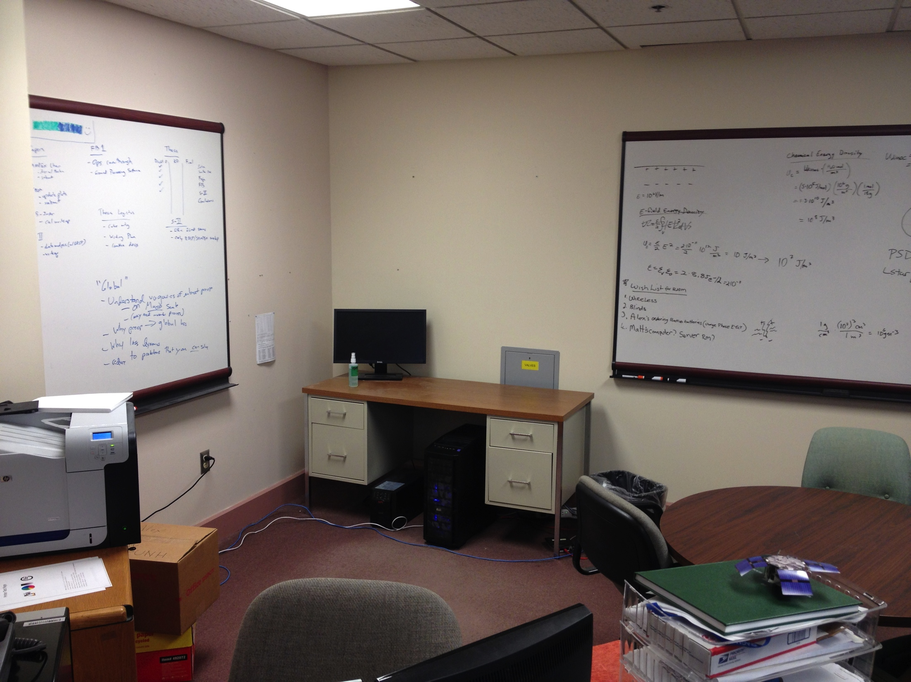
ISIS SOC – Facilities
Facilities:
Primary SOC at UNH
  Heritage: IBEX SOC
Backup SOC at SwRI or other institution (not UNH)
  Heritage: IBEX SOC
Dedicated GSEOS machines for EPI-Hi and EPI-Lo
IBEX & CRaTER SOC
IBEX & CRaTER Servers

Slide 19
SOC Description – Command, Telemetry & Ground Support
State-Of-Health Products: SOH Software
Commanding
Systems – GSEOS
Orbit Planning Products:
Orbit Planning Software
Command Load Testing Software

Slide 20
SOC Description – Science and Data Pipeline Software Systems
Data Level Products:
Pipeline Software
Data Visualization Tools:
Pipeline Software
Ancillary Science Products:
Pipeline and Ancillary Software

Slide 21
SOC Description – Operations Planning
Commanding of EPI-Hi and EPI-Lo
  “Flatsat” at UNH used to test command loads
    SwRI engineer will be responsible for using the native design products during Phase C to create a “behavioral model” of EPI-Hi and EPI-Lo
    Constraint Checking Modules
  Standard Commanding performed via GSEOS at UNH SOC
  Commissioning and Contingency response, commanding may optionally be done by EPI-Hi and EPI-Lo via GSEOS
Planning for instrument operations
  Planning software
    Automated routines & Templates for initial planning
    Interactions with ISIS SOC interfaces for finalization of planning
  Develop rough plans three orbits ahead
    Test command load
  Develop definitive plans one orbit ahead
    Final testing
    Upload

Slide 22
SOC Description – Commanding
GSEOS used during I&T and as much of testing as possible
  Coordinated by ISIS SOC Test Lead
Common GSE-OS platform for instrument GSEs/SOC
“Fly as we test (detailed further later)”

Slide 23
Factors: ISIS Commanding Needs
Particle events are sporadic so the goal is to approach 100% coverage
  Whenever possible, we want ISIS instruments taking data
  Do not preclude operations of instruments and data acquisition at any location or for any time interval during any orbit
Need sufficient time to analyze data after solar encounter phase and prepare for any needed uploads prior to the next encounter
  Considering ~daily snapshots for status/summary file
Continual health and safety monitoring
  Status/summary file sent down first in each DSN pass for health and safety monitoring
Ability to download all data
  Bulk of science data and burst mode in files subsequently sent down as downlink permits
Three-step Hierarchy of planned commands for near-term and longer-term changes
  Next Solar Pass
  Next Solar Pass + 1
  Next Solar Pass + 2

Slide 24
Commanding in First 2 Months
Based on STEREO experience EPI-HI will require 10-20 opportunities (on separate days) to send commands in the first two months
  Necessary to obtain/analyze at least a few hours of new data in between command opportunities to test whether the commands worked
  Therefore, need to collect data between commanding opportunities
ISIS EPI-Lo and EPI-Hi Statistics Gathering and Threshold Scans
  After initial checkout it is important that ISIS instrument gather as much data as possible (especially raw event data)
  Allows instruments to populate composition tracks so that TOF vs E flux boxes (EPI-Lo) and De vs Eprime boxes (EPI-Hi) can be adjusted before perihelion
  Threshold scans to determine optimal threshold values
  6 weeks need for these activities
  EPI-Lo does not need to be on continuously
ISIS EPI-Lo and EPI-Hi Table Loads and/or Software Updates
  Table updates expected (adjustment of flux box bins) 3 weeks into statistic gathering period
  Software updates as needed

Slide 25
Normal Science Operations
EPI-Hi and EPI-Lo operate the same whenever powered-on except for the volume/content of the data sent to the S/C inside/outside 0.25 AU
Spacecraft- Sun Distance R<0.25 AU (Normal Science Mode)
  Full nominal power
  High data collection rate and burst mode
Spacecraft- Sun Distance: 0.25 AU < R (Low-rate Science Mode)
  Full power when not downlinking and when possible
  Reduced data collection rate
  Commanding window should be scheduled late in the series of telemetry passes, although it may not be used every orbit
  Minimize power cycling the HV supplies
EPI-Lo will implement its operational mode changes via instrument autonomy logic supplemented by a macro capability
  Expect some planning tool to plan and coordinate operation

Slide 26
Nominal Operations
EPI-Hi and EPI-Lo capable of switching between two routine modes autonomously (based on data received once-per-second from the spacecraft).
At least three special operational modes are currently envisioned:
  Software upload mode
    During software upload mode, data acquisition functions and some non-essential functions will be halted.
  Calibration Science mode
  Safe mode

Slide 27
ISIS Science Operations Center Description: “Test as you Fly, Fly as you Test”
Instrument GSEs may have two types of operation:
  Specific: direct connection to instrument test ports
  Flight Mode: spacecraft simulator → instrument
GSE Flight-Mode operation incorporated into the SOC GSEO-OS system. Identical “look and feel” to the instrument/SOC teams during testing, I&T, commissioning and normal flight operations

Slide 28
SOC Description – Instrument Health & Safety
Health and Safety limits checked throughout testing, I&T and monitored throughout commissioning and flight
GSEOS used at ISIS SOC for health and safety monitoring during contacts
ISIS SOC develops software, and team pages with State-of-Health checks and long-term trending

Slide 29
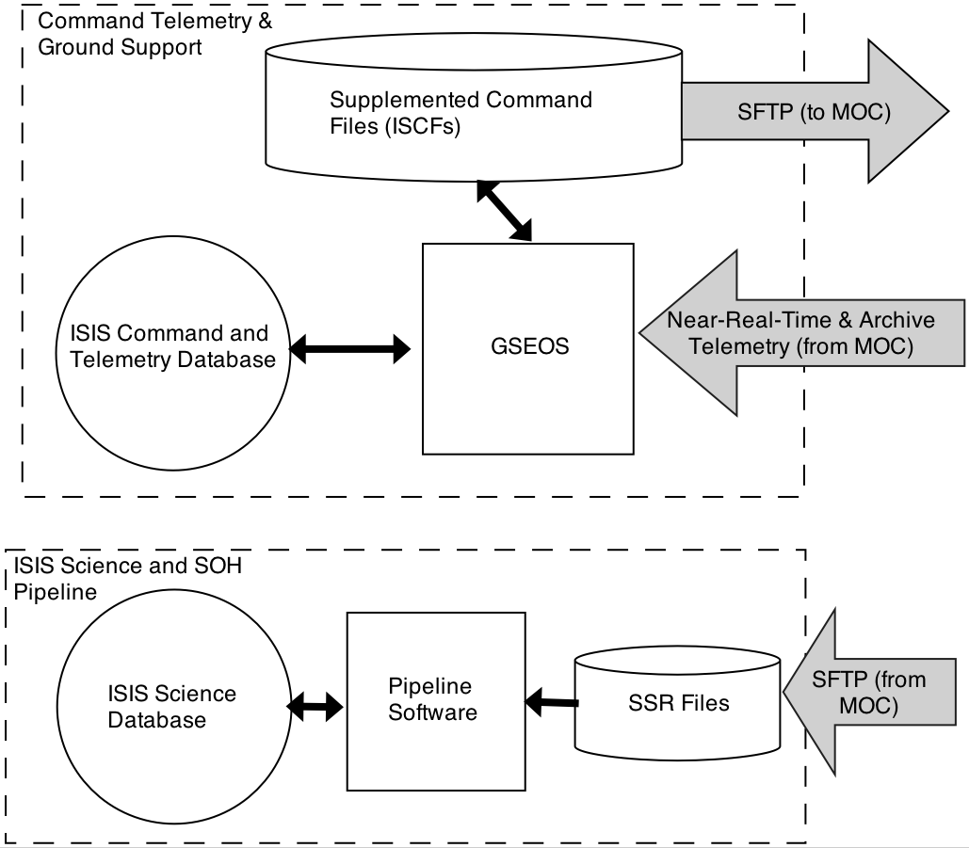
ISIS SOC – Telemetry Flow
Telemetry flows into ISIS SOC and Backup SOC

Slide 30
SOC Description – Data Processing
Data processing systems
  Pipeline code C, IDL, Perl, Java, etc ..
  Tools (MIDL, IDL Savesets, etc.. ) available for visualization and analysis
  Unix/Shell scripts launch executables in essentially any language to do their job with a clear i/o
Data processing algorithms
  Straightforward routines
    Decommutation
    Particle Identification
    Application of calibration data
Facilities
  All formal pipeline processing processed at ISIS SOC
Future planning products
  Use of SPICE ephem, SOC calendars for planning
  Automation where possible

Slide 31
ISIS Data Products (1/2)
ISIS SOC builds Level 1 and higher level data products from the Level-0 (raw) data received from MOC
Housekeeping and status data are processed as soon as possible after receipt (all products within 3 days, select quick products < 1 hour) and posted for viewing for the ISIS team through an ISIS SOC website.
  Housekeeping and status data downloaded first after passes, provide critical information from which to build command loads in subsequent passes.
Level 0 data are processed as they are made available after passes and are used to construct Level 1 and higher level data products

Slide 32
ISIS Data Products (2/2)
Higher level data products include combined solar wind, magnetic field and energetic particle data, which are time-ordered with common timestamps at a cadences TBD.
Level 1 and higher level data products are still in formulation as the instrumentation are in development.
The ISOC archives all ISIS data and delivers data products to appropriate Heliophysics Virtual Observatories and Data Centers.

Slide 33
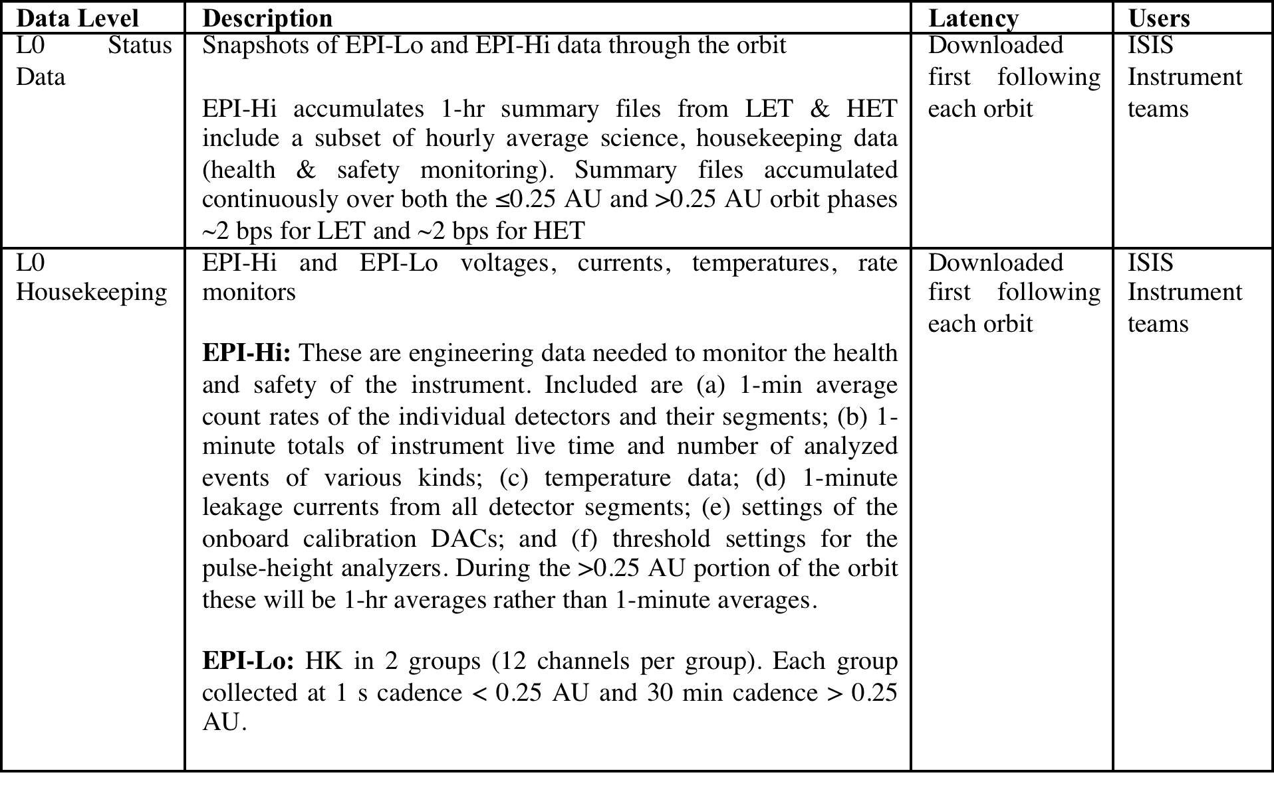
Level 0 Status and Housekeeping

Slide 34
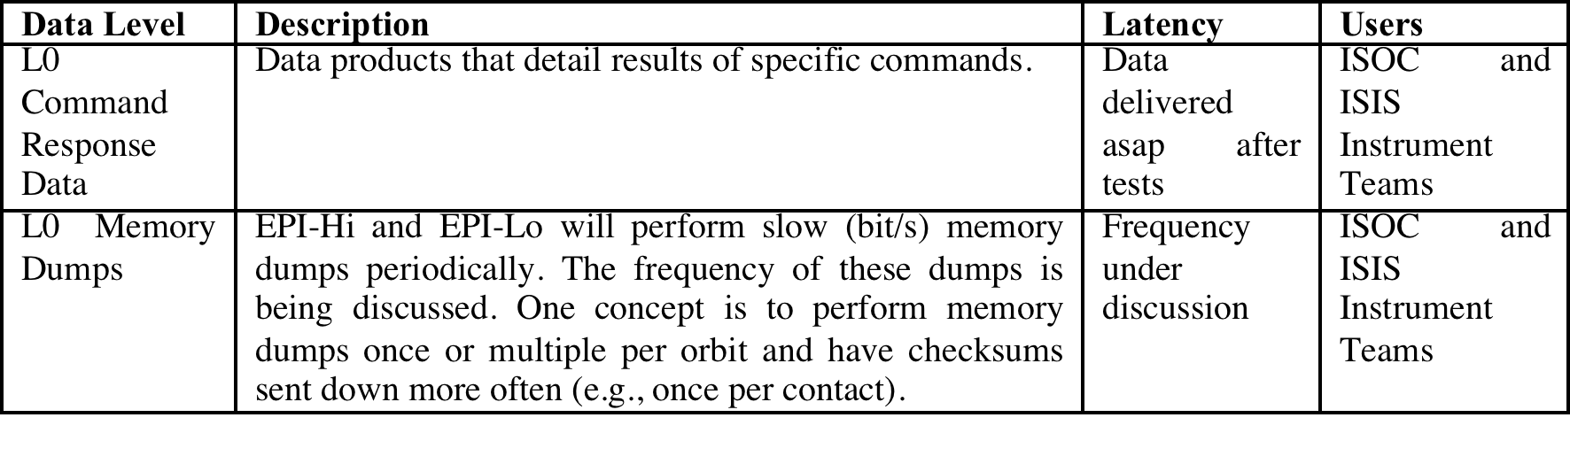
Level 0 Command Response/Mem Dumps

Slide 35
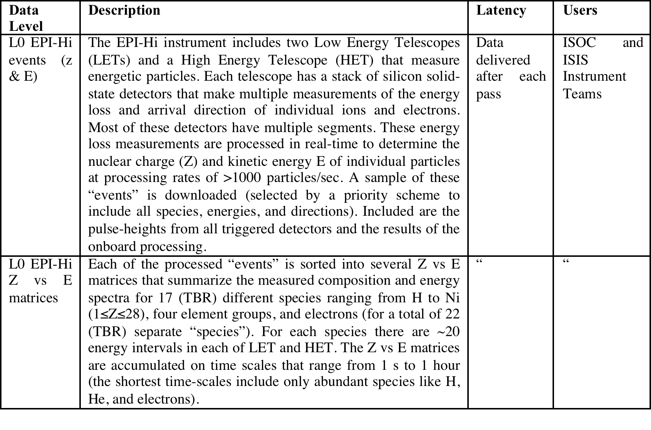
Level 0 EPI-Hi Events (1/2)

Slide 36
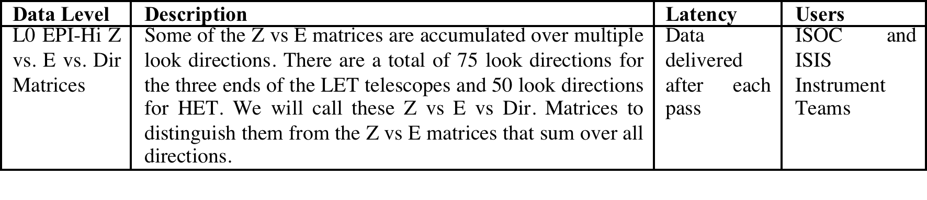
Level 0 EPI-Hi Events (2/2)

Slide 37
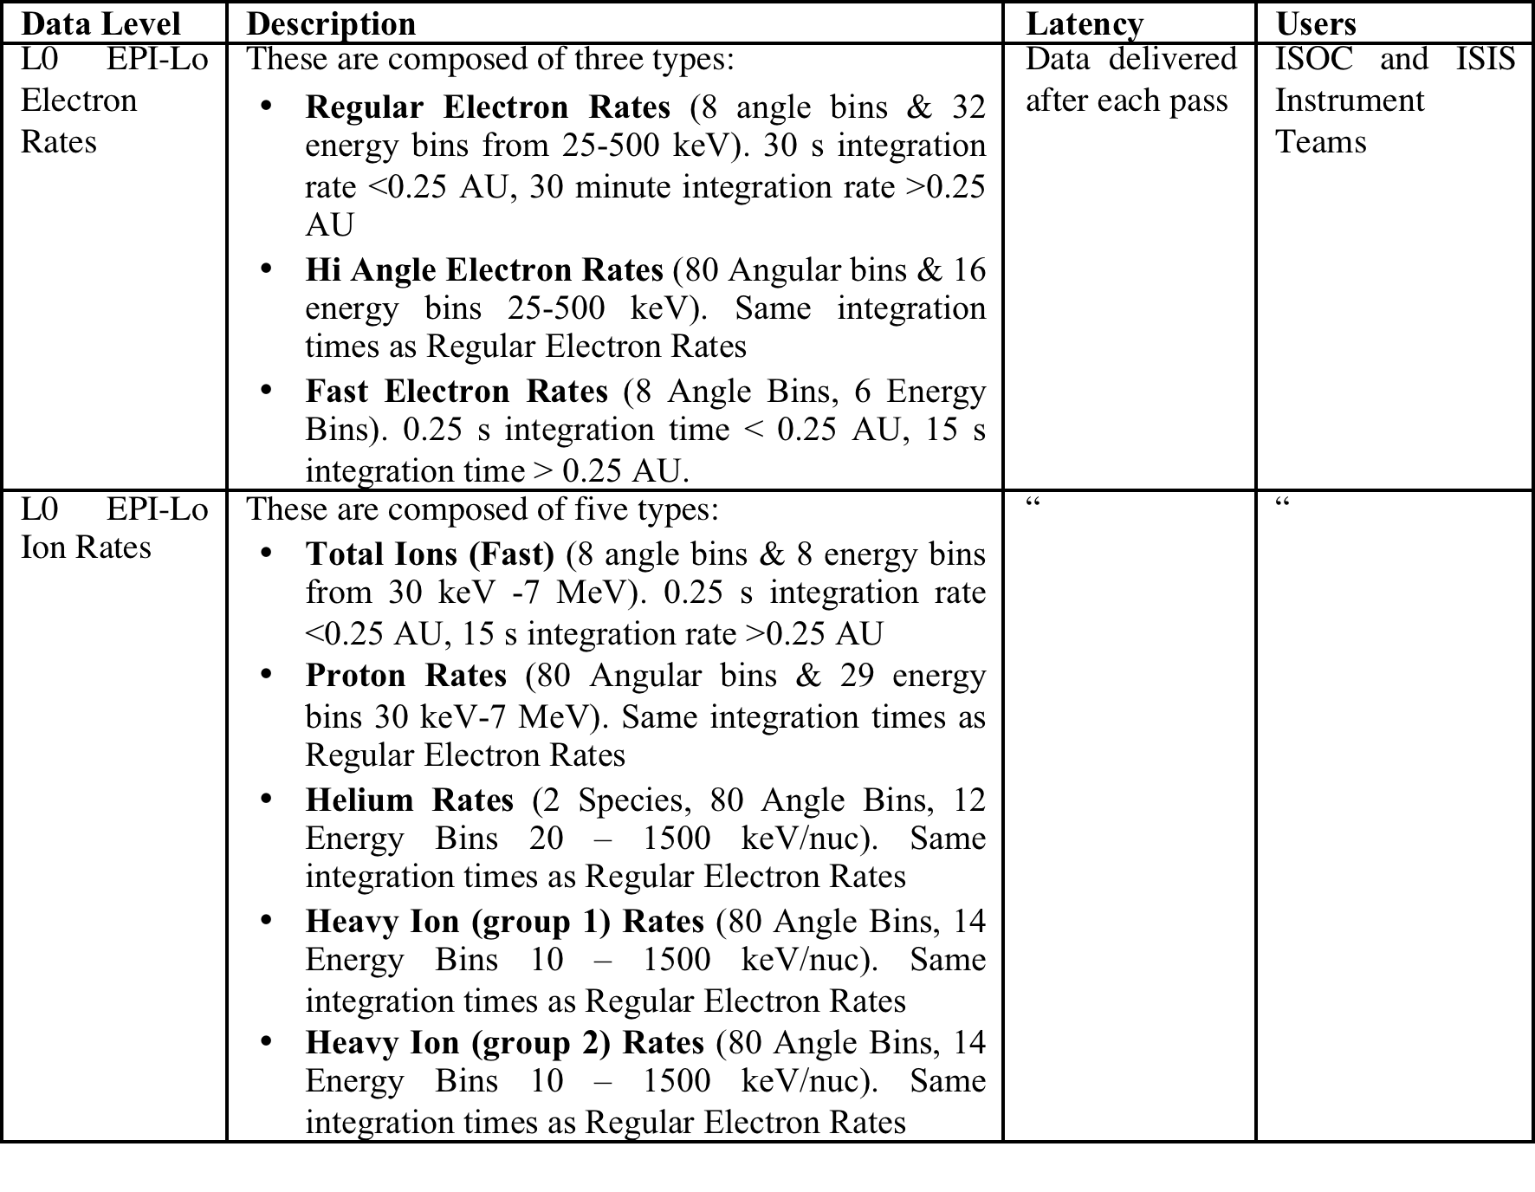
EPI-Lo Level 0 Rates

Slide 38
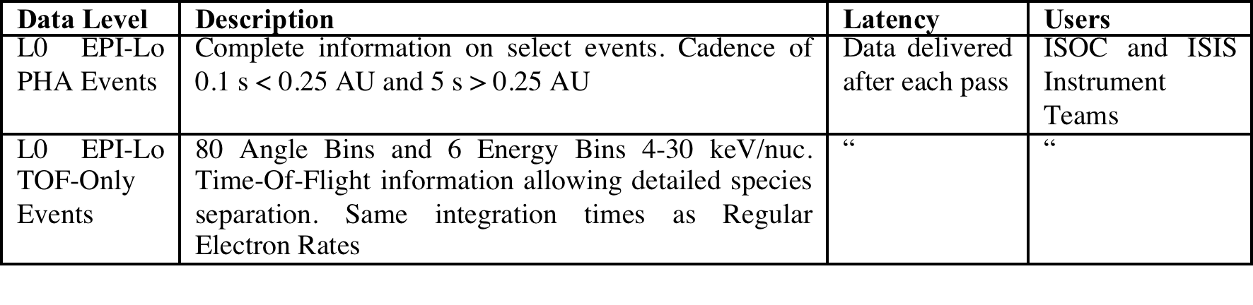
Level 0 EPI-Lo Events

Slide 39
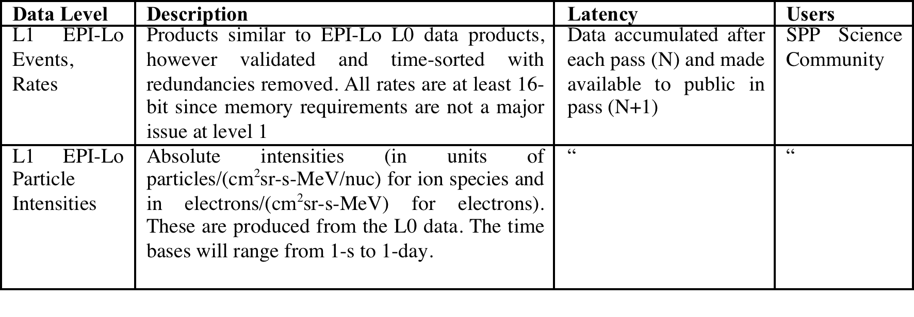
ISIS Level 1 Data (1/2)

Slide 40
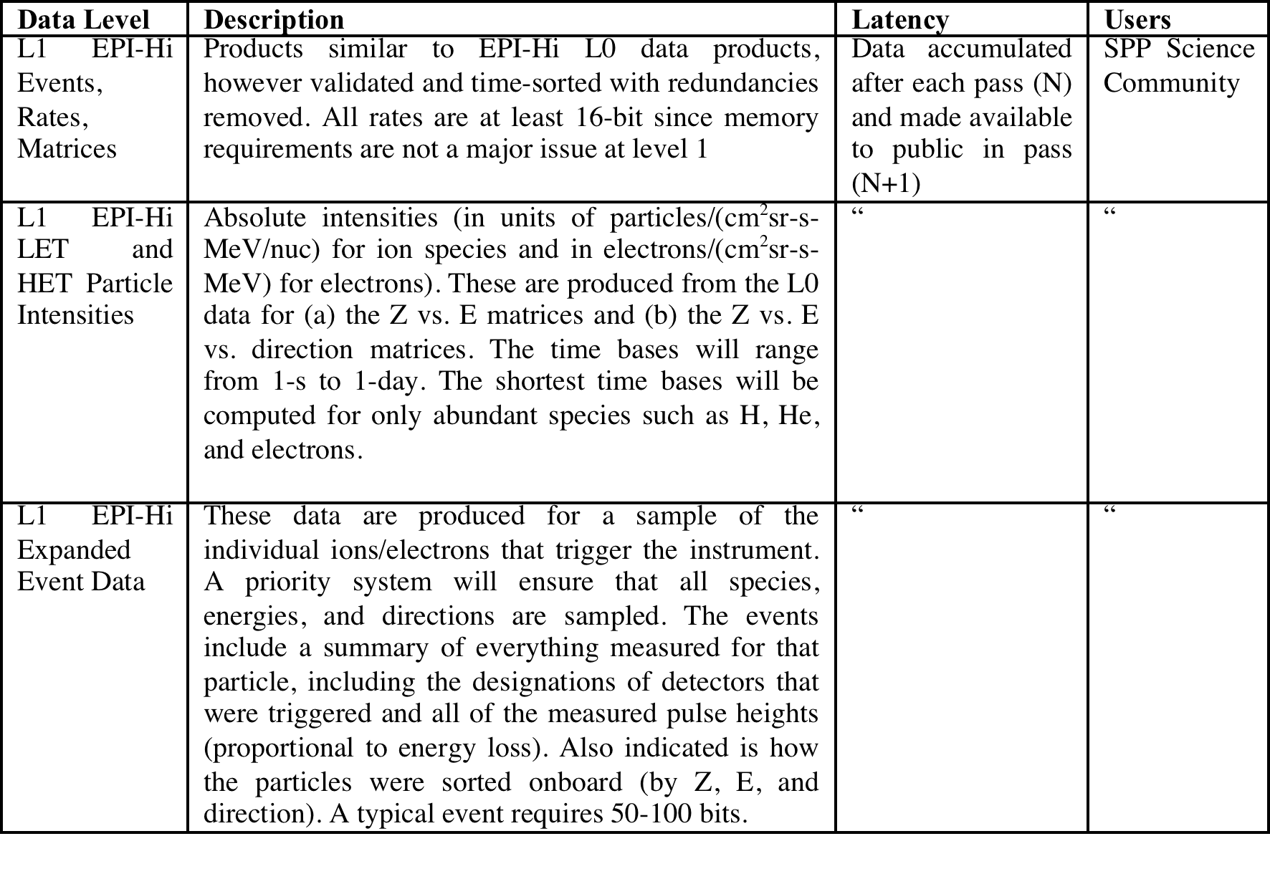
ISIS Level Data (2/2)

Slide 41
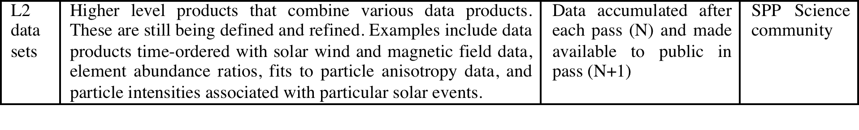
ISIS Level 2 and Higher

Slide 42
Data Products (Quicklook)
All Science Operations Centers shall provide for public dissemination a quick-look processed version of science data within 6 months (TBR) of downlink for the first three orbits after launch and 60 days (TBR) of downlink thereafter.
EPI-Lo:
  Spectrograms of:
    <1 MeV electron counts/data-interval (TBR) as a function of time, at a <= 1 hour (TBR) cadence, with 4 or more energy bins .
    <1 MeV/nucleon total ion or single species (TBR) counts/data-interval (TBR) as a function of time, at a <= 1 hour (TBR) cadence, with 4 or more energy bins.
EPI-Hi:
  Plots of 1-hour averages of four rates:
    1-5 MeV electrons
    2-10 MeV protons
    10-50 MeV protons
    4-40 MeV/nuc HiZ (6≤Z≤28)

Slide 43
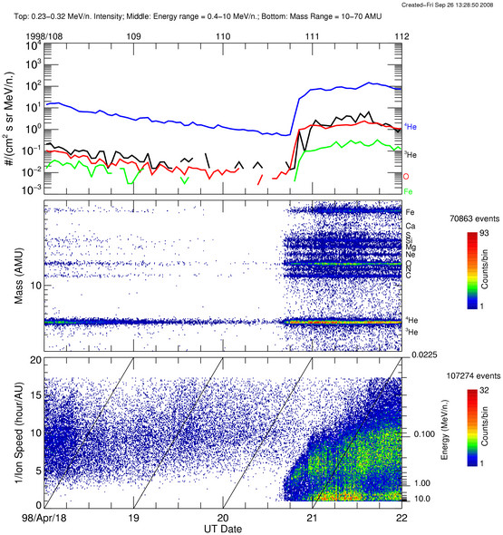
Possible data product for ISIS
One way of plotting SEP data
Top plot is the usual time-intensity profile
Each dot in the lower two panels is a particle detection
  Middle plot shows particle mass
  Bottom plot shows energy
Advantages:
  Easy identification of velocity dispersion in some events
  individual events are separated more clearly
  Composition easily identified
This is image taken from the ACE website:
ULEIS 4-day browse plots

Slide 44
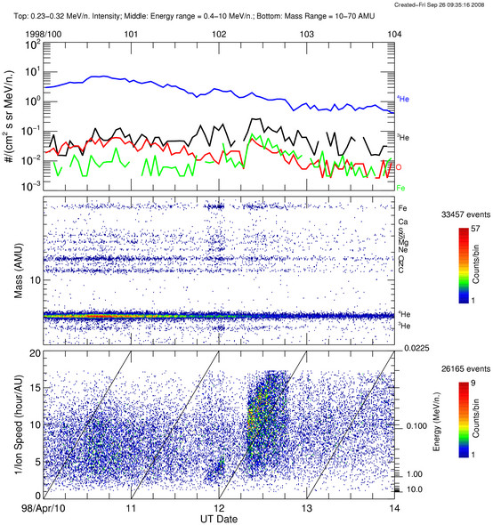
This is an example of an event probably associated with an impulsive solar flare (rich is heavy ions and ³He)

Slide 45
This is an example of an event probably associated with an impulsive solar flare (rich in heavy ions and ³He)
The entire event shows a clear velocity dispersion, but there is also a dispersionless intensity “dropout” during the event

Slide 46
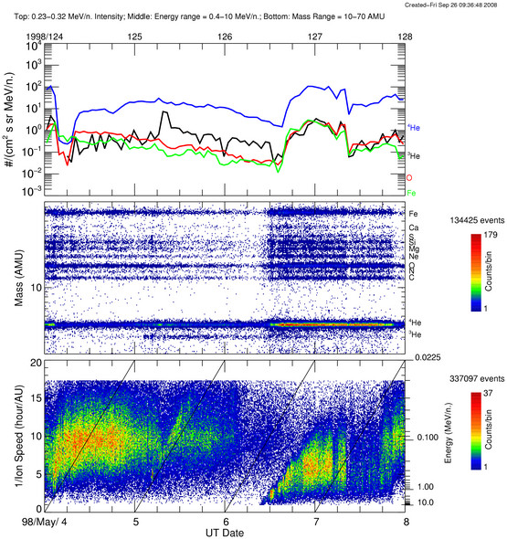
Possible data product for ISIS
Another good example (event starting before noon on May 6)

Slide 47
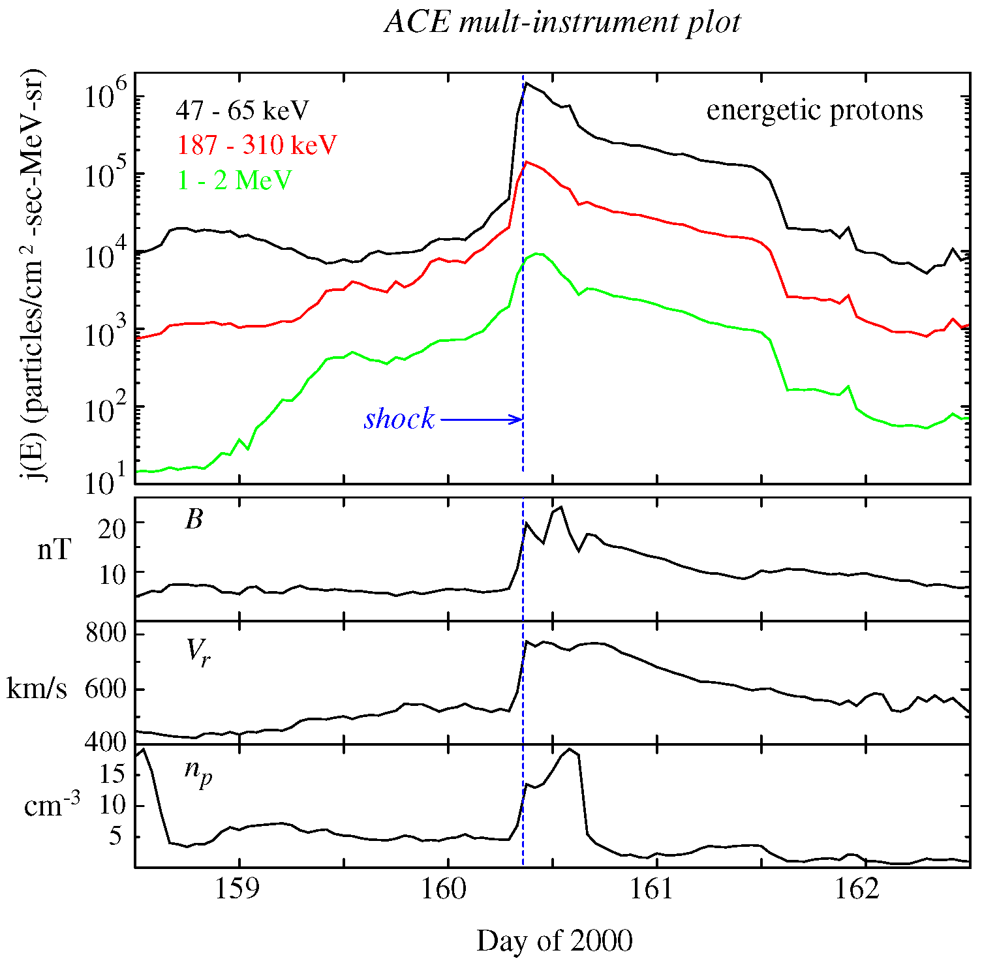
Possible data product for ISIS: Multi-instrument plots
Multi-panel plots showing energetic particle intensities along with field and plasma parameters

Slide 48
Possible data product for ISIS: Multi-instrument plots
It would be useful to be able to look at it in higher resolution as well

Slide 49
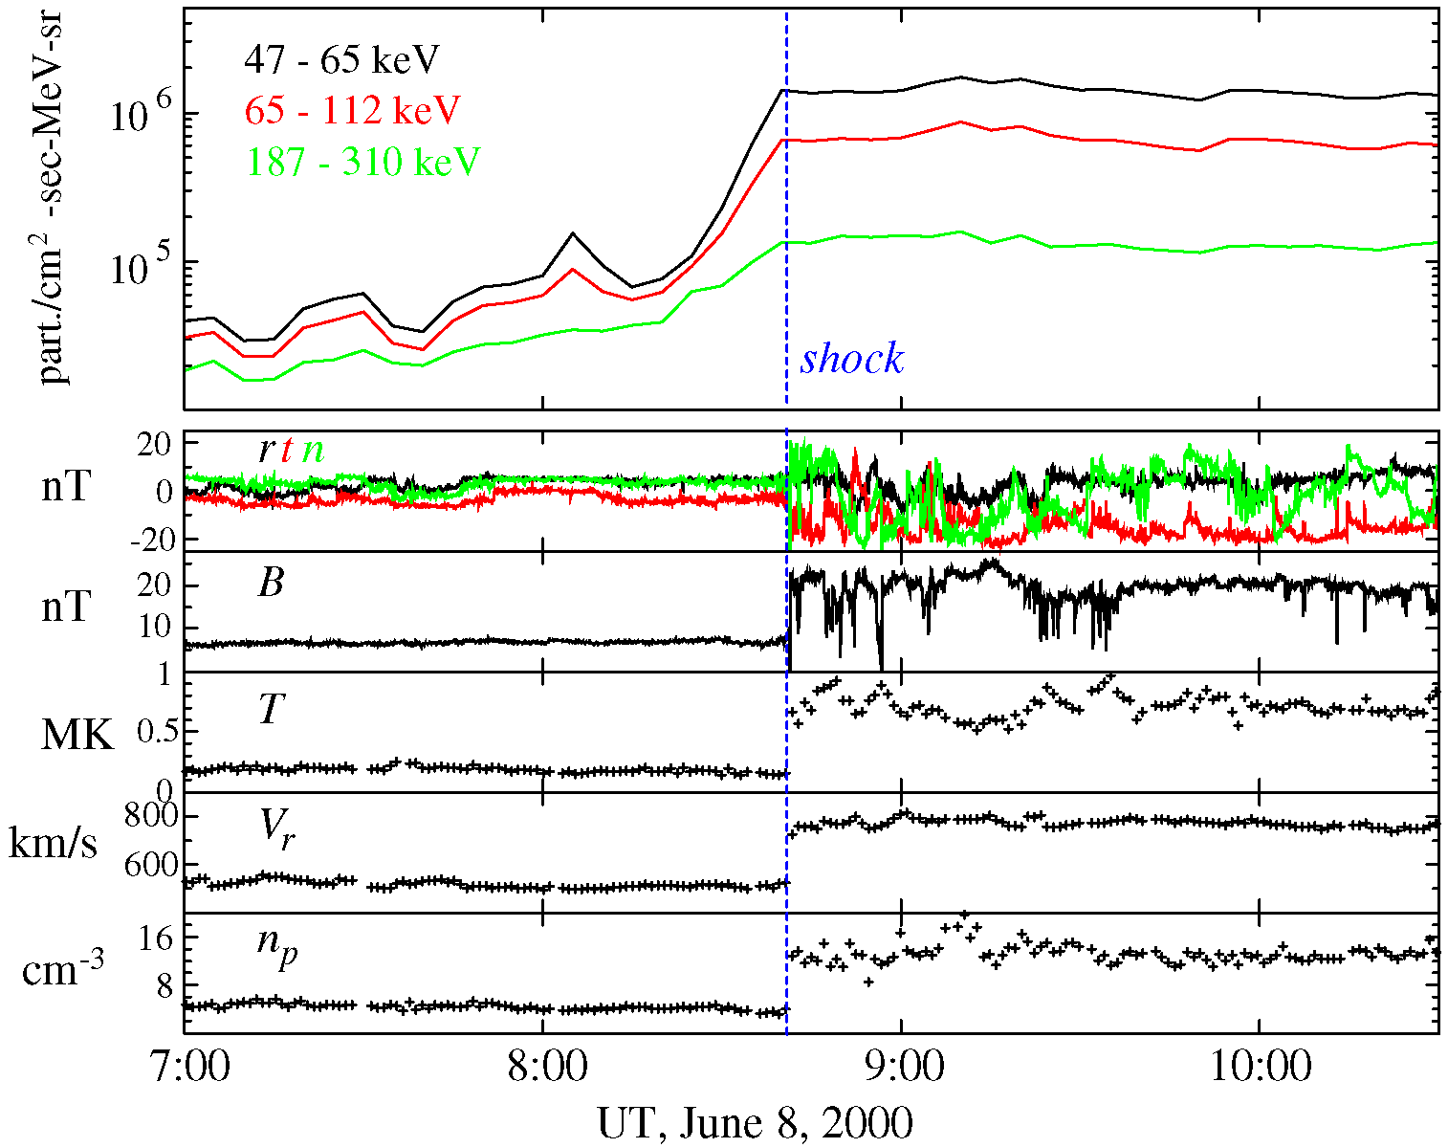
Same event at higher temporal resolution

Slide 50
ISIS Development Plan and Schedule
November , 2013 – I-PDR for ISIS/SOC - This review.
(/2014) S/C emulator available, MOC-SOC ICD finalized - start of development of test SOC
  [CSCI-1] Implementation of GSE-OS at UNH.
  [CSCI-1] Begin writing/implementation of SOC/MOC communications layer [*note]
  [CSCI-1] Start implementation of SOC – instrument teams communication layer
(/2015) Pre-CDR ISIS SOC Peer Review (Paper-only review)‏
  [CSCI-1] As instrument GSEs become operational/established, begin integration of instrument GSE-OS scripts, displays and codes into the SOC GSE-OS system – contingent on instrument GSE schedule
  Purchase SOC HW components - Computers, servers, raids, UPSs, shipping crates, etc.
(/2015) Test MOC available
  [CSCI-1] Begin testing of SOC/MOC interface and communications.
  [CSCI-1] As instrument GSE-OS codes are established at ISIS-SOC, test their functionality.
  [CSCI-1] As instrument commanding protocols/codes are established, test SOC – instrument teams communication layer
  [CSCI-1] As L0 test files become available test or implement HK, quicklook displays for SOC-CTG.
  [CSCI-2] Start work with instrument teams to define L0 -> L1 processing codes

Slide 51
ISIS Science Operation Center
Development Plan - Schedule (2 of 3)‏
(/2017 ) Pre-Instrument Delivery ISIS SOC Peer Review (Full SOC/MOC interoperability)‏
  [CSCI-2] Have full L0 -> L1 codes operational based on test / calibration data
(/2017) MOC comes on-line
  [CSCI-1] Full end-end testing of test SOC to support I&T
  [CSCI-1] Transitioning of test SOC to APL for I&T
  [CSCI-2] Start on work with instrument teams to implement L1->L2 processing codes
  [CSCI-3] Extend PAPCO PRBEM cdf module to fully support ISIS data
  [CSCI-4] Implement initial ISIS web sever with DAS-2 using ancillary data (UNH GEO, etc)‏
(/2017) Pre-Launch ISIS SOC Peer Review (lessons learned from I&T)‏
  [CSCI-1] Transition from test SOC to full flight SOC
  [CSCI-2] Start work on L3 processing codes (needs sample data from other SOCs)‏
(/2018) Mission Simulation #3 fill “in the life” test
  [CSCI-1] Final SOC adjustments, modification
  [CSCI-2] Complete on work with instrument teams to implement L1->L2 processing codes using best currently available calibration information
  [CSCI-2] Complete and implement L3 processing codes

Slide 52
ISIS Science Operation Center
Development Plan - Schedule (3 of 3)‏
  [CSCI-2,4] Implement and test SOC-SDC Quality control loop
  [CSCI-3] Test full PAPCO operability with existing L1, L2 test data
  [CSCI-4] Have working version of ECT web site with L1 to L3 data and ancillary data
(/2018) Launch [L]
  L to L+60days – Instrument Commissioning. Real Time SOC operations via Portable SOC at APL
  >L+60days - Nominal Phase E Operations. SOC ops transitioned to fixed SOC at UNH.
  L+90days – Return Portable SOC to UNH as redundant backup unit
(Phase E) – normal ISIS-SOC operations at UNH
  [CSCI-2] refinement of calibration procedures in L1-L2 codes based on on-orbit performance
  [CSCI-2] Implementation of L3 -> L4 processing codes
  [CSCI-3] Addition of Level 4 data products
  [CSCI-4] Addition of Level 4 data products
  [CSCI-3] (PAPCO) implementation of addition feature request from instrument teams
  [CSCI-4] (DAS-2) implementation of addition feature request from instrument teams
(TBD) Archive Activities

Slide 53
ISIS SOC Test Plan
GSEOS & Commanding
  Create commanding scenarios
  Test connectivity to MOC
  Interfaces to EPI-Hi and EPI-Lo
  Test command load on Flat-Sat at UNH
Data flow between facilities
  Creation of faux telemetry stream
    State-of-Health packets
    Science Data
  Test flow from MOC to SOC
  Test creation of science data through level 1 from telemetry stream through pipeline

Slide 54
Current Status
  Partial components of ISIS SOC exist in the IBEX SOC
  ISIS SOC GSEOS systems to be constructed
    J. Legere to start working with instrument teams
  Facilities for the ISIS SOC including the SOC room and secure server room in existence and ready for ISIS SOC servers

Slide 55
ISIS SOC is READY!
ISIS SOC team will support
→ Testing throughout Development
  → SPP Integration &Test

Slide 56
Additional Slides

Slide 57
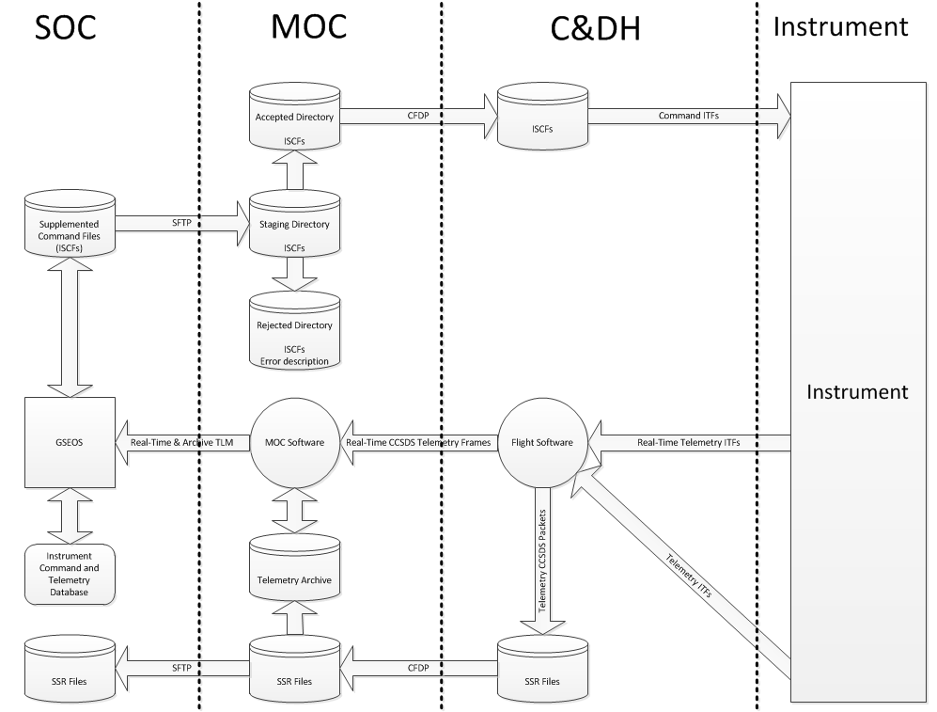

Slide 58
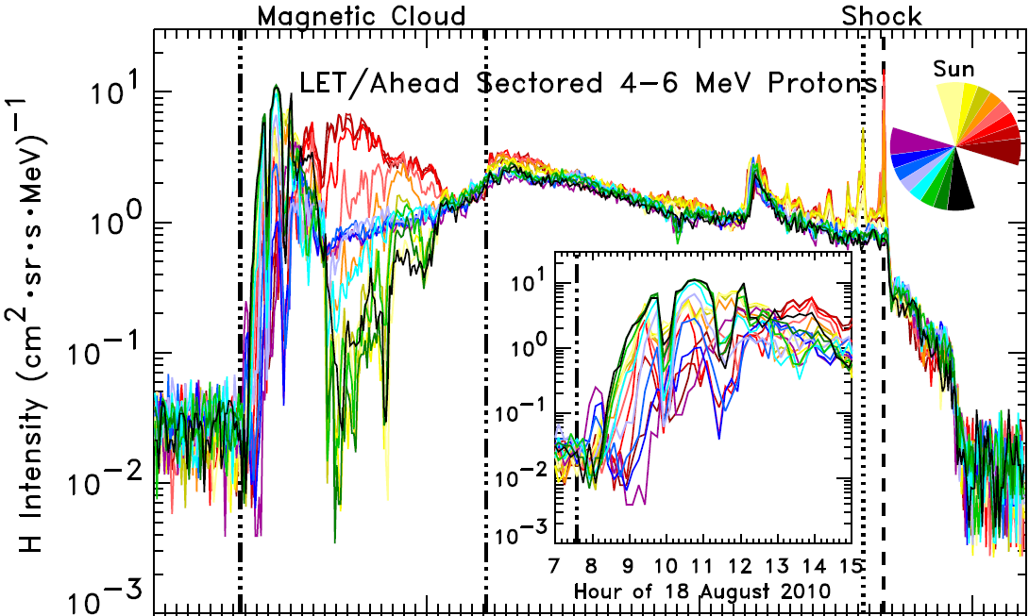
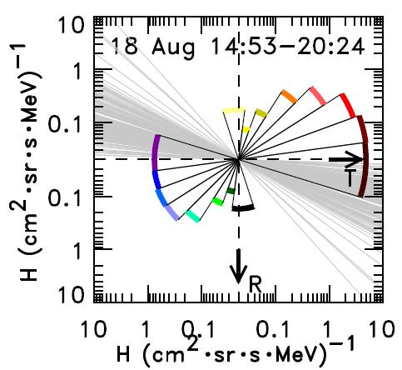
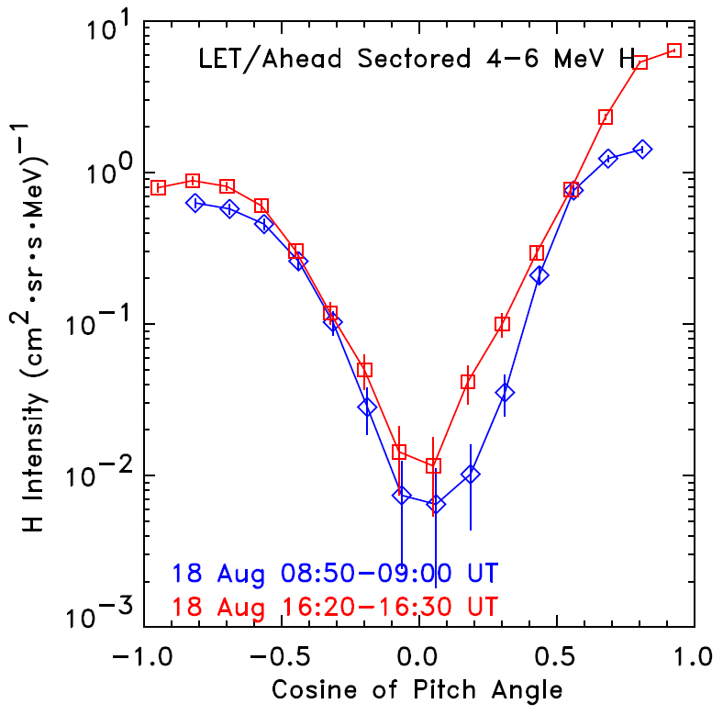
STEREO Sees Enormous Proton Anisotropies in a Solar Energetic Particle Event
Usually Solar Energetic Particles (SEPs) are mostly isotropic, with nearly equal intensities coming from all directions, although sometimes a “beam” of particles may appear for a few hours at the start of an event as particles stream outward from the Sun along magnetic field lines.
The Low Energy Telescope (LET) onboard the twin Solar Terrestrial Relations Observatory (STEREO) spacecraft measures particle intensities in 16 viewing directions in the ecliptic (as illustrated by the color wheel in the top plot). During an SEP event on 18 August 2010, LET on STEREO- Ahead saw vastly different proton intensities in different directions, with intensities in some directions nearly 1000 times higher than those in others. These large anisotropies persisted for a long time, nearly 17 hours into the event.
Particle intensities were highest along the magnetic field direction (shown by gray lines in the lower left plot) and lowest perpendicular to the field, and they traveled in both directions along the field (bottom two figures).
4 days earlier, the same solar active region produced a coronal mass ejection with a magnetic cloud, a structure of magnetic field lines twisted like a rope, with both footpoints anchored at the Sun. STEREO-Ahead was passing through this magnetic cloud when the 18 August event went off, sending particles down both legs of this conduit in a tight beam. The structure of the cloud caused the unusual distribution of particle intensities.
Figures from Leske et al., Solar Physics, 2012 (in press)

Slide 59
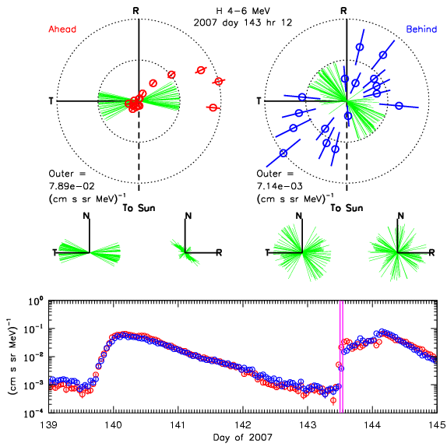
Pitch angle distributions from LET for the onset of the May 23 event
(Alan Cummings makes movies of LET data using 1-hr averages. See 3 slides & Chollet et al. 2011)
139 140 141 142 143 144 145

Slide 60
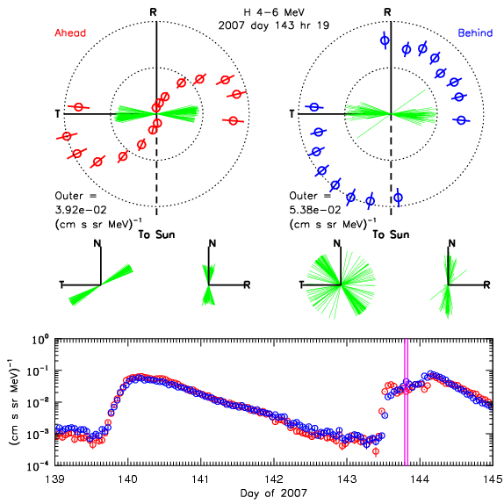
139 140 141 142 143 144 145

Slide 61
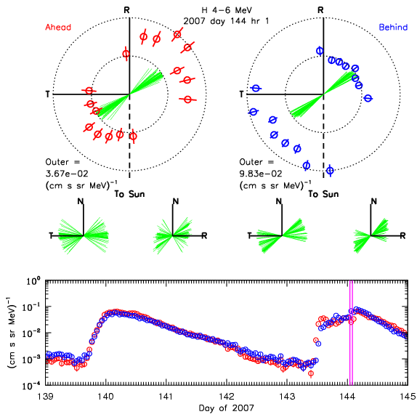

Slide 62
Example of display
by Brandon Dotson
Plotted relative to the magnetic field
The horizontal scale is Day of 2010

Slide 63
LV and HV Checkout
May be staggered, e.g., shift 1 EPI-Lo, shift 2 EPI-Hi, etc (IS THIS OK?)
Both EPI-Lo and EPI-Hi require real-time commanding with simultaneous up/down linking and access to data during the initial turn-on
EPI-Lo 3 days for LV and HV Checkout (approx. 1 track ~ 10 hours each )
  Ideally consecutive/otherwise within a few days of one another
  Day 1. LV checkout, including biasing SSDs.
  Day 2. HV checkout 1. Initial ops and testing to low/intermediate voltage
  Day 3. HV checkout 2. If no problems ramp to full voltage, gather engineering data
EPI-Hi 2 days for LV and HV checkout (~4-6 hours each )
  Day 1. Check engineering data, single-detector, and coincidence count rates and detector discriminator levels. Most likely send commands to run diagnostic tests and possibly adjust thresholds if there are noisy detectors.
  Day 2 can either be consecutive or a few days later. Will also want real time data and ability to send commands to adjust discriminator levels based on data from Day 1. Could possibly upload revised tables.

Slide 64
Commanding in First 2 Months
Based on STEREO experience EPI-HI will require 10-20 opportunities (on separate days) to send a few commands in the first two months
  Necessary to obtain/analyze at least a few hours of new data in between command opportunities to test whether the commands worked
  Therefore, we need to collect data between commanding opportunities

Slide 65
Nominal Operations
R<0.25 AU
  Full nominal power
  High data collection rate and burst mode
0.25< R<0.76 AU
  Full power when not downlinking
  Full power or low-power mode when downlinking
  Reduced data collection rate
  A commanding window should be scheduled late in the series of telemetry passes, although it may not be used every orbit.
R > 0.76 AU
  Full or low-power mode
  Reduced data collection rate

Slide 66
Prelim Data Downlink Requirements
 | Perihelion (<0.25 AU) | Cruise (>0.25 AU)
I-EPI-Hi (rate) | 3.2 kbps | 60.5 bps
I-EPI-Hi (total) | 3.2 Gbit/orbit | 0.7 Gbit/orbit
I-EPI-Lo (rate) | 12.6 kbps | 225.4 bps
I-EPI-Lo (burst) | 51.7 kbps | 200 kbits/orbit
I-EPI-Lo (total) | 12.7 Gbit/orbit | 2.7 Gbit/orbit

Slide 67
Prior to Second Encounter
Once telemetry from the first encounter starts, the high-priority Status-Summary file is sent down first to permit health and safety monitoring
Bulk of EPI-Hi science data will be in lower-priority files that will be sent down as down-link permits.
Inevitable need for commanding opportunities to adjust on-board analysis system, fine-tune thresholds, repeat diagnostic tests, late in series of telemetry passes.

Slide 68
Content Guidelines for the Definition of the ISIS Con Ops
Instrument deployment requirements, if any - Where in timeline?
  -Requirements on spacecraft during deployment
2. Instrument check-out requirements
duration, power, data, command opportunities
3. Requirements prior to Solar Encounter
4. Solar Encounter ops scenario(s)
5. Data downlink requirements, downlink preview data/selected data
6. Special operations requirements (such as software loads, memory refreshes, etc.)

Slide 69
Operations Concept Drivers
No requirement to change spacecraft attitude during solar encounter science operations
  Enables decoupled spacecraft & payload operations
Sufficient power for all instruments during solar encounter phase
  No duty cycle requirements on instruments
  Enables decoupled spacecraft & payload operations
7 Venus fly-bys and multiple TCMs
  Requires mission design & navigation team interfaces
  Requires detailed maneuver planning & execution process
  No payload operations during Fly-Bys

Slide 70

Orbital Operations Planning Concept
0.25 A.U.
Solar Encounter
Period
24 Solar Encounter Orbits
Orbital Periods Vary (169 days to 88 days)
(~ 11 Days)
Cruise/Downlink Period
0.25 A.U.
Solar Encounter Period
Cruise/Downlink Period
  Encounter Phase
  Primary science data collection phase – All instruments can be powered on
  LGA periodically available for communications & Nav
  Real-time commanding supported but not nominally planned
  Cruise Phase
  All instruments nominally powered off
  LGA for communications – H/K data only
  Commanding as needed to support spacecraft maintenance
  Instrument commanding for next encounter
  Science Downlink Phase
  All instruments nominally powered off
  HGA for communications – SSR playbacks
  Commanding as needed to support spacecraft maintenance

Slide 71
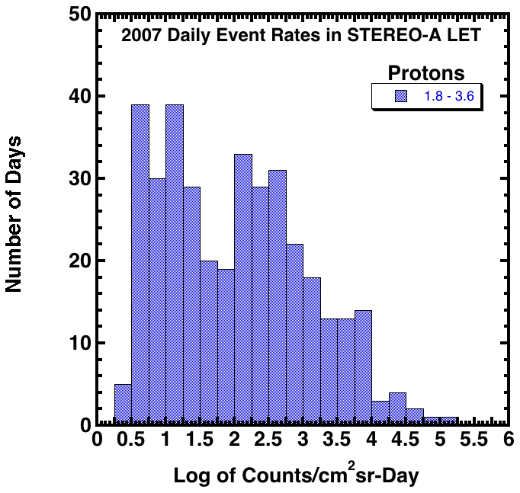
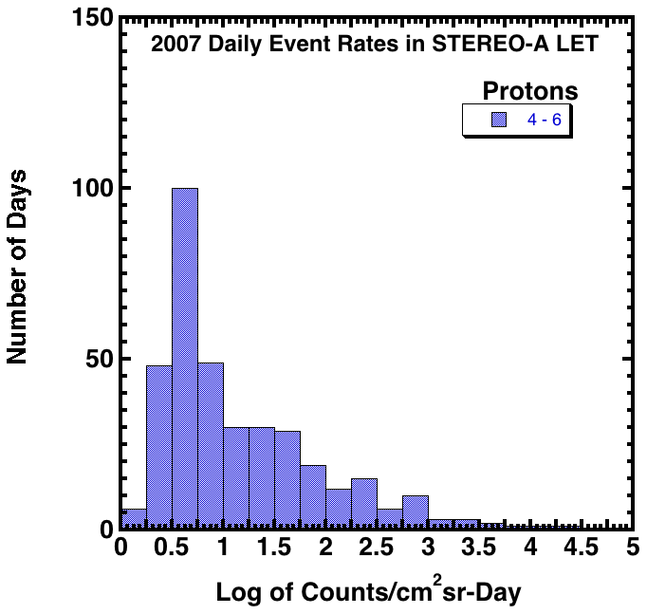
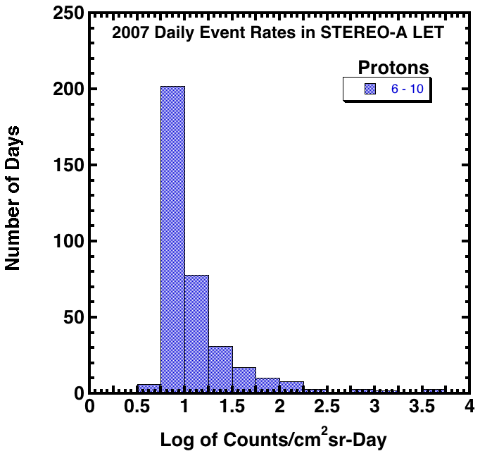
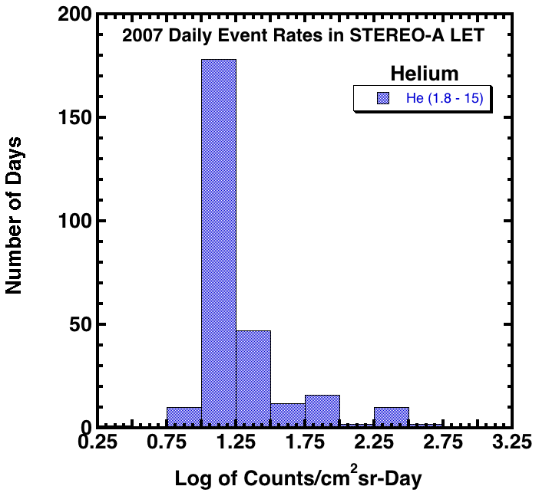
Examples of Daily event Rates based on 2007 STEREO Data
(higher H and He rates mostly in CIR events and 2 small SEP events)

Slide 72
Calibration
EPI-Hi In Flight Calibration – Illustrated with Examples from STEREO/LET
the main data product from EPI-Hi consists of count rates as a function of species, energy, look direction, and time
species are determined from plots such as the one shown in the figure
each point on the plot derived from the measurement of a single energetic particle
black tracks correspond to different chemical elements
red lines defining boundaries between tracks are derived from a combination of calculations and corrections based on pre-flight accelerator test data
the locations of the species boxes must by checked (and possibly adjusted) in flight
without this adjustment the count rate data can be seriously compromised
once the box locations have been correctly set they should be stable for years
Fe
Si
O
C
He
H

Slide 73
Calibration
EPI-Hi In-Flight Calibration – Importance of Measurements during an Active Period
One active day in December 2006
One quiet day in January 2007
one active day of data can be sufficient for calibrating the locations of the tracks of all major elements
data from a quiet day can give a good indication of the location of the proton track, but data are too sparse to calibrate tracks for most heavier elements

Slide 74
Proposed In-Flight Calibration Plan for EPI-Hi
in-flight calibration should be done after instrument commissioning has been completed; at that time detector thresholds will have been correctly set and basic functionality of the instrument will be have been checked
in-flight calibration should take place as early as possible, preferably with enough time before first perihelion pass to allow evaluation of calibration data and adjustment of instrument parameters before the pass
one day of data, even under quiet conditions, will be useful for allow checking the proton track location
checking the location of heavy element tracks will require either a day of data taken during a significant solar energetic particle (SEP) event or an extended period of data collection under quieter conditions
large SEP events events could be rare in 2018 (near solar minimum) and their occurrence can not be reliably predicted
need to have enough flexibility in scheduling so that a day of data accumulation can be scheduled with no more than 1 to 2 days notice when an active period does occur
it is possible that no suitably-active period will occur before the first perihelion pass; in this case our best guess at species box locations will be used and calibration will be required during the first orbit that has significant activity

Slide 75
In-Flight Calibration Plan for EPI-Hi – Continued
in boxes we need to downlink a large sample of individual pha events containing the detailed information from which the black points on the plot are derived
during normal operation (not calibration), only a small subset of the pha events are transmitted to the ground, thereby maintaining a modest a EPI-Hi telemetry allocation
an average pha event consists of approximately 100 bits
to calibrate species boxes for all of the EPI-Hi telescopes and energy ranges will require~10⁶ pha events acquired during a relatively large SEP event (the plot at the left contains ~15,000 data points), thus ~100 Mb of downlinked pha data
EPI-Hi will provide a mode for collecting pha events for transmission to the spacecraft at a higher than the normal bit rate in order to efficiently collect these data
Fe
Si
O
C
He
H

Slide 76
Telemetry volumes
Up to 125 Gbits collected each orbit
  Assumes 11.6 days near perihelion
  138 .5 days in cruise phase
 | Perihelion (<0.25 AU) | Cruise (>0.25 AU)
I-EPI-Hi (rate) | 3.2 kbps | 60.5 bps
I-EPI-Hi (total) | 3.2 Gbit/orbit | 0.7 Gbit/orbit
I-EPI-Lo (rate) | 12.6 kbps | 225.4 bps
I-EPI-Lo (burst) | 51.7 kbps
I-EPI-Lo (total) | 12.7 Gbit/orbit | 2.7 Gbit/orbit

Slide 77
Orbit Planning Activities
Detailed operations planning performed for each orbit
  24 total orbits (Orbital period varies between 169 - 88 days)
Key operations planning required for each orbit include:
  Venus Fly-By Events
  TCMs
  Spacecraft Slews
  HGA downlink opportunities
    High priority downlink periods each orbit
    Dictates SSR management scheme
    Slews will be required for some downlinks
  Spacecraft housekeeping & maintenance activities
    Flight software loads Command Sequence Uplinks
    Autonomy loads Parameter maintenance
    Special sub-system and/or payload tests
  Eclipse & solar conjunction periods
  Doppler range & Delta-DOR tracking requirements
  Solar encounter operations (POCs)
Orbital operations template created to capture and schedule these activities

Slide 78
Orbital Operations Template
Activity
Week
(P-9 to P-7)
Week
(P-7 to P-5)
Week
(P-5 to P-3)
Week
(P-3 to P-1)
Week
(P-1 to P+1)
Week
(P+1 to P+3)
Week
(P+3 to P+5)
S/C Phase
Cruise
Science D/L
Cruise
Encounter
Cruise
Spacecraft Housekeeping
Latch Valve
Test (99)
Instr. S/W
Load (136)
G&C Ephem Load (152)
Load Tlm
Tables (178)
SSR Playbacks
TBD frequency & duration
Delta- DORs
SSR Playbacks (10 hrs/day)
(125 – 139)
TCMs
Venus Fly-bys
TCM # 5 (101)
Venus Flyby # 3 (115)
Science Data Collection
(156 – 167)
Solar Encounter
Eclipse Period
(169 1.5 hrs)
Solar Conjunction
SEP < 1.0 deg for 12 hrs
(155)
SSR Playbacks (10 hrs/day)
(125 – 139) HGA
Contacts for H/K data & NAV
(156 – 157) LGA
TCM & Flyby DSN supports
(100 – 120) LGA
DSN Contacts
P = Perihelion
Note – Numbers in parentheses denote DOY for illustrative purposes only

Slide 79
Decoupled Payload
Operations
Heritage on TIMED, STEREO and planned for RBSP
Instruments operate independently of S/C bus operations and each other
Nominally all instruments are powered ON for this approach
  Enough power to operate all instruments simultaneously during entire solar encounter
  Outside of solar encounter may not have enough power to operate all instruments simultaneously
No requirement to change spacecraft attitude during normal instrument operations
  Except for periodic calibrations?
Instrument POCs operate their instrument (plan, cmd, assess)
  Instrument POCs forward commands to MOC independent of station contact times; commands are stored in a POC Queue; Queue is opened during station contact and commands are transmitted to S/C.

Slide 80
Decoupled Payload Operations
S/C bus controls power switching to the instrument’s main power
Instruments cannot command the S/C bus (i.e. cannot control S/C Attitude or Power switching)
Mission Operations Team (MOT) operates the S/C bus and controls power status of Instruments – normally always ON
Mission Operations Center (MOC) monitors detailed Health and Status of the Spacecraft Bus through “alarms”
Each Instrument POC is responsible for monitoring their own instrument’s health and safety
  MOC monitors high-level instrument Health and Status
    Current draw from bus
    Temp sensors from S/C bus

Slide 81
Questions from the MOC
What is needed during commissioning?
Before 0.25 AU do we *require* data?
What do we need before 0.25 AU?
How do we want to split out the three available files?
  Status/Summary
  Nominal mode data
  Burst Data
Note that we will have up to 3 files, and may have different APIDs within each file

Slide 82
Additional Questions
Will not have much time before solar passes (<0.25 AU)
  Two levels of changes
    Changes to upload prior to next solar pass
    Changes to upload prior to (next solar pass + 1)
~Daily snapshots (or on some cadence)
  This would allow us to get down and analyze data covering the solar pass quickly to assess what changes will be needed in the next solar pass

Slide 83
Data Products (2/3)

Slide 84
Data Products (3/3)

Slide 85
BACKUP

Slide 86
ISIS Science Operations Center Description: “Test as you Fly, Fly as you Test”
EPI-LO
(same as EPI-HI shown below)
Common GSE-OS platform for instrument GSEs/SOC
Instrument GSEs may have two types of operation:
- Specific: direct connection to instrument test ports
- Flight Mode: spacecraft simulator → instrument
GSE Flight-Mode operation incorporated info the SOC GSEO-OS system. Identical “look and feel” to the instrument/SOC teams during testing, I&T, commissioning and normal flight operations
SPP MOC/APL
(Mission Operations Center)
Instrument
Commands
Data/SOH
Level Zero
SPP S/C
simulator
EPI-HI / Cal Tech
ISIS SOC/UNH
(Science Operations Center)
Detailed Diagnostics
EPI-LO
EPI-HI
Flight Mode Data/SOH
EPI-HI GSE
(GSE-OS)
ISIS Instrument Team Input
Duplicates SOC functionality
Instrument specific
functionality

Slide 87
Command-Load Sizes
EPI-Lo
  Command lengths vary.
    For example to set a HV level would require five bytes.
    Table loads would need much more space, typically 256 bytes
EPI-Hi
  Instrument commands are variable in size.
    Routine instrument commands are generally 10 - 100 bytes.
    Flt software patches can be hundreds of bytes.
    Flt software binary upload would be thousands of bytes.
  For the longer commands and table uploads, we generally break the upload into a sequence of separate commands designed to fit into the size of the CCSDS telecommand packet defined in the MOC-SOC ICD.
  During the definition of the MOC-SOC ICD, we work with the MOC and SOC to ensure that the sequencing of these multi-packet uploads can be properly orchestrated, with appropriate hand-shaking, etc.

Slide 88
Number of commands in an orbit
EPI-Lo
  Plan to be in one mode throughout encounter (< 0.25 AU), so there should be few to none.
  Still the possibility that we might want to use a super-high rate "burst mode" during intervals within 0.25 AU, but ideally that would require only a macro to be fired to set the new mode and another macro to return to the old mode. Maybe a few bytes for each operation.
  More commands during cruise as we power on/off and into various modes.
  Many commands during commissioning.
EPI-Hi
  We do not yet know

Slide 89
ISIS Macros
EPI-Lo
  Macro capability and plans to use it
EPI-Hi
  Macro capability
  Mix of macros and “raw commands”

Slide 90
Commissioning
At least once during the instrument commissioning period, and perhaps occasionally afterwards, ISIS will need to collect a large quantity of raw event data (e.g., Pulse Height Analysis measurements) during a sizable SEP event outside 0.25 AU. Obtaining high quality ion composition is one of the prime reasons for this need.
EPI-Hi Commissioning several days
EPI-Lo Commissions 7 days

Slide 91
EPI-Lo Commissioning
EPI-Lo Commissioning
EPI-Lo Post-Launch Operations
From launch to mission day ≥14.
- EPI-Lo remains off except for decontamination heaters (or elevated temperatures using S/W controlled S/C heaters)
EPI-Lo Power On and Checkout
From mission day ≥14 to EPI-Lo checkout day 7
- Day 1: LV checkout, turn HV on to low levels (e.g. MCP=400V)
- Day 3: Bring HV to intermediate (e.g. MCP=1600V)
- Day 5: Bring HV to barely operational (e.g. MCP=1800V)
- Day 7: Bring HV to operational (e.g. MCP=2000V)
Notes
1. Other checkout activities may be run in parallel with EPI-Lo HV ramp up.
2. All HV ramp up should be done with real time visibility, although HV can remain up between passes (off track).
3. Before continuing HV ramp up each day, the data from the previous “night” should be downloaded and reviewed for signs of trouble.
4. It might be possible to conduct these four days of checkout on consecutive days, but this is not preferred.
5. We must delay HV ramp up until after primary deployments are completed, as these can generate contamination

Slide 92
Calibration Science Mode
Calibration Science mode is a mode during which statistically significant samples of Pulse Height Analysis (PHA) event data will be accumulated and returned to validate onboard assignments of species, energy, and incidence angle, and for assessing instrument backgrounds. ISIS requests that this mode be activated outside 0.25 AU by command one or more times early in the mission when and if sufficiently high intensities of solar energetic particles are present for calibration purposes. This mode, which will be used for a few days after activation of the mode, will require the return of a data volume significantly greater than that provided by the Low-rate Science Mode but will be maintained within the ISIS data-per-orbit allocation. The details of implementing this mode are TBD.
Safe mode is a mode where the instrument sits in a ``quiet'' state, awaiting commands from the ground, performing no data acquisition functions. This mode is reserved for instrument I&T, commissioning, and instances where the flight software encounters some irrecoverable fault (TBD).
The modes provided here are quite high level and many additional modes will be defined in the future. Many of these modes will be specific to EPI-Hi and to EPI-Lo. Detailed operation and specification of the mission, spacecraft, and ground systems will influence the modes of the instruments. It is possible that some “modes” rather than strictly being distinct instrument configured modes could be modes of operation.
EPI-Lo has limited storage capacity, while EPI-Hi has none (apart from buffering in RAM). Except for a small amount of EPI-Lo burst data, all engineering and science data are almost immediately sent over to s/c.

Slide 93
OLD – no to use ..

Slide 94
“Do you store the commands inside your instrument and operate on them using the command timing or do you expect the spacecraft to send the commands to you at the proper time?”
EPI-Lo
  Expect the S/C to send commands at the proper times
  Have the capability to load a macro that can then wait for a specific MET to execute a command.
  If command-space is at a premium during particular phases we could utilize this capability by loading a macro during another phase, alleviating the need for the s/c to command us at the busy time.
EPI-Hi
  Expect the spacecraft to send the commands to our instrument at the proper time.
  If we have to implement our own command-storage and timing, it would be an extra instrument Flt software development task, perhaps several days to ~1week of work.

