Slide 1
EPI-Lo Calibration
Don Mitchell
Notes:
introduction

Slide 2
Outline
Introduction
Species and Energy Ranges
Facilities
Calibration Plan
Test Flow
In-Flight Calibration

Slide 3
EPI-Lo Calibration
EPI-Lo measurements are intended to generate the information needed to derive differential intensities (j[cm² -sr-s-keV]⁻¹ )
The goal of EPI-Lo characterization and calibration efforts, is to develop the quantitative procedures for converting the count rates (R [counts s⁻¹]) reported by EPI-Lo into estimates of j for the various defined ranges of energies, particle species, and arrival angles
“Calibration” for a particle instrument like EPI-Lo means determining the following:
Transfer function from counts into flux (physical units)
Characteristic of “Rate-out” versus “Rate-in”
Response to visible and ultraviolet light
Response to high energetic particle backgrounds

Slide 4
Calibration Types
Foreground
Ions and Electrons in the energy range of interest to the instrument
Background
Electrons
Characterize the rates from penetrating radiation
Light
Characterize rejection of UV background, primarily H-alpha
Characterize rejection of sunlight and glint

Slide 5
Accuracy & Precision
Parameter | Required | Goal (Capability) | Comment/Heritage
Electron Energies | 50 - 500keV | 25 - 1000 keV | Electron capability from JEDI, RBSPICE
Ion Energies | 50 keV/nucleon – 15000 keV Total E | 50 keV/nucleon – 15000 keV Total E | Capability partially based on RBSPICE capabilities. Top energy ~250keV/nuc for Fe
Energy Resolution | 45% for required energy range | 40% for required energy range | Telemetry limited
Time sampling | 5 sec | 1 sec | Telemetry and/or statistics limited
Angle resolution | <30° x <30° | Ions, ~15 x 12 to <30° x <30° e-, 45° | Varies with elevation
Pitch Angle (PA) Coverage | 0°-90° or 90°-180°, some samples in both hemispheres | 0°-90° or 90°-180°, some samples in both hemispheres
Time for Full PA | 1 – 5 sec | 1 – 5 sec | Telemetry limited
Ion Composition | H, He3, He4, C, O, Ne, Mg, Si, Fe | H, He3, He4, C, O, Ne, Mg, Si, Fe | He3/He4 ~50 to 1000 keV/nuc
Electron Sensitivity: I=Intensity (1/cm².sr) | j = 1E1-1E6/cm²-s-sr | Sensor-G:0.144 (cm².sr) Pixel-G: ~0.02 (cm².sr) Up to 6E6 1/s counting | j=Intensity (1/cm²-s-sr) G=Geom. Factor (cm²-sr) 8 pixels/sensor
Ion Sensitivity | j = 1E1-1E6/cm²-s-sr | Sensor-G:0.16 (cm².sr) Pixel-G: ~0.002 (cm².sr) Up to 3.5E6 1/s counting (TOFxE) | 80 pixels/sensor

Slide 6
Foreground Calibration Requirements
Foreground Electrons
40 keV to 1000 keV (Needed for understanding backgrounds)
1 keV to 30 keV Electron Gun at APL
30 keV to 100 keV Radioactive sources at APL
125 keV to 1.6 MeV Accelerator at GSFC
Foreground Ions (H, He3, He4, O, Fe)
40 keV to 15000 keV (Level 4 Requirements)
(Goal: protons to 15 MeV)
3 keV to 170 keV Accelerator at APL
30 keV to 5 MeV Degraded alpha sources
125 keV to 1.6 MeV Accelerator at GSFC
1 MeV to 15 MeV Accelerator at LBL

Slide 7
Test as You Fly
The instruments will be tested in flight-like environments
Since the instrument will need to operate in a high background environment, we will characterize response to high energy penetrating radiation, UV light, and low energy plasma (all potential sources of background counts for EPI-Lo)

Slide 8
Background Calibration Requirement
Background Electrons
1 keV to 10 MeV (from the expected environment)
1 keV to 50 keV Electron Gun at APL
125 keV to 1.6 MeV Accelerator at GSFC
1 MeV to 10 MeV Accelerator at Idaho
Background Ions
3 keV to 50 MeV (from the expected environment)
3 keV to 170 keV Accelerator at APL
30 keV to 5 MeV Degraded alpha sources
125 keV to 1.6 MeV Accelerator at GSFC
1 MeV to ~100 MeV Accelerator at LBL
Photons
UV and visible lamps at APL

Slide 9
The JHU/APL Calibration Facility
The APL particle accelerator is a versatile system capable of producing a broad range of ion species at energies from 20 to 170 keV
The system includes a electron-impact ionization source, extraction gap, Einzel Lens and Wien filter mounted in the insulated terminal structure along with all associated power supplies
The system will produce beams of H, He, O, and noble gas ions with intensities over the range of 100’s to 1,000,000 particles/cm²/sec at the target position (mm² - cm²)
We also have a variety of radioactive sources as stimulus.

Slide 10
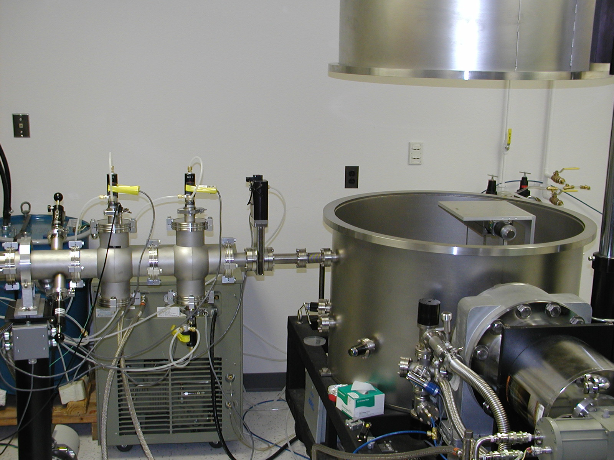
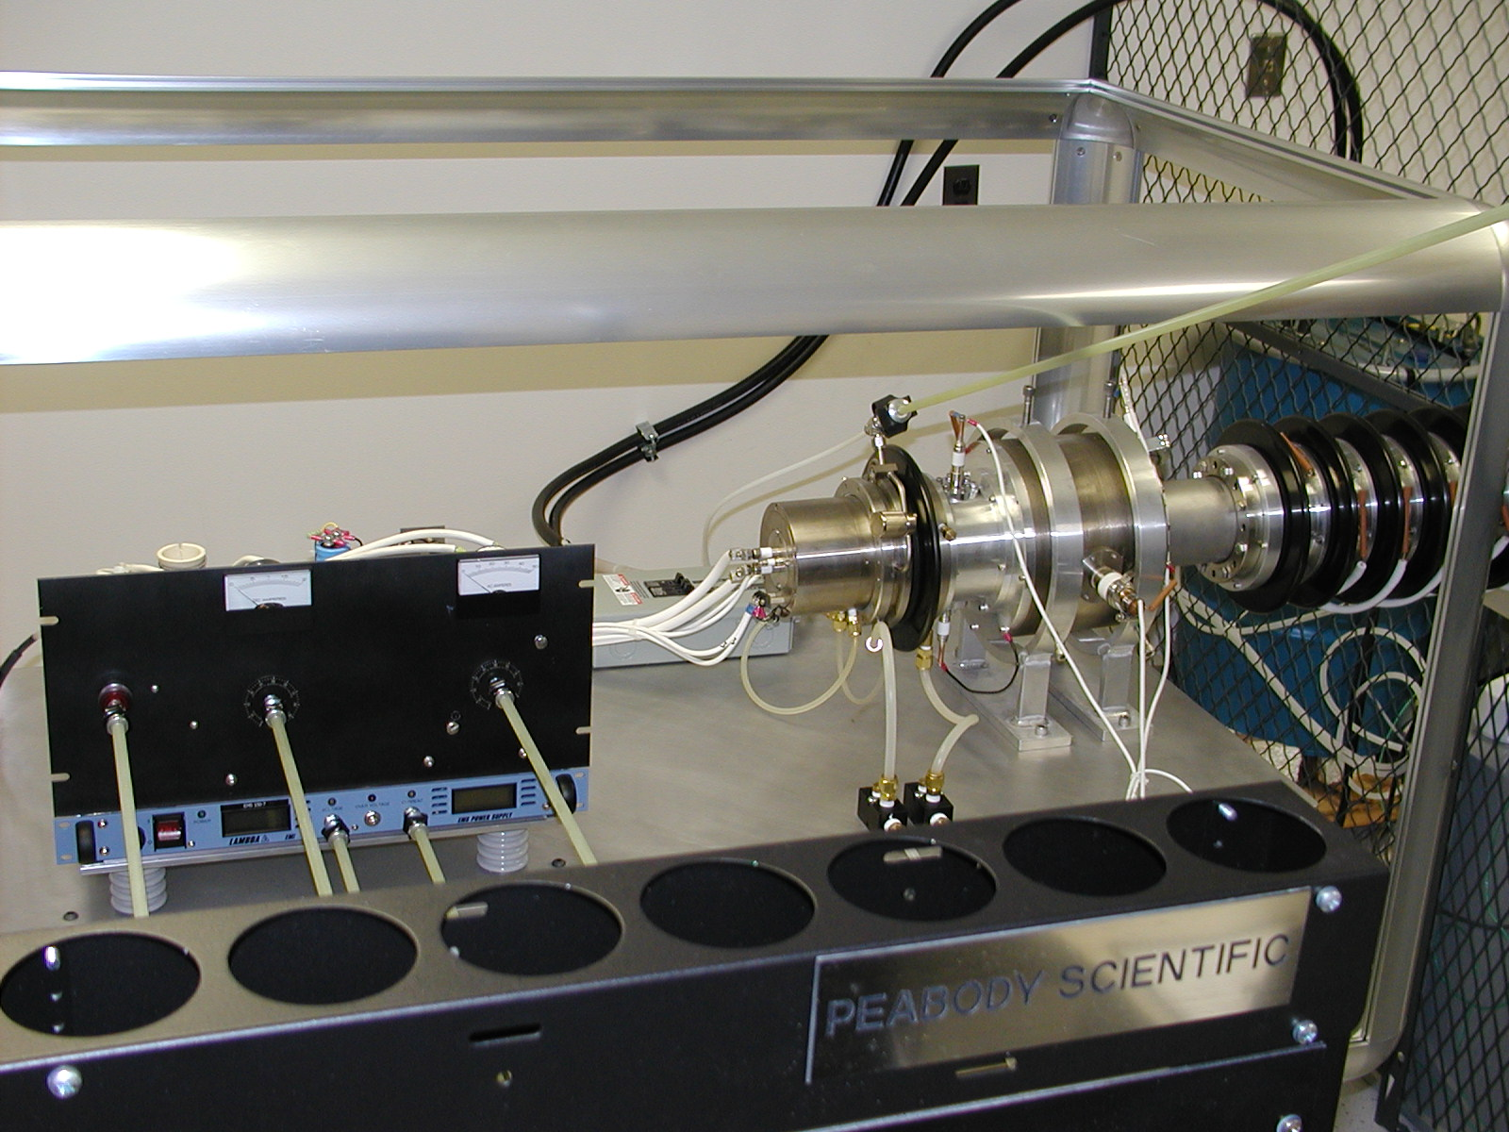
The JHU/APL Calibration Facility
All ions from a gas source
Energy continuously tunable: 3 to 170 kV
Wien filter
Beam intensity between 10 and 10¹⁰ ions/cm²/s
Purposed built articulation stage

Slide 11
Beam Tests at GSFC
It is planned to have four calibration sessions at the accelerator at the Goddard Space Flight Center. Each session starts with a one-day setup, check, and pump:
Session 1: Exploratory run to characterize EPI-Lo
Session 2: Use H beam to scan both angles to complete characterization of the transfer function
Session 3: Characterize sensor response with e- beam from ~100 keV to 1 MeV
Session 4: Use heavy ions (He, O, and Ar) to characterize the instrument response

Slide 12
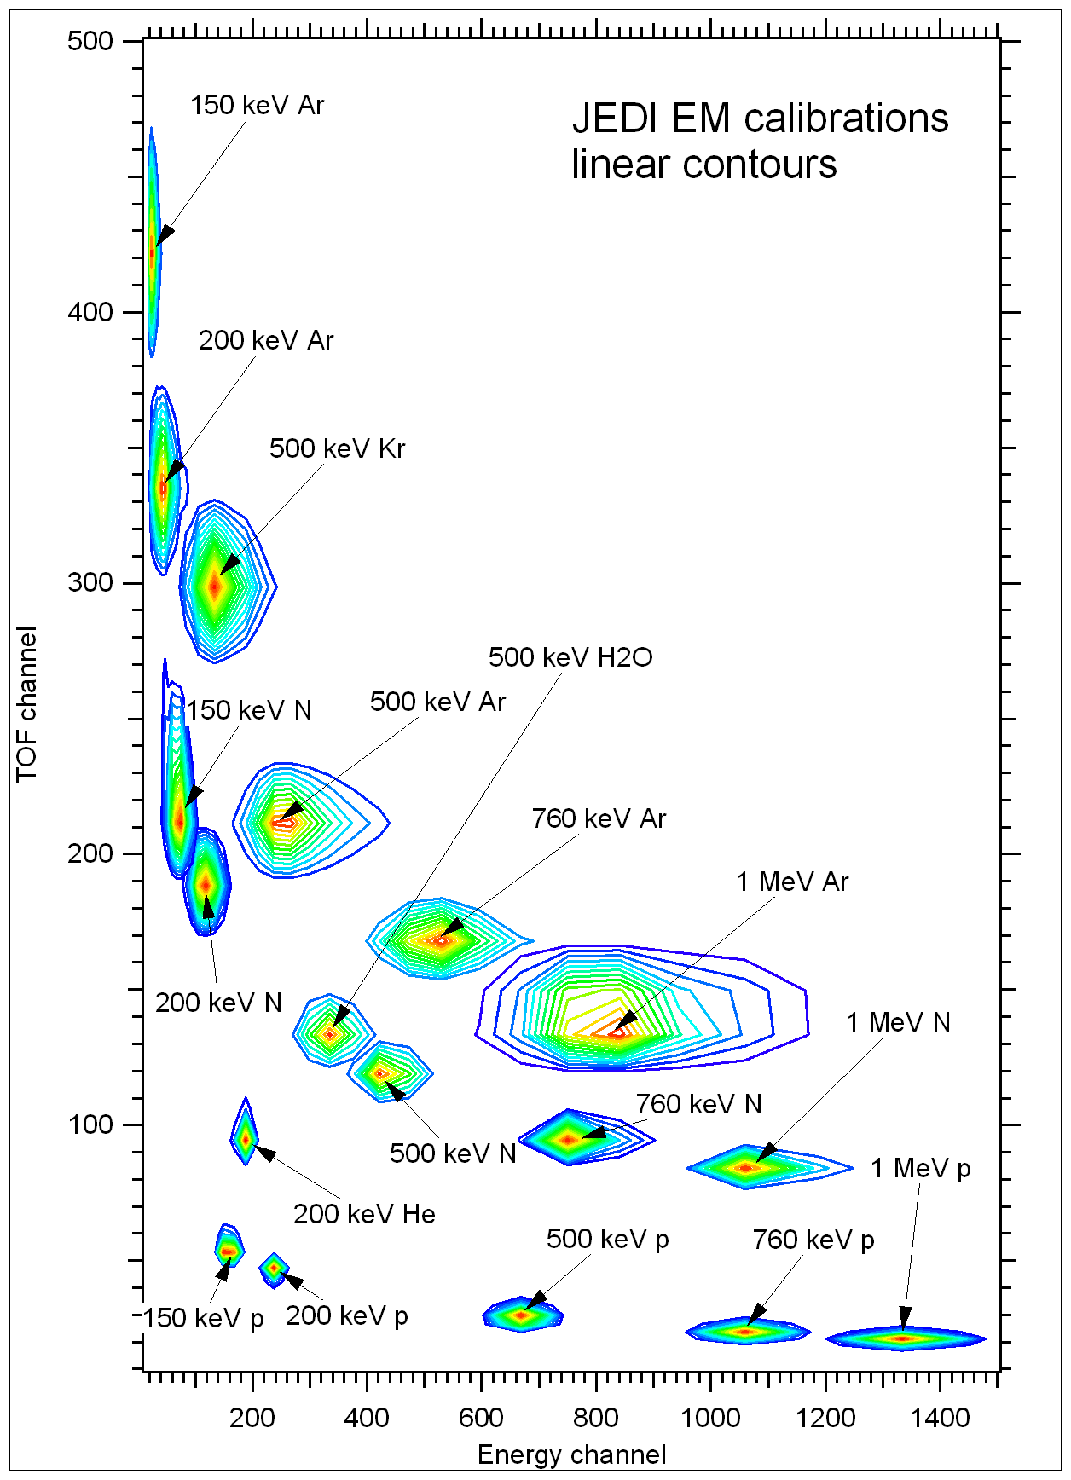
GSFC JEDI EM calibration results
Representative results from JEDI Cal.

Slide 13
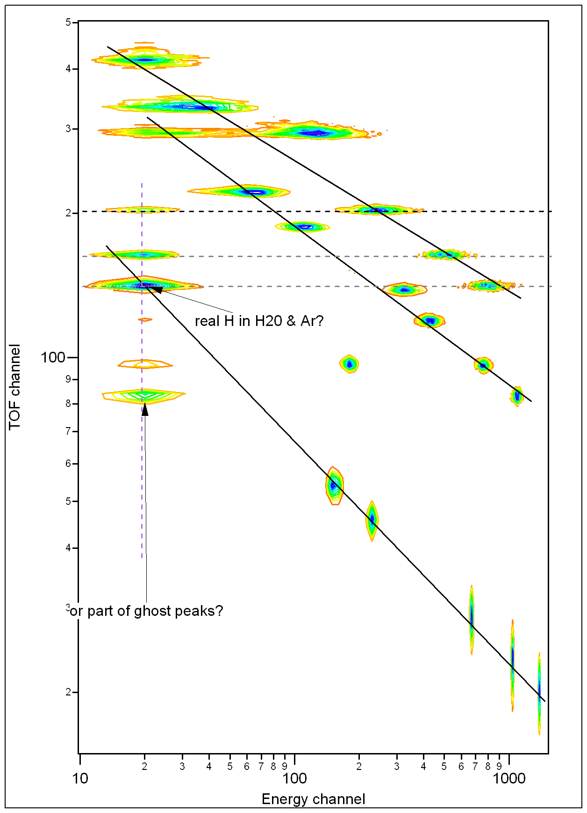
GSFC JEDI EM calibration results
Representative results from JEDI Cal.
Essentially the same figure with log scales and a different histogramming code.
Ghost peaks have appropriate TOF for beam, but low energy. They only appear for high energy heavies, and so are not expected to significantly affect foreground measurements of lower energy particles (they will be a minor contribution to “noise”)

Slide 14
EPI-Lo Development Summary
Component Testing
Aliveness
Limited Performance Test
Assembly Testing
Functional
Limited Performance Test
Prototype “EM” Testing
Validate instrument design and performance
Energy response;
Instrument efficiency;
Instrument geometry factor
Establish testing procedures
Flight Model (FM)
Qualified each unit as proto-flight unit
Test to acceptance levels

Slide 15
Calibration Approach (Flight units)
FM Unit
All instrument integration activities will be performed in a Class 5 clean room environment
Test in bell jar to characterize geometry, energy response, and sensitivity
Compare with EM results
Calibrate in Beam Facilities at APL, GSFC, and LBL to characterize energy response, sensitivity, dynamic range
Test Philosophy:
FM will be fully calibrated
pre- and post-environmental qualification spot calibration
In-flight cross calibration between EPI-Lo and EPI-Hi

Slide 16
EPI-Lo Calibration Schedule
Final calibration for FM slated for three weeks
Major calibration efforts will be performed at APL facility
Substantial understandings of the instrument performance will be made with the EPI-Lo EM characteristics

Slide 17
Tests at Instrument Level
30
*Science requires relative/absolute accuracy: 20%/50%. Ground calibration 20% precision, reduced to 10% in flight.

Slide 18
In-Flight Calibration
On-orbit and cruise calibration achieves relative calibration to 10% precision
Uniformity confirmed by evolution of pitch angle distribution from onset to shock passage.
Such calibrations cover the entire energy and FoV coverage with linear instrument response (targeted rates, no pulse pileup)
Built-in features to determine on-orbit instrument ion performance
Measure pulse-height spectrum of secondary electrons from incident protons as function of time-of-flight
Unit has built-in stimulus to inject known pulse through the front-end electronics

Slide 19
Summary
Calibration plan satisfies all Level IV requirements
Calibration facilities have been identified that meet EPI-Lo needs
APL operates and maintains the key EPI-Lo calibration facility which allows maximum flexibility
Begin component testing
Questions?

