Slide 1
Verification
Nigel Angold
Notes:
introduction

Slide 2
Verification - Outline
Documentation
Verification Process Definition
Verification Program Concept
Verification Program Planning
Verification Methods
Requirements Verification Matrix
Verification Process
Performance Requirements
Environmental Requirements
Interface Requirements
Assurance Requirements

Slide 3
Documentation
SPP System Verification and Validation Plan, 7434-9099
ISIS Verification and Validation Plan, 16105-ISIS_VVP-01
These documents define the Verification Process:
Verification Program Concept
Verification Program Planning
Verification Methods
Requirement Verification Matrix
Verification Process
Notes:
NOTE: this is the outline provided by Scott

Slide 4
Verification Process Definition
Verification Program Concept:
ISIS instrument requirements verification is part of the overall SPP verification campaign.
EPI-Lo requirements will be verified by APL.
EPI-Hi requirements will be verified by Caltech.
Tracking of all ISIS requirements verification will be performed by the ISIS Systems Engineer, reporting to the SPP Requirements & Verification Engineer.
Notes:
NOTE: this is the outline provided by Scott

Slide 5
Verification Process Definition
Verification Program Planning:
Verification and Validation Plans produced before PDR.
Test and Calibration Plans, inputs for I&T before CDR.
Test, Verification and Calibration reports generated throughout all pre-launch phases.
Notes:
NOTE: this is the outline provided by Scott

Slide 6
Verification Process Definition
Verification Methods:
Test Most requirements should be verified by test or supported by quantitative test data.
Analysis Some requirements cannot be verified by test (e.g. due to cost or physical limitations) or may not be fully verifiable by testing alone.
Demonstration Applied to some qualitative requirements that cannot be easily tested or requirements that cannot be tested over a full range of relevant scenarios.
Inspection Used to verify a describe a design characteristic or method or where a requirement may be satisfied solely by the review of documentation.
Every requirement must be verified by one or more of the above methods.
Notes:
NOTE: this is the outline provided by Scott

Slide 7
Verification Process Definition
Requirement Verification Matrix:
Tracking of verification by means of matrices containing:
Requirement reference number
Requirement Description
Verification Method: one or more of Test, Analysis, Demonstration and Inspection
Verification Activity
Closure Status: closed, open, waived, deferred, etc.;
Closure Date
Responsible Organization
Comments
Notes:
NOTE: this is the outline provided by Scott

Slide 8
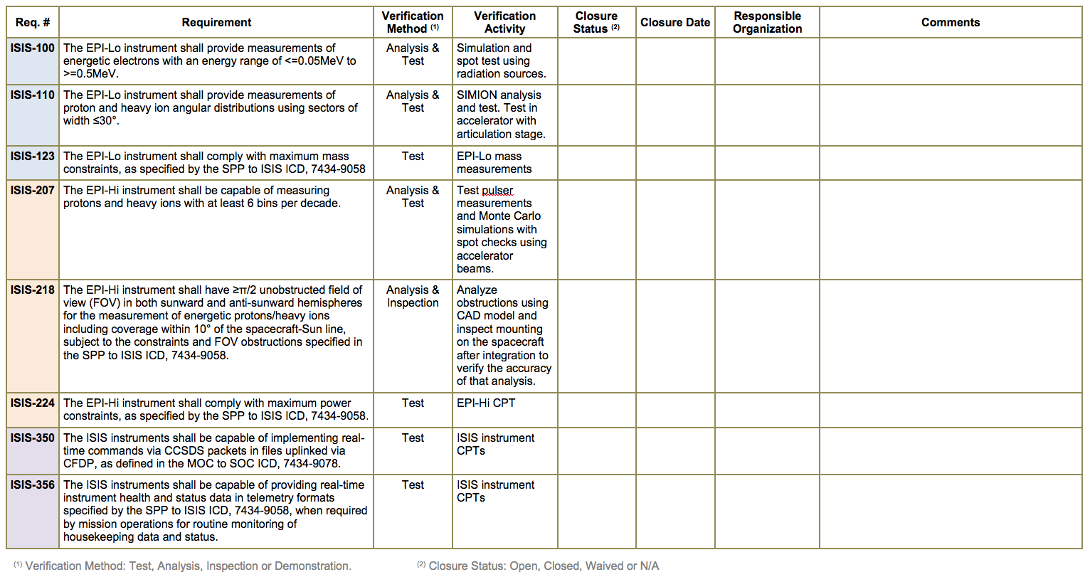
Verification Process Definition
Example Verification Matrix entries from ISIS IRD:
Currently tracking 82 instrument requirements in the IRD Verification Matrix
Notes:
NOTE: this is the outline provided by Scott

Slide 9
Verification Process Definition
Verification Process:
Development of Verification Procedures
Procedures approved by the design engineer, the systems engineer, the project manager, and QA and released prior to execution.
Will comply with the format requirements and configuration control authority of the originating agency (APL, Caltech, or SwRI).
Performance of Test Readiness Reviews
Required before installing flight hardware into a test environment.
Test Execution
Test engineer assigned
QA participation
Equipment calibrated before test
Test procedures under document control
Notes:
NOTE: this is the outline provided by Scott

Slide 10
Verification Process Definition
Verification Process continued:
Post-test Reviews
Test results are reviewed and approved by the ISIS SE to ensure adequate verification of requirements.
All hardware non-conformances or failures shall be documented.
Any corrective actions identified shall be processed by the cognizant engineer and elevated as appropriate.
For any test failure, the reason must be identified.
Hardware under test / test setup must not be disturbed in any way that prohibits duplication of a test failure.
The post-test review will result in a “pass” or “fail”.
Completion of the Verification Matrix
Verification is tracked by entering data into the Verification Matrix.
Notes:
NOTE: this is the outline provided by Scott

Slide 11
Verification Process Definition
Verification Process continued:
Requirement Closure
A requirement will be declared “closed” when all verification activities planned for and associated with the requirement have been completed satisfactorily.
Waivers and Deviations
In cases where it may be acceptable that a requirement is not met, a waiver or deviation will be filed with the JHU/APL SPP Project Office, and NASA Goddard Program Office, as appropriate.
The SPP waivers and deviations process is documented in the SPP Configuration Management Plan, 7434-9006.
All hardware non-conformances or failures shall be documented.
Notes:
NOTE: this is the outline provided by Scott

Slide 12
Performance Requirements
Performance requirements are defined in:
Level 1 Requirements for the Solar Probe Plus Mission
SPP Mission Requirements Document (Level 2), 7434-9047
SPP Level 3 Payload Requirements Document (Level 3), 7434-9051
ISIS Instrument Requirements Document (Level 4), 16105-ISIS-IRD-01
Level 2 - 4 documents:
Each document contains a Requirement Verification Matrix.
Level 2 and 3 verification typically inspection of documention verifying lower level requirements found in the ISIS IRD.
ISIS Systems Engineer will flow verification data up to the appropriate document owners.
Performance requirements are formally managed by the SPP Requirements & Verification Engineer and are tracked in the SPP System Requirements Database, DOORS.
Notes:
NOTE: this is the outline provided by Scott

Slide 13
Environmental Requirements
Environmental requirements are defined in:
SPP Contamination Control Plan, 7434-9011
SPP Environmental Design and Test Requirements Document, 7434-9039
SPP Electromagnetic Environment Control Plan, 7434-9040
Environmental requirements documents:
Each document contains a Requirement Verification Matrix.
ISIS Systems Engineer will flow verification data up to the appropriate document owners.
Environmental requirements are not maintained in the SPP System Requirements Database, DOORS.
Notes:
NOTE: this is the outline provided by Scott

Slide 14
Interface Requirements
Interface requirements are defined in:
SPP to ISIS ICD, 7434-9058
SPP General Instrument to Spacecraft ICD, 7434-9066
MOC to SOC ICD 7434-9078
Interface requirements documents:
Each document contains a Requirement Verification Matrix.
ISIS Systems Engineer will flow verification data up to the appropriate document owners.
Interface requirements are not maintained in the SPP System Requirements Database, DOORS.
Notes:
NOTE: this is the outline provided by Scott

Slide 15
Assurance Requirements
Assurance requirements are defined in:
SPP Product Assurance Implementation Plan (PAIP), 7434-9003
EPI-Lo Product Assurance Implementation Plan (PAIP), 7464-9001
EPi-Hi Product Assurance Implementation Plan (PAIP), CIT-SPP-004
Assurance requirements documents:
Each document contains a Compliance Matrix
Comply
Do not Comply
Comply with Caveats
N/A
Assurance requirements are not maintained in the SPP System Requirements Database, DOORS.
The SPP System Assurance Manager is responsible for verification of Assurance requirements.
Notes:
NOTE: this is the outline provided by Scott

