Slide 1
Ground Support Equipment
Reid Gurnee
Notes:
introduction

Slide 2
Outline
Board Level GSE
Spacecraft emulators
GSEOS
Safe / Arm plugs
Calibration GSE
Shipping Containers

Slide 3
Board-Level GSE
Each lead engineer is responsible for developing their own board-level GSE.
  Power Board: Load board, active load, HV load, breakout box, breakout board, I2C stimulus
  Event Board: energy and TOF preamp boards, test port box, breakout box, I2C slave, commercial pulsers
  Anode Board: Commercial pulsers, scope, HV power supply
All GSE is peer reviewed
Need EPI-Hi inputs
RBSPICE CDR August 3 & 4, 2009

Slide 4
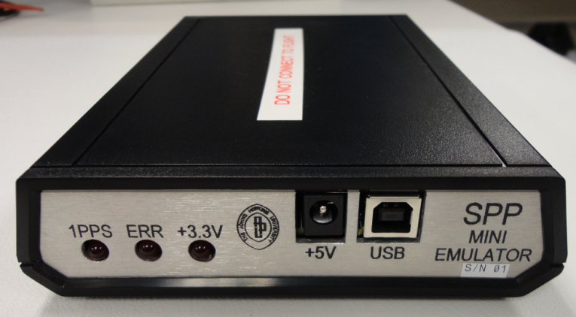
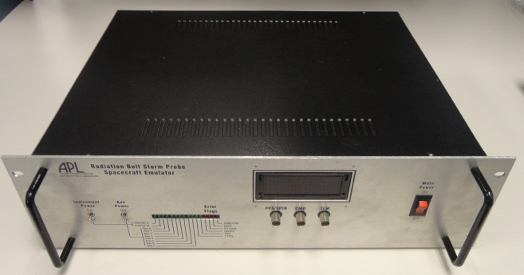
Spacecraft Emulator
Mini emulator
  Provides Instrument Data Interfaces only, No Power Interfaces, No Temperature Interfaces
  Provides virtual 1PPS
  GSEOS Interface is fully compliant
  Non-flight use only
Full emulator
  Provides Instrument Data, Power and Temperature Interfaces (no power supply)
  Provides virtual 1PPS
  Designed for use with Flight hardware
GSE verification performed by project
3 full, 2 mini emulators for ISIS???

Slide 5
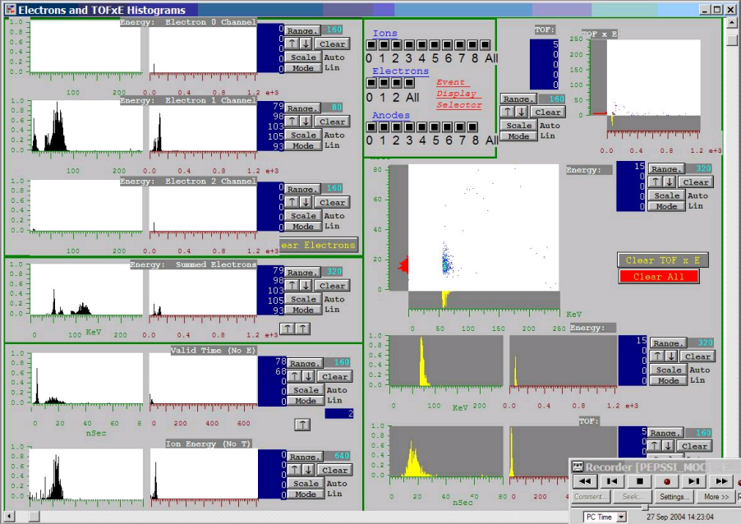
GSEOS
Common GSE software for all instruments
Display screens and instrument customizations can be used through all development cycles from bench testing, I&T deployment, to flight operations
Same platform used for EM, Flight, and Spacecraft operations
  Test scripts can be developed by individual teams, tested on EMs, and then executed at the S/C level
Software verification performed by project

Slide 6
Safe / Arm plugs
EPI-Lo has a HV air-safe plug
  When installed HV is limited to air safe levels (hardware and software limited)
  Plug will be removed for S/C TV testing
  Plug will be permanently removed during final closeout
Instrument covers
  ISIS instruments will have red-tag covers to protect the apertures
  Covers will be temporarily removed for S/C TV testing
  Covers will be permanently removed during final closeout

Slide 7
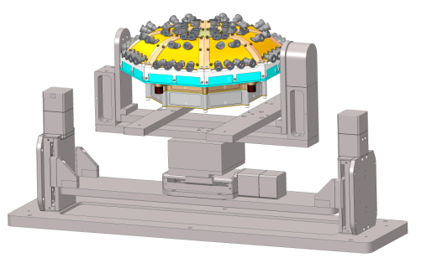
Calibration GSE for Instrument Articulation
Requirements
  Use in APL accelerator facility
    Vacuum compatible (low outgassing)
  Cover full FOV for one octant
Status
  Specified and purchased custom system from Newmark Systems
  Received January ‘09
  Re-furbished in ’12 at Newmark. Added additional controller and position sensor feedback on all motors.
  Fully set up in vacuum chamber with all feed-throughs and control software
Future Work
  Build adaptor plate for EPI-Lo
  Test with mass prototype
Instrument
Articulation stage
RBSPICE CDR August 3 & 4, 2009

Slide 8
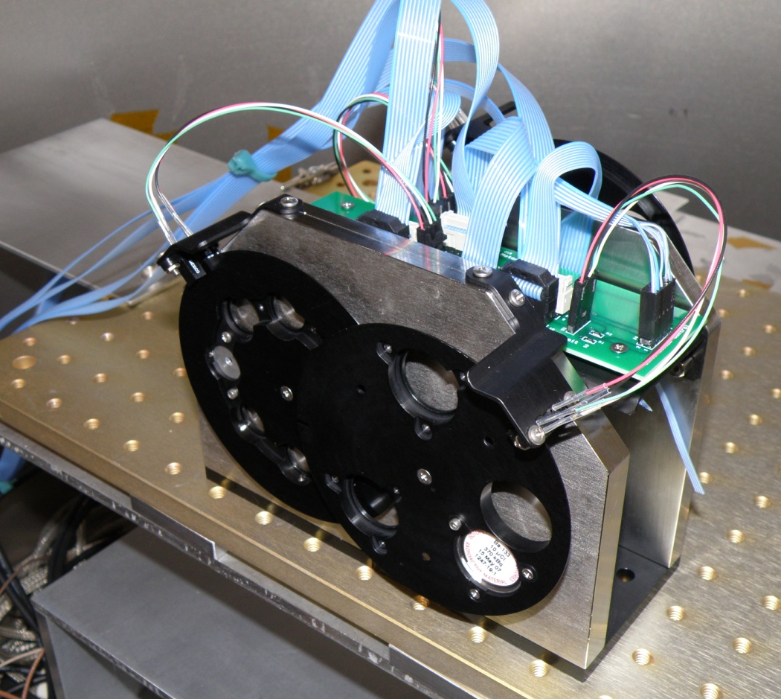
Calibration GSE for Beam Generation
Requirements
  Use in APL calibration facility with particle accelerator
    Vacuum compatible (low outgassing)
  Allow user to select ion or electron calibration source and intensity
  No stray light from optical switches
Status
  Designed and built custom system
    Three-wheel implementation
    Optical switches off when not homing
  Installed and in use in APL facility
Detector wheel
Foil wheel
Optional slide?
Source wheel
RBSPICE CDR August 3 & 4, 2009

Slide 9
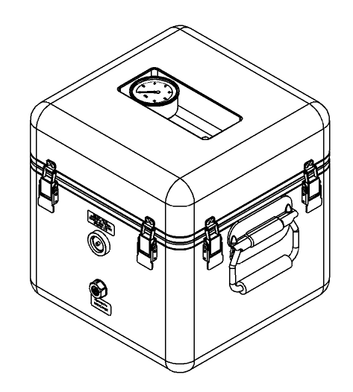
Mechanical GSE
Shipping Container
  Requirements
    N2 purged, humidity controlled and monitored
    Low outgassing
    Shock mounted and monitored
    Hermetically sealed with pressure relief valve
Environmental Test Fixtures
  Thermal Vacuum Fixture
  Vibration Plate Fixture
Purge Suitcase
RBSPICE CDR August 3 & 4, 2009

Slide 10
Summary
GSE highly leveraged from previous programs
Most GSE is built and reading for instrument testing

