Slide 1
ISIS Structural
Nick Alexander
Notes:
introduction

Slide 2
Outline
Summary of mechanical design/structural requirements
Description of the ISIS overall mechanical configuration
Description of plans for fabrication of mechanical/structural items
Description of the finite element models (FEMs) and load cases used to demonstrate structural integrity of applicable components
Information on structural design margins as well as plans for strength verification

Slide 3
Mechanical Design Requirements
ISIS bracket must hold EPI-Hi & EPI-Lo in position on the SPP deck
ISIS bracket must be capable of independently removing EPI-Hi & EPI-Lo, in either order
ISIS bracket must survive all environments for deck mounted components
  Minimum resonant frequency >80 Hz
  Quasi-static loads
  Random vibration
  Sine vibration
  Shock
All ISIS suite testing shall be performed on the bracket, with instruments or instrument analogs as appropriate

Slide 4
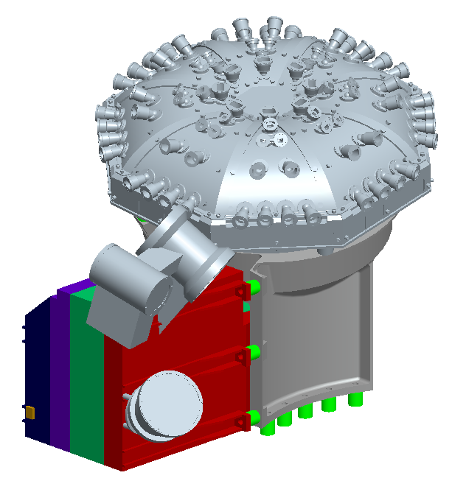
Mechanical Design Overview (1/2)

Slide 5
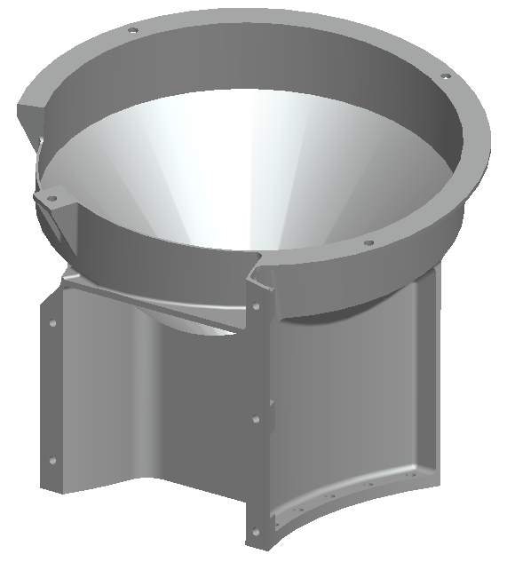
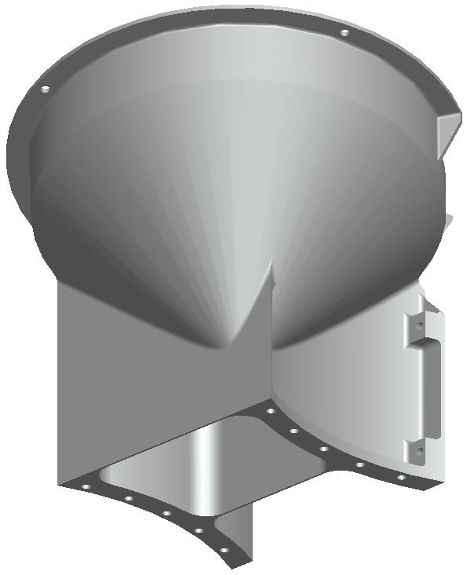
Mechanical Design Overview (2/2)

Slide 6
Bracket Fabrication
The ISIS bracket can be machined using conventional machining processes
  Monolithic design, will be machined from a single block
  All operations can be performed on conventional machines (i.e. lathe, mill, etc.)
Thermal isolators & mass models will also be fabricated to be used during structural testing
  G10 isolators will be machined to flight-like quality
  Mass models to reflect instrument mass properties with flight-like mounting interfaces
Bracket height increase due to TPS shift can easily be accommodated as needed
  Working with S/C mechanical team; any shift in the TPS only requires translation normal to the deck to remain adjacent to the umbra

Slide 7
FEM - Setup
Model includes bracket, EPI-Hi & EPI-Lo mass models (at max allocation) and thermal isolators
  Bracket & mass models assigned Aluminum 6061-T6 material properties
  Thermal isolators assigned G10 material properties
Mass models represent accurate mass & CG properties
  Test results will be easy to compare to model
  Mass models are stiff enough to not introduce modes
Edge to surface connections for all mounting interfaces
Fixed supports on all 10 bracket mounting holes

Slide 8
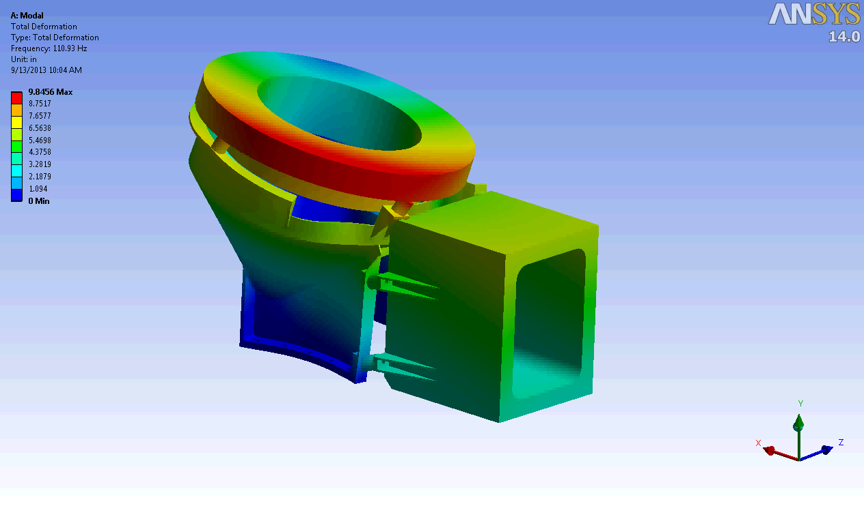
FEM - Modal Results

Slide 9
FEM - Structural Setup
PSD G acceleration applied uni-axially, all 3 major axes
  2 direction lateral to panel, 1 direction normal to panel
PSD input from EDTRD
  Section 4.4.3, Tables 4-8 & 4-9
Frequency (Hz) | Qualification (G²/Hz) | Protoflight (G²/Hz) | Acceptance (G²/Hz)
20 | 0.01 | 0.01 | 0.01
60 | 1.25 | 1.25 | 0.63
200 | 1.25 | 1.25 | 0.63
350 | 0.04 | 0.04 | 0.04
500 | 0.04 | 0.04 | 0.04
2000 | 0.01 | 0.01 | 0.01
Overall Grms | 16.4 | 16.4 | 12.6
Duration (mins) | 2 | 1 | 1
Frequency (Hz) | Qualification (G²/Hz) | Protoflight (G²/Hz) | Acceptance (G²/Hz)
20 | 0.01 | 0.01 | 0.01
35 | 0.04 | 0.04 | 0.04
500 | 0.04 | 0.04 | 0.04
2000 | 0.01 | 0.01 | 0.01
Overall Grms | 6.8 | 6.8 | 6.8
Duration (mins) | 2 | 1 | 1
Table 4-8: Side Panels Mounted Components Normal to Panel
Table 4-9: Side Panels Mounted Components Lateral to Panel

Slide 10
FEM - Structural Results (Preliminary)
Still running stress cases
  Deck-lateral cases are well within necessary safety margins
  Refining model to mitigate high stress concentrations in deck-normal case
Need to perform bolt analysis for bracket mounting bolts
  Baseline is QTY:10 10-32 SHCS (A286)

Slide 11
Structural Design Margins
Structural results must meet Safety Factors per EDTRD
  Section 4.4.2.2, Table 4-5 for Metallic Structures (Tested)
    Ultimate: 1.40 (Aluminum 6061-T6 F_{TU} = 42 ksi*)
    Yield: 1.25 (Aluminum 6061-T6 F_{TY} = 35 ksi*)
Margin of Safety must always be positive
  MS = Allowable/(FS x Applied) – 1.0
  Maximum Allowable Stress (Ultimate) = 30 ksi
  Maximum Allowable Stress (Yield) = 28 ksi
ISIS bracket will be exposed to random vibration with mass models attached for verification prior to EPI-Hi & EPI-Lo testing
*Per MIL-HDBK-5J

Slide 12
Structural Testing
ISIS bracket will be tested at SwRI facilities with EPI-Hi & EPI-Lo mass models
  G10 thermal isolators will be included
  Mounted using flight quality mounting hardware
Tests will check natural frequency, random vibe response, sine vibe response
  Natural frequency must be >80 HZ (EDTRD_0095)
  Must survive random vibration loads (EDTRD_0111) per tables in EDTRD 4.4.3
  Must survive sine sweep loads (EDTRD_0114) per sine environment (TBD) given in EDTRD 4.4.4
  Pre & post test low-level sine sweeps used to identify any change in fundamental frequency

