Slide 1
EPI-Hi Electronics
Branislav Kecman / Rick Cook
Notes:
introduction

Slide 2
EPI-Hi Electronics
Implementation and Status
Branislav Kecman
Cognizant Electrical Engineer

Slide 3
Outline
Design/Assembly/Test Flow
Boards Status
Layout Example
Parts Status
Major Parts Used
In-House Screening
Resources
Power
Mass
Harness Diagram
Thermal Harness

Slide 4
Design/Assembly/Test Flow
Mechanical design
S. Shuman
GSFC
Preliminary design
and schematic
R. Cook
J. Burnham
Detailed design
and schematic
J. Burnham
B. Kecman
Peer review
SwRI, JPL
EM layout
J. Burnham
B. Kecman
EM layout
review
SwRI
EM assembly
J. Burnham
B. Kecman
Test/rework/test
R. Cook
B. Kecman
J. Burnham
Parts identification, EM and flight
B. Kecman, J. Burnham
J. Tumlinson SwRI
Parts stress
analysis
J. Burnham
Parts procurement, EM and flight
B. Kecman, M. Windhausen GSFC
Flight layout mods
J. Burnham
B. Kecman
Flight layout
review
SwRI
Flight board
assembly & inspection
JPL
Flight board test
R. Cook
B. Kecman
J. Burnham
Staking,
conformal
coating
JPL

Slide 5
Boards Status
Board | Sche-matics | Peer review | EM layout | EM fab | EM parts procured | EM test start
Telescope (x 3) | 80% | √ | 10% | 0 | 60% | Mar ‘14
DPU | 100% | √ | ~100% | 0 | 90% | Jan ‘14
LVPS | 100% | √ | 100% | In process | 100% | Nov ‘13
Bias Supply | 100% | √ | 60% | 0 | 80% | Feb ‘14

Slide 6
DPU Board Layout

Slide 7
Parts Status
Parts list submitted to Parts Control Board for review
All parts comply with Level 2 per NASA EEE-INST-002
Currently ordering parts for EM and prototype boards
Will use spare flight parts from Caltech, GSFC, SwRI and JPL stock if Lot Date Code < 5 years old
Controlled access, temp. and humidity in parts storage
Using 2 custom databases, Parts & Kits, for inventory tracking and kitting of parts for assembly since ACE (‘93)
Lead bending on all IC packages done at JPL
JPL will package PHASIC and HKchip
Screening spec for PHASIC and SOW for HKchip submitted to PCB for review
Plan to test rad-hard PHASIC and HKchip die for TID and Latch-up at LBNL’s 88” Cyclotron

Slide 8
Major Parts Used
Parts with heritage:
Microsemi/Actel FPGA, RTAX250SL-CQ208B, NuSTAR
Aeroflex SRAM 4Mb (128k x 32), UT8R128K32, “
PHASIC hybrid, heritage STEREO
New parts for SPP:
Aeroflex SRAM 16Mb (512k x 32), UT8CR512K32
Aeroflex MRAM 16Mb (2M x 8), UT8MR2M8
HKchip

Slide 9
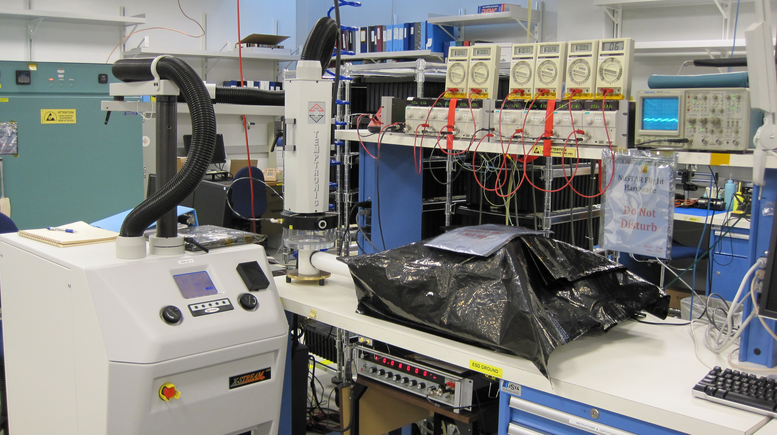
In-House Screening

Slide 10
Resources - Power
Subsystem | Power [ W ]
LET1 board | 1.06
LET2 board | 0.76
HET board | 0.95
DPU board | 0.62
Bias Supply @ Beginning Of Life | 0.12
LVPS @ BOL (70% efficiency) | 1.50
Total @ BOL | 5.0
End Of Life
Bias Supply @ End Of Life | 0.68
LVPS @ EOL (70% efficiency) | 1.74
Total @ EOL | 5.8

Slide 11
Resources - Mass
Subsystem | Mass [ g ]
LET1 telescope LET1 board | 225 258
LET2 telescope LET2 board | 145 233
HET telescope HET board | 120 250
DPU board Bias Supply & RF shields LVPS & RF shields | 197 225 + 130 160 + 100
Elec. box, hardware & shielding Telescope brackets Thermal hardware MLI blankets | 925 + 250 +100 160 50 100
Total | 3,628

Slide 12
Harness Diagram

Slide 13
Thermal Harness Diagram

