Slide 1
EPI-Lo Sensor
Don Mitchell, Matt Hill, Ralph McNutt
DRAFT 2013-10-14 5:53 PM
Notes:
introduction

Slide 2
Outline EPI-Lo Sensor Design
ISIS Science Requirements Relevant for EPI-Lo
EPI-Lo Instrument
Block Diagram(s)
Principles of Operation Overview
Sensor Voltages
Electrostatic Optics
Collimators and Start Foils
Solid State Detectors & Stop Foils
  Anti-coincidence System
  GEANT
Microchannel Plate (MCP)
Mass Resolution
Light & Dust Mitigation
Follow-up from peer reviews
Summary
THIS IS NOT UP TO DATE...IGNORE THIS PAGE.

Slide 3
The EPI-Lo Instrument Requirements
Parameter | Required | Goal (Capability) | Comment/Heritage
Electron Energies | 50 - 500keV | 25 - 1000 keV | Electron capability from JEDI, RBSPICE
Ion Energies | 50 keV/nucleon – 15000 keV Total E | 50 keV/nucleon – 15000 keV Total E | Capability partially based on RBSPICE capabilities. Top energy ~250keV/nuc for Fe
Energy Resolution | 45% for required energy range | 40% for required energy range | Telemetry limited
Time sampling | 5 sec | 1 sec | Telemetry and/or statistics limited
Angle resolution | <30° x <30° | Ions, ~15 x 12 to <30° x <30° e-, 45° | Varies with elevation
Pitch Angle (PA) Coverage | 0°-90° or 90°-180°, some samples in both hemispheres | 0°-90° or 90°-180°, some samples in both hemispheres
Time for Full PA | 1 – 5 sec | 1 – 5 sec | Telemetry limited
Ion Composition | H, He3, He4, C, O, Ne, Mg, Si, Fe | H, He3, He4, C, O, Ne, Mg, Si, Fe | He3/He4 ~50 to 1000 keV/nuc
Electron Sensitivity: j=Intensity | j = 1E1-1E6/cm²-s-sr | Sensor-G:0.144 (cm².sr) Pixel-G: ~0.02 (cm².sr) Up to 6E6 1/s counting | j=Intensity (1/cm²-s-sr) G=Geom. Factor (cm²-sr) 8 pixels/sensor
Ion Sensitivity | j = 1E1-1E6/cm²-s-sr | Sensor-G:0.16 (cm².sr) Pixel-G: ~0.002 (cm².sr) Up to 3.5E6/s rate (TOFxE) | 80 pixels/sensor

Slide 4
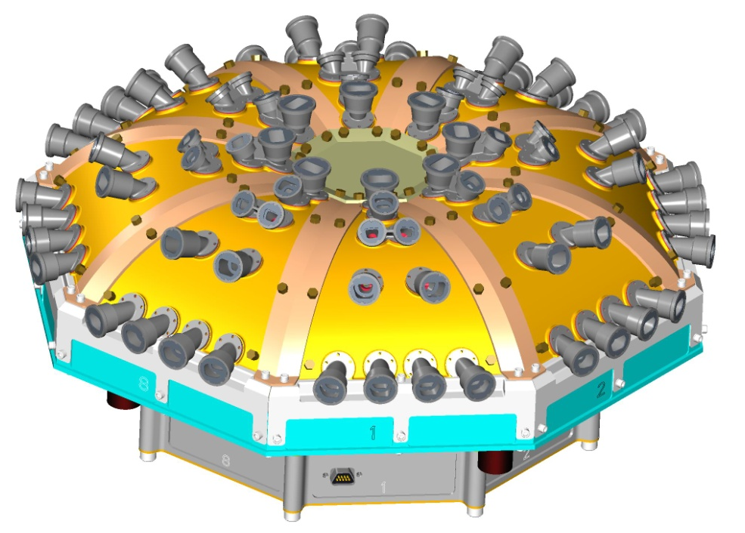
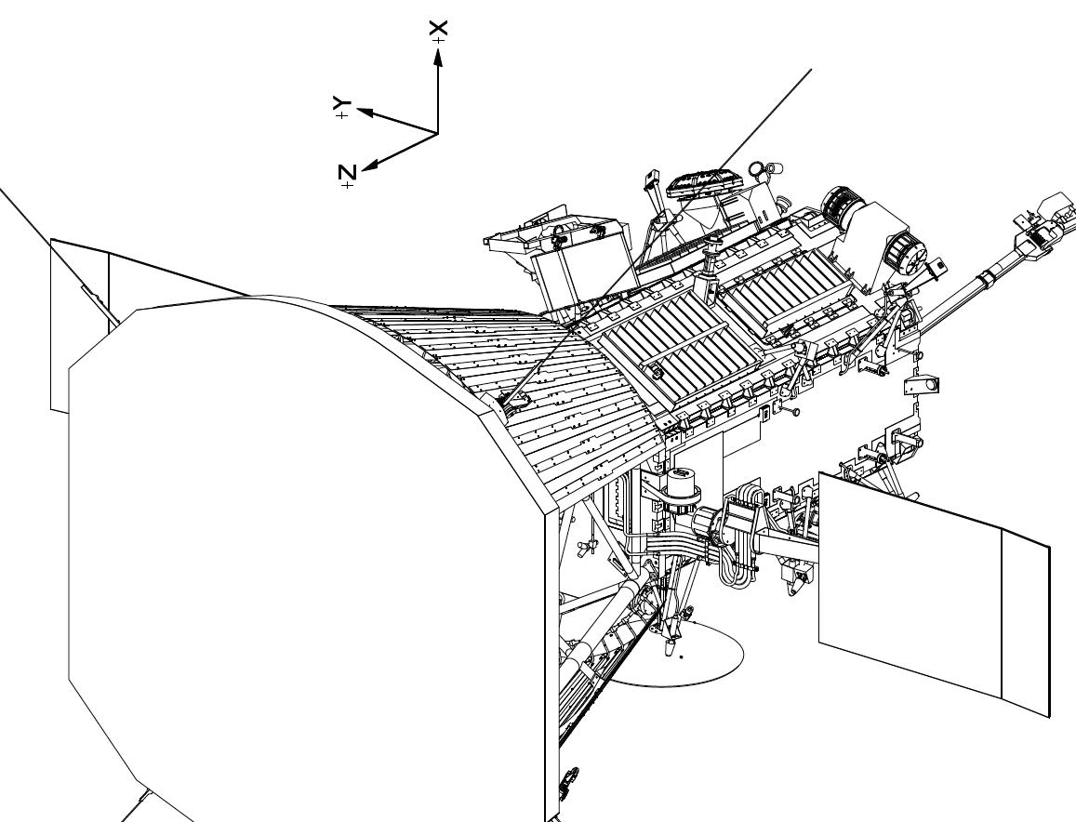
The EPI-Lo Instrument

Slide 5
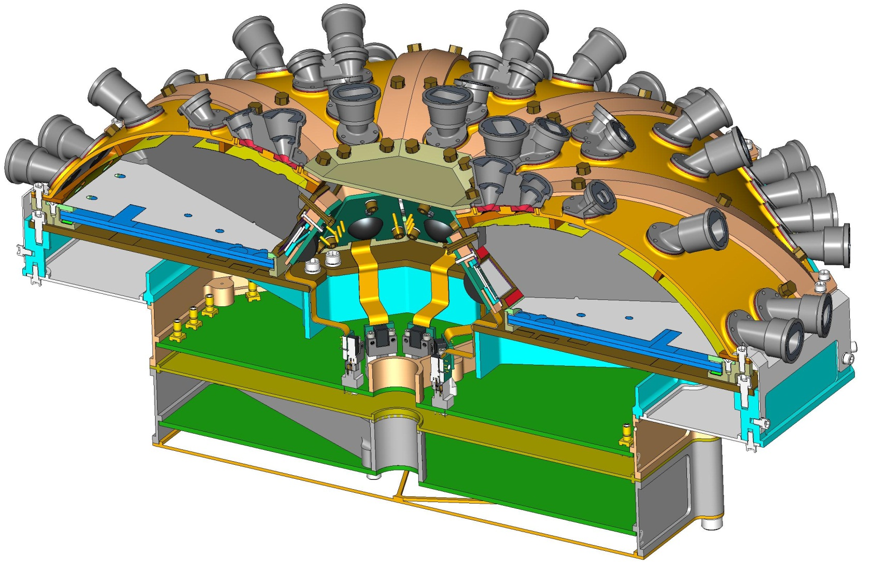
EPI-Lo Instrument, cut-away
ANODE PWB ASSY
EVENT PWB ASSY
POWER SUPPLY ASSY
EPI-LO CROSS-SECTION VIEW ISOMETRIC

Slide 6
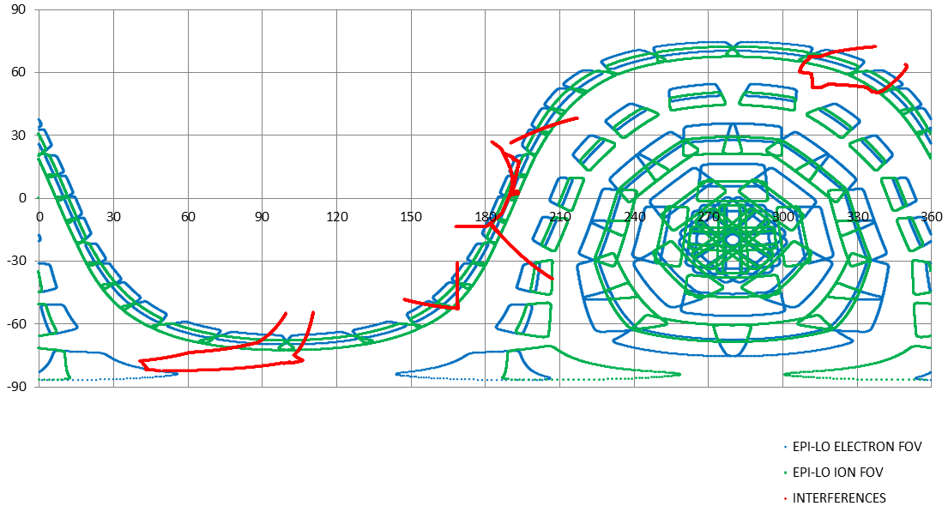
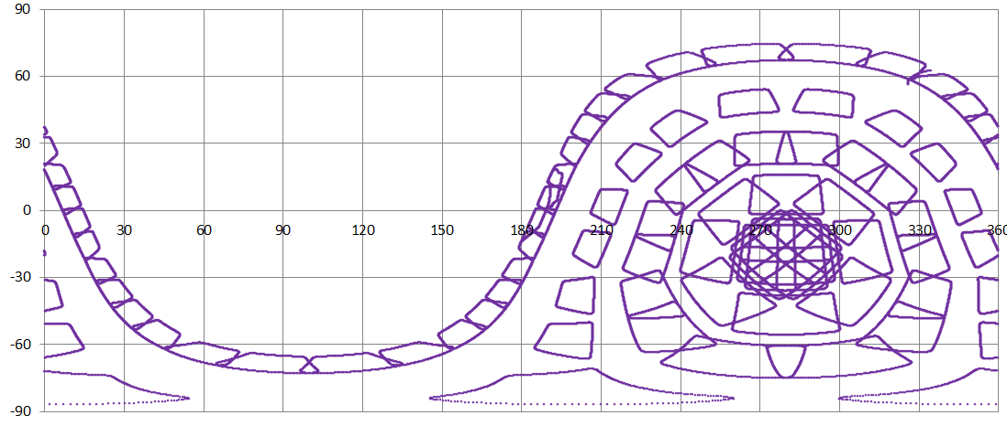
The EPI-Lo Field of View
SUN
RAM

Slide 7
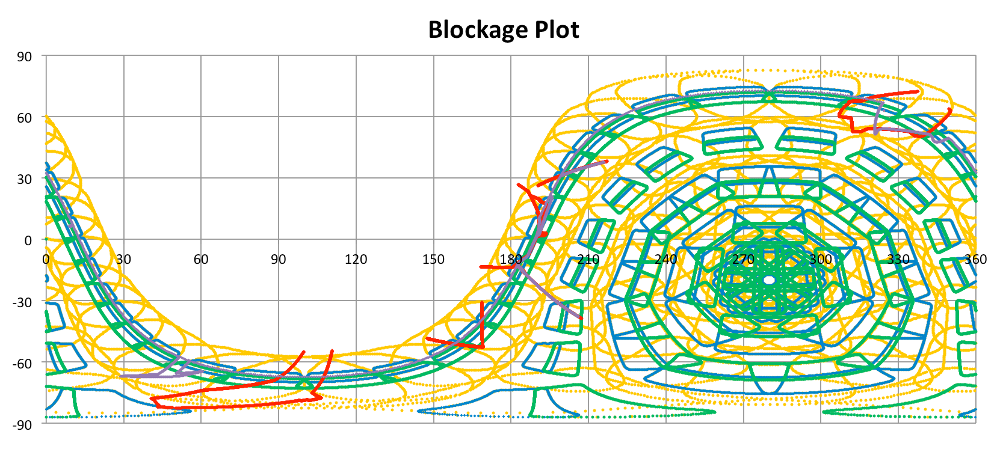
Collimator Foil FOV
Foil FOVs shown in yellow (these are not with the latest collimators).

Slide 8
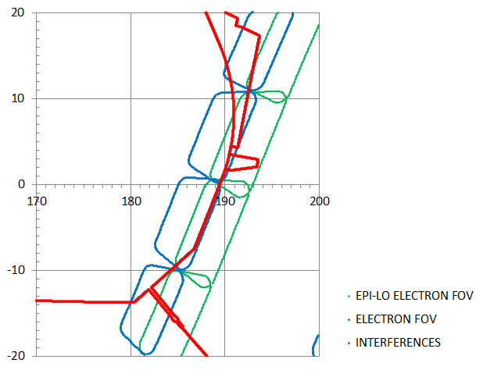
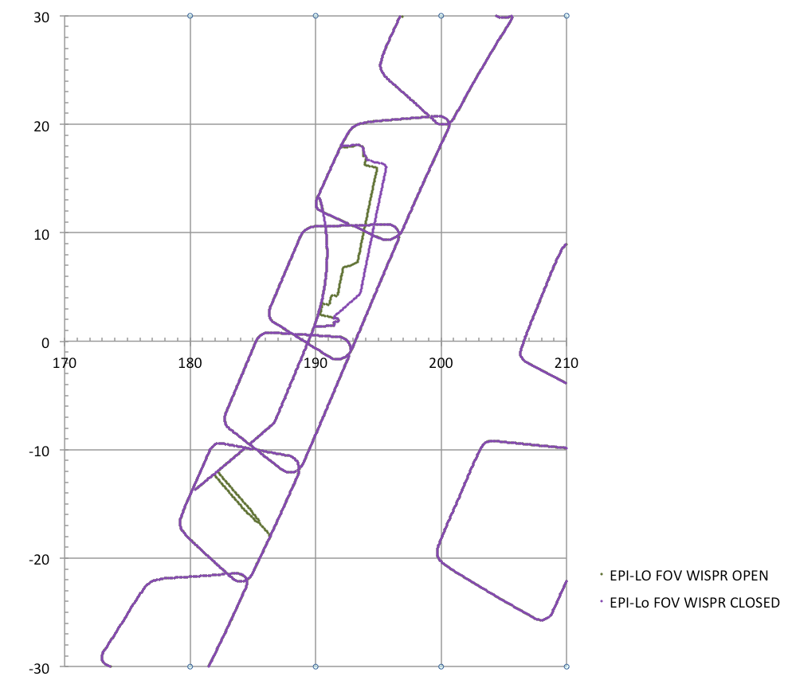
The EPI-Lo Field of View
These trapezoids, with the rounded corners, represent EPI-Lo unobstructed FOV’s
This line(s) represent the obstruction caused by WISPR: Red was March 2013 and 2011-ish envelope and yellow is the Sept 2013 one. Outer purple is the closed door (Sept 2013).
This line(s) represents the obstruction caused by the TPS
Don’t think this red obstruction was in 2011 model. Part of WISPR?
SUN
At 0 degrees elevation, the viewing angle is 9.4 degrees off from looking straight at the sun
ion
electron

Slide 9
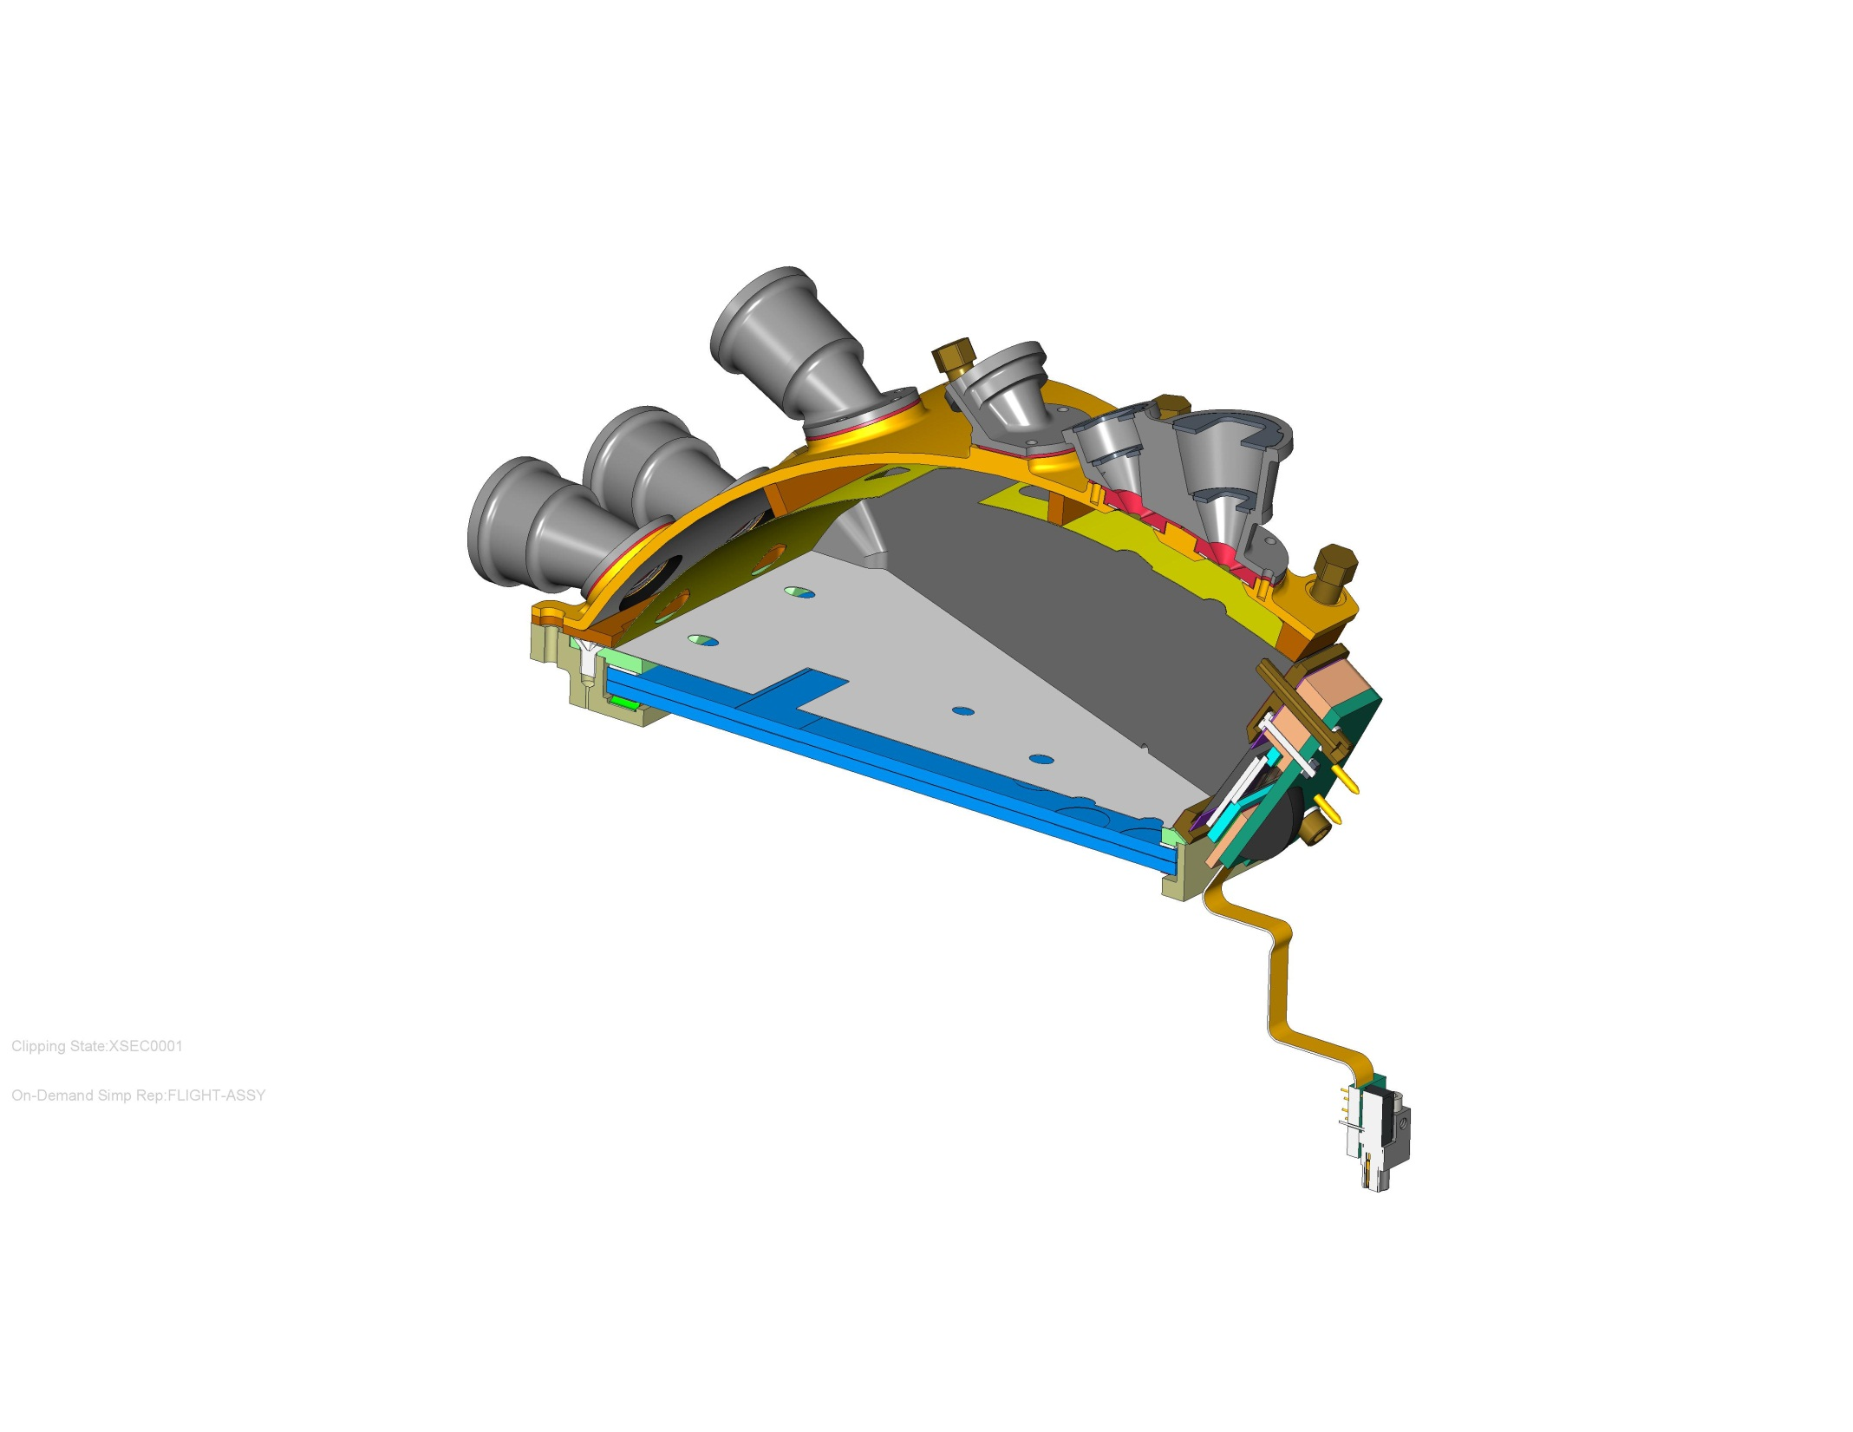
EPI-Lo Wedge Components
SENSOR WEDGE COVER, GROUND
APERTURE START FOIL GRID, GROUND
COLLIMATORS, AT GROUND
ACCELERATION SURFACE, +1kV
INSULATOR, SENSOR WEDGE COVER
ULTEM 1000
MCP COMPRESSION PLATE, 1kV
SCREWS, TORLON
MCP GRID, 1kV
BOTTOM MCP 2.9kV
TOP MCP, 900V
(TOP OF ANODE PWB NOT SHOWN, 3KV)
EPI-LO INDIVIDUAL SENSOR WEDGE ASSY CROSS SECTION

Slide 10
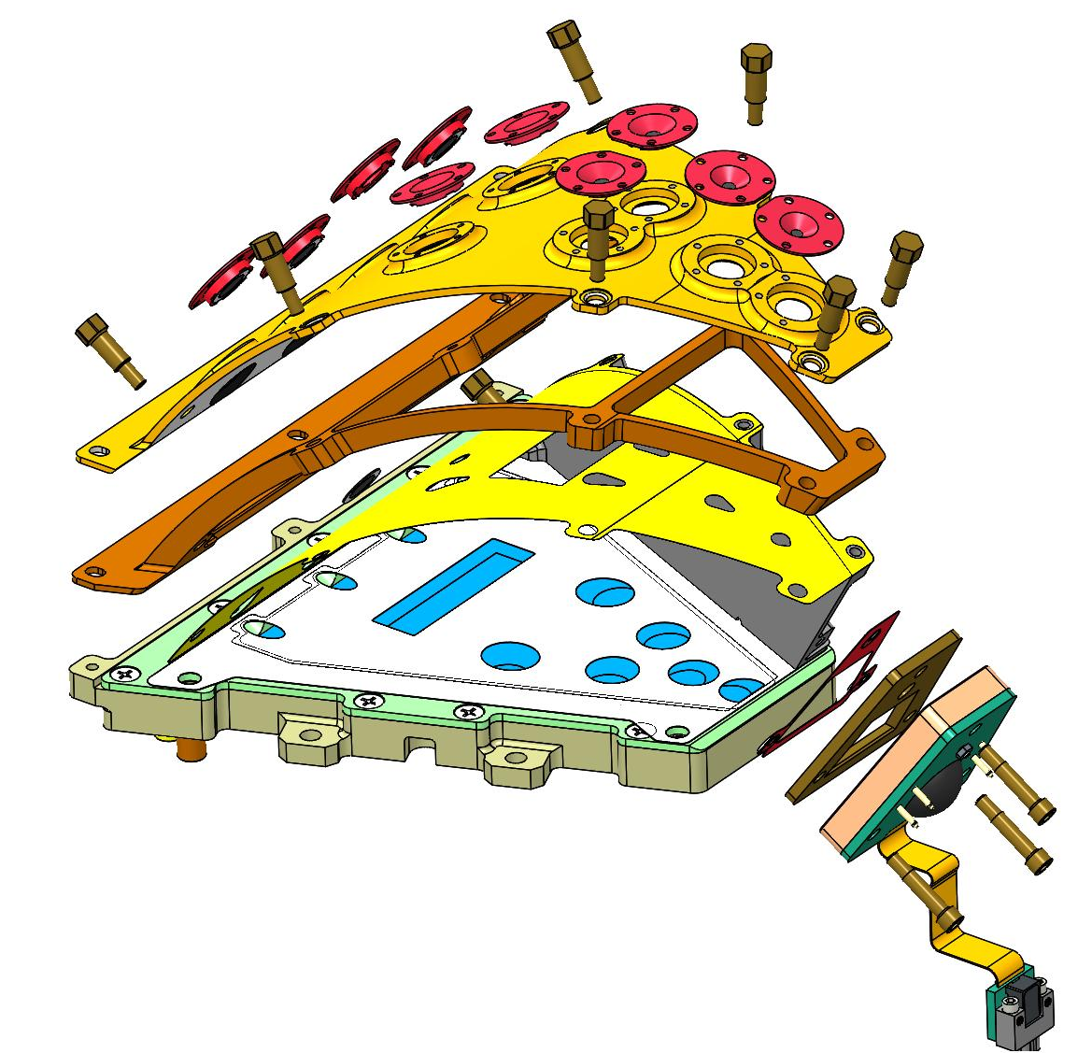
EPI-Lo Wedge, Exploded View
APERTURE START FOILS, GROUND
WEDGE COVER, GROUND
WEDGE COVER INSULATOR, ULTEM 2300
WEDGE GRID, 1KV
SIDE WALL REMOVED FOR CLARITY
EPI-LO INDIVIDUAL SENSOR WEDGE ASSY CROSS SECTION

Slide 11
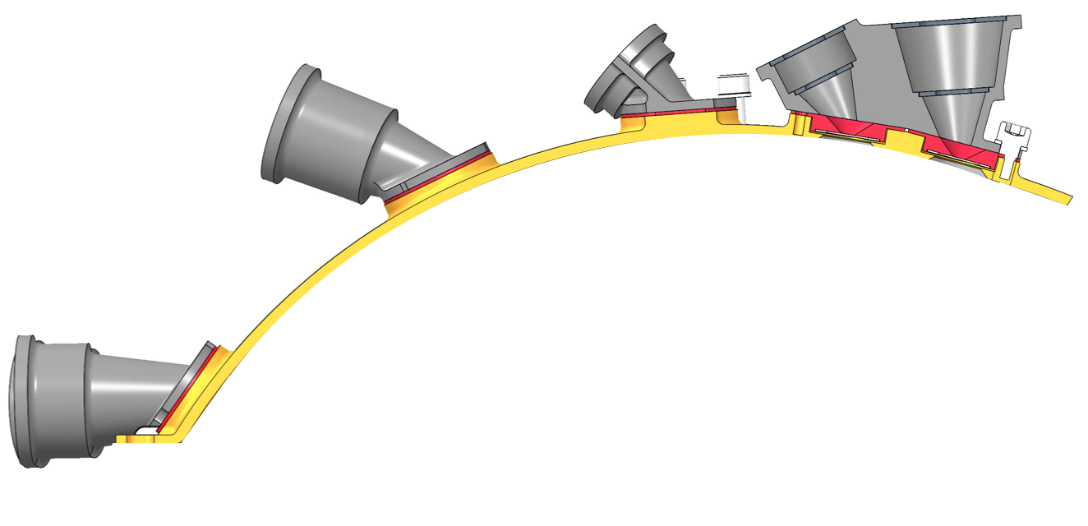
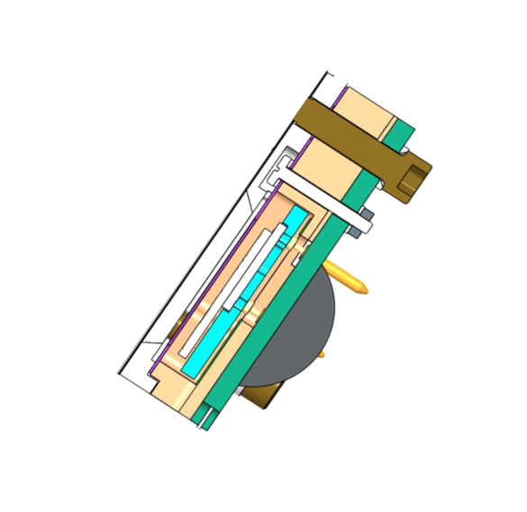
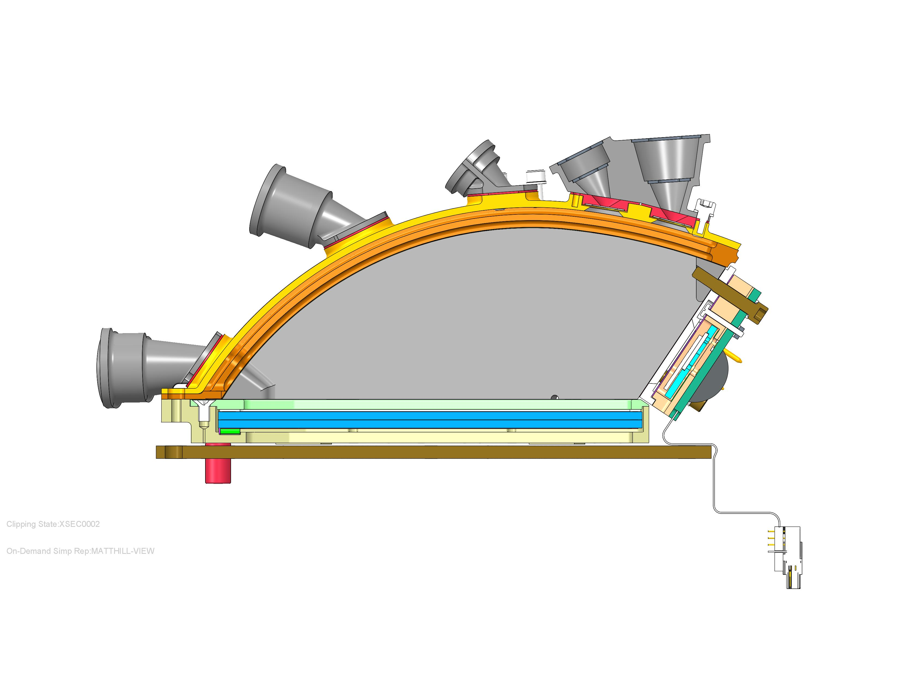
Sensor Functional Schematic
Start Acceleration
Grid
Baffles
Collimators
Start Foils
Stop Accel. Grid
MCP Grid
Stop Foil
Start Foils
Microchannel
Plate (MCP)
Solid State
Detectors (SSDs)
Anode
MCP Spacer

Slide 12
Sensor Voltages
start e⁻
acceleration
region
stop e⁻
accel.
region
Ground
All Foils
at Ground
100 V retarding
potential region
Equipotential
Volume
MCP
900 V
2900 V
Ground
SSDs
Anode
1000 V
3000 V

Slide 13
Secondary Electrons & Potentials
start e⁻
acceleration
region
stop e⁻
accel.
region
Grid
Equipotential
Volume
Grid
Grid
MCP
100 V retarding
potential region
2000 V
Across Plates
100 V
MCP-to-Anode
SSDs
Anode

Slide 14
Ions (Energy, TOF, and Position)
Incident Ion
Start
Secondary
Electrons
Stop
MCP
SSDs
Anode

Slide 15
Electrons: Energy (& Position)
Incident Electron
Secondary
Electrons
(infrequent)
MCP
Anode
SSDs

Slide 16
Energetic Electron Measurement
?
?
?
?
?
Secondary Electrons from Start Foils possible, but Low Probability;
Start Electron present identifies entrance aperture

Slide 17
Energetic Ion Measurement
Ion Measurement Logic can require TOF or not, but with no TOF, no species

Slide 18
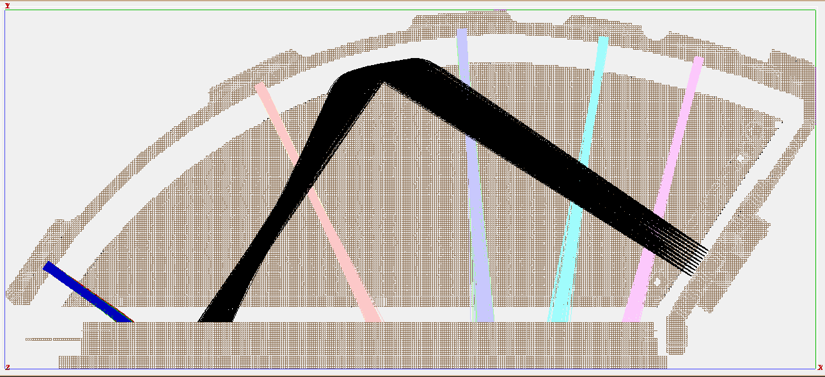
Electrostatic Optics
SIMION simulation of electron optics using ~3eV random initial electron velocities.

Slide 19
Sensor Voltages
start e⁻
acceleration
region
stop e⁻
accel.
region
Ground
All Foils
at Ground
100 V retarding
potential region
Equipotential
Volume
MCP
900 V
2900 V
Ground
SSDs
Anode
1000 V
3000 V

Slide 20
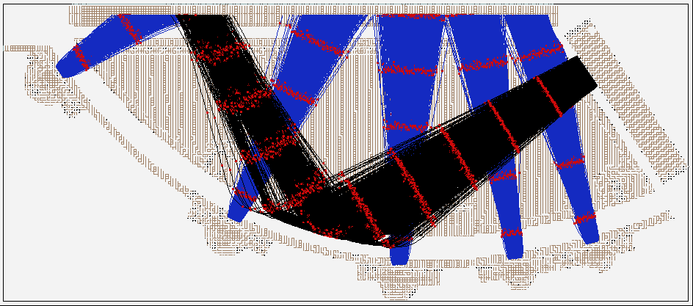
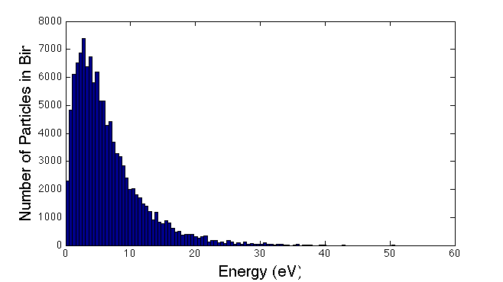
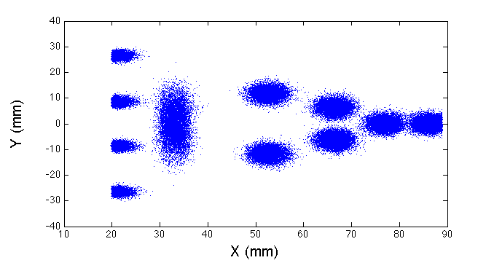
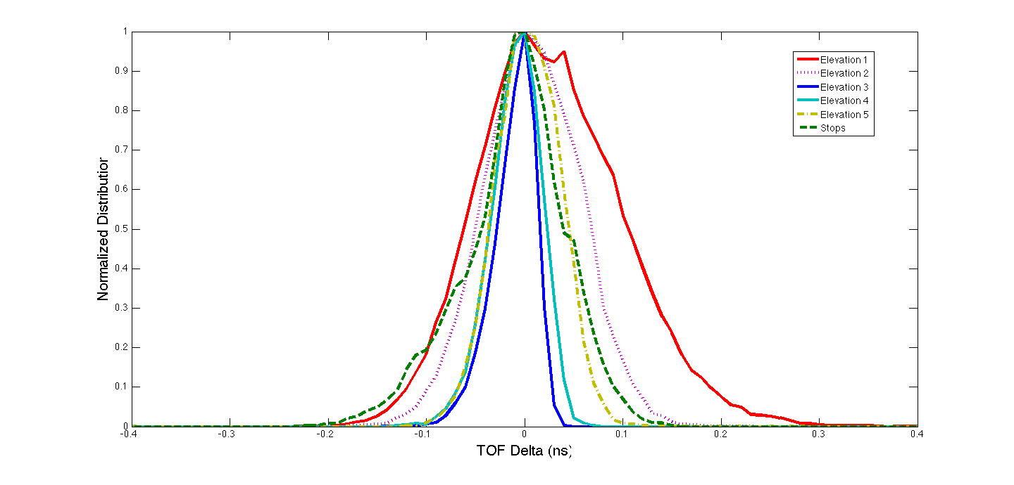
SIMION, Allegrini Energy Distribution
Sample Trajectories
Initial Energy Distribution
Hit Locations
Electron Dispersion
Elevation 3
Elevation 5
Name | Mean TOF (ns) | TOF Sigma (ns)
Elevation 1 | 1.06 | 0.19
Elevation 2 | 2.17 | 0.13
Elevation 3 | 2.35 | 0.05
Elevation 4 | 2.33 | 0.06
Elevation 5 | 2.32 | 0.12
Stops | 5.23 | 0.11
Elevation 4
Elevation 2
Elevation 1
20

Slide 21
EPI-Lo Wedge, Exploded View
APERTURE START FOILS, GROUND
WEDGE COVER, GROUND
WEDGE COVER INSULATOR, ULTEM 2300
WEDGE GRID, 1KV
SIDE WALL REMOVED FOR CLARITY
EPI-LO INDIVIDUAL SENSOR WEDGE ASSY CROSS SECTION

Slide 22
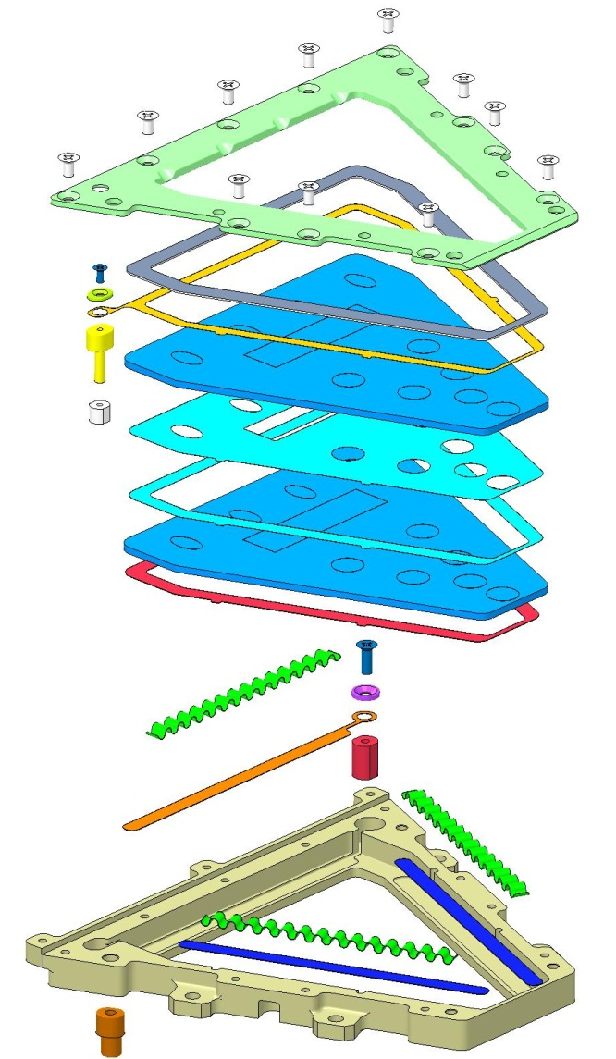
MCP Inter-Plate Spacer also a mask
COMPRESSION PLATE
SCREW
GUARD WASHER
INSULATED SHIM, ULTEM 1000
900 V LUG ASSY
900V ELECTRODE
NUT
MCP
SPACER .002
ALTERNATE SPACER
SLIDE-SPACER-ELECTRODE
MCP
LINEAR EXPANDERS, 3 PLACES
SCREW
WASHER
2.9KV ELECTRODE
2.9KV LUG ASSY
SLIDES FOR EXPANDERS, 2 PLACES
1KV LUG ASSY
EXPLODED VIEW “NEW” MCP ASSEMBLY

Slide 23
SIMION, Alegrini Energy Distribution
Sample Trajectories
Initial Energy Distribution
Hit Locations
Electron Dispersion
Elevation 3
Elevation 5
Name | Mean TOF (ns) | TOF Sigma (ns)
Elevation 1 | 1.06 | 0.19
Elevation 2 | 2.17 | 0.13
Elevation 3 | 2.35 | 0.05
Elevation 4 | 2.33 | 0.06
Elevation 5 | 2.32 | 0.12
Stops | 5.23 | 0.11
Elevation 4
Elevation 2
Elevation 1
23

Slide 24
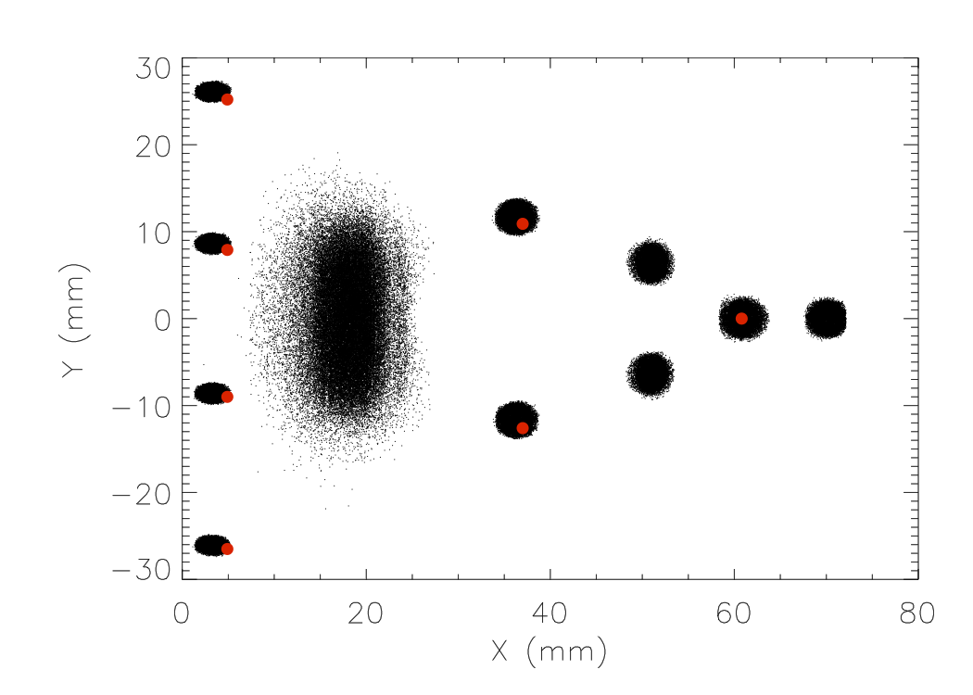
Microchannel Plate (MCP)

Slide 25
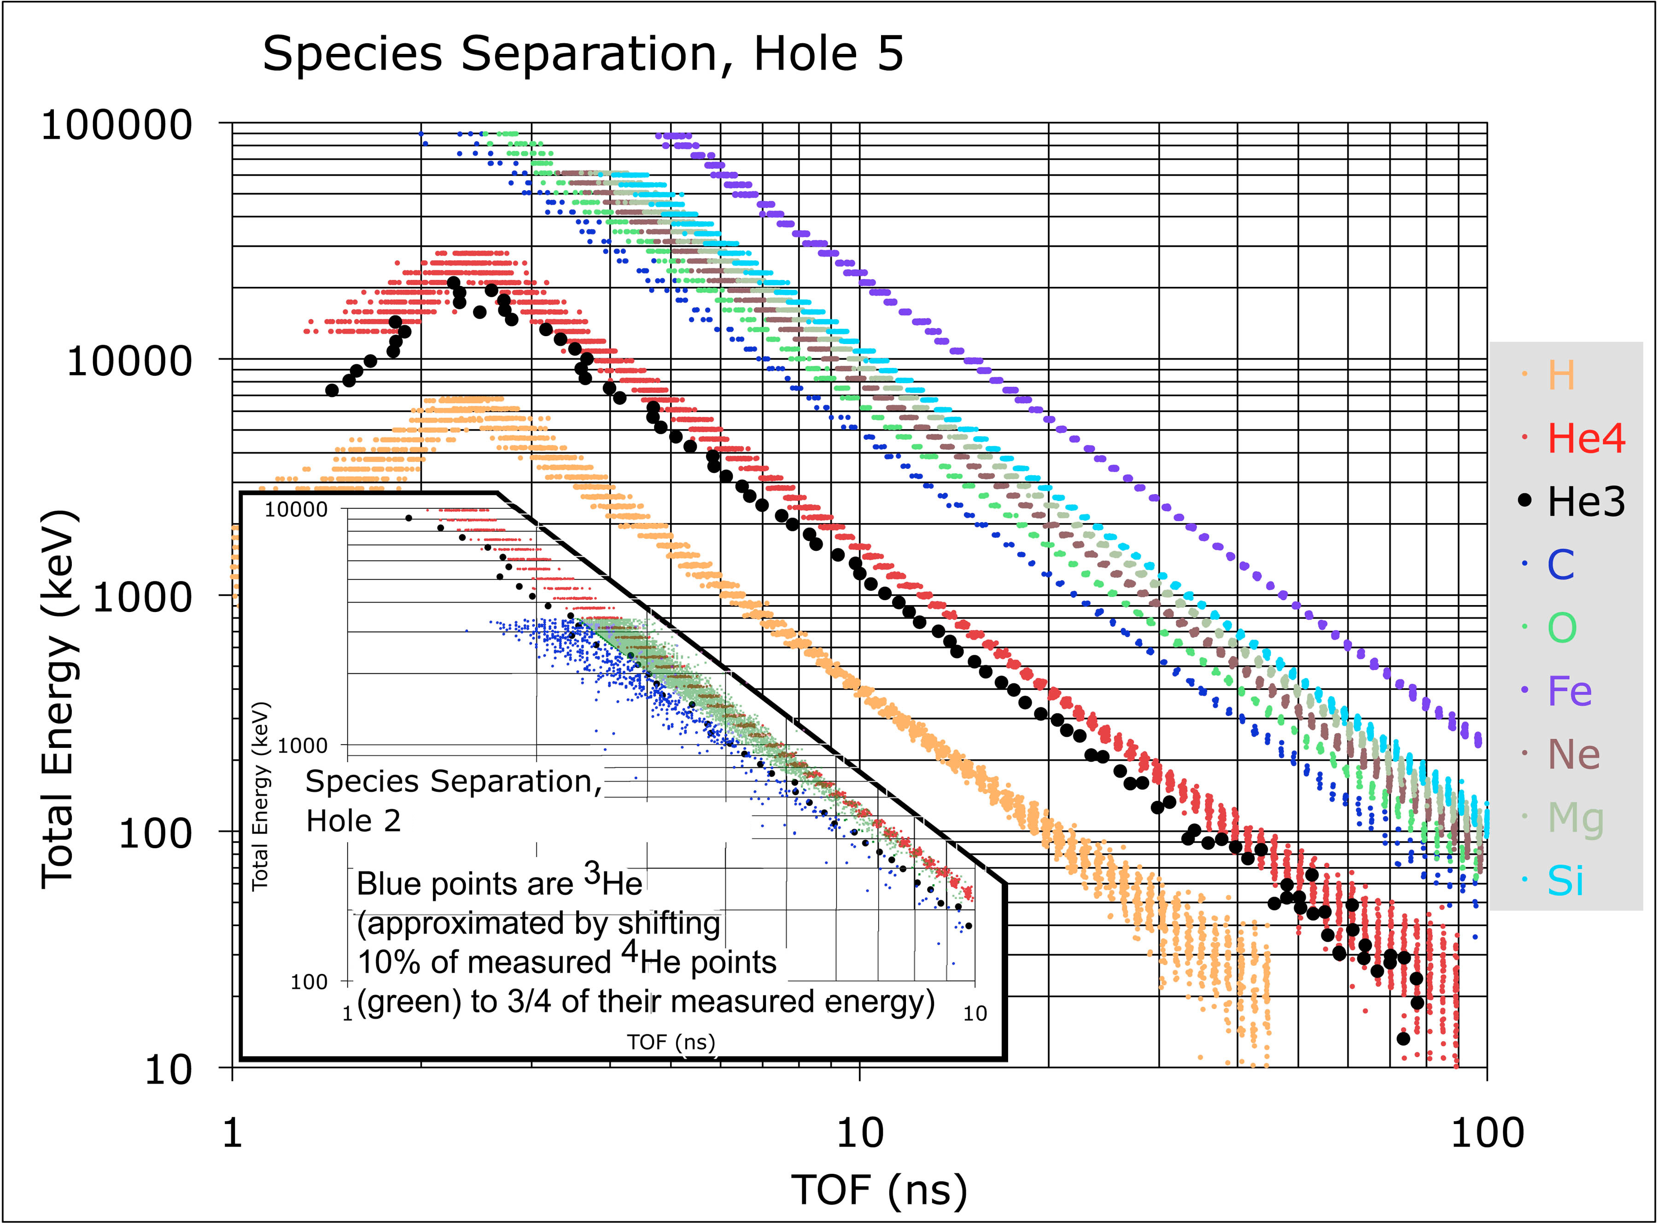
Mass Resolution

Slide 26
Mass Resolution

Slide 27
Collimators and Start Foils
Foils Mount on Apertures (red)
    Each elevation tailored for equal GF
    Second foil planned at intermediate baffle (vented)
    Third foil may be needed for SW electrons
Collimators screw-mount to outer cover, capture foils
    Each Elevation and azimuth is unique

Slide 28
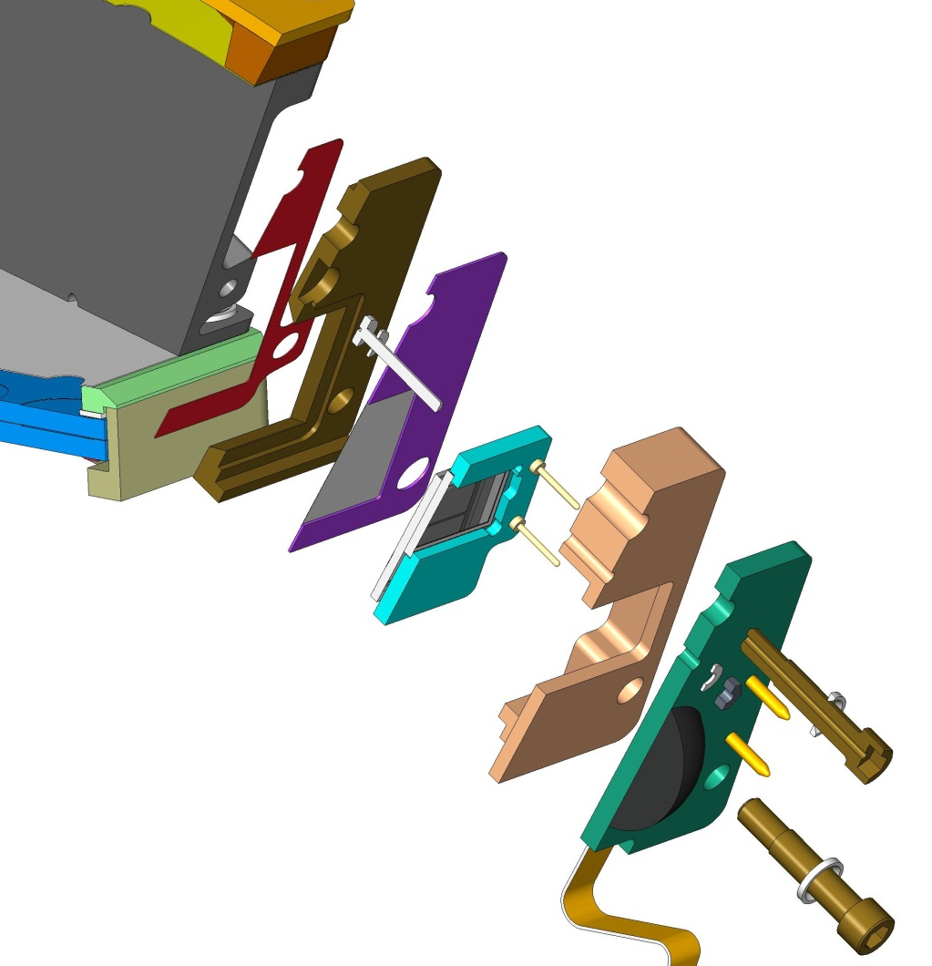
EPI-Lo SSD Assemblies (8)
SSD WEDGE GRID, 1KV
SSD STOP GRID-FOIL, GROUND
SENSOR WEDGE 1KV
GROUNDING SCREW
SSD ASSY HOUSING, ULTEM 1000
ENERGY PWB ASSY
SSD INSULATOR, ULTEM 1000
SSD ASSY
SCREWS, TORLON
SSD ASSY TO WEDGE EXPLODED CROSS SECTION

Slide 29
Anti-coincidence System
Electron SSD is backed by an anti-coincidence SSD

Slide 30
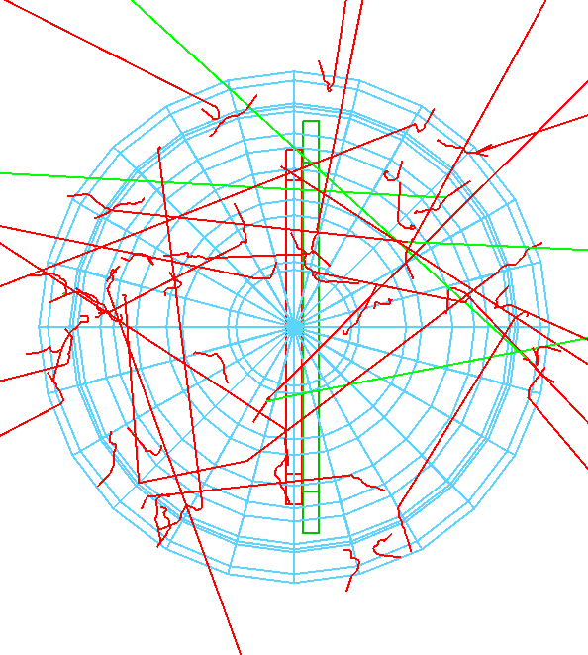
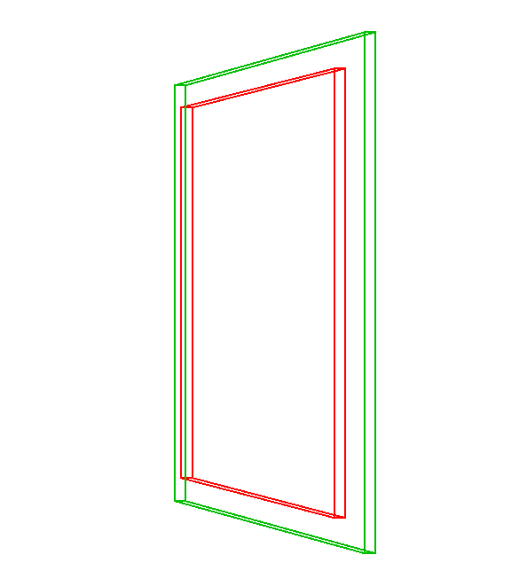
Anti-coincidence System: GEANT
Setup for GEANT4 model of electron SSD anticoincidence

Slide 31
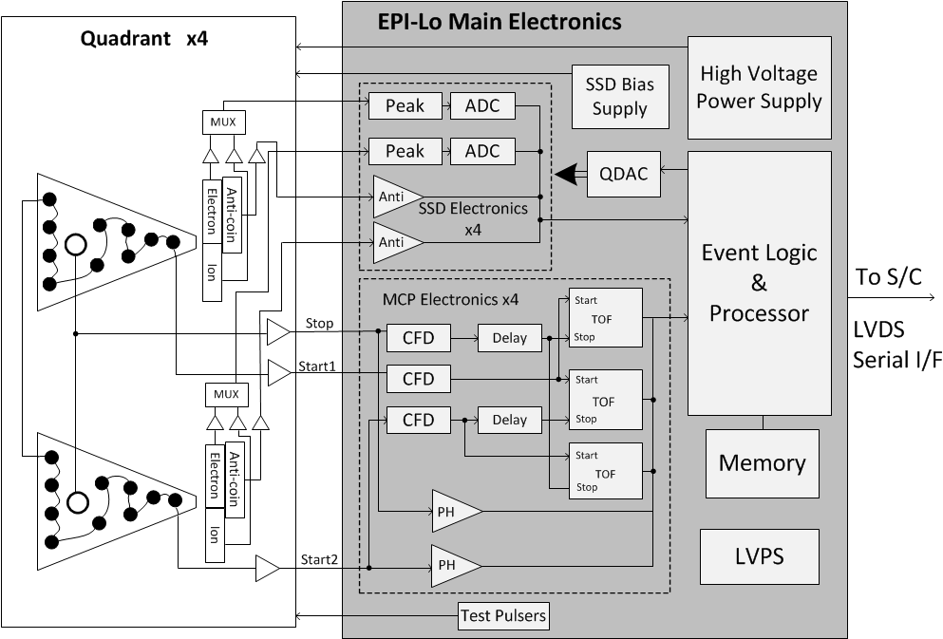
EPI-Lo Block Diagram

Slide 32
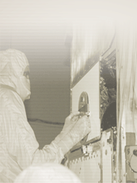
Sensor Voltages
Collimators
Grounded Foils
Tecan Grid
1000V
SSD
100V
+ 900V
MCP
MCP
+2900V
100
900V (total diode drop)
+3000V
Anode/Preamp
MCP Return is a ground reference at HVPS (allows MCP current measurement across resistor)
MCP return
Voltage Control Cartoon
HVPS Out +3000V

Slide 33
EPI-Lo Block Diagram

Slide 34
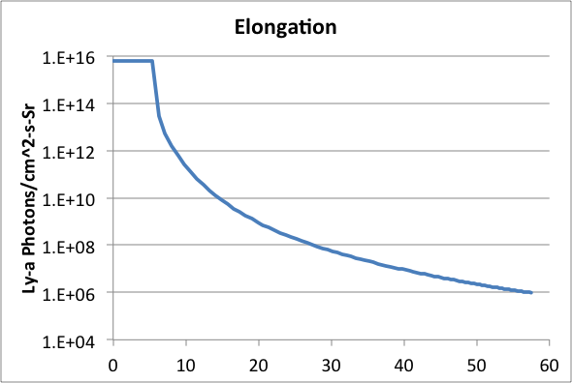
Light & Dust Mitigation
Dust may produce pinholes in the Start and collimator foils. Foils are designed to reduce UV by ~3 orders of magnitude. Pinholes may account for as much as ~3.5% of a foil area, so one pinhole can reduce effectiveness of attenuation to ~1/30.
For the 4 foils closest to the TPS edge, the suppression factor must be ~4 orders of magnitude. For these, pinholes are even more problematic.
Edge of TPS
Intensity of Ly-α EUV vs elongation. Most EPI-Lo entrances include angles no closer than 20 degrees elongation (which implies a maximum Ly-α intensity of ~10⁹). For 4 apertures close to the TPS, the maximum is ~10¹², but average ~10¹⁰.

Slide 35
Light & Dust Mitigation
Dust may produce pinholes in the Start and collimator foils. Foils are designed to stop solar wind energy electrons. Pinholes may account for as much as ~3.5% of a foil area, so one pinhole can reduce effectiveness of attenuation to ~1/30.
Solar wind electrons have an energy of ~100eV or less. If these enter the Start foils (through a pin hole), the electron optics will nominally guide them to the Start areas of the MCP.
The solar wind electron flux is ~2 x 10¹²/cm²-s-sr. A foil pinhole, if it includes the full area of a support grid element, is ~6.25 x 10⁻⁴ cm². The angular acceptance of a collimator is ~.02 sr. So the geometric factor of a pinhole is ~1.25 x 10⁻⁵cm²sr. So the flux through a pinhole would be expected to be ~2.5 x 10⁷/s. If every aperture had 1 pinhole, the total for a quadrant would be ~5 x 10⁸/s, clearly too much.
Adding a second foil in each aperture would greatly reduce the number of solar wind electrons expected to enter the TOF volume, but would still result in ~5 x 10⁶/s, a bit more than we would like.
Mitigation might involve either a third foil, or a design for which pinholes are either much smaller than a grid element, or low probability.

Slide 36
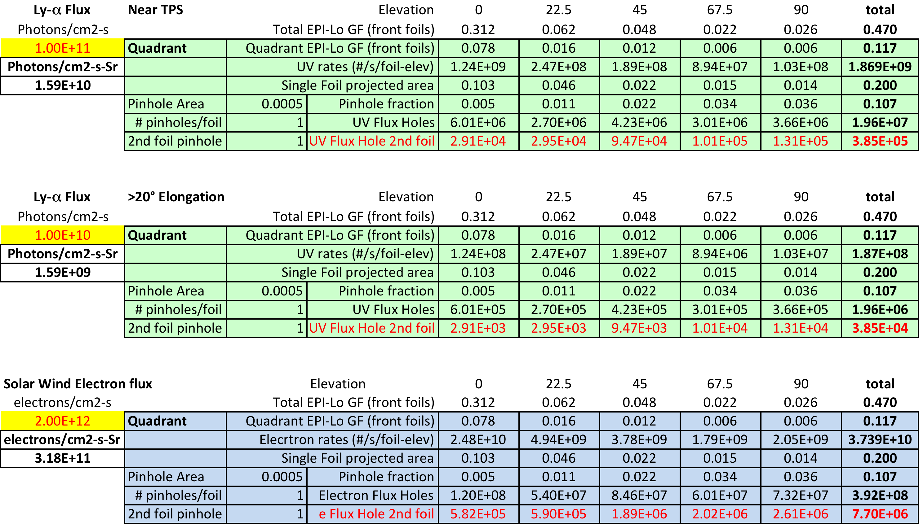
Light & Dust Mitigation
Calculation of impact of pinholes on rates. Because photoelectron efficiency is <10%, the UV rates are not a problem. The solar wind electron rates could be a problem.

Slide 37
Light & Dust Mitigation
TBD

Slide 38
Dust: Simulating the Environment
elevation angle
90 deg
Impacts within the back foil angle will pass through the collimator opening and front foil and hit the back foil
Impacts within the front foil angle will pass through the collimator opening and hit the front foil
67.5 deg
45 deg
22.5 deg
0 deg
align with plane of instrument
Collimator
opening
+Z
+x-ish
+Z-ish
0 deg
315 deg
45 deg
Impacts in the hemisphere will hit the “virtual surfaces” (ignores the collimator)
azimuthal angle
Front foil
270 deg
90 deg
Virtual surface
Back foil
225 deg
135 deg
NOTE: actually only polar angle is limited, not position on surface, so foil area was adjusted to account for this and produce actual foil geometry factors,
180 deg

Slide 39
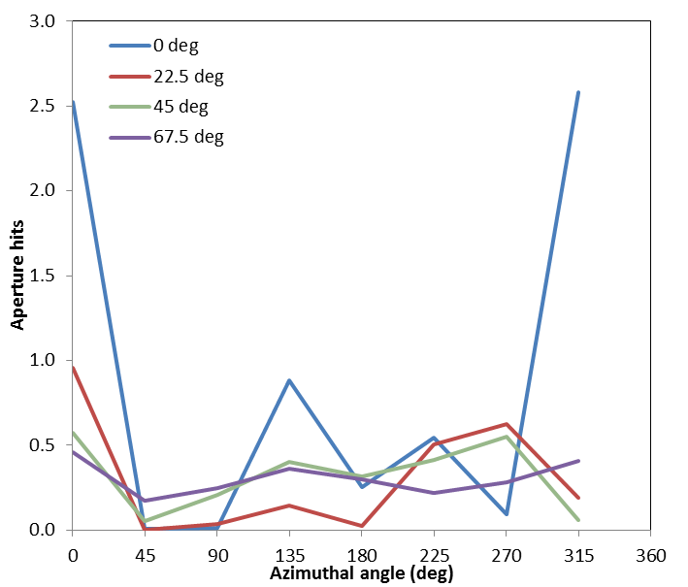
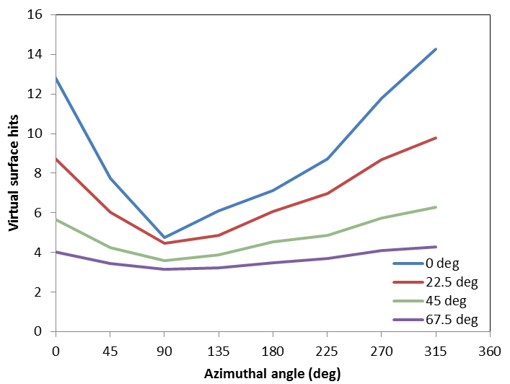
Dust: Simulating the Environment
Each unprotected foil would expect ~10 damage-inducing hits per mission. Reduced to ~1 hit per mission with collimator. Order of magnitude decrease.

Slide 40
Dust: Lab tests
TBD

Slide 41
SLIDE PREPARATION NOTES
Are we handling dust in this presentations? Assuming yes.
Should we discuss photons suppression here? Assuming yes, it’s background.
How about details like how the MCPs work (in general)? Or this could be handled when someone discusses the anode boards. Special features like the inter-plate mask (or is that handled in a mechanical section)?
Backup slides: MCPs
We are only supposed to respond to requirements, so I wasn’t going to go into any of the rate estimates from the work that I (Matt) and Rob D. did since that is for goals. Is this the right approach?

Slide 42
Follow Up from Peer Reviews
TBD

Slide 43
Summary
TBD

Slide 44
Backup

Slide 45
EPI-Lo Instrument
Peer Review
APERTURE START FOILS, GROUND
WEDGE COVER, GROUND
WEDGE COVER INSULATOR, ULTEM 2300
WEDGE GRID, 1KV
SIDE WALL REMOVED FOR CLARITY
EPI-LO INDIVIDUAL SENSOR WEDGE ASSY CROSS SECTION

Slide 46
EPI-Lo Instrument
Peer Review
COMPRESSION PLATE
SCREW
GUARD WASHER
INSULATED SHIM, ULTEM 1000
900 V LUG ASSY
900V ELECTRODE
NUT
MCP
SPACER .002
ALTERNATE SPACER
SLIDE-SPACER-ELECTRODE
MCP
LINEAR EXPANDERS, 3 PLACES
SCREW
WASHER
2.9KV ELECTRODE
2.9KV LUG ASSY
SLIDES FOR EXPANDERS, 2 PLACES
1KV LUG ASSY
EXPLODED VIEW “NEW” MCP ASSEMBLY

Slide 47
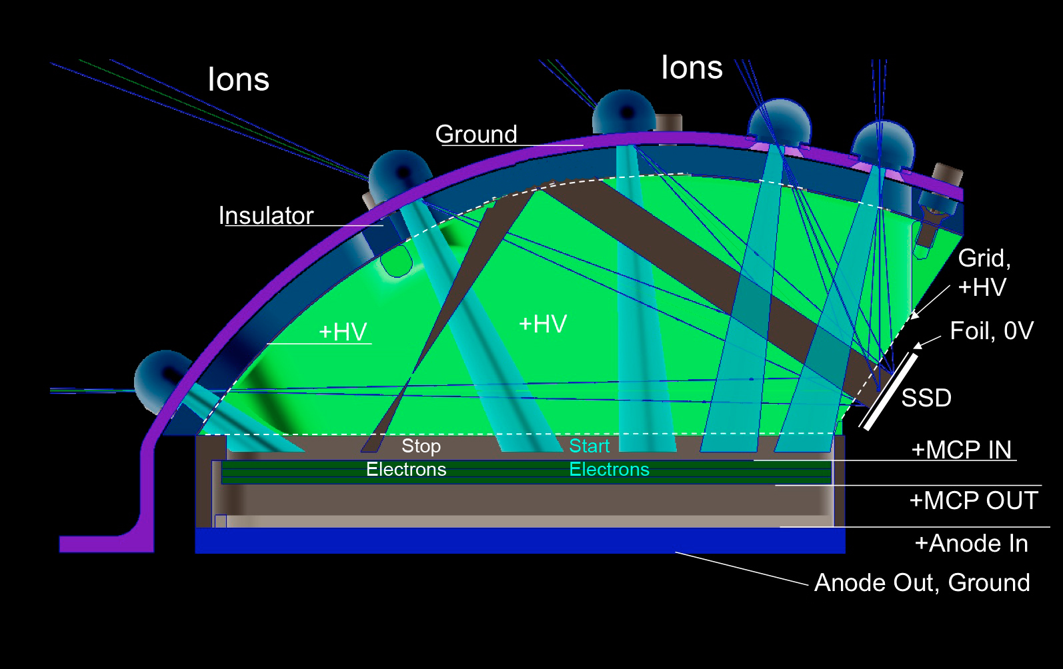
Principles of Operation

