Slide 1
Systems Engineering
John Dickinson
Notes:
introduction

Slide 2
Outline
Instrument driving requirements
Flow down of instrument performance requirements to major subsystems
Instrument interfaces
  Electrical
  Mechanical
  Thermal
Environmental design and test requirements
Resources allocated to the instrument
  Mass, Power, Telemetry Volume, SSR Volume
Instrument command and autonomy
Major trades performed in Phase B
Major changes since MDR

Slide 3
ISIS Systems Engineering Approach
Distributed Systems Engineering
  Both EPI-Hi and EPI-Lo have a dedicated SE
ISIS SE role is to
  Coordinate interactions with the project
  Maximize use of shared resources
  Provide oversight of technical tasks

Slide 4
SPP Req.s Doc. Architecture and Status
Level 1
L1 Requirements For The SPP Mission
Appendix E to Living With a Star Program Plan
Status Key:
Started
Draft: Key Driving
Draft: Complete
Preliminary
Baseline
Solar Probe Plus (SPP) Level 2 Mission
Requirements Document (MRD)
Level 2
SPP Level 3 Payload
Requirements Document (PAY)
Level 3
EDTRD
EMECP
CCP
MPCP
PCP
SPP-ISIS ICD
GI ICD
MOC/SOC ICD
SPP ISIS Level 4 Instrument Requirements Document (IRD)
Level 4
Notes:
Instrument Requirements are derived directly from Project L1->L2->L3 Requirements and environmental, materials, and parts plans
Dual instrument ICDs guide spacecraft interfaces (electrical, command and data, mechanical, thermal, and ground)
All documents have been reviewed and signed off by SPP
Environmental Design and Test Requirements Document
Electromagnetic Environment Control Plan
Contamination Control Plan
Materials and Processes Control Plan

Slide 5
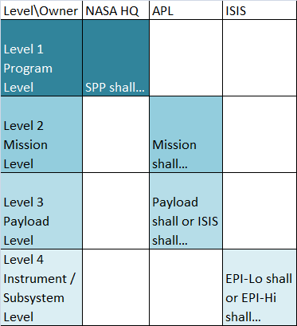
Level Definitions
L1 requirements are defined by NASA as advised by the SPP Science Working Group
  This document belongs to NASA
  “SPP mission shall”
  Program Level Requirements
L2s are APLs response to the L1s
  This document belongs to APL/Project Office
  “Mission shall”
  Mission Requirements Document
L3s are performance and functional requirements on individual mission elements
  This document belongs to APL/Project Office
  “Payload shall" or "ISIS suite shall“
  Payload Requirements Document
L4s are the payload response to L3s
  This document belongs to ISIS
  “EPI-Lo shall” or “EPI-Hi shall”
  Instrument Requirements Document
Notes:
Different levels of requirements apply to different levels of implementation.
Documents are owned by different institutions.
ISIS team is involved and performs reviews at all levels – direct signature on L2-L4 (Does Dave sign L1s?).

Slide 6
SPP Requirements Documents
Project Requirements Document | Version | Date
NASA L1 Requirements For The SPP Mission Appendix E to Living With a Star Program Plan | Rev. - | 9/6/2011
APL 7434-9047, Solar Probe Plus (SPP) Level 2 Mission Requirements Document (MRD) | Rev. C | 8/30/2013
APL 7434-9051, SPP Level 3 Payload Requirements Document (PAY) | Rev. - | 6/27/2013
APL 7434-9066, SPP General Instrument to Spacecraft ICD | Rev. - | 10/3/2013
APL 7434-9058, SPP to ISIS ICD | Rev. - | [in review]
APL 7434-9078, SPP MOC to SOC ICD | Draft | [in review]
APL 7434-9039, SPP Environmental Design and Test Requirements Document | Rev. - | 6/18/2013
APL 7434-9040, Electromagnetic Environment Control Plan (EMECP) | Rev. - | 4/23/2013
APL 7434-9011, SPP Contamination Control Plan (CCP) | Rev. - | 6/17/2013
APL 7434-9009, SPP Materials and Processes Control Plan (MPCP) | Rev - | 6/11/2013
APL 7434-9001, SPP EEE Part Control Plan (PCP) | Rev. A | 4/11/2013
JPL D-8545, JPL Derating guidelines | Rev. E | 8/4/2006
Plus other Mission Assurance Documents
Notes:
Specific Requirements Document Names and Numbers
Also shows current revision level for APL documents
ISIS reviews and signs off on all documents

Slide 7
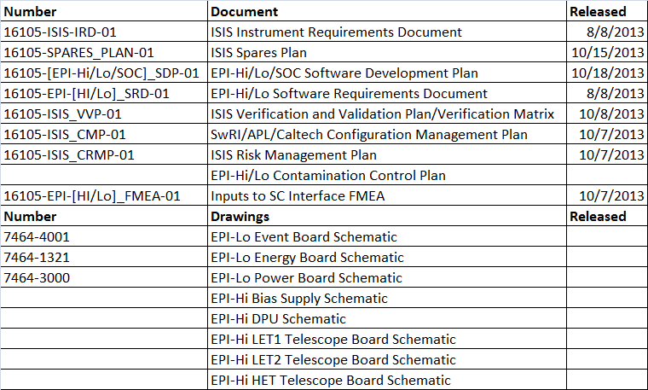
ISIS Response Documentation
Notes:
ISIS has provided all deliverable documents required for PDR to the Project
Instrument designs are well under way in the form of board schematics

Slide 8
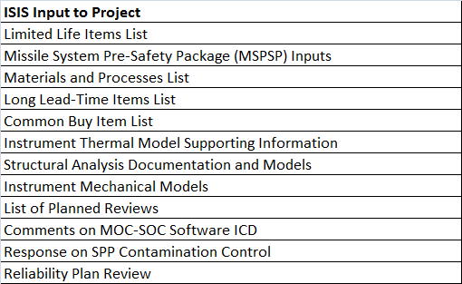
Reviewed Supporting Documents
In addition to the Requirements documents, ISIS has provided feedback on the following documents/topics:
ISIS has been responsive to inputs required by Project
Notes:
ISIS has been responsive to inputs required by Project

Slide 9
Driving Requirements at L1/L2
The Mission shall measure energetic electrons, as follows:
  Energy range: ≤ 0.05 to ≥ 3 MeV
  Highest cadence: ≤ 1s for selected rates
  FOV: ≥ π/2 sr in sunward and anti-sunward hemispheres
  Angular sectoring: ≤ 45 degree sectors
  Composition: n/a
The Mission shall measure energetic protons and heavy ions, as follows:
  Energy range: ≤ 0.05 to ≥ 50 MeV/nucleon
  Highest cadence: ≤ 5s for selected rates
  FOV: ≥ π/2 sr in sunward and anti-sunward hemispheres
  Angular sectoring: ≤ 30 degree sectors
  Composition: at least H, He, 3He, C, O, Ne, Mg, Si, Fe
Both EPI-Hi and EPI-Lo are required to meet all requirements at all energy ranges
Notes:
ISIS Driving L1/L2 Requirements

Slide 10
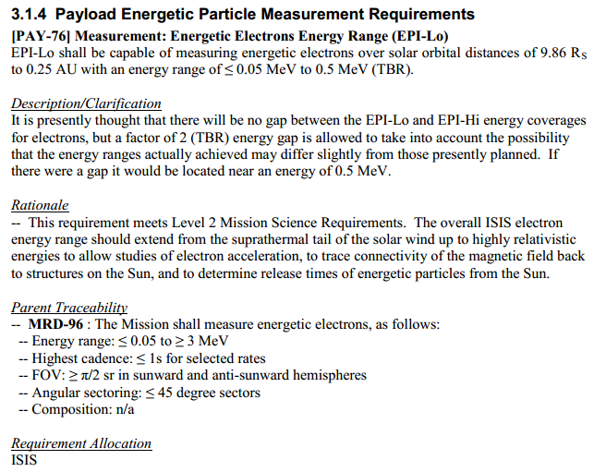
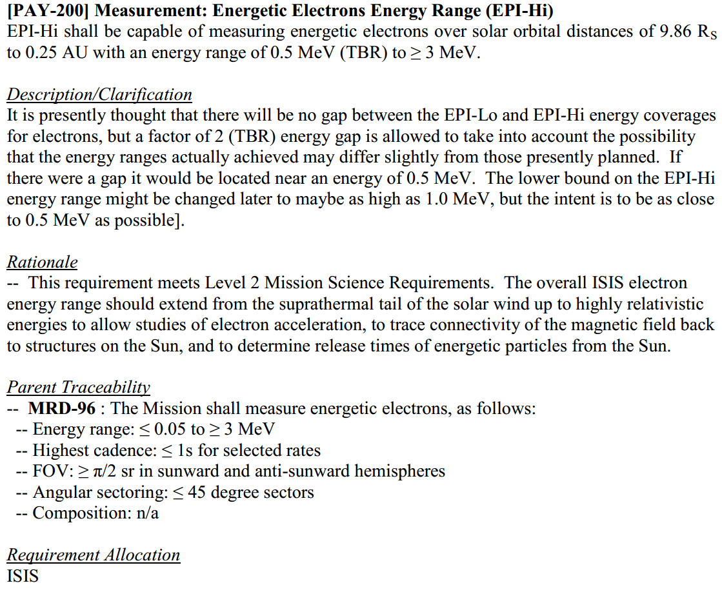
Requirements Flowdown to L3
L2: The Mission shall measure energetic electrons, as follows:
  Energy range: ≤ 0.05 to ≥ 3 MeV
L3:
Traceability to L2 as well as more detail captured at L3
  Description/Clarification, S/C Rationale, Parent Traceability, Requirement Allocation
Notes:
Each driving requirement flows to at least 1 L3 requirement
A description/clarification is captured at the S/C level
Further, S/C rationale is captured at L3

Slide 11
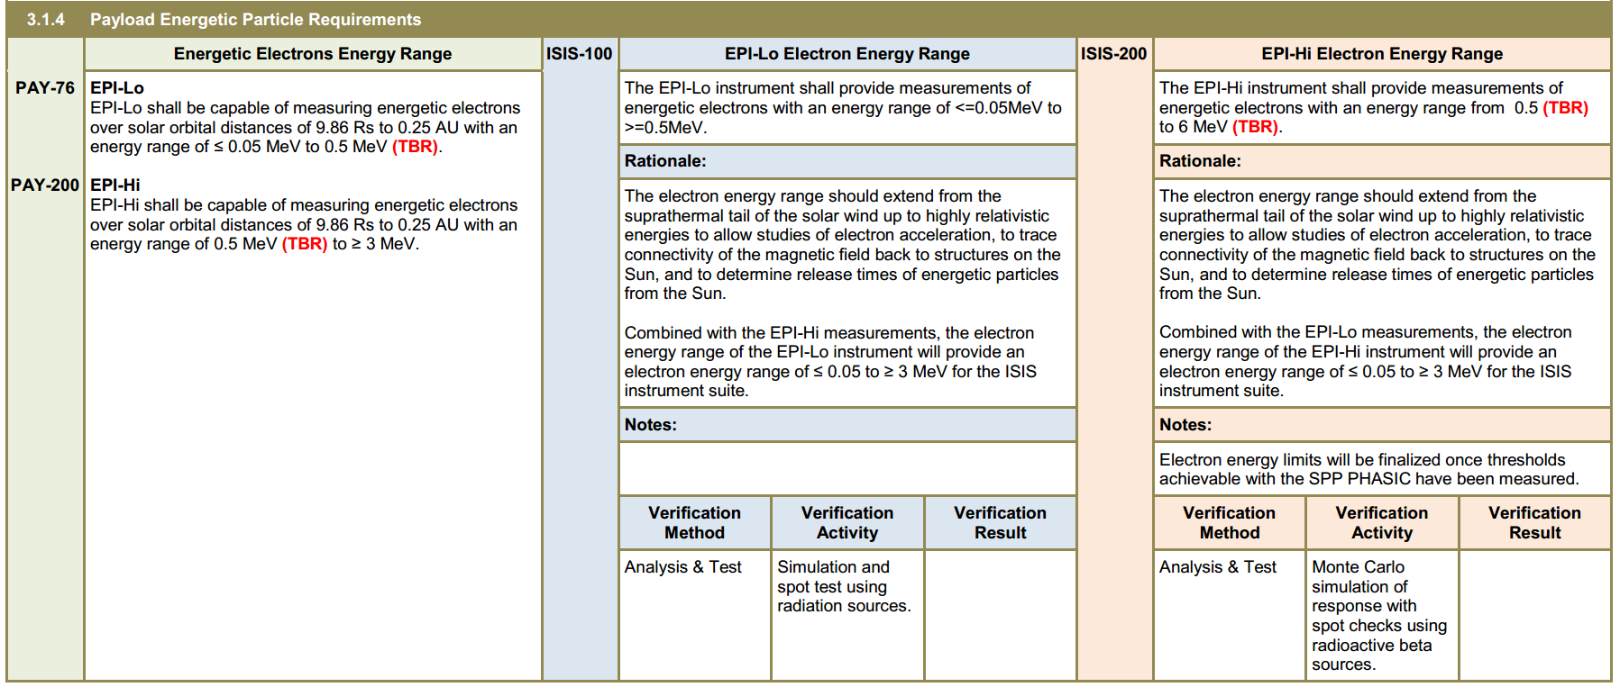
Requirements Flowdown to L4
L4:
Traceability to L3, ISIS Rationale, Verification Method, and Verification Activity captured at L4
NEEDS UPDATE FOR ISIS
Notes:
Illustration of science requirements flowdown
L3 requirements flow down to at least 1 L4 requirement
Flow down is captured in the requirements document itself (show a picture)
Every L4 requirement is verifiable either directly or via several activities
L3 requirements are verified directly by roll-up of L4 requirement verification

Slide 12
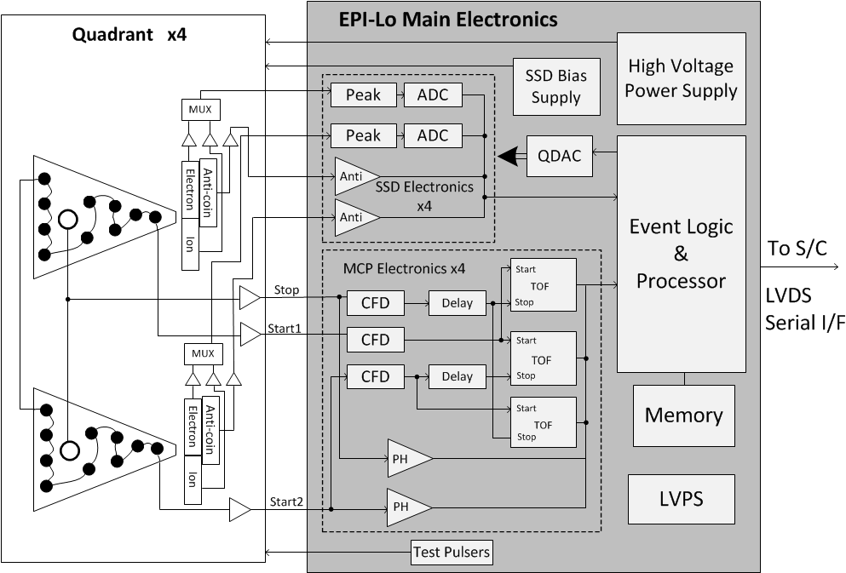
EPI-Lo Block Diagram
Unique EPI-Lo to S/C
Interfaces include:
S/C power
Cmd/Tlm
Survival Heaters
S/C Temp Sensors
EPI-Lo mounted to shared ISIS Bracket
Notes:
Individual Instrument Block Diagrams
Both instruments are entirely separate
Each instrument has it’s own individual connections to the S/C, including: power, command and telemetry, heaters, temperature sense

Slide 13
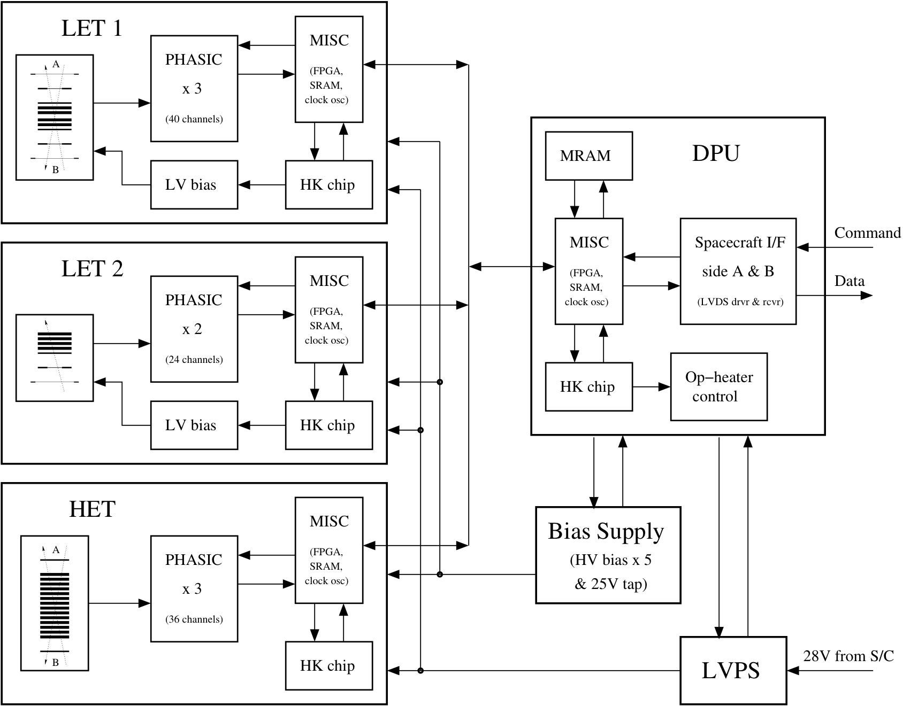
EPI-Hi Block Diagram
Unique EPI-Hi to S/C
Interfaces include:
S/C power
Cmd/Tlm
Survival Heaters
Operational Heaters
S/C Temp Sensors
EPI-Hi mounted to shared ISIS Bracket
Notes:
Each instrument has it’s own individual connections to the S/C, including: power, command and telemetry, heaters, temperature sense

Slide 14
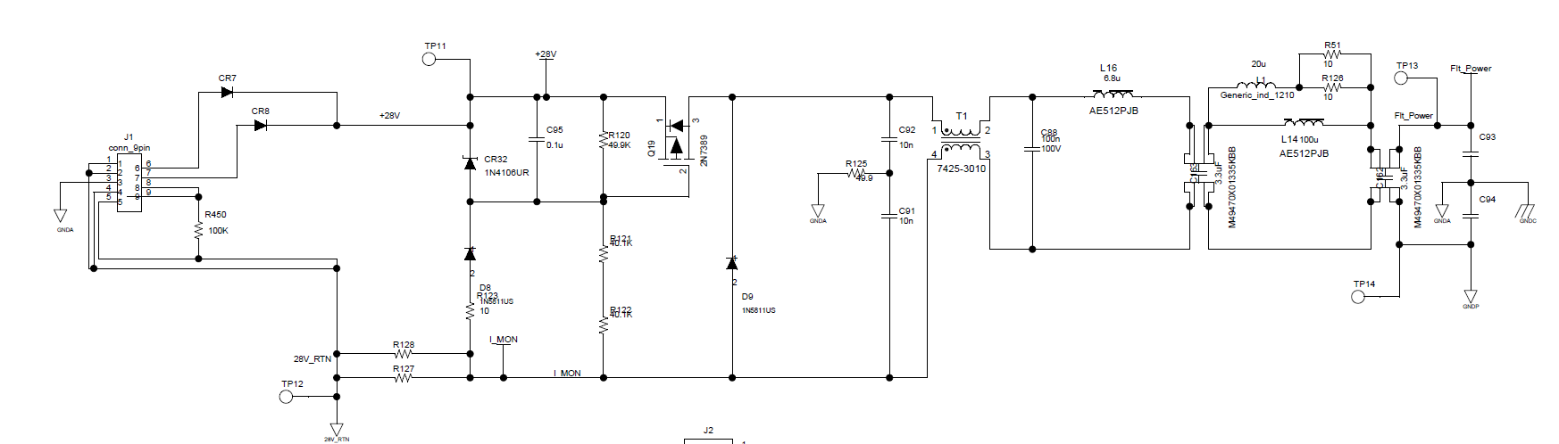
Spacecraft Interfaces
Power
  Main Instrument Power
  Survival Heaters
  Operational Heaters (EPI-Hi)
Command & Telemetry
  Side A/B LVDS UART
Grounding
  Chassis Ground
Thermal
  Heaters
  Thermistors
  Thermal Strap
Captured in GI and SPP-ISIS ICDs
Instrument Interface Circuit
Notes:
Spacecraft interfaces to the instrument
They are captured in the ICDs
Specifically, main power has a S/C fuse, high side FET, and low side current monitor
Instrument interface has filtering and primary isolation

Slide 15
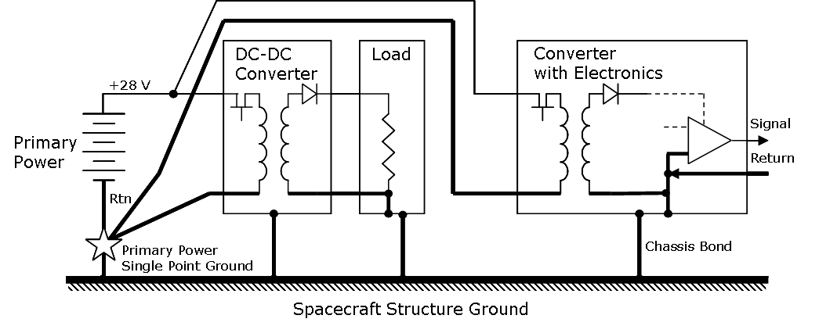
Spacecraft Grounding Diagram
Captured in GI ICD
Notes:
Spacecraft has the primary star ground for the S/C

Slide 16
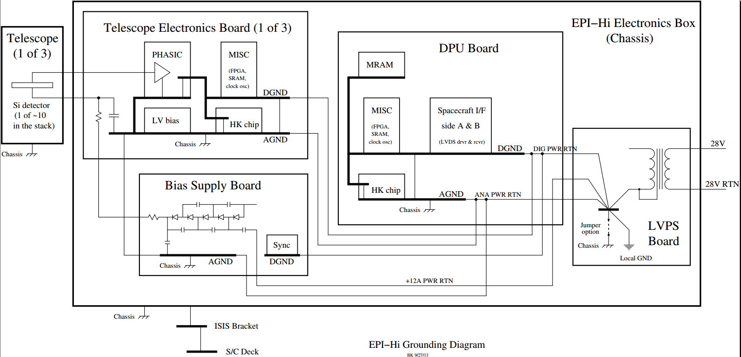
Instrument Grounding Diagrams
EPI-Lo
Captured in SPP-ISIS ICD
Notes:
Instrument grounds are isolated from S/C return
Instruments have local single point grounds
Instrument Chassis is tied to the S/C chassis through a ground strap (IS THIS THE ONLY CONNECTION???)

Slide 17
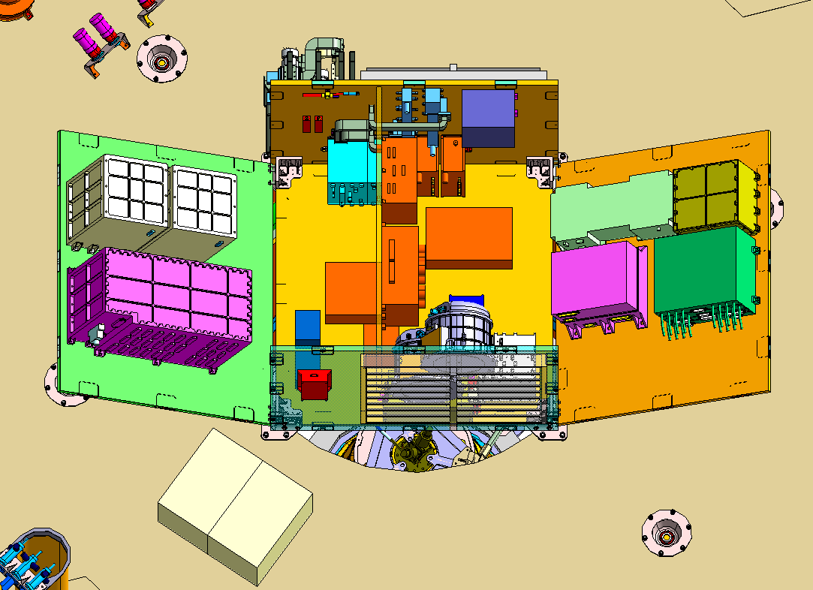
Mechanical Interfaces
Mechanical - Vault
  Electronics box location settled in vault
  Vault cable feedthrough plate with mouseholes for HV cables in work with LM
  Keep Out Zone at a corner of JADE box for clearance on cables to MWR box
  Ebox thermally conducts
  through mounting
  Latest Ebox Volume:
    28.37 x 22.86 x 18 cm
    (11.169” x 9” x 7.085”)
  Max Ebox Volume:
    29.53 x 23.18 x 18 cm
    (11.625” x 9.126” x 7.087”)
  Defined axis of growth – only
  in box +Z direction (s/c -X/-Y)
NEEDS UPDATE FOR ISIS
JADEEbox

Slide 18
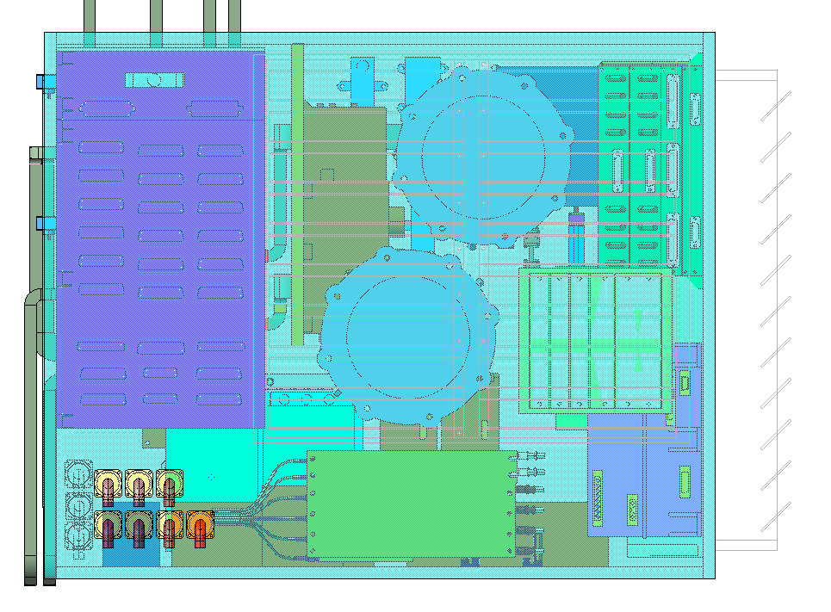
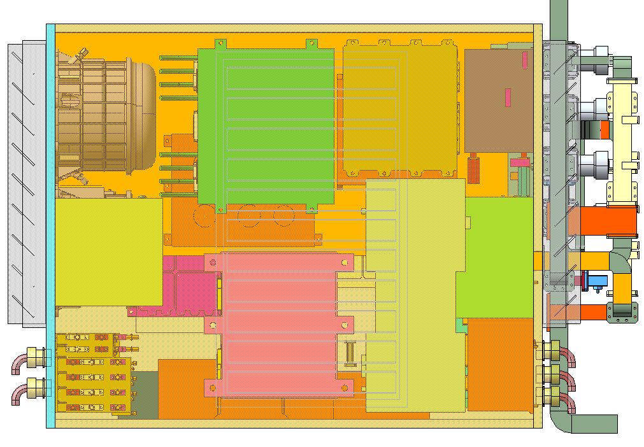
Spacecraft Sep Plane Keep Out Zone
JADE
Electronics
JADE harness
Keep Out Zone,
5.82 cm x 1.6 cm
1.6
1.6 cm
MWR
NEEDS UPDATE FOR ISIS
5.82 cm
JADE
Electronics
JADE harness KOZ,
7.1 cm x 1.6 cm
0.95
TBD

Slide 19
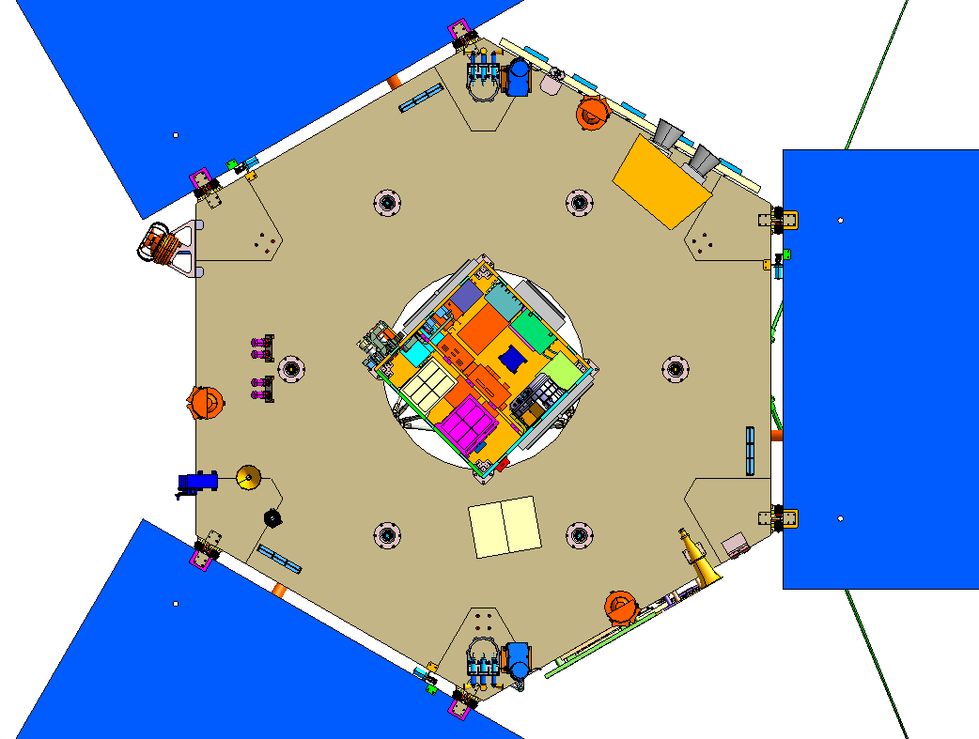
JADE Spacecraft Accommodations
JADE-E060
+Y
Instrument
Electronics
Hinged panel
JADE Ion Sensor
NEEDS UPDATE FOR ISIS
JADE-E180
Spacecraft
+X
(Mag Boom)
JADE-E300

Slide 20
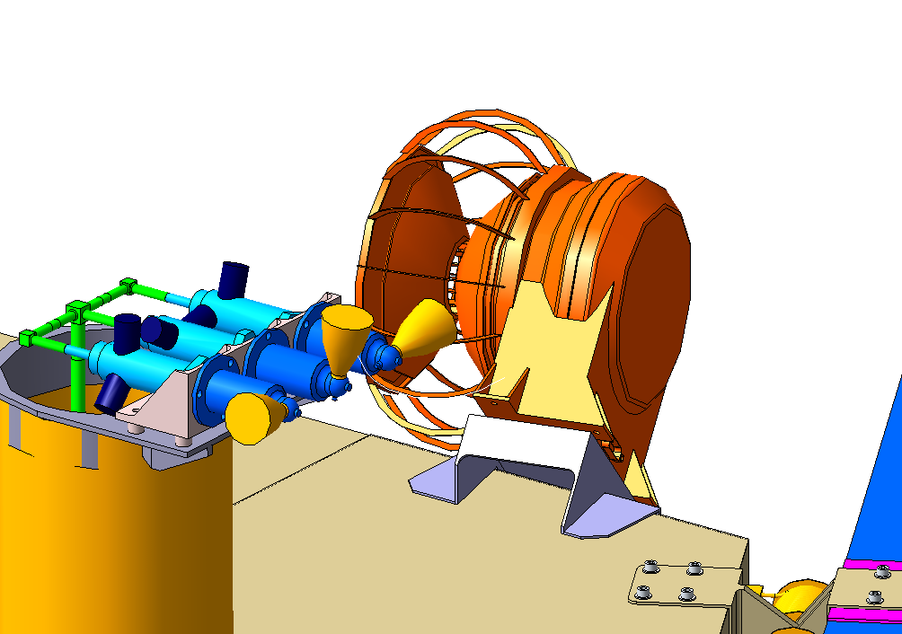
ISIS Instrument Mounting to Bracket
New JADE Ion Proposed Bracket – To be worked with LM and documented in MICD
Plume Shield will be implemented to minimize contamination in direction of s/c deck from thrusters
Proposed Ion Bracket
NEEDS UPDATE FOR ISIS
Thruster

Slide 21
ISIS Mounting to Spacecraft Deck
New JADE Ion Proposed Bracket – To be worked with LM and documented in MICD
Plume Shield will be implemented to minimize contamination in direction of s/c deck from thrusters
Proposed Ion Bracket
NEEDS UPDATE FOR ISIS
Thruster

Slide 22
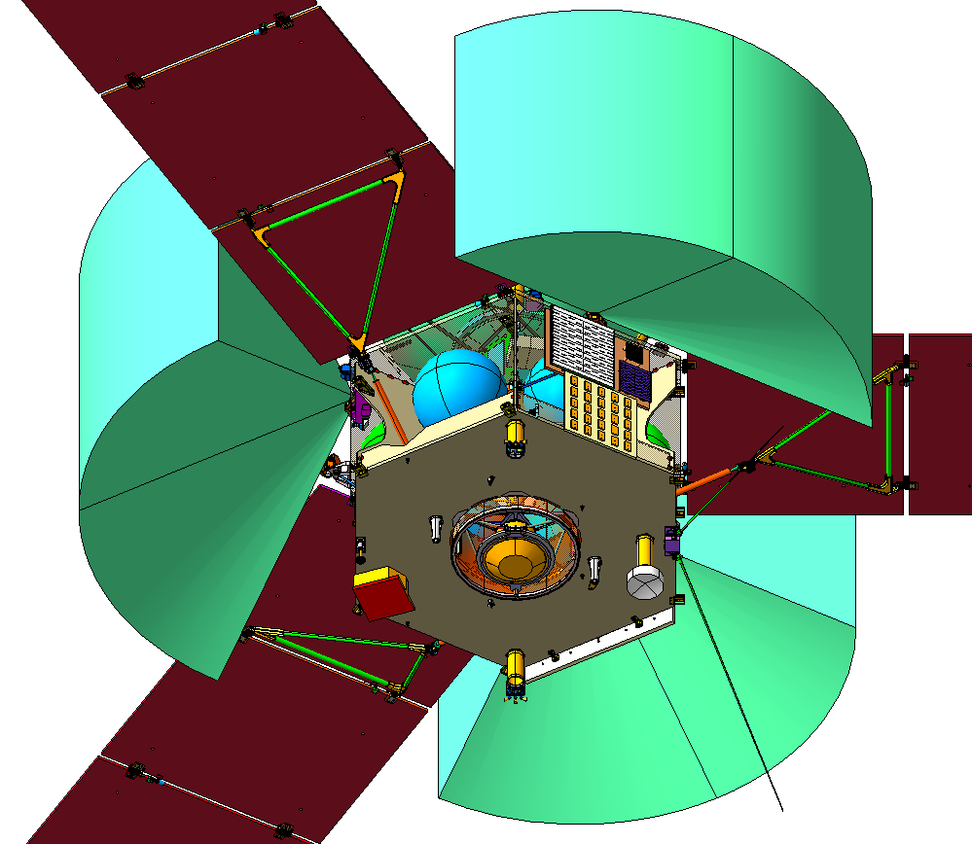
EPI-Hi Field Of View
Jade 60 X 120
Keep Out FOV
NEEDS UPDATE FOR ISIS

Slide 23
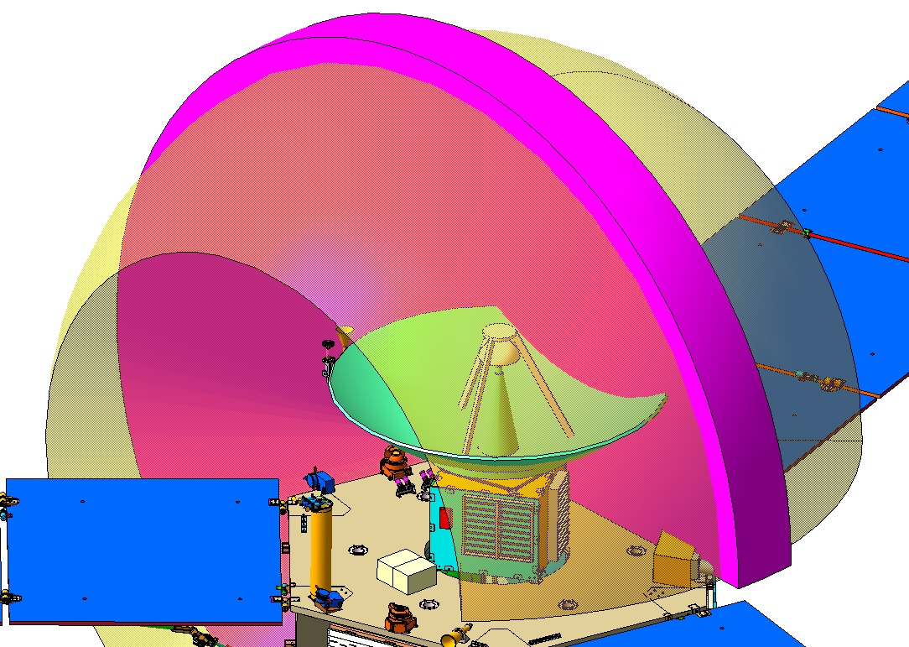
EPI-Lo Field Of View
180º away from deck should be clear
Obstructions from HGA and Thrusters/ Plume Shield will be documented in MICD
270° x 10° undeflected FOV
270° x 90° goal
NEEDS UPDATE FOR ISIS

Slide 24
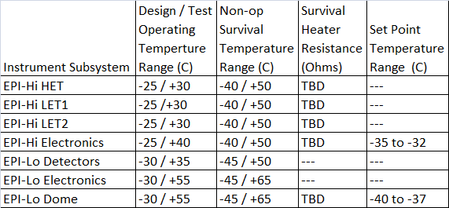
Thermal Interfaces
EPI-Hi:
  Both survival and operational heater services from the spacecraft
  Instrument controls operational heater
  Spacecraft controls survival heater
  Has 5 temp sensors monitored by spacecraft
EPI-Lo:
  Has a dual use survival/operational heater, used during survival conditions, instrument pre-on warm-up, and in low power modes
  EPI-Lo has 2 temp sensors
Individual thermal straps to spacecraft deck
Notes:
EPI-Hi has both survival and operational heater services from the S/C
EPI-Hi controls operational heater, S/C controls survival heater
EPI-Lo has a dual use survival/operational heater, used during survival conditions, instrument pre-on warm-up, and in low power modes
EPI-Lo has 2 temp sensors
EPI-Hi has 5 temp sensors monitored by S/C

Slide 25
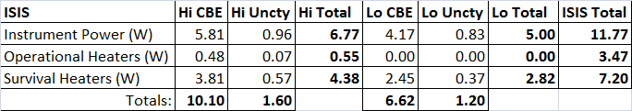
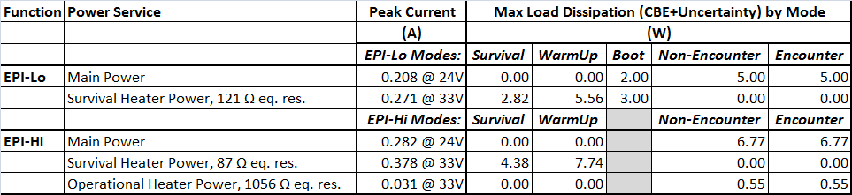
Resources - Power
ISIS Current Best Estimates and Uncertainties
ISIS Power by Mode and service
EPI-Lo has a low-power Boot safe-hold mode in which survival heaters are used as operational heaters to maintain instrument above Cold Op. temps
EPI-Hi is either on or off
During Survival, heater power is duty cycled to ensure instrument stays above survival temperature
During Warm-up, heater has a 100% duty cycle to warm the instrument prior to normal operations (Encounter Mode)
Notes:
ISIS maintains individual Current Best Estimate values on each instrument
An Uncertainty on these estimates is suggested by the cognizant engineer and carried at the ISIS project level
The total CBE + Uncertainty remains within the S/C allocation for the instruments
For power, individual modes and power services are broken out for different phases in the mission

Slide 26
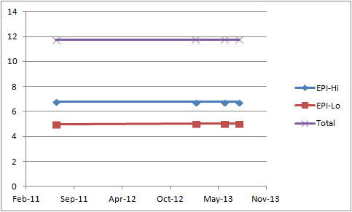
Resource – Power (Trend)
Because all resources on SPP are tightly constrained, mass and power estimates have been rigorously maintained based on heritage instruments from the beginning
As a result of this attention to rigorous estimation, there has been no change in instrument power allocation over time
Notes:
The ISIS power estimates have remained very stable over the life of the mission

Slide 27
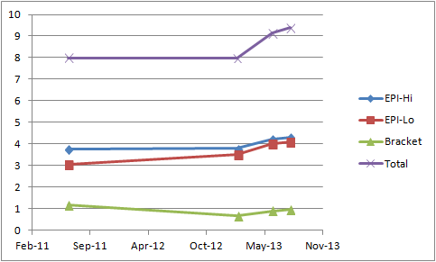
Resources - Mass
With the S/C orbit change, the Instruments were asked to choose key areas to increase mass to reduce risk (in June, 2013)
This increased instrument allocation by 1.5 kg.
Request | NTE (kg) | Risk Addressed
ISIS Bracket Change to Follow Umbra at TPS Shift | 0.300 | APL proposal. Also hold 0.100 kg as lien.
Increase Size of Four EPI-HI Boards | 0.336 | Mitigate board area allocation risk.
Heavier Than Expected MCPs | 0.900 | Realized mass growth.
Total | 1.536
Notes:
ISIS Mass estimates have also been very stable.
With the S/C orbit change, the Instruments were asked to choose key areas to increase mass to reduce risk (in June, 2013)
This enabled ISIS to reduce the following risks: ISIS bracket change to follow late TPS shift, size increase of the four EPI-Hi boards to alleviate layout anxiety, and MCP mass that was heavier than expected.

Slide 28
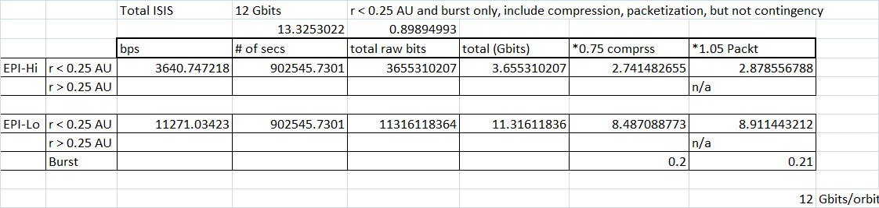
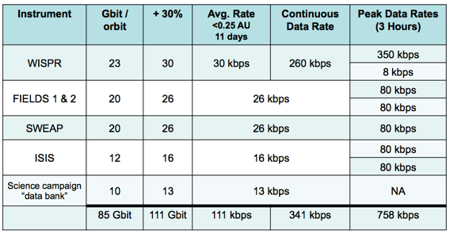
Resource - Telemetry
ISIS Telemetry request is unchanged since Phase A
Notes:
ISIS telemetry is unchanged since Phase A
S/C can accommodate our needs

Slide 29
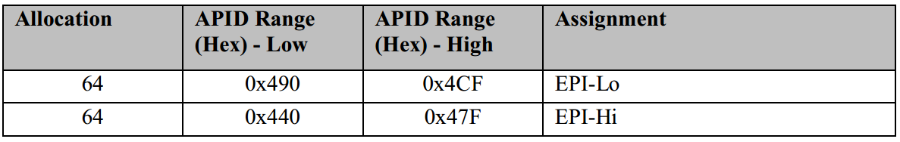
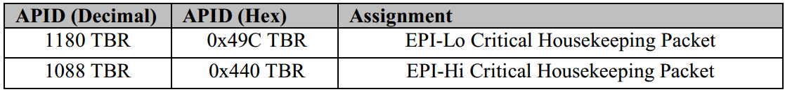
CCSDS APIDs
CCSDS APIDs assigned in SPP-ISIS ICD
EPI-Lo and EPI-Hi have each been allocated a contiguous range of 64 APIDs for CCSDS telecommand and telemetry packets.

Slide 30
Autonomy Summary
The spacecraft will monitor and respond to:
ISIS Power requests instrument critical housekeeping telemetry packet:
  instrument power-down (response = power-down)
  instrument power-cycle (response when < 0.25 AU = power-cycle; response when >= 0.25 AU = power-down)
ISIS Stale aliveness status as determined from the sequence count in the ITF (response when < 0.25 AU = power-cycle; response when >= 0.25 AU = power-down)
Excessive instrument power levels as determined from spacecraft Power Distribution Unit (PDU) telemetry (response = power-down)
Excessive instrument temperature as determined from spacecraft Remote Interface Units (RIUs) (response = power-down)

Slide 31
ISIS AI&T

Slide 32
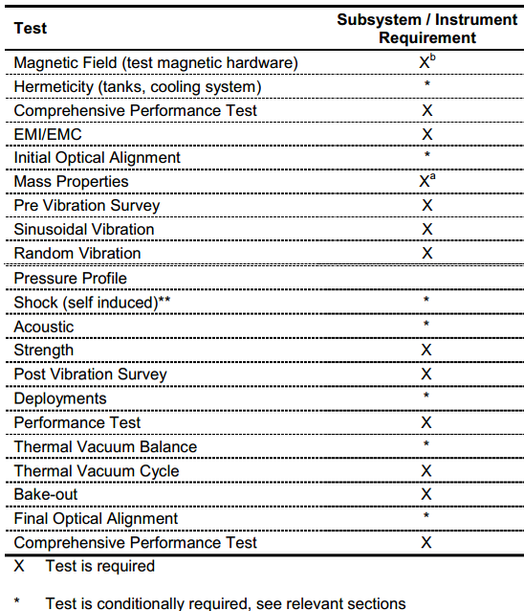
Environmental Requirements & Tests
Key Environmental Requirements set in EDTRD:
  Duration: 7 years
  Orbits: 24
  Solar Illumination: 1 sun on any aperture
  TID: 70 kRad behind 60 mils Al [CHECK THIS???]
  SEL: >80 MeV-cm2/mg
  Dust: Probability of no damage >95%
    EPI-Lo: 124.3 um particle diameter
    EPI-Hi: 68.5 um particle diameter
  Stiffness: >80 Hz Res. Freq.
  Shock: 40G @ 100 Hz at separation interface
Notes:
ISIS is prepared for all Environmental testing levied by EDTRD
As will be shown in the AI&T presentation, ISIS undergoes all prescribed environmental testing.

Slide 33
ISIS Concept of Operations
Commissioning – 2 days for ISIS alone
  Initial Turn-on and Checkout with Real-Time Telemetry
Multi-Instrument Commissioning – 5 days for Instrument Suite
  EPI-Hi & EPI-Lo performs statistics gathering for calibration
Calibration goal: at least 1d of data during significant SEP event on orbit 1-2
Spacecraft-Sun Distance R<0.25 AU (Normal Science Mode)
  Full nominal power
  High data collection rate and burst mode
Spacecraft-Sun Distance: 0.25< R<0.76 AU (Low-rate Science Mode)
  Full power when not downlinking
  Full power or low-power mode when downlinking
  Reduced data collection rate
  Commanding window should be scheduled late in the series of telemetry passes, although it may not be used every orbit
  Minimize power cycling the HV supplies

Slide 34
Major Changes Since MDR
Mission Orbit Change
Embraced Quadrant Architecture on EPI-Lo
Added Anti-Coincidence in EPI-Lo
NEEDS UPDATE FOR ISIS

Slide 35
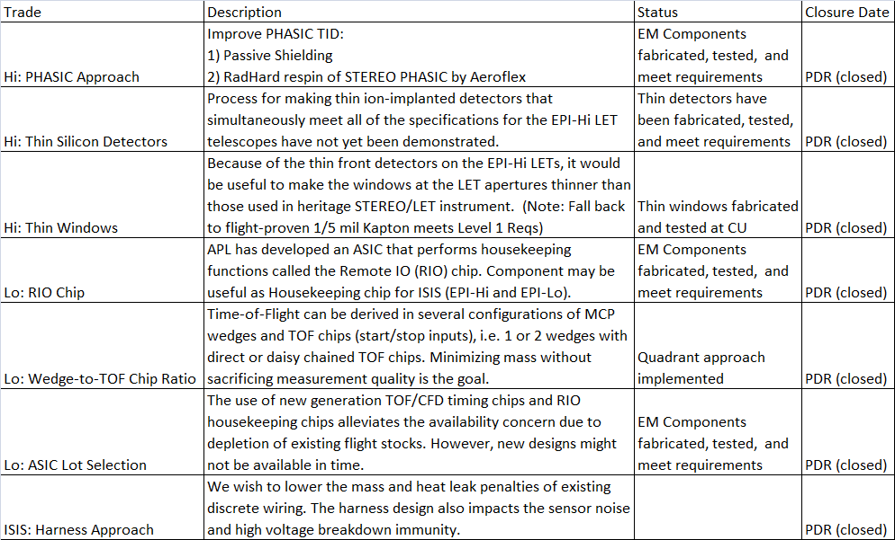
Trade Studies

Slide 36
Summary
ISIS takes a comprehensive and distributed approach to systems engineering
ISIS requirements are approached with flowdown and verification in mind
  Requirements flowdown is easily traceable and well understood
  ISIS design meets or exceeds all Level 3 requirements
ISIS to Spacecraft electrical, mechanical, and thermal interfaces are well described in the ICDs
ISIS Resource estimates are within spacecraft allocations
  ISIS has cultivated a reputation as a good steward of mission resources
Plans are in place for Environmental Testing and AI&T
ISIS has demonstrated tremendous design maturation and clarification throughout Phase B
Next steps
  Continue with EM builds and testing

Slide 37
Requirements Verification
Verification Planning
  Inspection, Analysis, Test
  Specs lead to VTP where individual requirements are checked off
  Completing VTP’s in EM so we have the documents ready for FM build
  Linking specs, and VTP’s / As-Run tests in DOORS
  Verification Matrix shows how each requirement will be verified, and links to the appropriate test procedure
  Reviewing Juno Verification and Validation Plan, D-34004
NEEDS UPDATE FOR ISIS

Slide 38
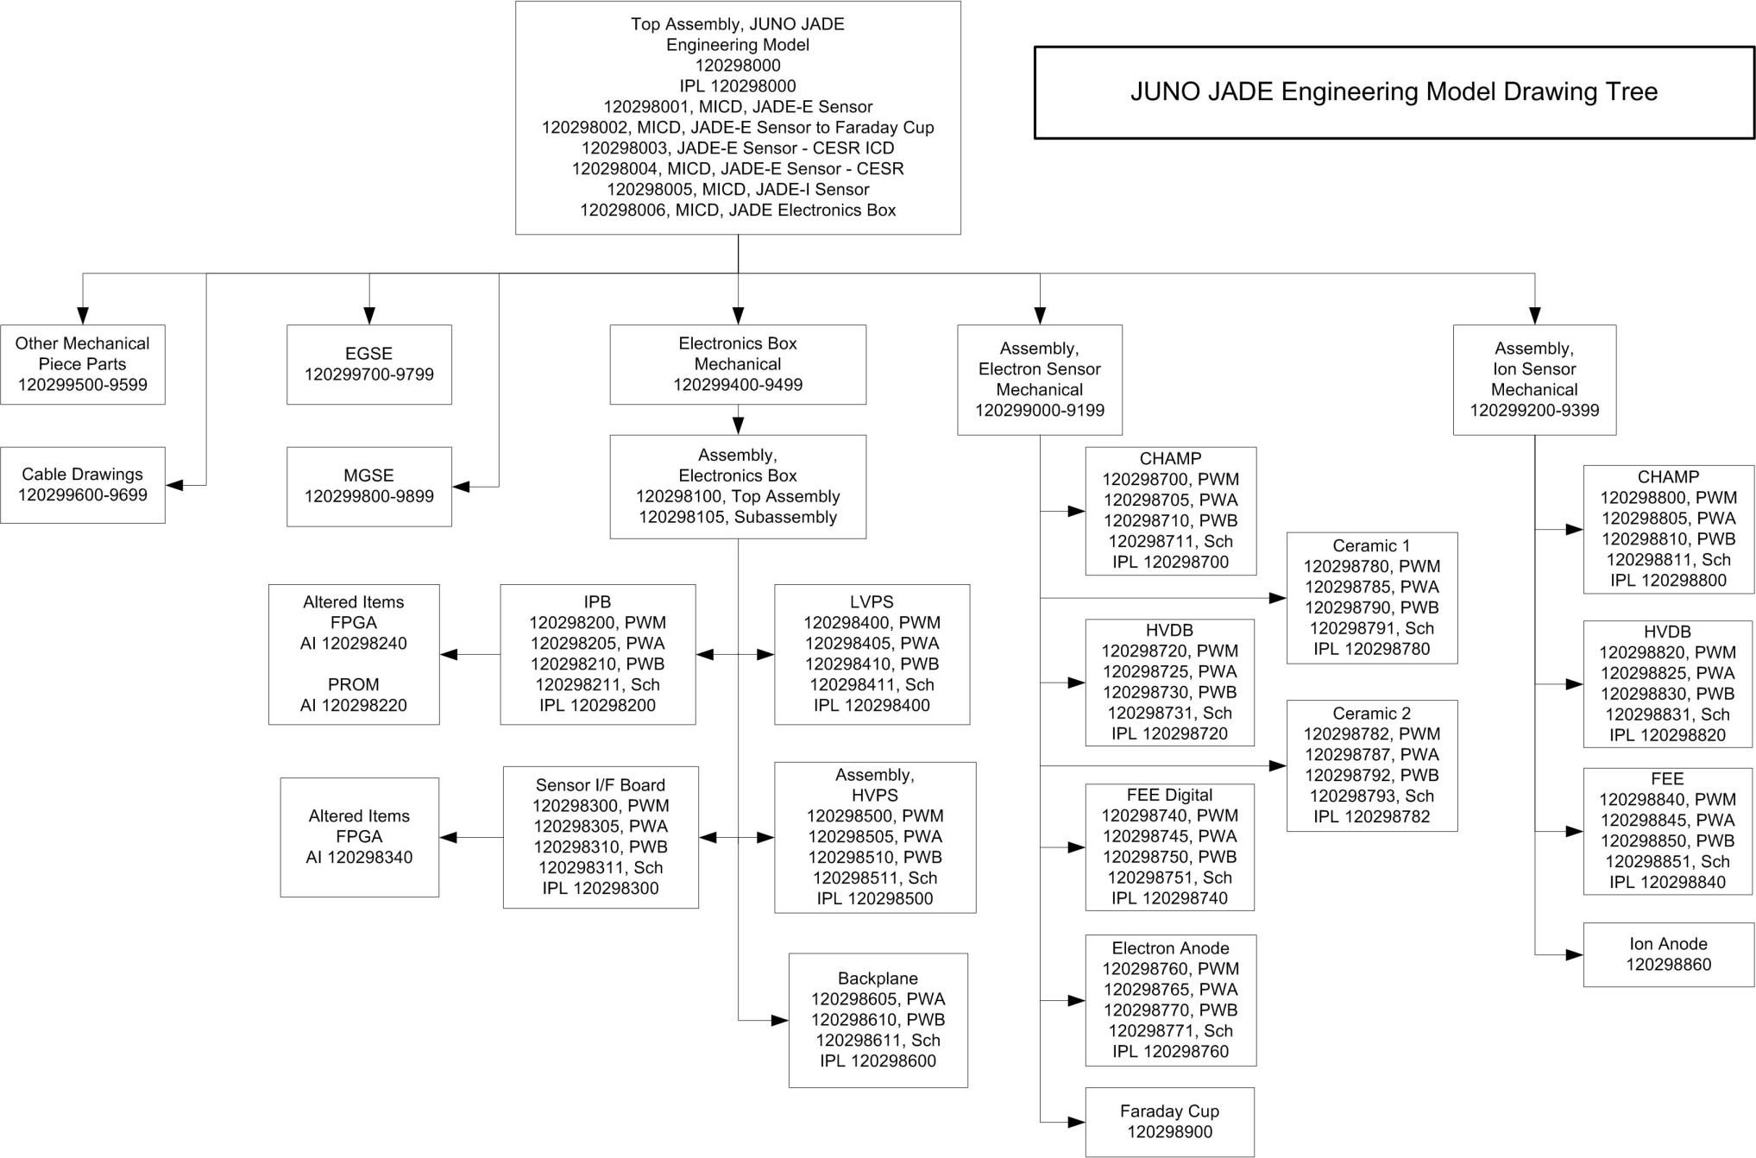
EM Drawing Tree
NEEDS UPDATE FOR ISIS

Slide 39
JADE Operations
JADE Hardware Modes
  Boot
    Instrument has been turned on and is booting up, not ready to respond to commands
  Low Voltage Engineering
    Low power mode, no high voltage. Initial post-boot state.
    Functional testing, initial low voltage turn-on and checkout.
  High Voltage Engineering
    Allows direct control of high voltage via commands.
    Allows for initial checkout of high voltage performance, as well as specific calibration activities.
    No automatic sweeping of high voltage.
  High Voltage Survey
    Low rate science data collection mode that is active for most of the 11-day nominal science orbit, outside of the +/- 3 hr perijove prime observation period.
  High Voltage Science
    High rate science data collection mode. Active during the +/- 3 hr around perijove region in a nominal science orbit.
  High Voltage Science + Burst
    Burst data collection is active in addition to high voltage science mode.
    Burst data is the uncollapsed data products produced by each sensor, sent out over the dedicated High Speed Synchronous (HSS) RS-422 data line to be collected in buffers by the spacecraft. Occurs over the north and south polar regions of Jupiter only, within the prime science observation region.
NEEDS UPDATE FOR ISIS

Slide 40
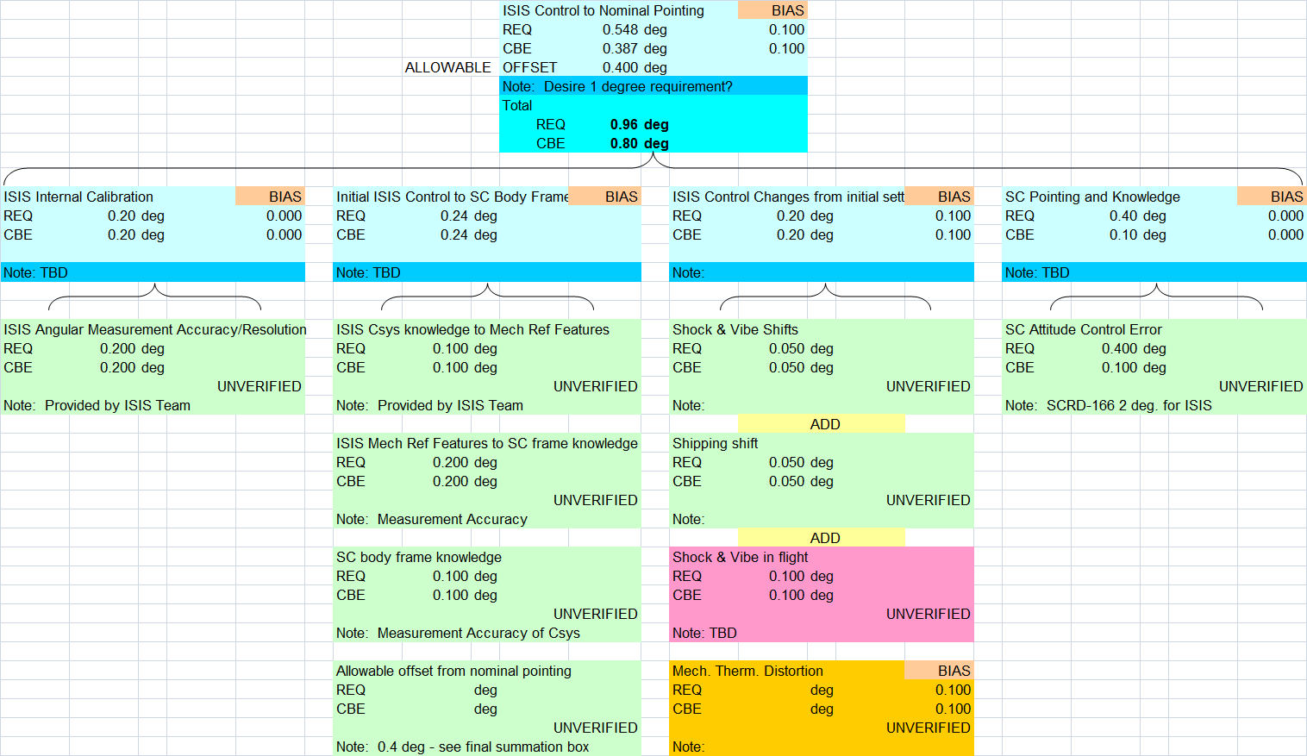
Pointing: Level 3 Requirements
L3-PRD-35 (flowed from L2-PS-796)
  During the science orbits, the Juno Project shall provide attitude reconstruction with respect to inertial space for each Waves, UVS, JADE sensor/antenna's electrical boresight with errors within ±20 milliradians, with 99.73% certainty, to each instrument's team. Excluded from this requirement are the following periods:
    30 minutes following any thruster firing
    5 hours following any OTM, precession greater than 10 mrad or appendage articulation
  JADE Allocation: 4.4 mrad (0.25 degrees)
    Verified by Test during Calibration for knowledge of JADE Boresight
NEEDS UPDATE FOR ISIS
DELETE?
Notes:
Considering delete
ISIS Pointing requirements are well understood
ISIS requirements are within S/C capabilities
Flowdown and tolerances are well understood

Slide 41
JADE Prelim Test Verification Matrix
NEEDS UPDATE FOR ISIS

Slide 42
Contamination Requirements
L2-PS-813 Pressure at JADE aperture; HV On
  The Juno Project shall limit in-flight pressure at the JADE sensors’ apertures to less than 1x10E⁻⁶ Torr during operation of its detector high voltage level. The MCPs within the instrument can be degraded if their high voltage is operated at pressures above this level.
  Verification – Inspection (MICD / Ideas / at ATLO), Analysis (outgassing pressures)
L2-PS-814 Thruster line-of-sight to the JADE Sensor Aperture
  The Juno project shall eliminate direct line-of-sight between the nozzle opening of any RCS engine and the entrance aperture of any JADE sensor (excluding the Faraday Cups), as defined in the JADE-Spacecraft ICD.
  Verification – Inspection (MICD / Ideas / At ATLO)
NEEDS UPDATE FOR ISIS
Notes:
Contamination requirements are based on heritage missions, documented in EPI-Lo and EPI-Hi individual CCPs
Concerns include EPI-Hi detectors and EPI-Lo MCPs
Ground purge requirements are established w/S/C in SPP-ISIS ICD

Slide 43
Contamination Budget
L3-PLS-381: The Juno Payload shall meet the instrument exterior surface contamination levels listed in L2-PS-809.
Fabrication and Assembly on Class 100 flow bench of critical detector components (MCPs and carbon foil)
Testing and calibration in Class 10,000 clean rooms
Witness plates used to monitor facilities with flight hardware
Contamination Source | External Surface Levels
 | Delivery to ATLO | EOL (L2-PS-809)
Particulate | 500 | 550
NVR | A/2 | A (100 Å thick)
NEEDS UPDATE FOR ISIS
Notes:
Delete?
Summary of CCPs?

Slide 44
JADE Operations and Operability
Flight Operations
  Initial HV checkout after over 1 month Flight System outgassing time
  Earth Flyby Operations – latest temperatures show JADE will be within operating temperature limits at EFB and will be available to take data
  Cruise Operations – solar wind in-flight calibration
  Calibrations – once a month preferred during cruise, once an orbit at Jupiter
    Voltage-gain curve
    Solar wind measurement during cruise
    Cross calibrate with Faraday Cups, other Juno instruments
    L3-PLS-472: Calibration over the ascending magnetic equator crossing of the flight system on at least 5 science orbits.
  Designed for automated ops on-orbit except for calibration period where we may upload new lookup tables to tweak parameters such as MCP gain or integration times
NEEDS UPDATE FOR ISIS

Slide 45
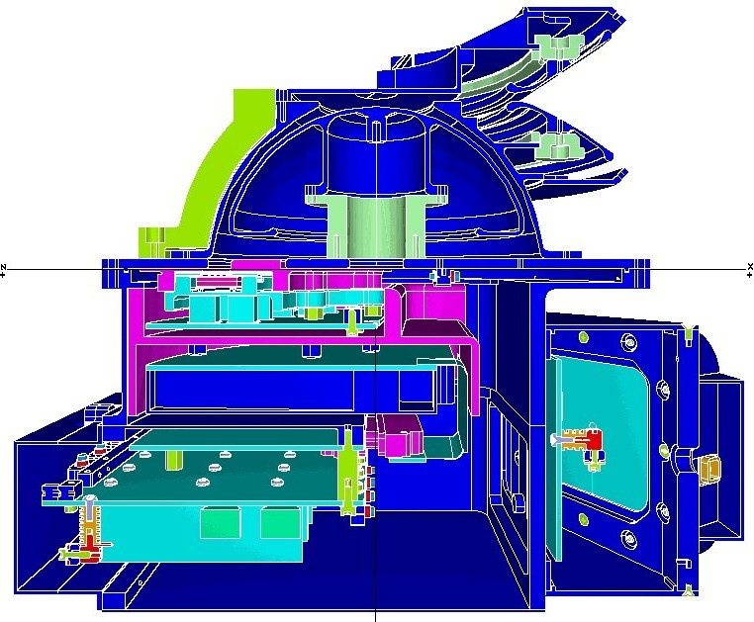
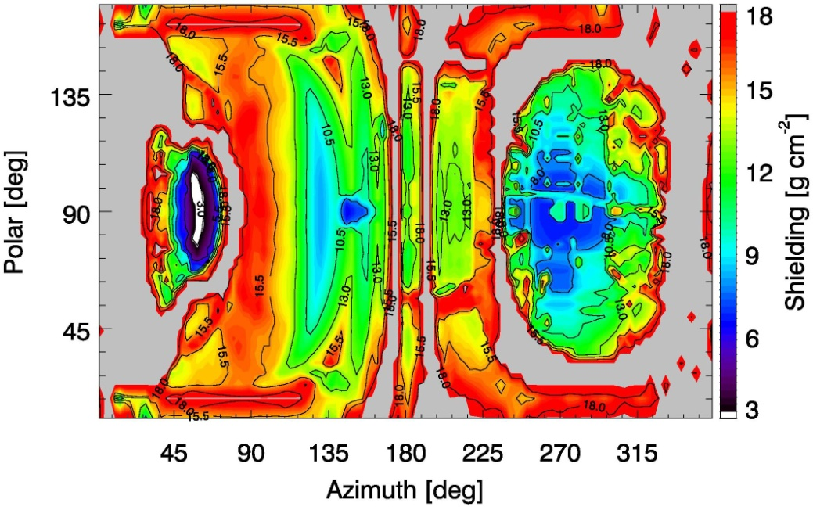
NOVICE results
Preliminary mass optimization study on electron sensor NOVICE results
Based on noise and flux analysis, JADE is aiming for ~8.5 g/cm² shielding – light-medium blue on figure
Other areas have more shielding than we need
NEEDS UPDATE FOR ISIS

