Slide 1
ISIS Science
Dave McComas
Notes:
introduction

Slide 2
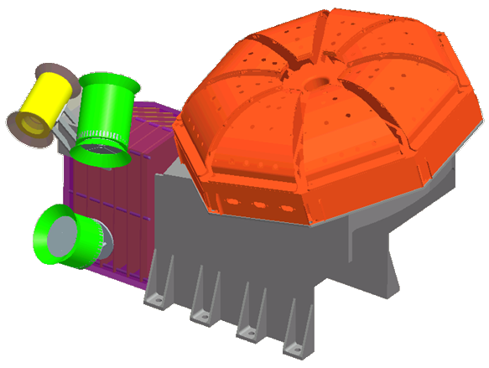
Outline
Science Team
SEP Events
Measurement near the Sun
Science Goals
Origins
Acceleration
Transport
Measurement Summary
Driving Requirements
Primary Measurement Requirements
Updated
ISIS

Slide 3
ISIS Science Team
PI: Dave McComas* (SwRI)
Co-I: Eric Christian (GSFC), Deputy PI
Co-I (Lo Lead): Ralph McNutt* (APL)
Co-I (Hi Lead): Mark Wiedenbeck* (Caltech/JPL)
Co-I (SOC Lead): Nathan Schwadron (UNH)
Co-Is: Alan Cummings (Caltech), Mihir Desai (SwRI), Joe Giacalone (UArizona), Matt Hill (APL), Stefano Livi (SwRI), Bill Matthaeus (UDelaware), Dick Mewaldt (Caltech), Don Mitchell (APL), Tycho von Rosenvinge (GSFC)
Senior Science Mentor (SSM) Team Members: Rob Gold (APL), Tom Krimigis (APL), Ed Roelof, (APL) and Ed Stone (Caltech)
*SPP Science Working Group (SWG) Members

Slide 4
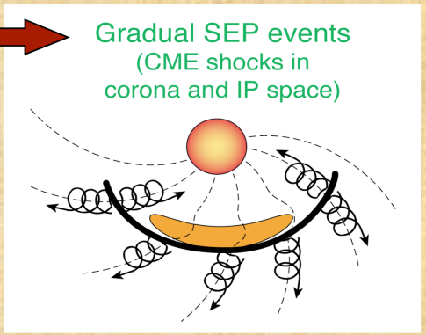
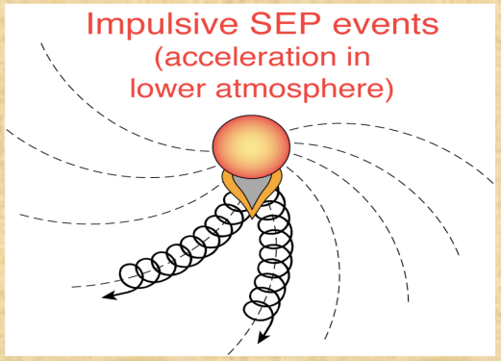
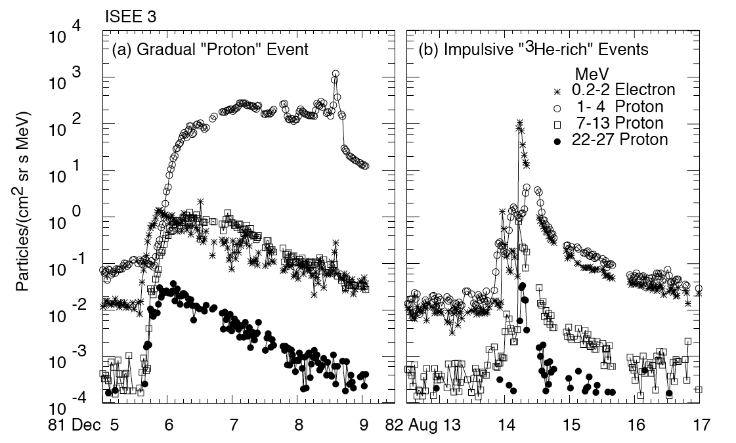
SEP Events: Gradual vs. Impulsive
Reames (1999)

Slide 5
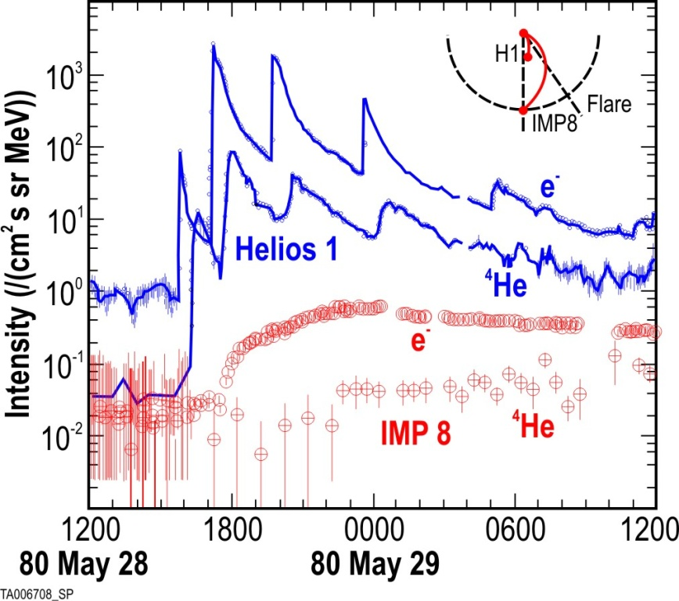
Need to measure near the sun
Testing, discriminating, and refining SEP acceleration models is difficult at 1 AU due to distance from sources and mixing during transport
Helios showed advantages of near-Sun observations of SEP processes near origin
ISIS explores corona and inner heliosphere with state-of-the-art sensors and refines our understanding of acceleration, seed particles and transport, advances new models, and discovers new phenomena
Electron (e) and He (α) time profiles from Helios-1 (0.3 AU) and IMP-8 (1 AU) during five ISEP events in 1980 (from Wibberenz and Cane 2006). Magnetic connections to the flare site are indicated at upper right. Helios-1 observed five injections; IMP-8 only one. ISIS samples ~50-100 ISEP and ≳50 large SEP events inside 0.25 AU, where each event will be sharply peaked and 100-1000 times as intense, enabling detailed studies of (1) flare and CME-shock acceleration, (2) seed particle identities, and (3) the effects of particle transport in the interplanetary medium.

Slide 6
ISIS Science Goals
Explore mechanisms that accelerate and transport energetic particles
Origin: Determine the seed populations and physical conditions necessary for energetic particle acceleration
Acceleration: Determine the roles of shocks, reconnection, waves, and turbulence in accelerating energetic particles
Transport: Determine how energetic particles propagate from the corona out into the heliosphere
Note: Includes coordinated analysis between ISIS and other SPP instruments of solar wind plasma, fields, and waves

Slide 7
Origin: Suprathermal Seeds of SEPs
How does the suprathermal particle population through which a shock moves influence the resulting intensity of Energetic Particles that are accelerated?
(Mewaldt et al. 2006)

Slide 8
Origins: SW Ion Suprathermal Tail Observations
What mechanisms produce the widely observed suprathermal tails and how do they feed into SEP acceleration? Are they produced in the corona by flares or are they produced in the heliosphere by stochastic acceleration?
(???? et al. ????)

Slide 9
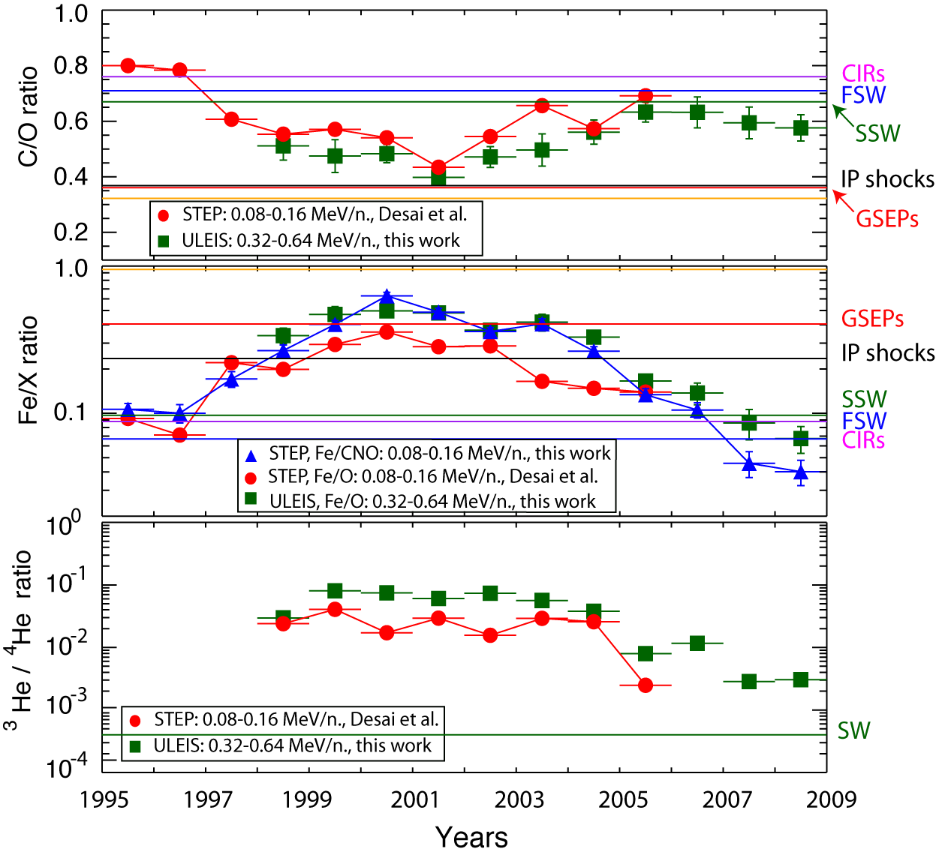
Origins: Temporal Variation of Composition
What causes the temporal variability in composition of the suprathermal tails?
Is the variation due to flare activity or changes in the physical conditions (turbulence, CMEs, compressions, prior shocks, etc.) in the inner heliosphere?
(Dayeh et al. 2009)

Slide 10
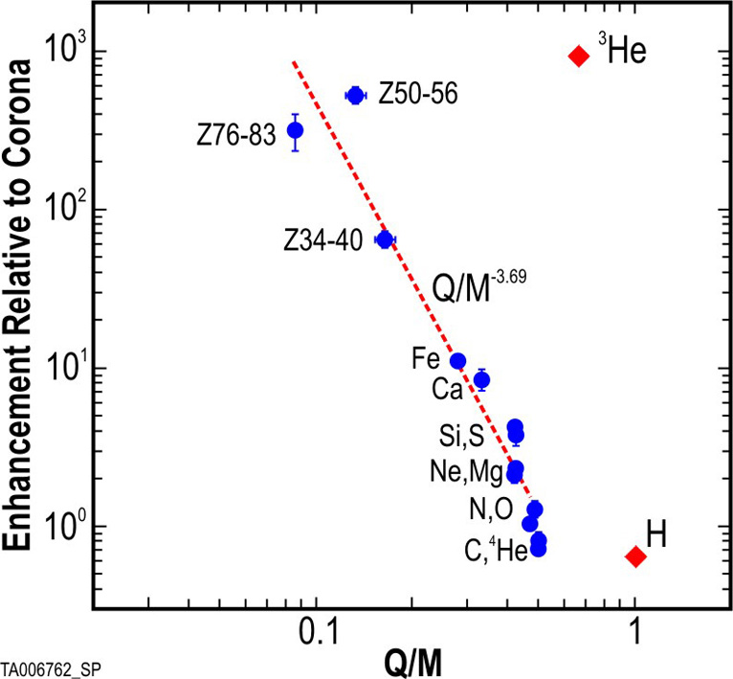
Acceleration: Impulsive Acceleration in Flares
Explosive reconnection in X-class flares accelerates electrons to >10 MeV and ions to >100 MeV/nuc, but not well understood
Fermi acceleration in collapsing magnetic islands
Possibly in conjunction with other mechanisms, e.g., stochastic acceleration by plasma waves, MHD turbulence, shocks, or direct electric field acceleration
Impulsive SEPs at 1 AU reveal correlations between MeV ions and electrons and have large enrichments in 3He, heavy ions such as Fe and rare trans-Fe species (see Fig)
Many large SEP events are “hybrids” with enrichments in 3He, heavy ions, and high-ionization states as well as shock-accelerated particles - Flare and shock contributions can only be separated near the Sun
Acceleration of ever-present suprathermal tails in the solar wind is not well understood - understanding has broad implications for particle acceleration in nature
Multi-event average impulsive SEP abundance enhancements (relative to coronal composition) plotted vs Q/M for equilibrium charge states at 3 MK (from Reames & Ng 2004). A fit to all ions except H and 3He gives a slope of (Q/M)-3.69. Note that trans-Fe species are enriched by factors of ~50-500. ISIS measures the Q/M-fractionation in multiple ISEP events and provides constraints for reconnection-driven particle acceleration models.

Slide 11
Acceleration: Diffusive Shock Acceleration (DSA)
Thought to be the primary acceleration mechanism at CME-driven shocks, however unresolved issues continue to hamper the development of theoretical models of large gradual SEP events:
existence and effects of proton-amplified Alfvén waves near quasi-parallel shocks
conditions that affect acceleration efficiencies of CME shocks
roles played by shock geometry on the injection thresholds
DSA models invoke proton-amplified Alfvén waves to trap ions near quasi-parallel shocks to increase acceleration efficiency
Near-Sun observational evidence of the roles of diffusion and wave amplification in SEP events
CME shock acceleration efficiencies are highly variable, likely due to different shock geometries, differing coronal conditions, and other poorly understood effects (e.g., seed particles) – can not be studied at 1 AU

Slide 12
Acceleration: SEP Energy Sources - CMEs
What fraction of the CME kinetic energy goes into accelerating energetic particles? Is it controlled by turbulence levels, self excited waves, seed particles, shock properties, prior CMEs?
SEP-CME: Comparison of the kinetic energy of accelerated SEPs with the CME kinetic energy indicate that as much as ~10% of the CME energy goes into accelerated particles (Mewaldt et al. 2008).

Slide 13
Acceleration: CME-Driven Shock Efficiency
Why is the efficiency of CME-driven shock acceleration apparently greater when there has been a preceding CME? Do prior CMEs modify the turbulence and other physical parameters or simply provide different seed particles?
(Gopalswamy et al. 2004)

Slide 14
Transport: How do SEPs Get to Earth?
How are SEP properties affected by transport through the heliosphere? What are the roles of diffusion, adiabatic deceleration, magnetic structure, self excited waves, shock properties,
etc. ?
(Roussev ????)

Slide 15
Transport: Energy Spectral Breaks
Why does shock acceleration suddenly become less efficient at high energy? Is it because of M/q dependant escape or shock shape, or lack of waves…?
…Or, what else causes spectral breaks?
(Mewaldt et al., 2006)

Slide 16
Energetic Neutral Atoms (ENAs)
What can ENAs from solar eruptions tell us about how SEPs are accelerated and escape the Sun?
Calculated ENA emission profiles versus time as a shock moves from 2 to 20 Rs. (Mewaldt et al., 2009)

Slide 17
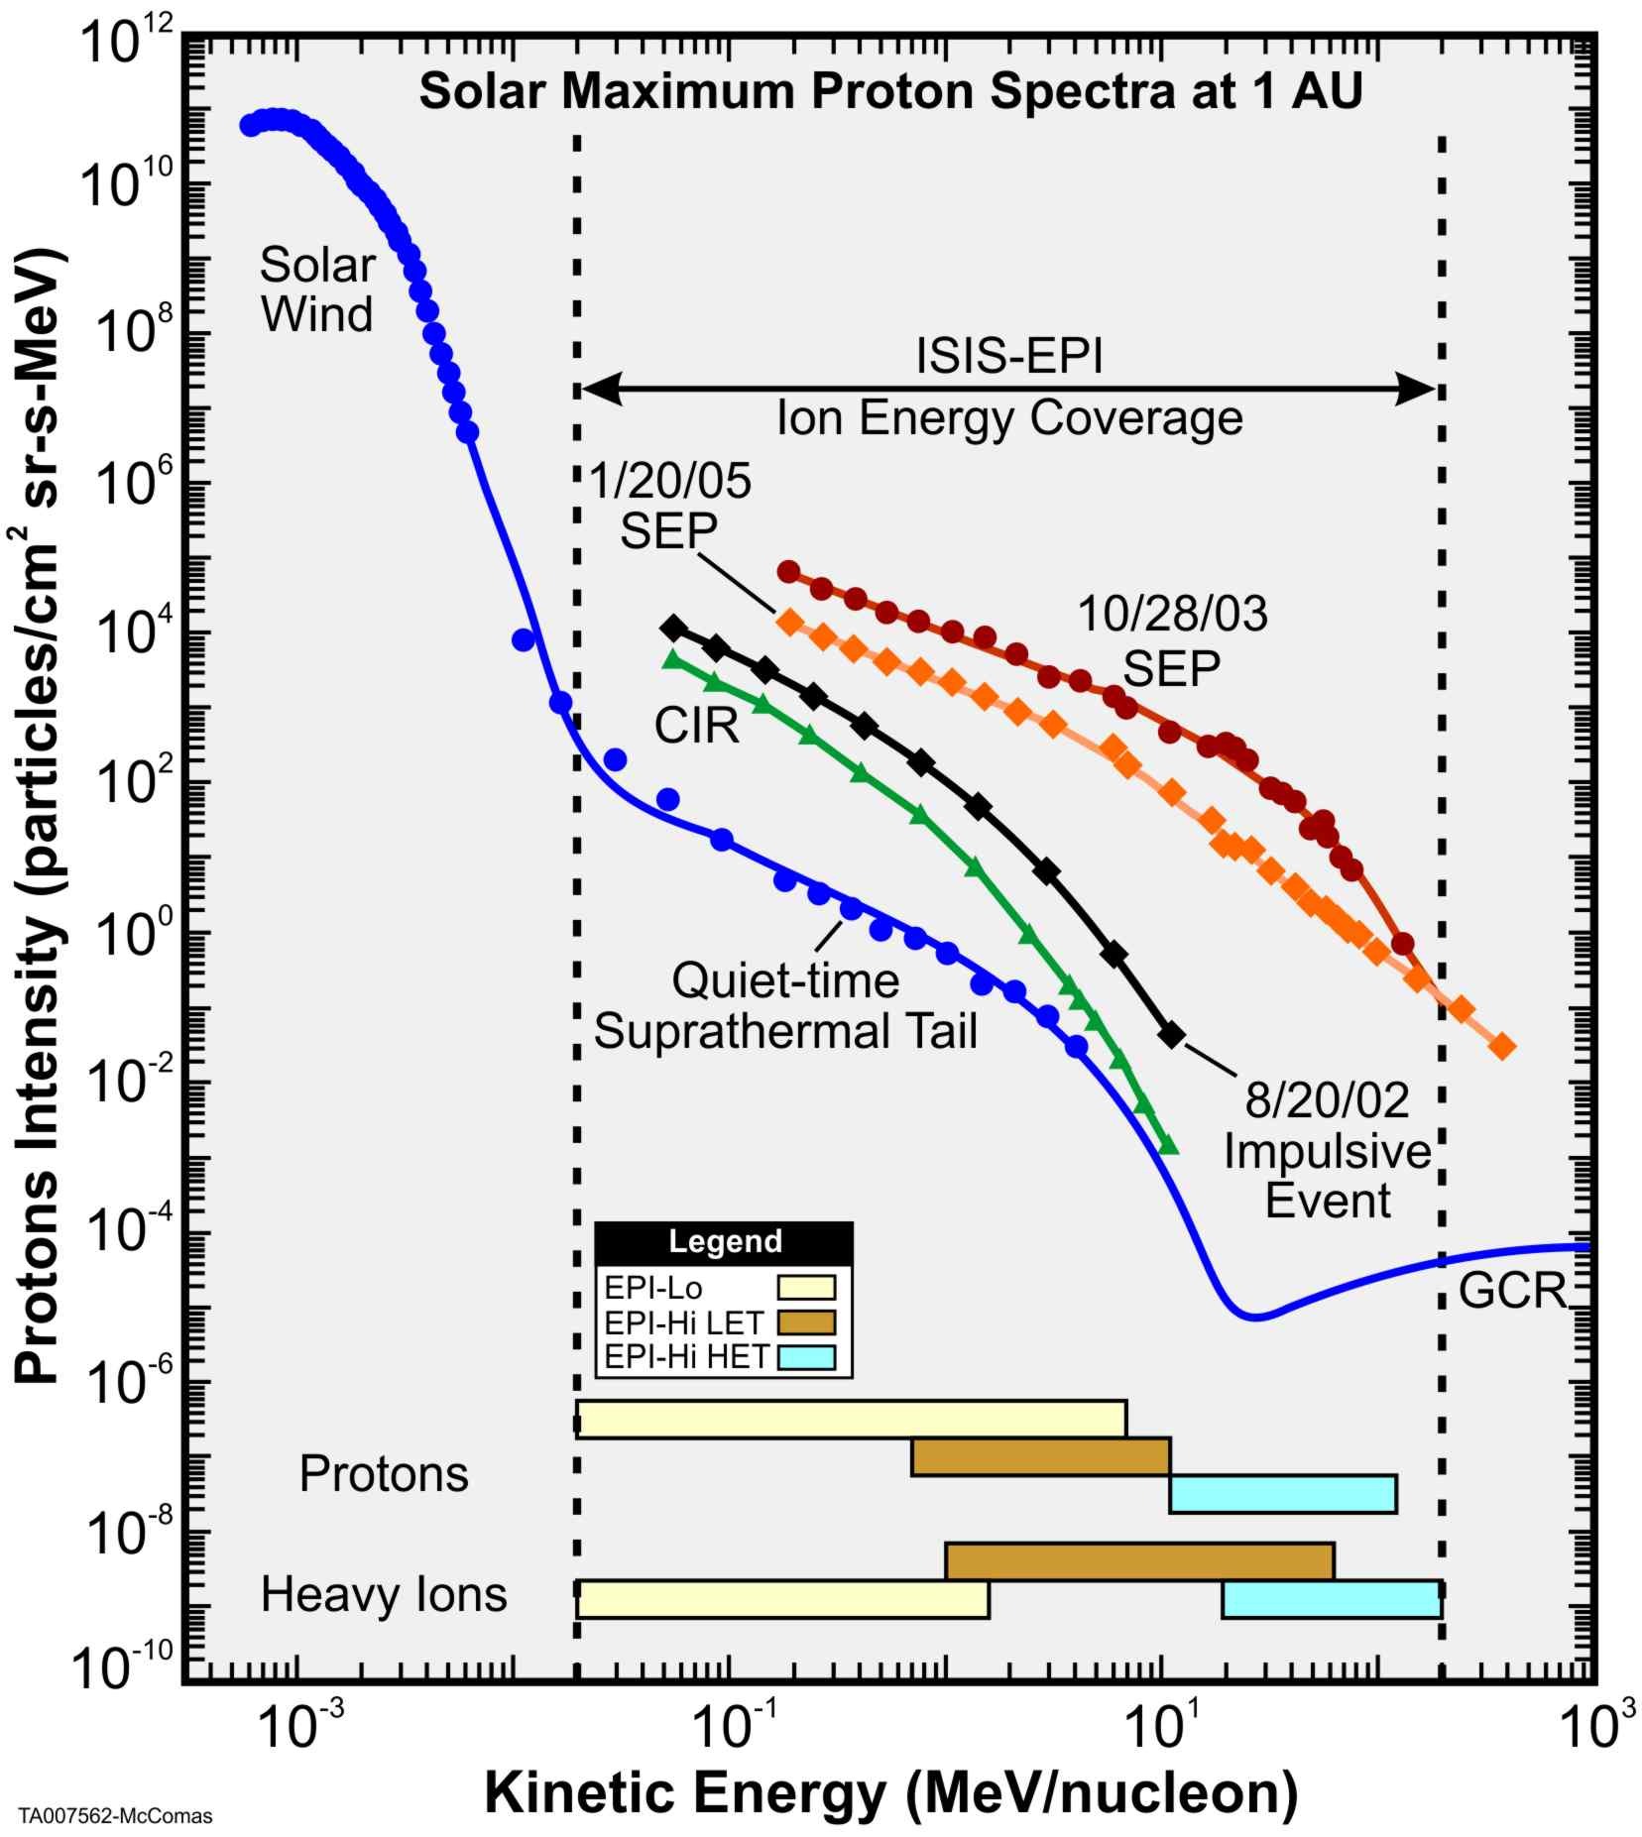
Measurement Summary
Determine in both gradual & impulsive Solar EP events:
Energy spectra
Composition (electrons, protons, major heavy elements)
Timing
Pitch angle distributions
Measure ³He as a key indicator of impulsive events
Measurements of other populations (CIRs, ACRs, and GCRs) provide important new information on the radial dependences of these particles
ISIS-EPI also provides electron measurements from ~0.025 to 6 MeV

Slide 18
Driving Requirements
Energetic electron energy range: ≤0.05 to ≥3 MeV
Energetic protons and heavy ions: ≤0.05 to ≥50 MeV/nuc
Field of View: ≥π/2 sr in both sunward and anti-sunward hemispheres including coverage within 10° of the nominal Parker spiral field direction at perihelion
Composition: at least H, He, ³He, C, O, Ne, Mg, Si, Fe
Maximum intensity <1MeV: ≥10⁶ particles/cm²sr-s
Maximum intensity >1MeV: ≥5x10⁵ particles/cm²sr-s

Slide 19
Primary Measurement Requirements
MRD Req’t | Parameter | Required | Comment/Heritage
MRD-96a MRD-97a | Energy range | e⁻: ≤ 0.05 to ≥ 3 MeV p⁺/i: ≤ 0.05 to ≥ 50 MeV | Combined energy range of all sensors; small gaps in energy coverage are acceptable
MRD-96b MRD-97b | Energy binning | ≥ 6 bins/decade
MRD-96c MRD-97c | Highest cadence | e⁻: ≤ 1s for selected high-statistics electron rates p⁺/i: ≤ 5s for selected high-statistics ion rates | Additional rates at lower cadences, as appropriate for expected statistics and bit rate allocation
MRD-96d MRD-97d | Field of view | ≥ π/2 ster coverage in both sunward and anti-sunward hemispheres, including coverage within 10 degrees of the nominal Parker spiral field direction at perihelion | Combined sky coverage of all sensors, some regions densely sampled rather than 100% covered
MRD-96e MRD-97e | Angular sectoring | e⁻: ≤ 45 degree sectors p⁺/i: ≤ 30 degree sectors
MRD-97e | Composition | at least H, He, ³He, C, O, Ne, Mg, Si, Fe | Measured species; not all measured under all conditions
MRD-98a | Max. intensity <1 MeV | ≥ 10⁶ particles/cm²-sr-s
MRD-98b | Max. intensity >1 MeV | ≥ 5x10⁵ particles/cm²-sr-s | Highest intensities measured over restricted fields of view

Slide 20
Summary
ISIS energetic particle measurements plan key role in understanding origins, acceleration, and transport mechanisms
Science goals have been mapped to measurement requirements
These key requirements have been flowed down into the instrument design through the systems engineering process

