Slide 1
Agenda and Meeting Logistics
Scott Weidner
Draft r7
Notes:
introduction

Slide 2
Outline
Meeting and Facility Logistics
Teleconference and WebEx
Day 1 Agenda
Day 2 Agenda
Maps
Everyone needs to refer to the Maps !!!
Main SwRI Entrance completely closed for construction
The maps provide instructions to the East Gate and directions to Building 263 where the PDR will be held

Slide 3
Meeting and Facility Logistics
Public Wireless Internet available in the Presentation Room
If you need to have messages delivered:
Messages through Maureen Ahr
Tel: (210) 522-2741
Fax: (210) 520-9935
E-mail: mahr@swri.edu
Restrooms – leaving Presentation Room, turn left and left and they are on the right side of the hallway
Splinter Meeting rooms will be available
Lunch will be catered on both days
Contribution jar provided for Government employees or those that require it
There will be a Social Hour in the Lobby of Building 263 on Tuesday (11/5/2013)

Slide 4
Teleconference and WebEx Day 1
Topic: SPP - ISIS - PDR - Day 1 Date: Tuesday, November 5, 2013 Time: 8:00 am, Central Standard Time (Chicago, GMT-06:00) Meeting Number: 576 374 250 ------------------------------------------------------- To join the online meeting (Now from mobile devices!) ------------------------------------------------------- 1. Go to https://swri15.webex.com/swri15/j.php?ED=244875262&UID=1460668832&PW=NYWMzMmJmNzlj&RT=MiM3 2. If requested, enter your name and email address. 3. If a password is required, enter the meeting password 4. Click "Join".
The meeting password will be sent in a follow-up email

Slide 5
Teleconference and WebEx Day 2
Topic: SPP - ISIS - PDR - Day 2 Date: Wednesday, November 6, 2013 Time: 8:00 am, Central Standard Time (Chicago, GMT-06:00) Meeting Number: 578 656 800 ------------------------------------------------------- To join the online meeting (Now from mobile devices!) ------------------------------------------------------- 1. Go to https://swri15.webex.com/swri15/j.php?ED=244875272&UID=1460668837&PW=NYTFkMzM5Njlh&RT=MiM3 2. If requested, enter your name and email address. 3. If a password is required, enter the meeting password 4. Click "Join".
The meeting password will be sent in a follow-up email (same as Day 1)

Slide 6
Day 1: ISIS PDR Agenda
Start Time | Topic | Presenter
8:00 am | 01: ISIS PI Introduction | McComas
8:05 am | 02: Agenda and Meeting Logistics | Weidner
8:10 am | 03: Review Board Introduction | Hersman
8:20 am | 04: ISIS Overview | Weidner
8:40 am | 05: ISIS Science | McComas
9:00 am | 06: Systems Engineering | Dickinson
9:40 am | Break
9:50 am | 07: EPI-Lo Sensor Design | McNutt
10:20 am | 08: EPI-Lo Technology Development | Gurnee
10:40 am | 09: EPI-Lo Mechanical | Cooper
11:10 am | 10: EPI-Lo Electronics | Gurnee
11:50 am | 11: EPI-Lo Software | Hayes
12:10 pm | Lunch

Slide 7
Day 1: ISIS PDR Agenda (Continued)
Start Time | Topic | Presenter
1:10 pm | 12: EPI-Hi Sensor Design | Wiedenbeck
1:40 pm | 13: EPI-Hi Technology Development | Wiedenbeck
2:00 pm | 14: EPI-Hi Electronics | Cook/Kecman
2:40 pm | 15: EPI-Hi Software | Davis
3:00 pm | Break
3:10 pm | 16: EPI-Hi Mechanical | Shuman
3:40 pm | 17: ISIS Power | Do
4:10 pm | 18: EMI/EMC | Gurnee
4:20 pm | 19: ISIS Structural | Alexander
4:50 pm | Adjourn
5:00 pm | Social Hour with Appetizers and Refreshments

Slide 8
Day 2: ISIS PDR Agenda
Start Time | Topic | Presenter
8:00 am | 20: ISIS Thermal | Dirks
8:40 am | 21: Assembly, Integration, and Test | Dickinson
9:00 am | 22: Flight Operations | Christian
9:20 am | 23: Ground Support Equipment | Gurnee
9:40 am | Break
9:50 am | 24: Verification | Angold
10:10 am | 25: EPI-Lo Calibration | Mitchell
10:25 am | 26: EPI-Hi Calibration | Mewaldt
10:40 am | 27: Performance Assurance | Gerhardus
11:00 am | 28: Risk Status | Dickinson
11:20 am | 29: Action Items | Angold
11:30 am | 30: Instrument Development Status | Weidner
11:50 am | Lunch and Review Board Caucus
1:00 pm | 31: Review Board Debrief | Hersman
1:30 pm | Adjourn

Slide 9
Day 2: ISIS SOC PDR Agenda
Start Time | Topic | Presenter
 | ISIS Science Operations Center (SOC) PDR
2:00 pm | 01: Introduction | Weidner
2:05 pm | 02: Review Board Introduction | Nair
2:10 pm | 03: ISIS Science Operations Center: List of Governing Documents, Heritage, SOC Organization | Schwadron
2:20 pm | 04: Requirements Analysis | Angold
2:40 pm | 05: SOC Description: Architecture, Software Systems | Schwadron
2:50 pm | 06: SOC Description: Operations Planning, Commanding | Christian
3:05 pm | 07: SOC Description: Instrument Health and Safety, Telemetry, Data Processing | Schwadron
3:15 pm | 08: Data Products | Schwadron
3:40 pm | 09: Development Plan and Schedule, Test Plan | Schwadron
3:55 pm | 10: Current Status | Schwadron
4:00 pm | Review Board Caucus
4:30 pm | 11: Review Board Debrief | Nair
5:00 pm | Adjourn

Slide 10
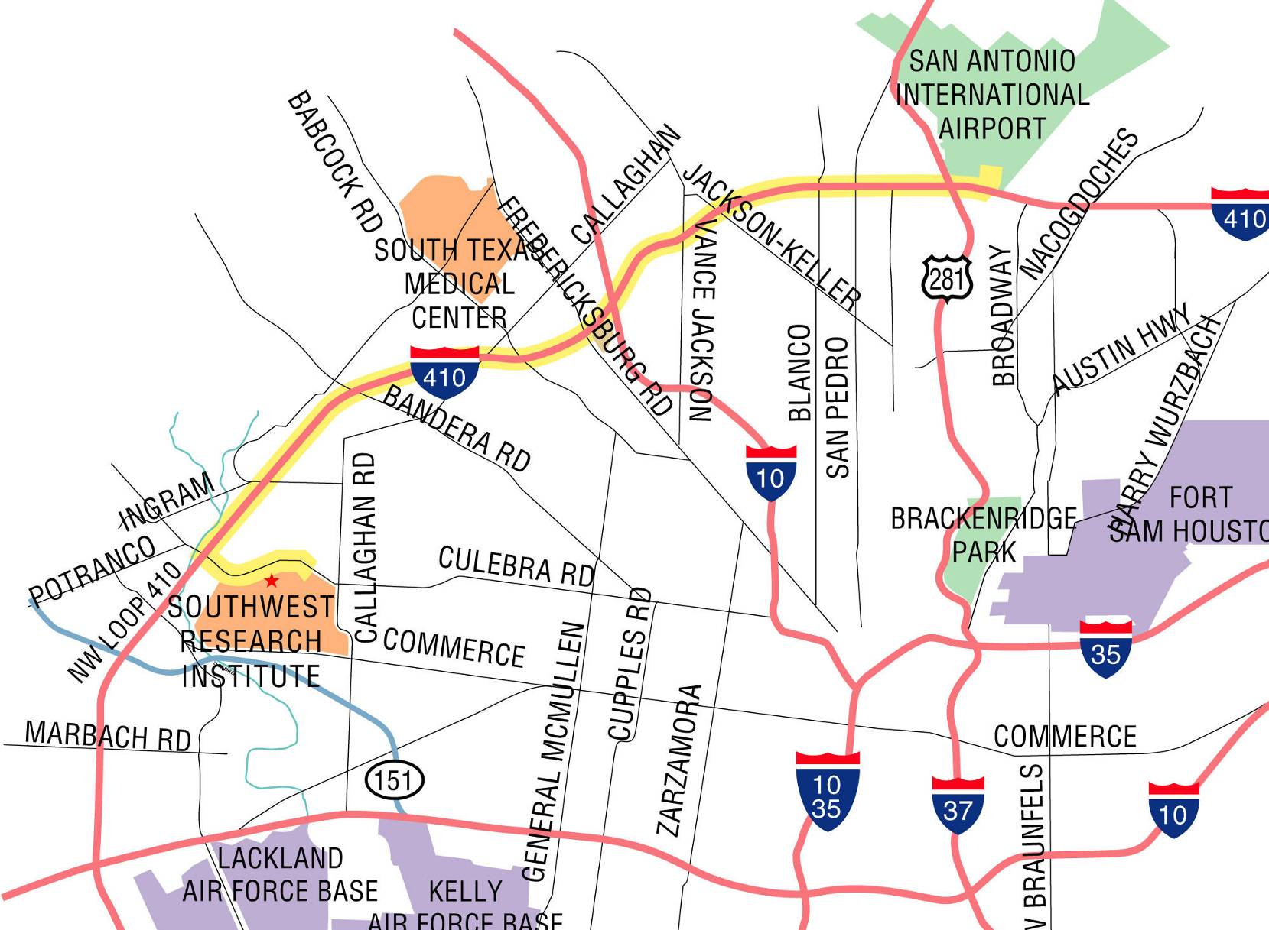
Map to SwRI

Slide 11
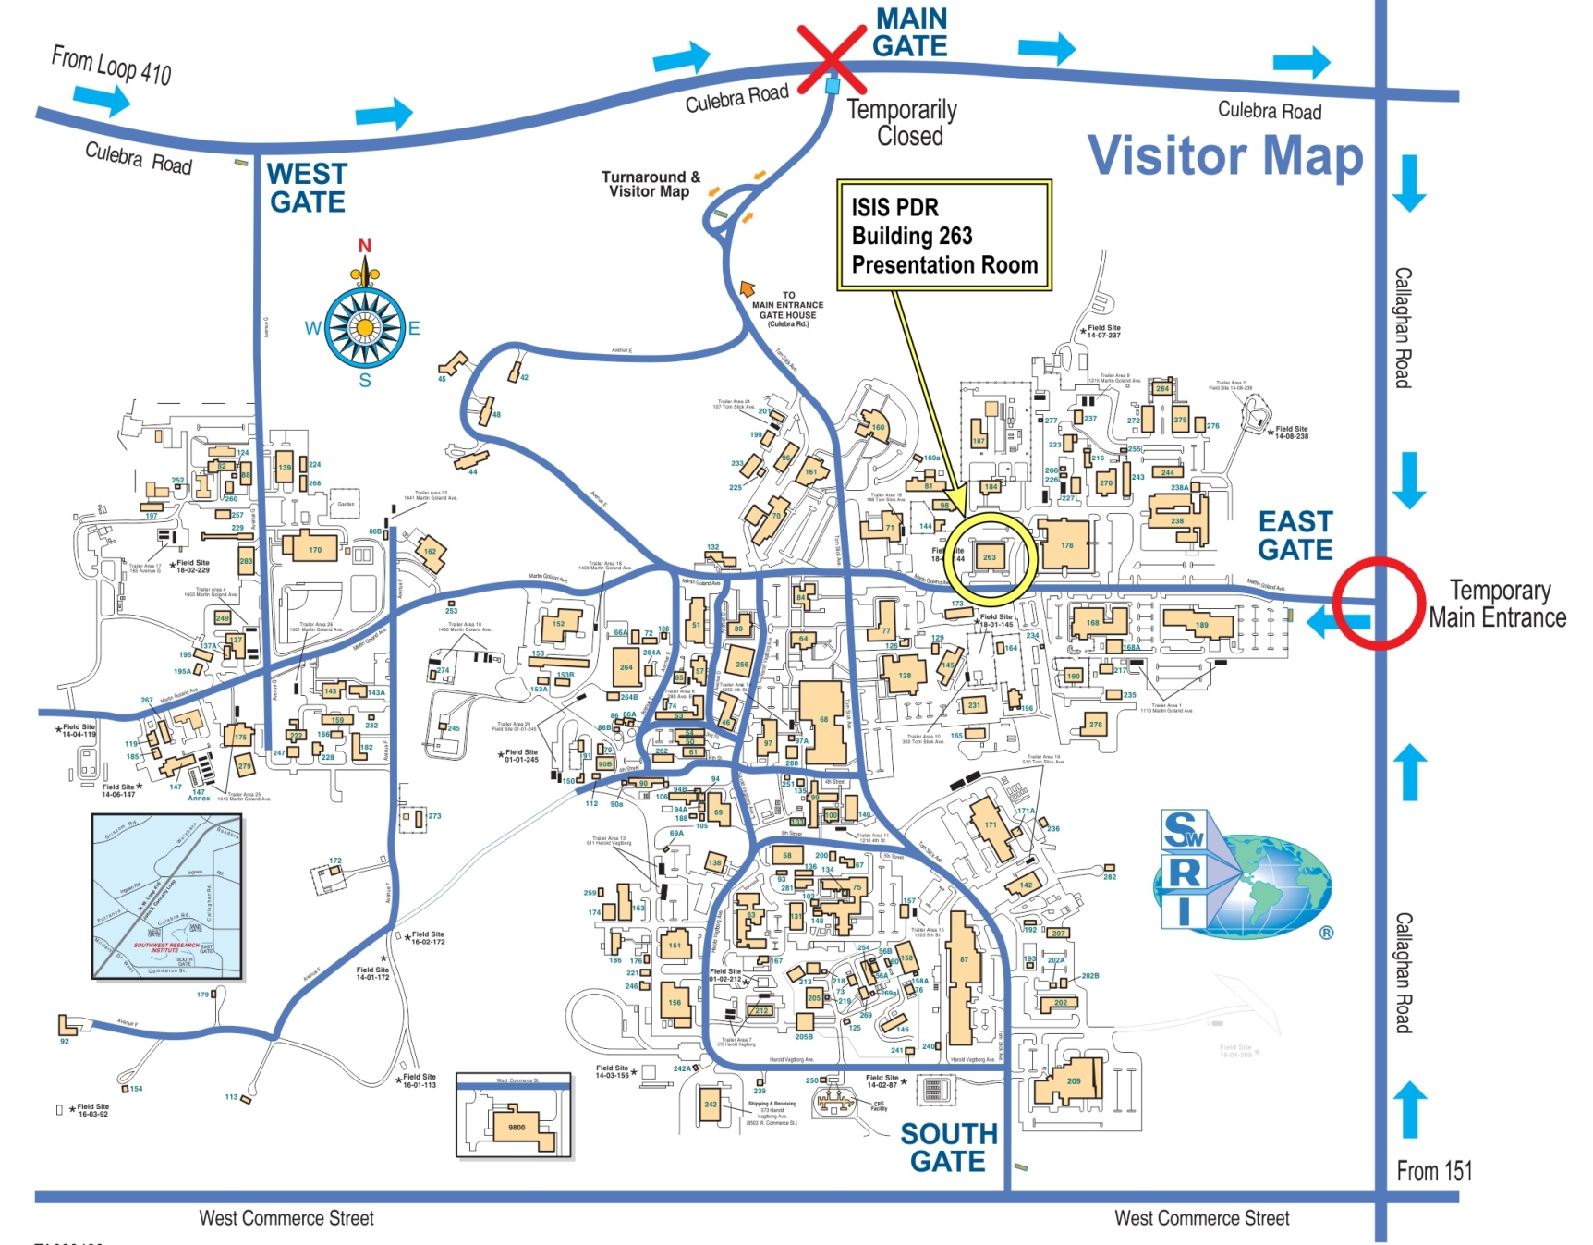
Main Gate is CLOSED for Construction Directions to PDR Location (Bldg 263)

