Slide 1
Agenda and Meeting Logistics
Scott Weidner
Notes:
introduction

Slide 2
Outline
Meeting and Facility Logistics
Teleconference and WebEx
Day 1 Agenda
Day 2 Agenda
Maps

Slide 3
Meeting and Facility Logistics
Meeting and Facility Logistics
Teleconference and WebEx
Day 1 Agenda
Day 2 Agenda
Maps

Slide 4
Teleconference and WebEx
To Be Announced

Slide 5
Day 1 Agenda
Start Time | Topic | Presenter
8:00 am | 01: ISIS PI Introduction | McComas
8:05 am | 02: Agenda and Meeting Logistics | Weidner
8:10 am | 03: Review Board Introduction | <chair>
8:20 am | 04: ISIS Overview | Weidner
8:40 am | 05: ISIS Science | McComas
9:00 am | 06: Systems Engineering | Dickinson
9:40 am | Break
9:50 am | 07: EPI-Lo Technology Development | Gurnee
10:10 am | 08: EPI-Lo Sensor Design | Hill
10:40 am | 09: EPI-Lo Mechanical | Cooper
11:10 am | 10: EPI-Lo Electronics | Gurnee
11:50 am | Lunch
12:50 pm | 11: EPI-Lo Software | Hayes

Slide 6
Day 1 Agenda Continued
Start Time | Topic | Presenter
1:10 pm | 12: EPI-Hi Technology Development | Wiedenbeck
1:30 pm | 13: EPI-Hi Sensor Design | Wiedenbeck
2:00 pm | 14: EPI-Hi Mechanical | Shuman
2:30 pm | 15: EPI-Hi Electronics | Cook/Kecman
3:10 pm | Break
3:20 pm | 16: EPI-Hi Software | Davis
3:40 pm | 17: ISIS Power | Do
4:10 pm | 18: EMI/EMC | Gurnee
4:20 pm | 19: ISIS Structural | Alexander
4:50 pm | Adjourn

Slide 7
Day 2 Agenda
Start Time | Topic | Presenter
8:00 am | 20: ISIS Thermal | Dirks
8:40 am | 21: Assembly, Integration, and Test | Dickinson
9:00 am | 22: Flight Operations | Christian
9:20 am | 23: Ground Support Equipment | Gurnee
9:40 am | Break
9:50 am | 24: Verification | Dickinson
10:10 am | 25: EPI-Lo Calibration | Hill
10:25 am | 26: EPI-Hi Calibration | Wiedenbeck
10:40 am | 27: Performance Assurance | Gerhardus
11:00 am | 28: Risk Status | Dickinson
11:20 am | 29: Action Items | Angold
11:30 am | 30: Instrument Development Status | Weidner
11:50 am | Lunch and Review Board Caucus
1:00 pm | 31: Review Board Debrief | <chair>
1:30 pm | Adjourn

Slide 8
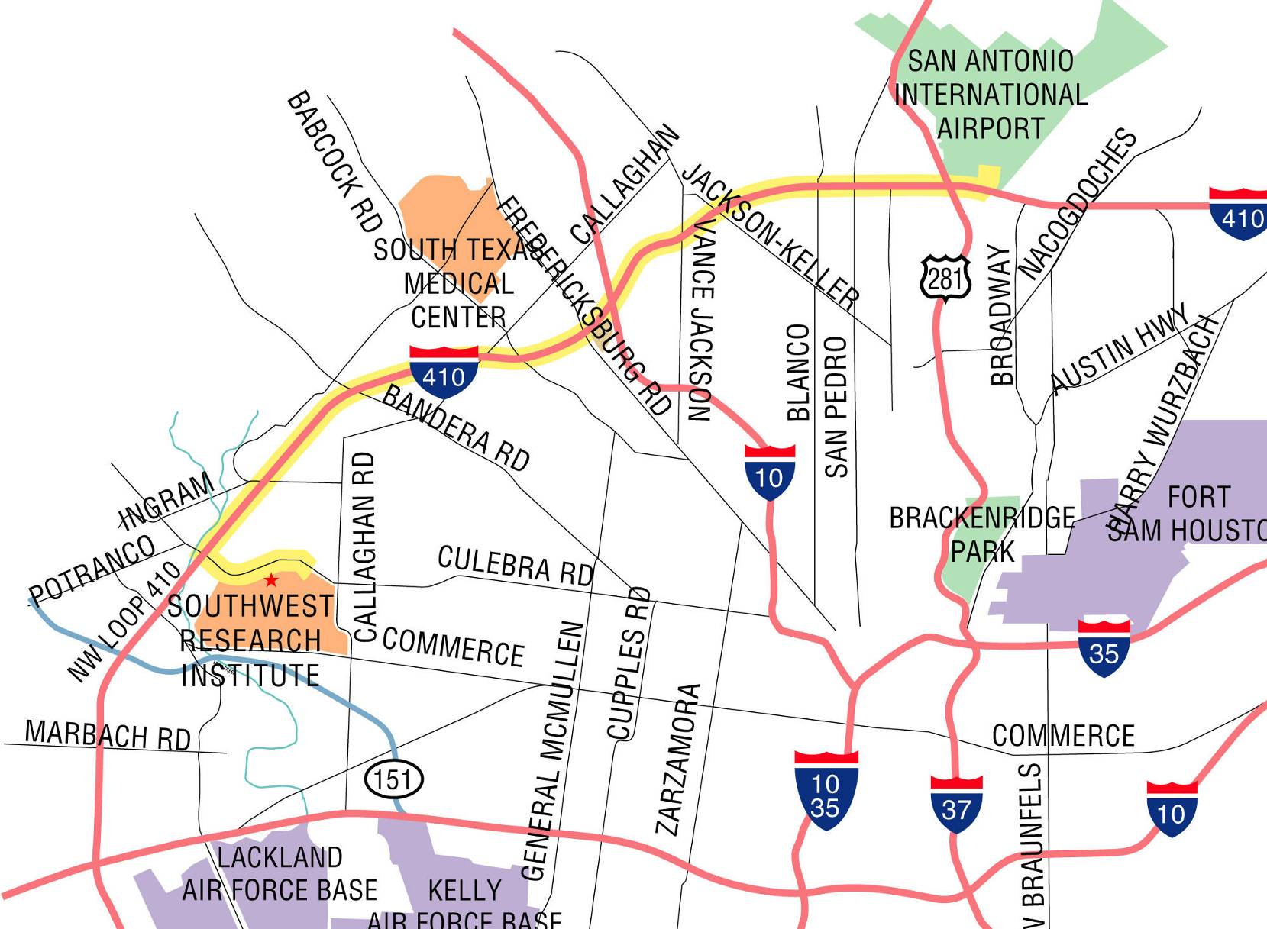
Maps: to SwRI

Slide 9
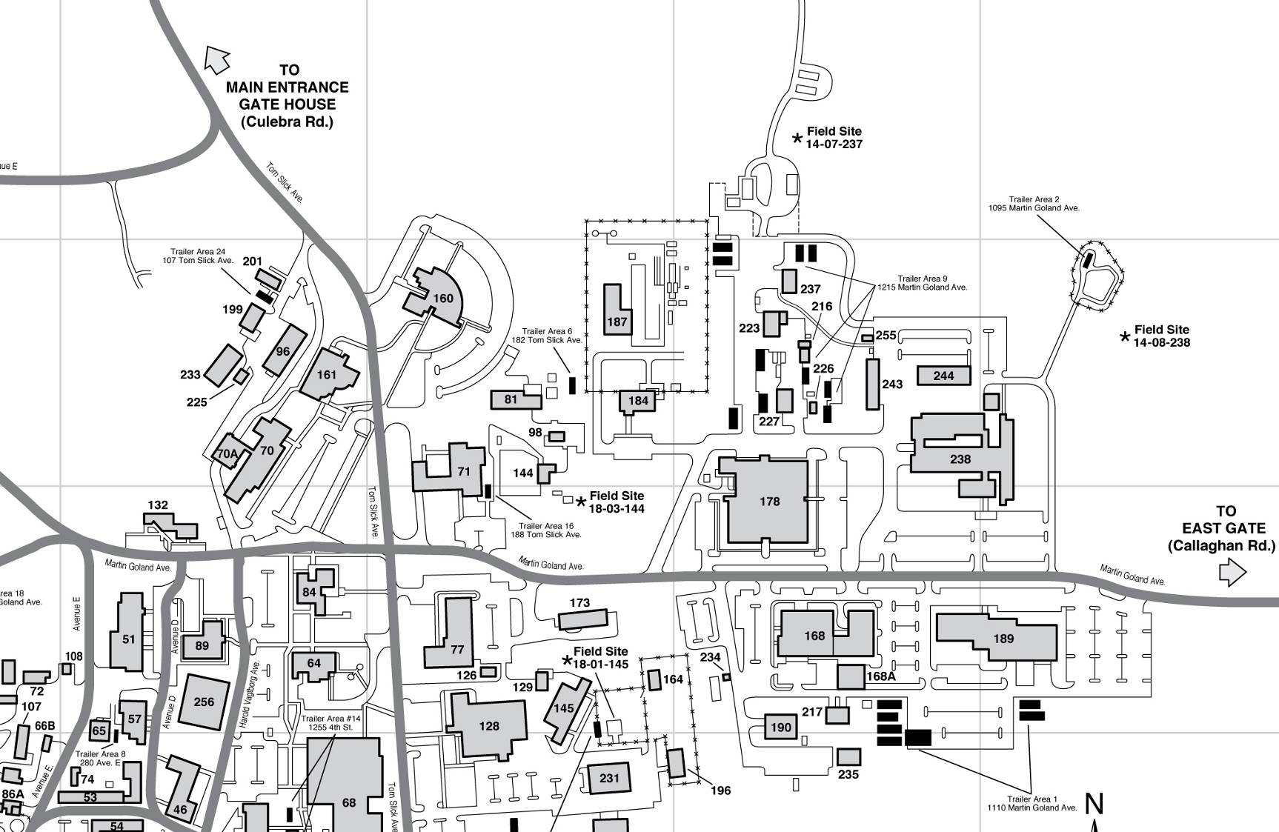
Maps: to PDR Location
Entrance From Culebra
Driving Directions:
From Culebra Entrance, follow
Tom Slick Ave to first Stop sign.
Turn left. 2nd building on left.
B263
JADE PDR
Building 263
1st Floor
Conf. Room

